Slide 1
Performance Analysis of BSS Color and DSC
Date: 2014/11/2
Authors:

Slide 2
Abstract
Promising performance of DSC has been shown through system simulation in [1]
Although effect on legacy STAs needs to be carefully considered
It has been raised that BSS Coloring, a mechanism introduced in 802.11ah, can yield to similar performance
Performance of DSC vs. BSS Coloring has been compared in this contribution

Slide 3
BSS Coloring
A mechanism introduced in 802.11ah
Assign a different color per BSS
How a color is selected by the AP is not defined
This color is indicated in the .11ah PHY Header
In this simulation, the color information is assumed to be in HT/VHT-SIG without increasing number of bits of SIG
Upon reception of a PPDU from an OBSS, i.e. with a different color, packet reception procedure may be abandoned
Whether a STA is abled to receive the next packet immediately after abandoning is also not defined in the standard
In this simulation, STA that supports this feature is abled to receive.
See also slide #8

Slide 4
DSC Algorithm
STA: Beacon RSSI based algorithm
Compare the RSSI of the most recently received Beacon with “Trigger Threshold” and if exceed the threshold, toggle DSC to ON. Otherwise toggle DSC to OFF
In this time Trigger Threshold is set to -41dBm
Rx sensitivity level during DSC-OFF is fixed to -82dBm
Rx sensitivity level during DSC-ON is a parameter (A dbm)
CCA threshold is always -62dBm
AP: Fixed
AP’s Rx sensitivity level is always set to A dBm.
CCA threshold is always -62dBm
AP
Beacon
Beacon
Beacon
Beacon
time
-40dBm
-50dBm
-38dBm
-40dBm
DSC=ON
DSC=OFF
DSC=ON
STA

Slide 5
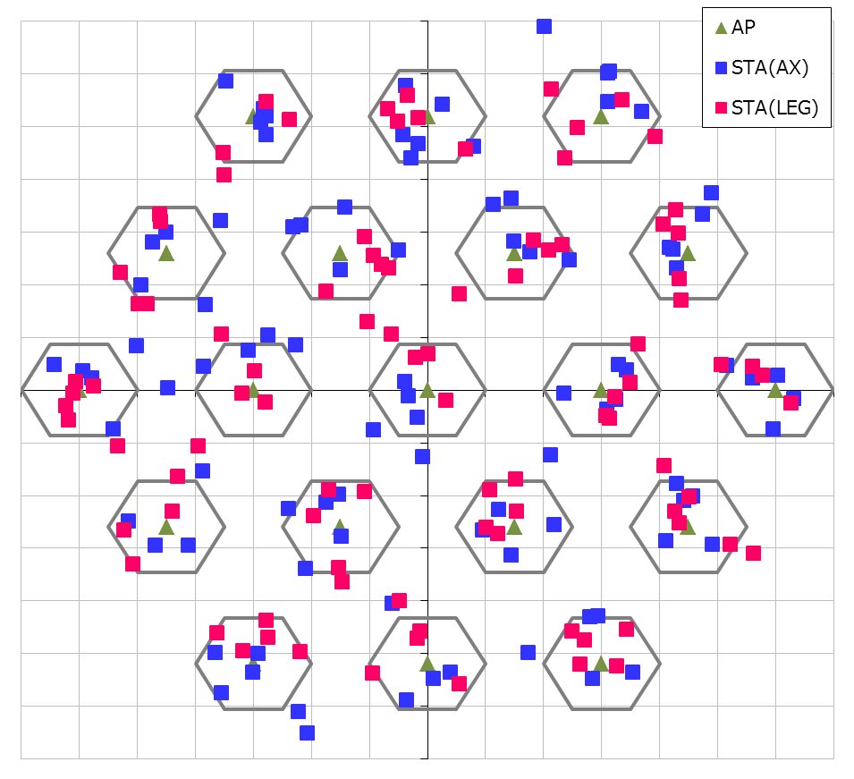
Simulation Conditions
Scenario-3
19-cell model with wrap-around (R=10m, Reuse=3)
Traffic model
10 uplink UDP Flows/BSS (Full-buffer condition)
No downlink traffic
MCS selection
Goodput maximizing MCS based on SINR by training[3]
Sensitivity control algorithm
Beacon RSSI based algorithm[5]
Parameters
Rx sensitivity level when DSC is used
-82dBm ~ -52dBm
See backup slide for details
30m
10m

Slide 6
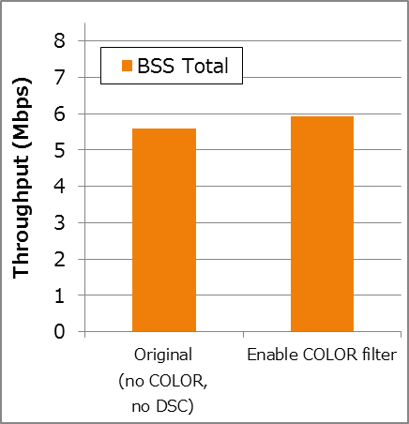
Throughput Comparison
BSS COLOR Filtering
There isn’t much gain using only BSS COLOR filtering itself.
6%
Up
BSS
Total
Tput

Slide 7
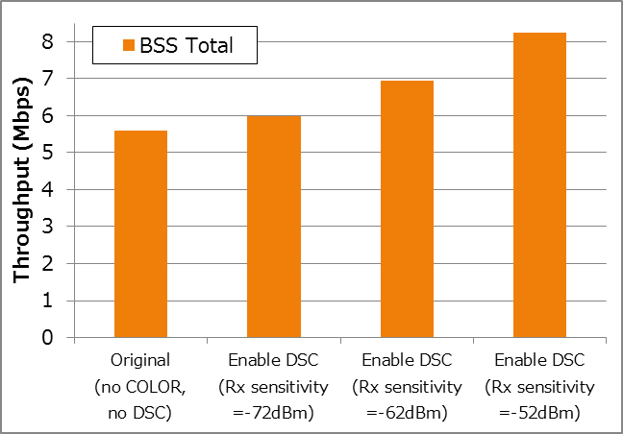
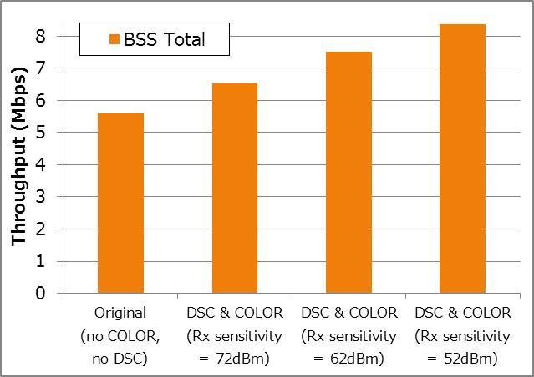
Throughput Comparison
DSC
DSC with BSS COLOR Filtering
BSS
Total
Tput
DSC provide more gain than COLOR filtering
When BSS COLOR filtering is used with DSC, it can provide additional gain when the offset of Rx sensitivity level is relatively small.
48%
Up
49%
Up
24%
Up
34%
Up
7%
Up
17%
Up

Slide 8
Analysis of DSC vs. BSS Coloring
A example of difference between DSC and Color filtering
[Note]Assume COLOR information is included in VHT-SIGA
[Note]Assume RSSI of interference packet is higher than CCA threshold for Color filtered packets.
OBSS STA’s Tx
(with different COLOR)
L-STF/
LTF
L&VHT
SIG
VHT-STF/
LTF/SIGB
PSDU
not detected at all
STA that enables
DSC
- Treated as CCA_IDLE -> can continue backoff
- Can receive another packets
COLOR doesn’t match
-> abandon Rx
detected
STA that enables
COLOR filtering
Rx
- Treated as CCA_BUSY -> cannot continue backoff
- Can receive another packets
 | DSC | BSS COLOR filtering
Increasing Tx opportunity | Can improve. | Cannot help for this.
Acquiring Rx opportunity for desired signal | Can improve. | Can improve but only when the packet has COLOR info.

Slide 9
Conclusion
Performance of BSS Coloring and DSC has been compared in SS3
There is not so much gain if only BSS Coloring is used and DSC outperforms in Simulation Scenario
But when BSS Coloring is used with DSC it can increase gain when the offset of Rx sensitivity level is relatively small

Slide 10
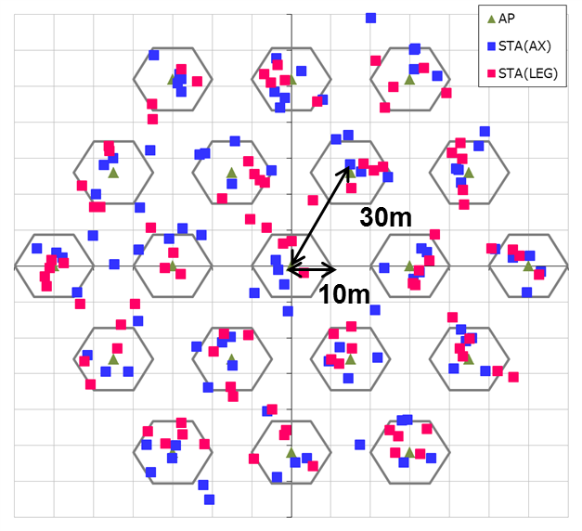
Simulation Setup details
Node | (AP x 1, STA x 10) x 19 (Half of STAs are 11AX STA, and others are Legacy STA)
Num of Drops [times] | 5
Traffic Model & Load | Uplink CBR UDP 30Mbps (from all STA -> Full Buffer condition)
Traffic Duration [sec] | 20
Access Category | AC_BE CWmin=15, CWmax=1023, AIFSN=3, TXOP limit=0
Tx Power [dBm] | AP:+23dBm(2 antennas), STA:+15dBm(1 antenna)
MCS Selection | Goodput maximizing MCS based on Training (MCS0 ~ MCS7)
Packet Length [byte] | (MPDU, MSDU, APP)=(1030, 1000, 972) Fixed
L2 Retry | 10
Ack Rate | Legacy 6.0Mbps
RTS/CTS | OFF
Max Aggregation Size | (A-MPDU, A-MSDU)=(8KB, NA)
NF [dB] | 7
Channel | TGn Channel D (pathloss, shadowing, fading)
Rx sensitivity level [dBm] | Parameter (-82 ~ -52: on 11ax-STAs & APs , -82 on Legacy-STAs)
CCA sensitivity level [dBm] | -62
Channel Setting [MHz] | (CenterFreq, BW)=(2412, 20)
Det. Cancel on PLCP err | Enable (PLCP error threshold is almost SINR=0dB)
DSC algorithm | See slide #4
BSS COLOR operation | AP and 11AX STA can handle COLOR information. (adding/filtering) STAs cannot filter packets that has no COLOR information (i.e. flow from Legacy STAs).

Slide 11
References
Masahito Mori, Sony, 11-14-1171-00-00ax-DSC-Simulation-Results-for-Scenario3
William Carney, Sony, 11-14-0854-00 DSC and Legacy Coexistence
Gwen Barriac, Qualcomm, 11-14-0851-02-00ax-rate-control-for-mac-and-integrated-system-simulations
Hongyuan Zhang, Marvell, 11-14-0372-02-0hew-system-level-simulations-on-increased-spatial-reuse
Graham Smith, DSP Group, 11-13-1290-01 Dynamic Sensitivity Control for HEW
Matthew Fischer, Broadcom, 11-13-1207-01-00ah-partial-aid-color-bits

