Slide 1
Box1 and Box3 calibration results
Date: 2014/11/3
Authors:

Slide 2
Abstract
Provide calibration result of following tests.
Box1 tests
Test1~5 for SS3
Box3 tests
Test1~3
These results are almost aligned.

Slide 3
Box1 tests (For Simulation Scenario 3)

Slide 4
Condition for Box1 calibration
80MHz 5G channel are used. (Freq=5000MHz)
STA num is 30 per BSS.
STAs are dropped based on SS3 association rules.
Tx Power is set to +20dBm(AP)/+15dBm(STA).
Wrap around is not used.

Slide 5
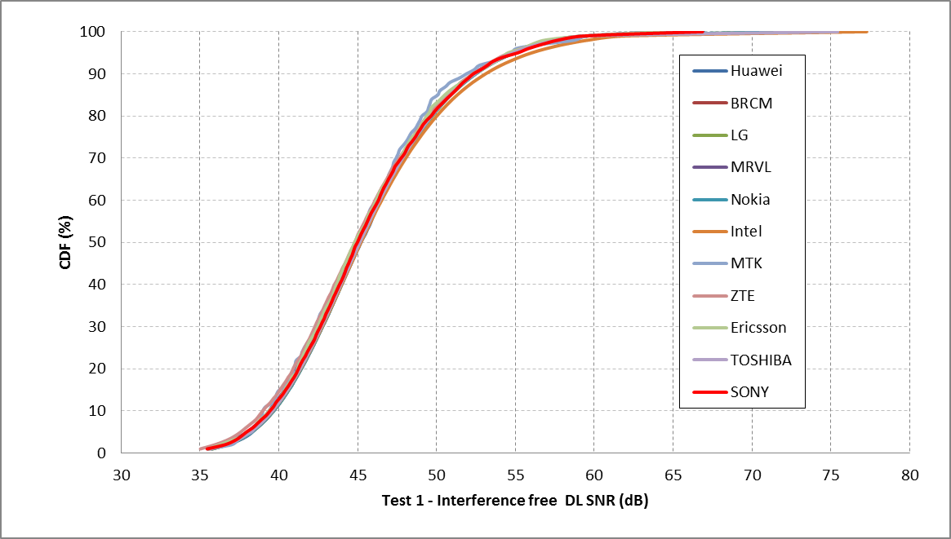
Box1 – Test1 (DL SINR when interference free)

Slide 6
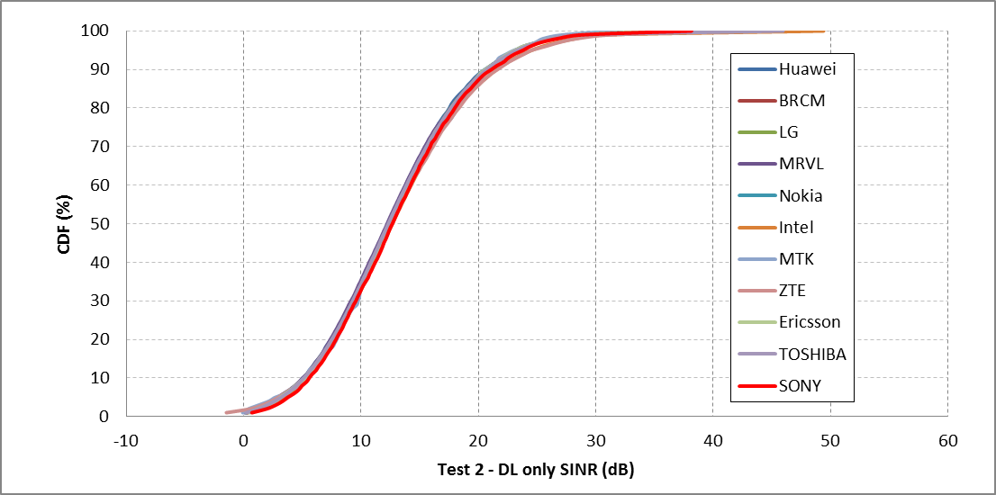
Box1 – Test2 (DL SINR for 100% DL)

Slide 7
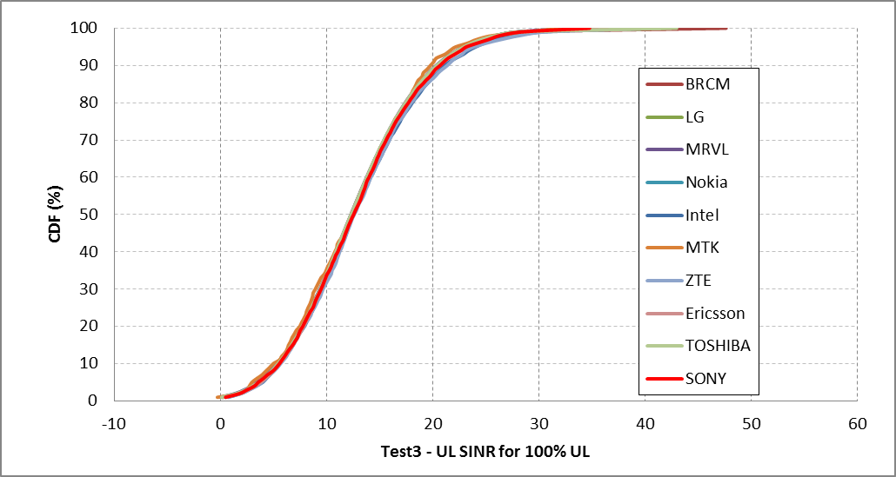
Box1 – Test3 (UL SINR for 100% UL)

Slide 8
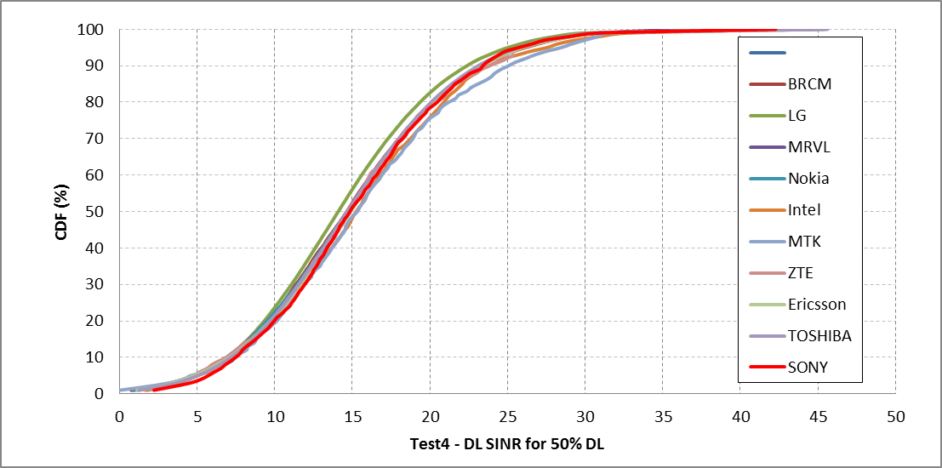
Box1 – Test4 (DL SINR for DL:UL=50:50)

Slide 9
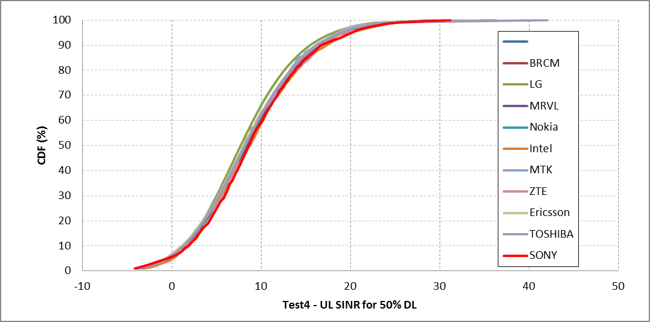
Box1 – Test4 (UL SINR for DL:UL=50:50)

Slide 10
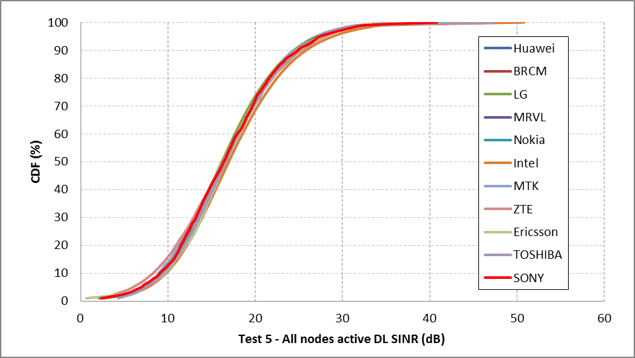
Box1 – Test5 (DL SINR when all nodes are active)

Slide 11
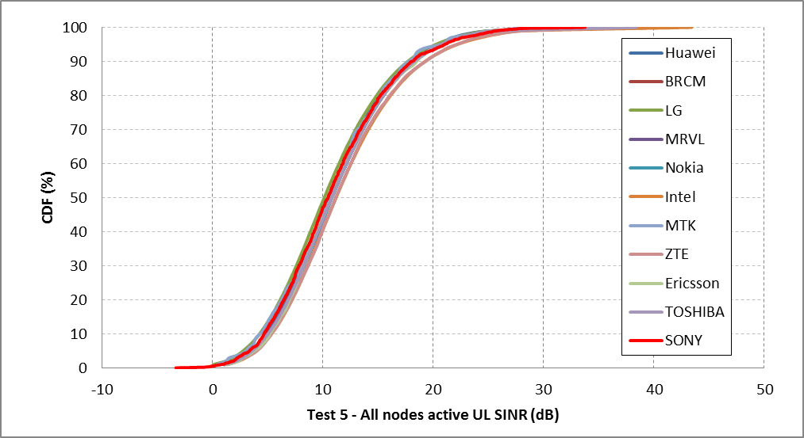
Box1 – Test5 (UL SINR when all nodes are active)

Slide 12
Box3 tests

Slide 13
Condition for Box3 calibration
Guard interval: long
Data preamble: 11ac
Bandwidth: 20 MHz
A-MPDU aggregation: 2 MPDU per A-MPDU
Max retries: 10
Fixed MCS: MCS0 (6.5 Mbit/s) and MCS8 (78 Mbit/s)
Modulation of Control Frame: Legacy 6.0Mbps
RTS/CTS: on and off
Cwmin: 15
AIFSN [BE]: 2
PER: 0
MSDU length: 500, 1000, 1500, 2000 bytes
Application data size: 464, 964, 1464, 1964 bytes
SIFS: 16us, DIFS = AIFS [BE] = 34us

Slide 14
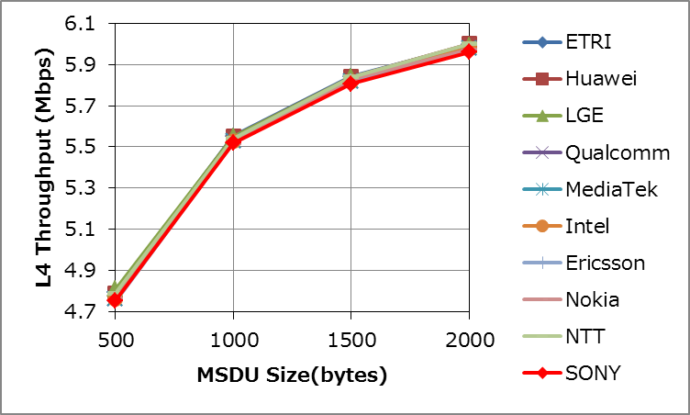
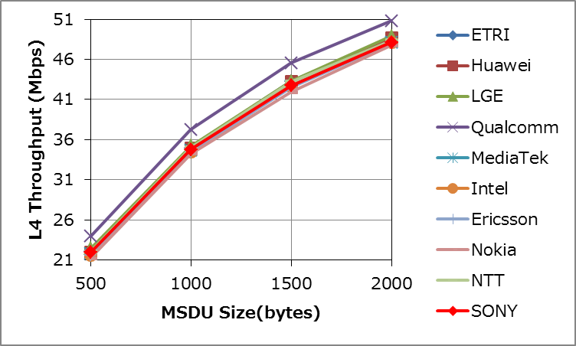
Test1a Results
 | MCS0 |  |  |  | MCS8
 | 500 | 1000 | 1500 | 2000 | 500 | 1000 | 1500 | 2000
ETRI | 4.79 | 5.55 | 5.84 | 5.99 | 21.99 | 34.94 | 43.27 | 48.68
Huawei | 4.79 | 5.55 | 5.84 | 6.00 | 21.98 | 34.91 | 43.24 | 48.67
LGE | 4.81 | 5.55 | 5.84 | 5.99 | 22.40 | 35.20 | 43.25 | 48.90
Qualcomm | 4.76 | 5.53 | 5.82 | 5.98 | 23.92 | 37.25 | 45.55 | 50.81
MediaTek | 4.76 | 5.53 | 5.82 | 5.98 | 21.71 | 34.65 | 42.71 | 48.15
Intel | 4.76 | 5.53 | 5.82 | 5.98 | 21.53 | 34.46 | 42.58 | 48.14
Ericsson | 4.75 | 5.52 | 5.82 | 5.97 | 21.53 | 34.47 | 42.57 | 48.09
Nokia | 4.76 | 5.52 | 5.83 | 5.97 | 21.19 | 34.22 | 41.93 | 47.74
NTT | 4.79 | 5.54 | 5.84 | 6.00 | 22.00 | 35.00 | 43.20 | 48.40
SONY | 4.76 | 5.52 | 5.81 | 5.96 | 21.91 | 34.78 | 42.74 | 48.13
MCS0
MCS8

Slide 15
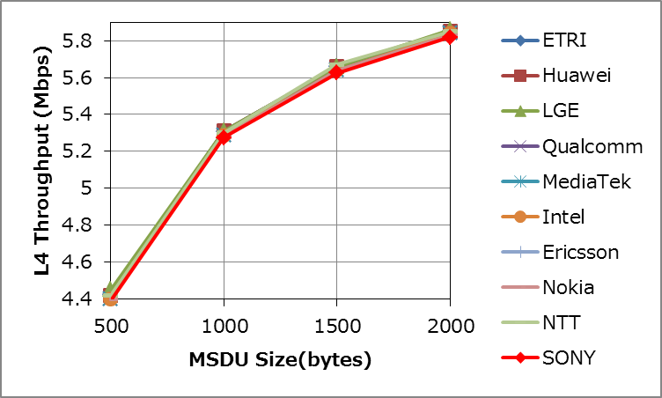
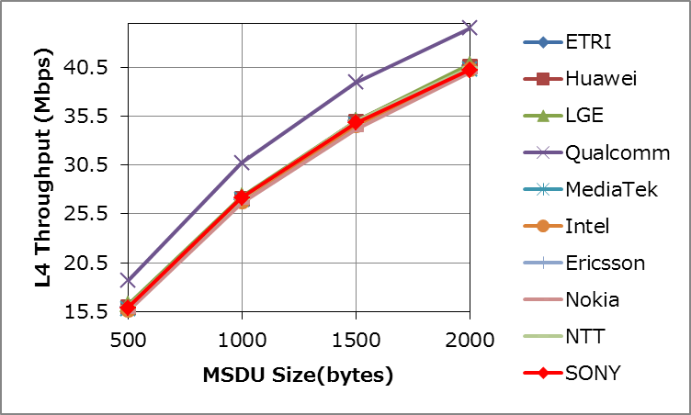
Test1b Results
 | MCS0 |  |  |  | MCS8
 | 500 | 1000 | 1500 | 2000 | 500 | 1000 | 1500 | 2000
ETRI | 4.42 | 5.31 | 5.66 | 5.85 | 15.94 | 26.97 | 34.99 | 40.63
Huawei | 4.42 | 5.31 | 5.66 | 5.85 | 15.94 | 27.07 | 34.97 | 40.61
LGE | 4.45 | 5.31 | 5.66 | 5.86 | 16.20 | 27.30 | 35.00 | 40.80
Qualcomm | 4.40 | 5.29 | 5.64 | 5.84 | 18.64 | 30.75 | 38.94 | 44.51
MediaTek | 4.40 | 5.29 | 5.64 | 5.84 | 15.79 | 26.90 | 34.62 | 40.24
Intel | 4.40 | 5.29 | 5.64 | 5.84 | 15.70 | 26.80 | 34.55 | 40.26
Ericsson
Nokia | 4.40 | 5.28 | 5.64 | 5.83 | 15.52 | 26.66 | 34.12 | 39.96
NTT | 4.42 | 5.30 | 5.67 | 5.85 | 16.00 | 27.10 | 34.97 | 40.40
SONY | 4.39 | 5.28 | 5.63 | 5.82 | 15.88 | 27.14 | 34.82 | 40.21
MCS0
MCS8

Slide 16
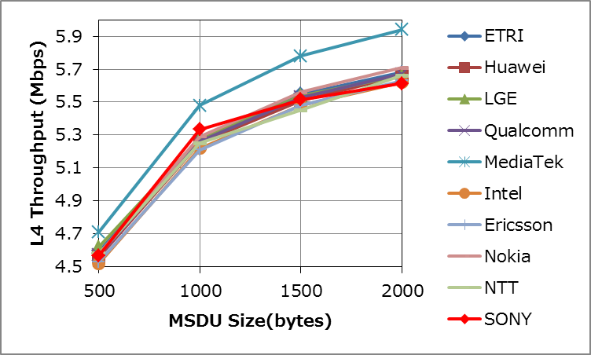
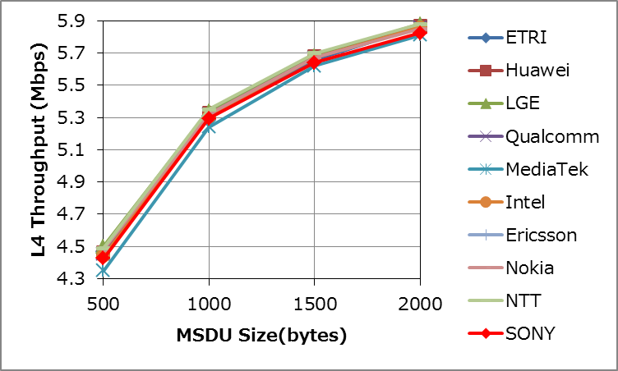
Test2a Results
 | no RTS/CTS |  |  |  | RTS/CTS
 | 500 | 1000 | 1500 | 2000 | 500 | 1000 | 1500 | 2000
ETRI | 4.59 | 5.28 | 5.55 | 5.68 | 4.47 | 5.31 | 5.65 | 5.87
Huawei | 4.56 | 5.25 | 5.51 | 5.66 | 4.46 | 5.33 | 5.68 | 5.87
LGE | 4.62 | 5.28 | 5.54 | 5.66 | 4.50 | 5.34 | 5.68 | 5.88
Qualcomm | 4.57 | 5.26 | 5.53 | 5.67 | 4.45 | 5.32 | 5.67 | 5.86
MediaTek | 4.71 | 5.48 | 5.78 | 5.94 | 4.35 | 5.24 | 5.62 | 5.81
Intel | 4.52 | 5.22 | 5.48 | 5.62 | 4.44 | 5.31 | 5.67 | 5.86
Ericsson | 4.53 | 5.21 | 5.48 | 5.63
Nokia | 4.58 | 5.29 | 5.56 | 5.71 | 4.48 | 5.32 | 5.67 | 5.85
NTT | 4.58 | 5.25 | 5.45 | 5.66 | 4.49 | 5.35 | 5.70 | 5.88
SONY | 4.57 | 5.33 | 5.52 | 5.61 | 4.43 | 5.29 | 5.64 | 5.82
no RTS/CTS
RTS/CTS

Slide 17
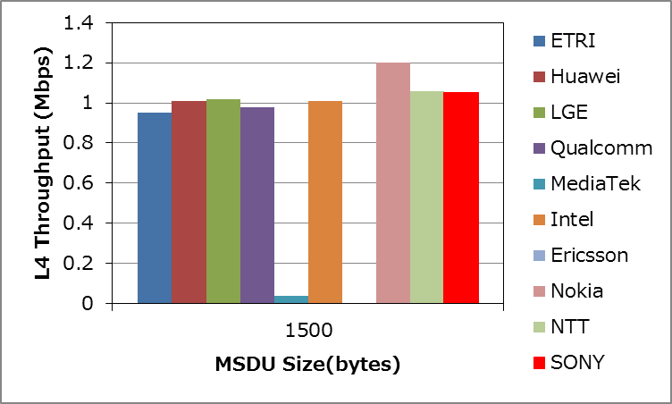
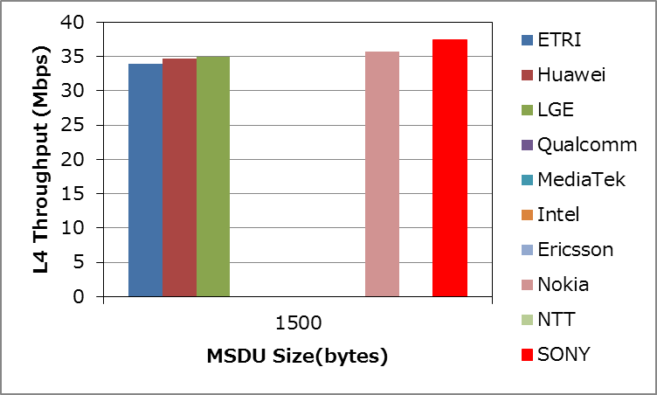
Test2b Results
 | MCS0 | MCS8
 | 1500 | 1500
ETRI | 0.95 | 33.96
Huawei | 1.01 | 34.75
LGE | 1.02 | 35.00
Qualcomm | 0.98
MediaTek | 0.04
Intel | 1.01
Ericsson
Nokia | 1.20 | 35.66
NTT | 1.06
SONY | 1.05 | 37.44
MCS0
MCS8

Slide 18
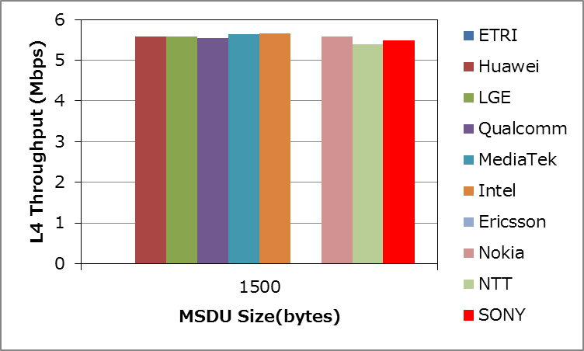
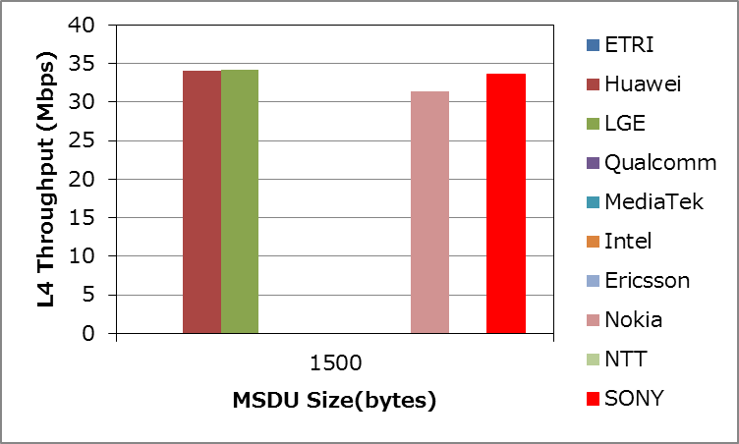
Test3 Results
 | MCS0 | MCS8
 | 1500 | 1500
ETRI | 5.61 | 33.82
Huawei | 5.58 | 34.05
LGE | 5.58 | 34.20
Qualcomm | 5.55
MediaTek | 5.64
Intel | 5.66
Ericsson
Nokia | 5.59 | 31.35
NTT | 5.40
SONY | 5.49 | 33.56
MCS0
MCS8

Slide 19
Conclusion
Box1 tests results
Performed simulations for Tests 1 – 5 for SS3
Box3 tests results
Performed simulations for Tests 1 – 3
These results are almost aligned with other calibrating companies.

Slide 20
References
11-14-0980-04-00ax-simulation-scenarios
11-14-0571-05-00ax-evaluation-methodology
11-14-0799-02-00ax-modifications-to-simulation-scenarios-and-calibration-process
11-14-0800-24-00ax-box-1-and-box-2-calibration-results
11-14-1342-01-00ax-mac-calibration-results

