Slide 1
Quasi-Orthogonal STBC
for SC-PHY in IEEE 802.11aj (45GHz)
Date: 2014-11-5
Presenter: Haiming Wang
Authors/contributors:

Slide 2
Background
In 802.11n/ac/ad, the orthogonal STBC is widely used for improving the performance of wireless communication systems.
The Alamouti code is the unique scheme to achieve the maximum diversity order as well as full rate transmission in case of 2 transmitting antennas.
Some alternative schemes could be applied in systems with more than 2 antennas. These coding schemes are suboptimal as they cannot achieve full transmission rate and full diversity order simultaneously.
One scheme of Orthogonal STBC can achieve full diversity order at a rate of 1/2.

Slide 3
Code matrix:
- Quasi Orthogonal STBC can achieve full rate transmission with impairing diversity order.
Code matrix:
The elements in each row are the symbols to be transmitted on each antenna.

Slide 4
Introduction
Quasi Orthogonal STBC(4×1 -1ss)
t₁ t₂ t₃ t₄
Data stream:
.... .....

Slide 5
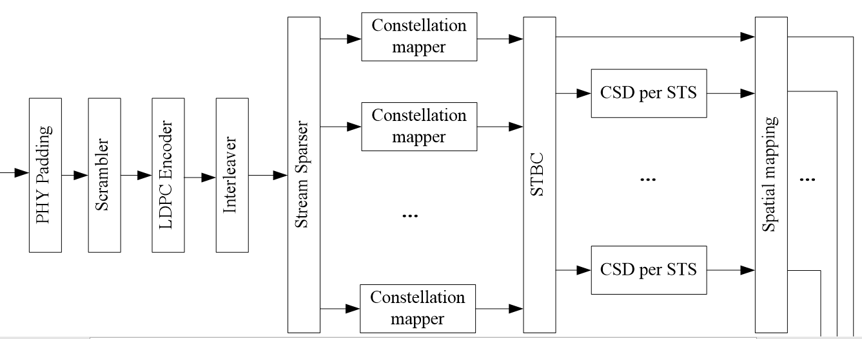
Location in Transmitter:

Slide 6
- Code block:
k-th time slot:
(k+1)-th time slot:

Slide 7
(k+2)-th time slot:
(k+3)-th time slot:
- Then the original data can be obtained using linear processing in the receiver.

Slide 8
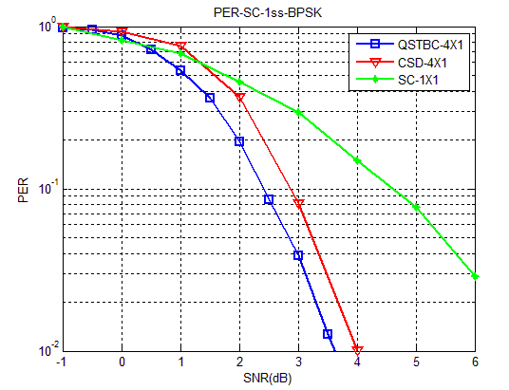
Simulation
- Comparisons of error performance of the 4×1 system with BPSK Modulation and 1/2-rate and 1-ss.
QSTBC outperforms CSD by 0.4dB approximately.(PER=0.1)
QSTBC outperforms SC-1×1 by 2.2dB approximately.(PER=0.1)

Slide 9
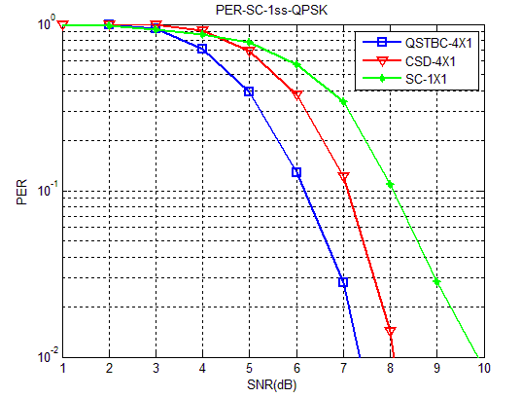
- Comparisons of error performance of the 4×1 system with QPSK Modulation and 1/2-rate and 1-ss.
QSTBC outperforms CSD by 0.8dB approximately.(PER=0.1)
QSTBC outperforms SC-1×1 by 1.2dB approximately.(PER=0.1)

Slide 10
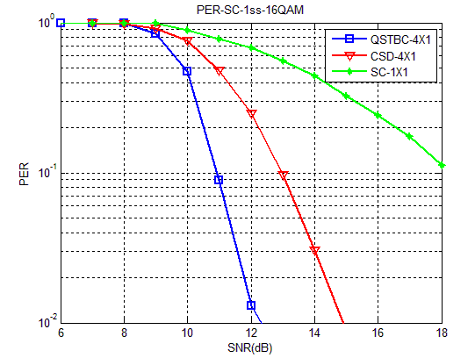
- Comparisons of error performance of the 4×1 system with 16-QAM Modulation and 1/2-rate and 1-ss.
QSTBC outperforms CSD by 2dB approximately.(PER=0.1)

Slide 11
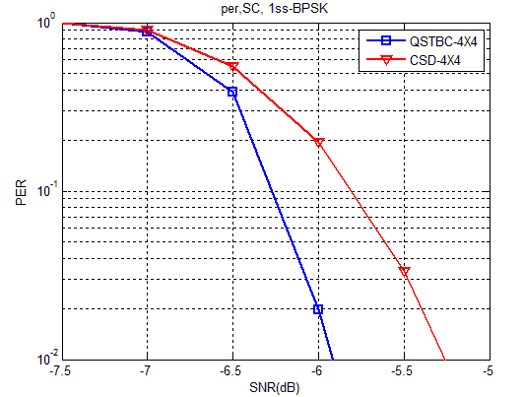
- Comparisons of error performance of the 4×4 system with BPSK Modulation and 1/2-rate and 1-ss.
QSTBC outperforms CSD by 0.5dB approximately.(PER=0.1)

Slide 12
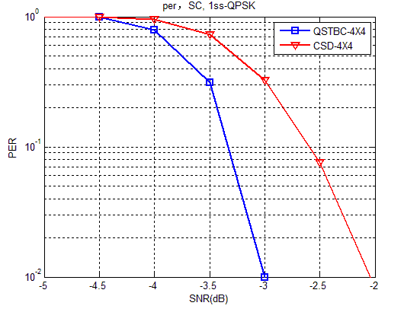
- Comparisons of error performance of the 4×4 system with QPSK Modulation and 1/2-rate and 1-ss.
QSTBC outperforms CSD by 0.8dB approximately.(PER=0.1)

Slide 13
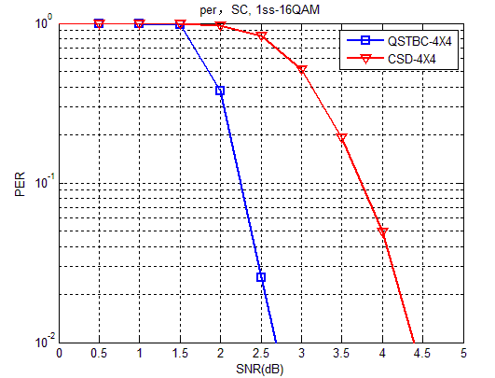
- Comparisons of error performance of the 4×4 system with 16QAM Modulation and 1/2-rate and 1-ss.
QSTBC outperforms CSD by 1.5dB approximately.(PER=0.1)

Slide 14
Conclusion
Similar as the conventional Alamouti’s code with 2 antennas, the QO-STBC can also obtain the full-rate transmission.
Considering the implementation of hardware, the decoding algorithm of QOSTBC based on linear processing is low-complexity, and all the signal processing can be performed on existing resources.
It’s reasonable to apply QO-STBC to the SC-PHY of 802.11aj (45GHz) to improve link robustness or extend coverage.
The QO-STBC is also possible to used for the OFDM-PHY of 802.11aj (45GHz).

Slide 15
Reference
[1] Single-Carrier Frequency-Domain Equalization for Space–Time Block-Coded Transmissions over Frequency-Selective Fading Channels
[2] Single-Carrier Frequency-Domain Equalizer with Multi-Antenna Transmit Diversity
[3] Frequency Domain DFE for Single-Carrier STBC Block Transmission
[4] Coding for MIMO Communication Systems, Tolga M.Duman, Ali Ghrayeb

Slide 16
Thanks for Your Attention!

