Slide 1
Efficiency Measurement for RTS/CTS
Date: 2014-10-30
Authors:

Slide 2
Abstract
This document presents the efficiency measurement for RTS/CTS
  Throughput and packet retransmission ratio were measured by the experiment in the dense area
  Measure results show that RTS/CTS can achieve slightly higher performance than the case without using RTS/CTS

Slide 3
PHY and MAC to Boost Throughput
MAC
access
efficiency
PHY
data
rate
Contribution [1] presented that decreasing collided data is a way to boost throughput.
We assumed RTS/CTS is one of the possible ways to decrease the packet collision.
We performed an experiment to evaluate the efficiency of RTS/CTS in a typical dense area in Tokyo

Slide 4
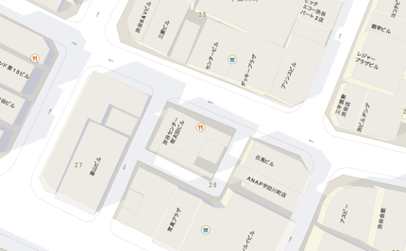
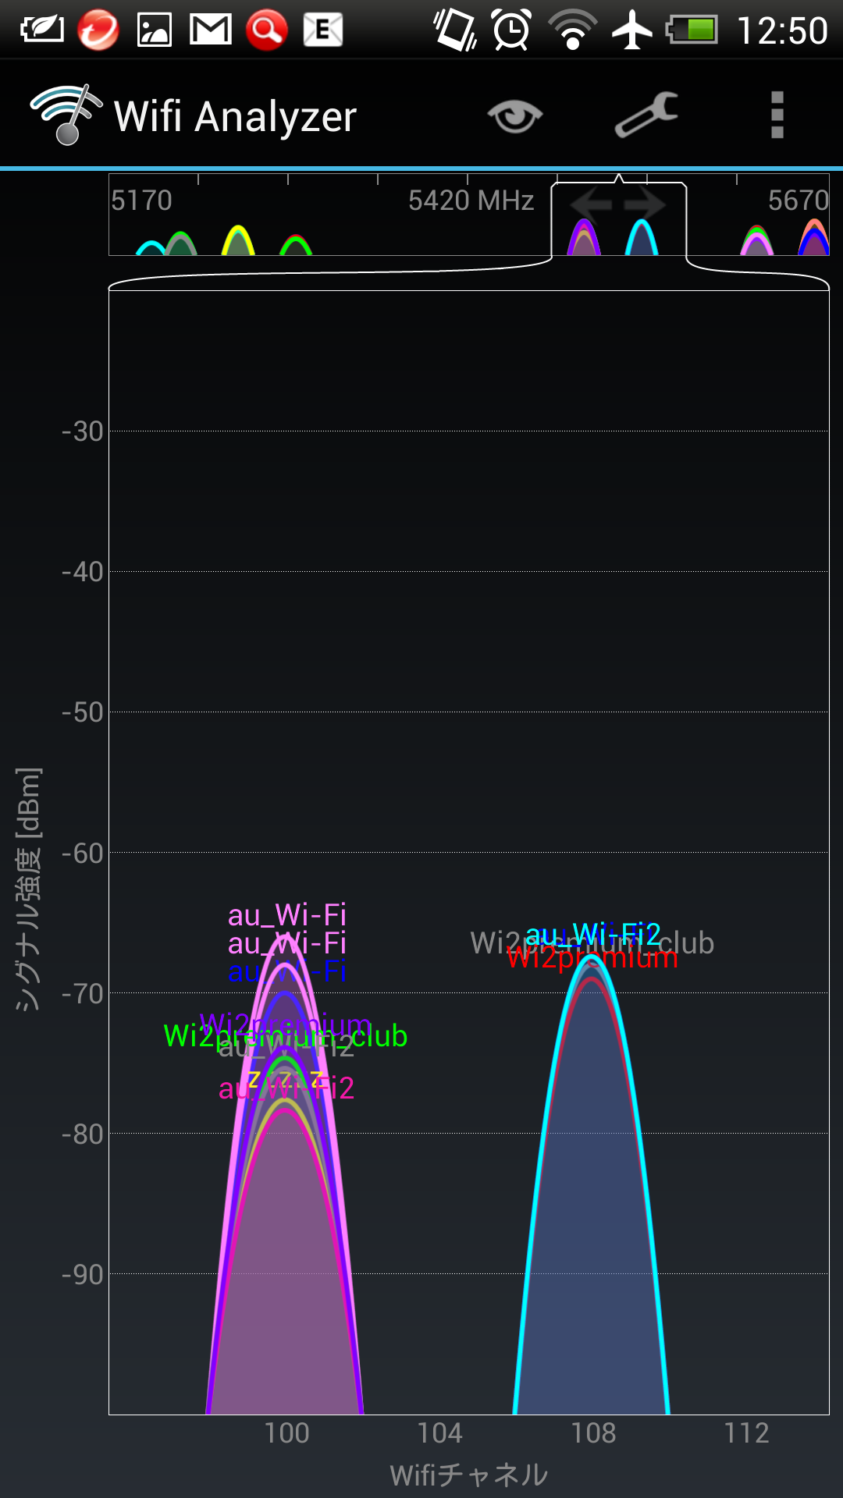
Measurement Scenario
Coffee shop @3rd floor
UDP throughput and retry rate were measured with/without RTS & CTS on the street which APs had been densely deployed.
AP
Frame capture
UDP packets
(1470B)
PC
CH100+104
(40MHzBW)
AP
@coffee shop
~20m
~50m
~100m
STA
Frames were captured at the AP side.
RTS
QoS
(UDP)
QoS
(UDP)
QoS
(UDP)
time
AP
CTS
BA
time
CH100
Many SSIDs were observed on CH100.
STA

Slide 5
Measured Packet Retransmission Ratio
Distance | RTS/CTS | Tx Power
 |  | Full | -6dB | -10dB
Near (20m) | without | 19.7% | 26.8% | 40.8%
 | with | 18.4% | 24.1% | 35.6%
Middle (50m) | without | 47.9% | 70% | Not connected
 | with | 44.4% | 60.5%
Far (100m) | without | 60.9% | Not connected | Not connected
 | with | 50.1%
The value in each case is an average of 30 measurements
Due to the protection of RTS/CTS, the packet retransmission ratio is always lower than the case without using RTS/CTS

Slide 6
Measured Throughput (Mbps)
Distance | RTS/CTS | Tx Power
 |  | Full | -6dB | -10dB
Near (20m) | without | 37.3 | 30.7 | 17.6
 | with | 36.3 | 29.8 | 17.8
Middle (50m) | without | 11.6 | 3.6 | Not connected
 | with | 11.6 | 4.5
Far (100m) | without | 6.6 | Not connected | Not connected
 | with | 7.0
The value in each case is an average of 30 measurements
In weak signal area, RTS/CTS can achieve higher throughput
  Benefit outweighs overhead

Slide 7
Summary
We measured the efficiency of RTS/CTS in a typical dense area in Tokyo
Measurement results show that the benefit of RTS/CTS in throughput outweighs the incurred overhead in the weak signal case

Slide 8
Reference
11-14/835r2, “Functional Requirements Discursion”, Joe Kwak, et al.

