Slide 1
PHY Rate for NG60
Date: 2014-11-02
Authors:

Slide 2
Parameters that affect PHY Rate
Channel Bonding
  Contiguous
  Fill gaps
MIMO
Constellation
Symbol length and Guard-Interval
Coding Rate
Modulation

Slide 3
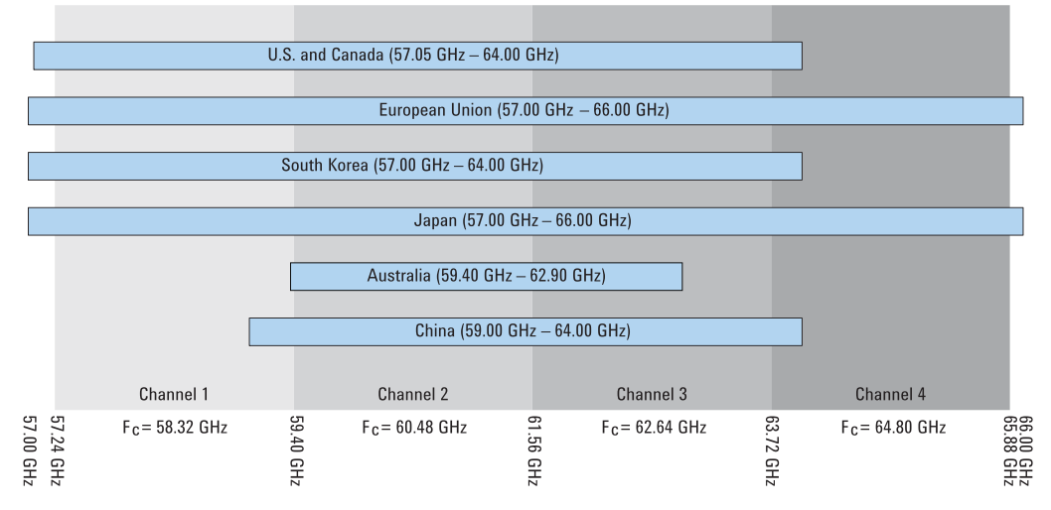
Channel Bonding
The 60G spectrum allocation specifies up to 4 channels

Slide 4
Channel Bonding

Slide 5
Channel Bonding
Simple channel bonding analysis can assume simple multiplication by number of channels.
In channel bonding gaps between channels can be used.
For simplicity, the analysis will be done for OFDM modulation:
In 802.11ad the following parameters are used
  FFT size 512
  Data carriers 336
  CP is 25%
  Sampling rate is 2.64Gsps
  Hence: bin width (carrier) is: 2.64G/512 = 5.1563 MHz
  Number of used bins (carriers) is: 355
Channel spacing is 2.16GHz, which are ~419 carriers.

Slide 6
Channel Bond
In 802.11ad there are 355 bins in a 419 bins spaced channels
Using simple extrapolation for same bin width:
The actual design may change the exact values to simplify the implementation.
Case | Equation | Data bins | factor
2ch | (355+419)*336/355 | 732 | 2.18
3ch | (355+2*419)*336/355 | 1129 | 3.36
4ch | (355+2*419)*336/355 | 1525 | 4.54

Slide 7
MIMO
Various MIMO configurations can be considered:
  2x2
  2x4
  3x3
  4x4
  And more
The MIMO capacity gain is
bounded by RF chains in
each end and by the channel.
Max capacity gain for a 4x4
setup is: 4
#1
#2
#3
#4
#1
#2
#3
#4

Slide 8
Constellation
802.11ad already supports QAM: 16QAM and 64QAM
We suggest to consider also modulations of 128QAM and 256QAM
Optimization may lead to APSK instead of QAM, but this will not affect capacity nor following analysis

Slide 9
Symbol Length and Guard Interval
802.11ad supports:
  OFDM: sample rate = 2.64Gsps, FFT size = 512, CP = 25%
  SC: sample rate = 1.76Gsps, symbol length = 512 (incl. GI), GI length = 64
For the purpose of this analysis we suggest to keep the symbol duration and GI the same (SC: GI length and GI spacing in time).
One may suggest some optimizations. Impact will be relatively small.
For very short links, that will be able to utilize high QAM, one may argue that the GI can be shorten, and/or symbols can be longer. Such modification will lead to improved efficiency. However the benefit is bounded by ~15%.

Slide 10
Coding rate
802.11ad supports the following rates: 1/2, 5/8, 3/4, and 13/16.
At this time we assume no change.
One may argue that for 256QAM 7/8 is better. However the difference is only about 6%.

Slide 11
Modulation
802.11ad supports: SC and OFDM
At this time we assume that same rate can be achieved in both modes.
This is a fair assumption, although optimization may shift the number slightly.

Slide 12
SC Modulation
SC channel bonding extension results in rate gain of 2, 3 or 4, proportional to the number of channels.
  Assuming same mask edges and roll-off factor.

Slide 13
PHY Rate Summary - 1
Combining the major factor and using the maximum achievable improvements:
Assumptions:
  256QAM
  Code rate: 7/8
  Additional improvement: 0%
Conclusion:
  100Gbps is an achievable PHY rate
MIMO \ Channels: | 1 | 2 | 3 | 4
1x1 | 9.70 | 21.15 | 32.60 | 44.05
2x2 | 19.40 | 42.30 | 65.20 | 88.09
3x3 | 29.11 | 63.45 | 97.80 | 132.14
4x4 | 38.81 | 84.60 | 130.39 | 176.19

Slide 14
PHY Rate Summary - 2
Combining the major factor and using a very conservative approach:
Assumptions:
  64QAM
  Code rate: 3/4
  Additional improvement: 0%
Conclusion:
  40Gbps is an achievable PHY rate (MIMO 2x2 and bonding of 3)
MIMO \ Channels: | 1 | 2 | 3 | 4
1x1 | 6.24 | 13.60 | 20.96 | 28.32
2x2 | 12.47 | 27.19 | 41.91 | 56.63
3x3 | 18.71 | 40.79 | 62.87 | 84.95
4x4 | 24.95 | 54.39 | 83.83 | 113.26

Slide 15
PHY Rate Summary - 3
Combining the major factor and using a moderate approach:
Assumptions:
  128QAM
  Code rate: 13/16
  Additional improvement: 0%
Conclusion:
  100Gbps is achievable PHY rate
MIMO \ Channels: | 1 | 2 | 3 | 4
1x1 | 7.88 | 17.18 | 26.49 | 35.79
2x2 | 15.77 | 34.37 | 52.97 | 71.58
3x3 | 23.65 | 51.55 | 79.46 | 107.36
4x4 | 31.53 | 68.74 | 105.95 | 143.15

Slide 16
Summary
It was shown that using the existing ideas for increasing the PHY rate, 100Gbps is an achievable goal.
Reaching 40Gbps looks feasible even with MIMO of 2x2, three channels bonding, 64QAM and current LDPC code. This fits into mobile small FF as well.
For the PAR and CSD we suggest to use 20Gbps (MAC rate)
This analysis was done by using existing parameters, without performing a detailed design of the proposed PHY.

