Slide 1
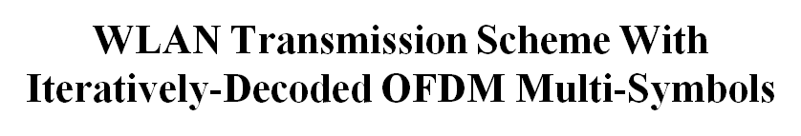
Date: 2014-11-04
Authors:
Notes:
September 2012

Slide 2
Outline
A glance at Bit-interleaved Coded Modulation with Iterative Decoding (BICM-ID)
Proposed transmission scheme
Simulation results
Summary
Notes:
Let me say some words about BICM-ID, as WLANs actually have sth in common (and highlight simillarities and differences)
Then I’ll introduce the proposed transmission scheme
Afterwards, I’ll present some simulation results and conclude

Slide 3


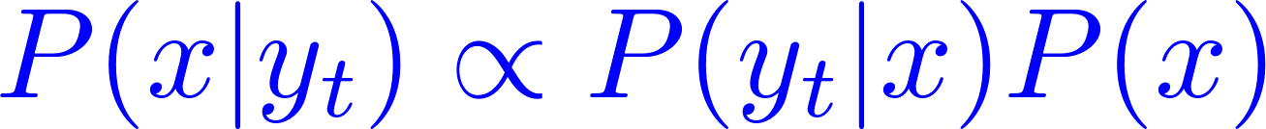
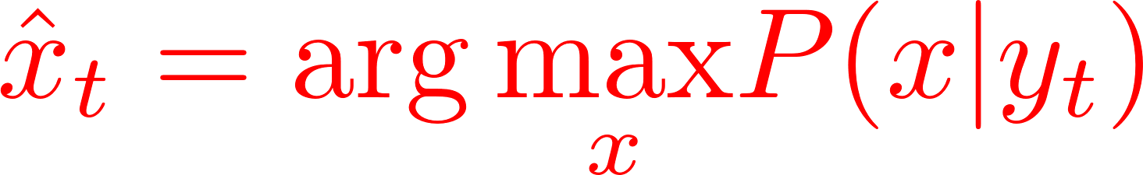
BICM
Data input
Conv.
encoder
Interleaver
Mapper
Fading channel
Data sink
SISO
conv.
decoder
Demapper
Deinterleaver
Notes:
So, let’s start from a basic BICM (without iterative decoding)
At the transmitter we have convolutional encoder, bit-wise interleaver, and symbol mapper. I’m considering equivallent baseband channel model, so the RF part is ommited. Please, note that the WLAN transmitter incorporates BICM principles.

Slide 4

BICM-ID
Data input
Conv.
encoder
Interleaver
Mapper
Fading channel
Data sink
SISO
conv.
decoder
Demapper
Deinterleaver
Interleaver
Requirements:
  appropriate labeling map
  short-constraint-length convolutional encoder
  pseudo-random interleaver (of a sufficient depth)
  high computational power
High receiver latency!

Slide 5
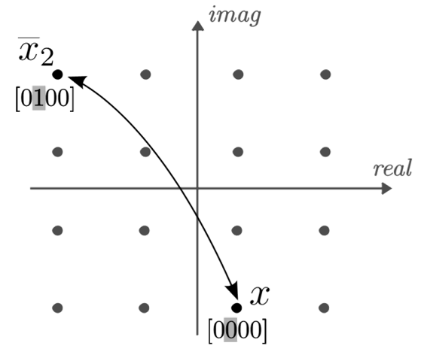
BICM-ID – labelings designed for iteratively decoded systems
maximize avg. Euclidean distance between constellation points, whose labels differ in exactly one bit

Slide 6
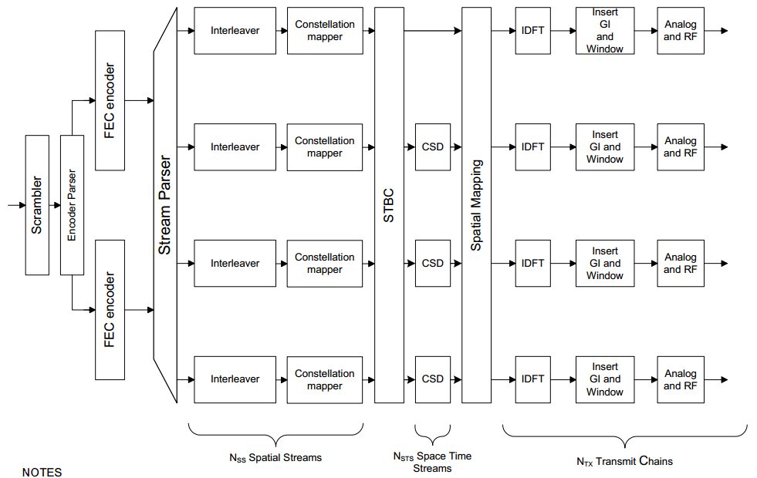
Interleaver depth issue in WLANs
802.11n transmitter

Slide 7
Proposed transmission scheme
OFDM
data symbols
space
stream
PHY
header
OFDM multi-symbol
time
Coding and interleaving applied individually
for every OFDM multi-symbol
RESULTS:
every OFDM multi-symbol can be decoded separately
parallel processing of individual multi-symbols possible

Slide 8
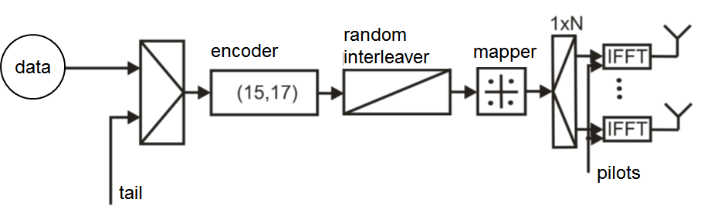
Transmitter (1)
3 tail bits appended for every multi-symbol
  (<1% of data payload (416 bits), in the case of 4 space streams,
  16-QAM modulation and 20 MHz channel)

Slide 9
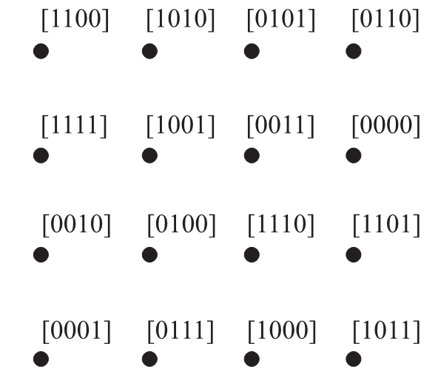
Transmitter (2)
„Optimal” 16-QAM
labeling map applied
in the mapper

Slide 10
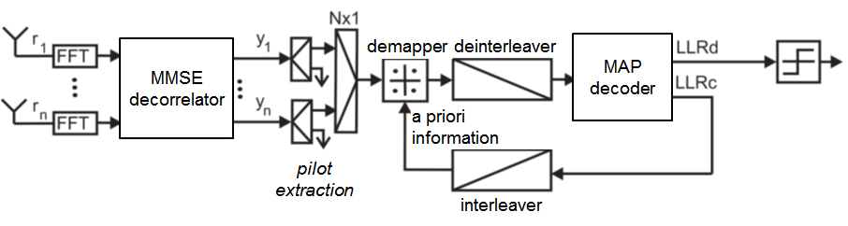
Receiver

Slide 11
Simulation results (1)
4x4 MIMO, 20 MHz uncorrelated Rayleigh fading channel
Iterative receiver, [15 17] code
Iteration #1
Conventional receiver
[171 133] code
Iteration #15

Slide 12
Simulation results (2)
4x4 MIMO, 20 MHz
WLAN B channel (2 clusters, max. delay spread of 15 ns)
Iterative receiver, [15 17] code
Iteration #1
Conventional receiver
[171 133] code
Iteration #15

Slide 13
Simulation results (3)
4x4 MIMO, 20 MHz
WLAN D channel (3 clusters, max. delay spread of 50 ns)
Iterative receiver, [15 17] code
Iteration #1
Conventional receiver
[171 133] code
Iteration #15

Slide 14
Simulation results (4)
4x4 MIMO, 20 MHz
WLAN E channel (4 clusters, max. delay spread of 100 ns)
Iterative receiver, [15 17] code
Iteration #1
Conventional receiver
[171 133] code
Iteration #15
Notes:
High-dispersive channel

Slide 15
Summary
System performance improved by iterative decoding
Receiver latency reduced thanks to individual coding and interleaving of every OFDM multi-symbol
  no need to wait for the reception of the original (possibly large) PPDU before the iterative decoding starts
Applicable for WLANs exploiting space multiplexing
  a need for both reasonably high interleaver depth and low correlation between sub-channels
Transmission over 40, 80, or 160 MHz channels should be considered in the future
  improved frequency diversity effect expected
Notes:
Especially good for high-dispersive channels

Slide 16
Straw Poll
Do you think the next generation WLANs should be designed for iterative decoding?
Do you find the proposed technique applicable for future WLANs?

