Slide 1
Next Generation Positioning
Project Proposal
Authors:
Name | Affiliation | Address | Phone | Email
Jonathan Segev | Intel |  | +972-54-2403587 | jonathan.segev@intel.com
Peter Thornycroft | Aruba |  |  | naveen.kakani@csr.com
Brian Hart | Cisco |  |  | brianh@cisco.com
Naveen Kakani | CSR |  |  | naveen.kakani@csr.com
Ganesh Venkatesan | Intel |  |  | ganesh.venkatesan@intel.com
James Wang | MediaTek |  |  | james.wang@mediatek.com
Gabor Bajko | MediaTek |  |  | gabor.bajko@mediate.com
Liwen Chu | Marvell |  |  | liwenchu@marvell.com
Carlos Aldana | Qualcomm |  |  | caldana@qca.qualcomm.com

Slide 2
Agenda
Motivation
Why 802.11 based positioning?
What do we have today?
Summary

Slide 3
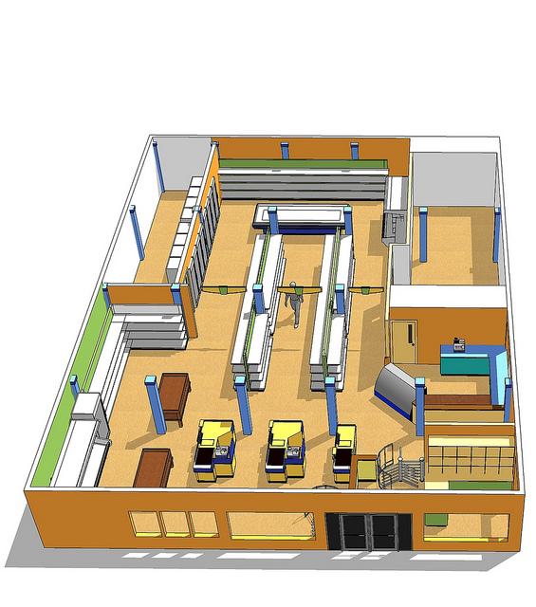


New Positioning Usages
  In previous* contributions we’ve seen a set of new usage models which are partially supported or not supported by the current REVmc protocol:
    Micro geo-fencing (moving from <1m to <0.1m).
    Direction finding.
    Improving scalability and reducing overhead.
  * 11-14-1193/01 – Beyond Indoor Navigation by Jonathan Segev, Carlos Aldana et-al
  11-14-1235/r0 – Scalable Location by Brian Hart, Peter Thornycroft and Mark Rison.
  11-14-1263/r0 – Direction Finding Positioning by James Wang, Gabor Bajko et-al

Slide 4


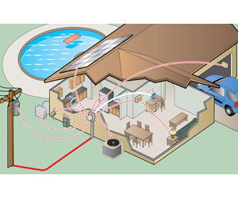
New Positioning Usages
  In previous* contributions we’ve seen a set of new usage models which are partially supported or not supported by the current REVmc protocol:
    High accuracy positioning for LOS environments (e.g. gaming <0.01m).
    Low PWR and IOT segment (sub 1Ghz band operation).
  * 11-14-1193/01 – Beyond Indoor Navigation by Jonathan Segev, Carlos Aldana et-al
  11-14-1235/r0 – Scalable Location by Brian Hart, Peter Thornycroft and Mark Rison.
  11-14-1263/r0 – Direction Finding Positioning by James Wang, Gabor Bajko et-al

Slide 5
Why 802.11 Based Positioning?
Positioning has symbiotic relation with data connectivity:
  Positioning means nothing without contextual information.
  Data connectivity improves with the addition of positioning.
802.11 based WLAN is almost ubiquitous in many indoor environments (malls, retail chains).
Building on existing technology enables reuse:
  Many of the use cases revolve around the smartphone (already packed with radios, reuse keeps complexity of actual device in check).
  Reuse of connectivity technology shortens and simplifies technology development.
Symbiotic relationship between data and
positioning services
Notes:
Making development effort easier.
time to market shorter which provide an opportunity for cost efficient strong penetration real world products.
Using existing connectivity technology also promotes interoperability as it uses existing SDOs and ITOs.
the Swiss army knife of modern days – the smartphone,
Vendor reluctant to add radios.

Slide 6
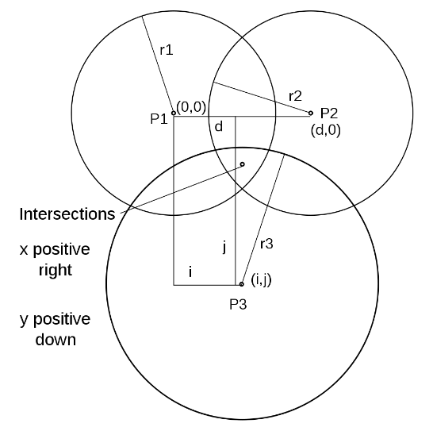
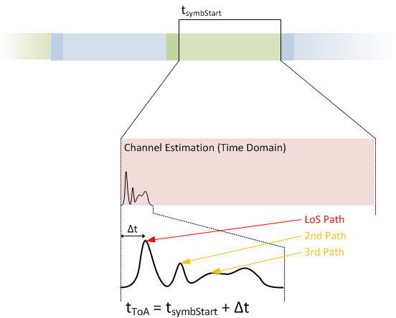
REVmc Location Support
Main items addressed by FTM introduction to REVmc:
  1:N operation - AP STA: non AP STA lead usage model.
  Multi channel operation: APs STA have a fixed operating channel while non AP STA move between AP STA’s channels.
  Non associated operation mode, multiple ranges are required to obtain single fix.
  Support for AP Location DB protocol.

Slide 7
Summary
We’ve described a new set of useful usage models that are of commercial use and interest.
We’ve described the challenges and area of technical development that are extension of existing technology in 802.11.
REVmc has enhanced the support for indoor positioning which will likely lead to implementations and market adoption in the near future.
The group should now take the next step to extend the positioning support, and this should be done in a dedicated SG.

Slide 8
Motion
Request approval by IEEE 802 LMSC to form an 802.11 Study Group to investigate the requirements and feasibility of improved 802.11 based positioning as described in 11-14-1193-01-0wng-beyond-indoor-navigation.pptx with the intent of creating a PAR and a CSD.
Moved by: Jonathan Segev
2nd by: Carlos Aldana
Y: N: A:

Slide 9
Backup

Slide 10
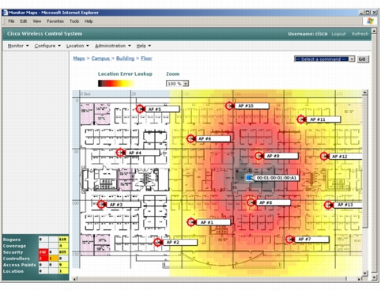
Evolution of 802.11 Based Positioning
RSSI
Time Of Departure
Fine timing measurement

