Slide 1
Service Identifiers and Bloom Filters
Date: 2015-11-07
Authors:

Slide 2
Overview
This presentation is an update to IEEE 802.11aq Draft 3.0
  A more very simple and more efficient set of hashes are proposed

Slide 3
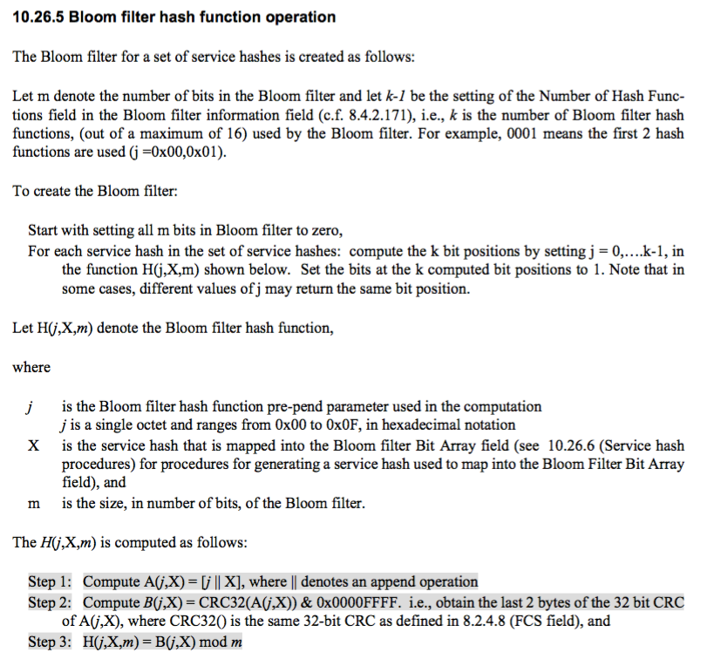
Draft 11aq/D3.0 Hash
Note that ‘X” is already formed from a SHA256 hash
Full CRC32 required for each hash value, only 2 bytes used

Slide 4
More Efficient Hashing
Observations
  2 byte CRC32 is calculated k times for each service and then mapped mod ‘m’
  SHA256 is already performed and must be created for each service
Recommendation
  Reuse octets from the SHA256 that serve as a unique identifier
  Each k-th hash could would simply XOR selected octets from the existing hash calculation
      Very high entropy and quality hash
      Very simple calculation per new service in filter O(k) XORs
      Useful since filter changes each time length changes

