Slide 1
Service Identifiers and Bloom Filters
Date: 2015-5-13
Authors:

Slide 2
Overview
This presentation is an update to 11-14-1262-02 with specific suggested changes to P802.11aq/D1.2 to address CIDs: 1800, 1801
A more very simple and more efficient set of hashes are proposed
A more efficient usage of Bloom Filters are proposed to provide a factor of 4 or more improvement in the number of services represented for the same probability

Slide 3
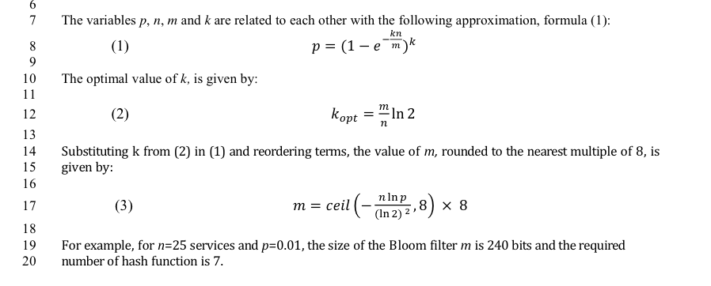
Current 11aq/D1.0 Bloom Filter Probability
For 1000 services (n) the Bloom Filter should be about 1200 octets for a 1% error probability

Slide 4
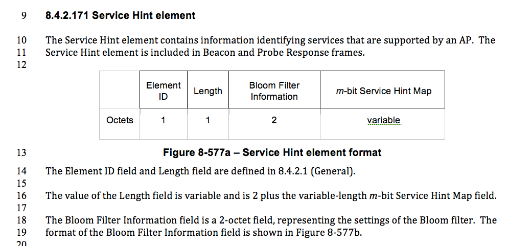
Service Hint Field
Limits Bloom filter to 254 octets. Calculations would be more efficient if powers of 2
Confusing, why not in Octets to match length.

Slide 5
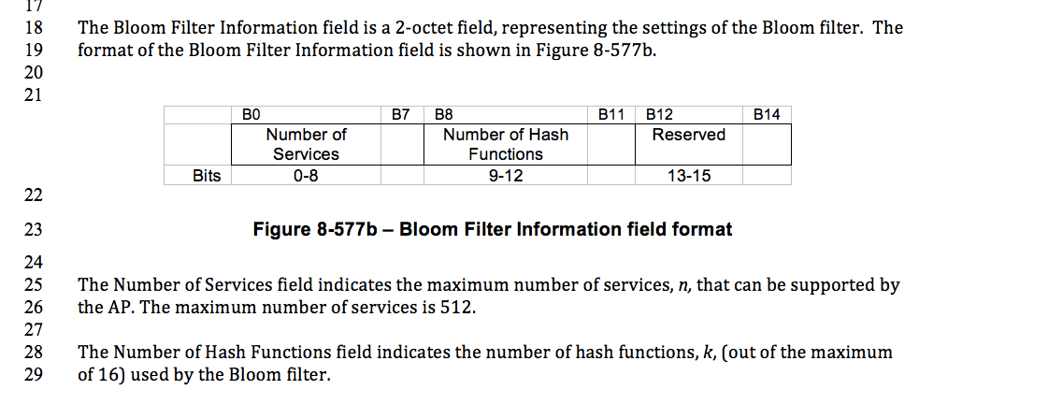
Bloom Filter Information Field
Not required or useful if this is the maximum number of services
Confusing, where is ‘k’ defined.

Slide 6
Bloom Filters for Discovery
Service Name
A UTF8 string value that uniquely identifies a service. This can be a Bonjour, DLNA or other types of identifiers. Example -> “service.name.example1”
Universal Service Id (USID)
A 16 octet unique identifier for a Service Name based on a hash of the Service Name. Example -> 0xa5caec4b28fb241de6ad99a845ee3a82
Hash Value (or Service Id)
A 6 octet identifier for a Service Name based on a hash of the Service Name. Example -> 0xa5caec4b28fb
Bloom Id
An M octet (M<256) identifier for a service that has bits set to one based on ‘k’ hash calculations. Example ->
Bloom Filter
An M octet (M<256) string that represents up to ‘n’ services and is formed by XORing multiple Bloom Id strings together to represent the set of services.
Example ->

Slide 7
Bloom Filter Parameters
Bloom Filters represent a set of services
detection of a service is by checking by validating that each bit in a service’s Bloom ID is contained in the Bloom Filter
False postive’s indicating service is contained but is not occurs with probability ‘p’
Parameters
‘M’ - the size of the Bloom Filter in octets
‘n’ - the maximum number of expected services in the filter
‘p’ – target probability of false positive detection
‘k’ – number of hash functions used to set bits in a Bloom Id

Slide 8
Scaling of Filters
For M = 254 octets
For a maximal length filter (per 1.2 draft) the useable size of the set of services is limited for useable probabilities.
A 254 octet filter can represent well roughly 200 services
N
Maximum
Services
P – Probability

Slide 9
Adjusting Bloom Filters
Only two parameters fully define a Bloom Filter:
The length of the filter ‘M’ in octets (M=m*8)
The number of bits per service ‘k’
The optimal max number of services and the probability can be calculated from M and k
Likewise, for ‘n’ services and a desired probability p, M and k can be calculated
Probability | Ratio | Calculated
p | m/n | k opt
0.00001 | 23.96 | 16.61
0.0001 | 19.17 | 13.29
0.001 | 14.38 | 9.97
0.002 | 12.93 | 8.97
0.005 | 11.03 | 7.64
0.01 | 9.59 | 6.64
0.02 | 8.14 | 5.64
0.05 | 6.24 | 4.32
0.1 | 4.79 | 3.32
0.2 | 3.35 | 2.32
0.5 | 1.44 | 1.00

Slide 10
Bloom Filter Information
“Number of Services” is not required since there are two other parameters available ‘k’ and ‘m’

Slide 11
Draft 11aq/D1.2 Hash
Note that ‘X” is already formed from a SHA256 hash
Full CRC32 required for each hash value, only 2 bytes used

Slide 12
More Efficient Hashing
Observations
2 byte CRC32 is calculated k times for each service and then mapped mod ‘m’
SHA256 is already performed and must be created for each service
Recommendation
Reuse octets from the SHA256 that serve as a unique identifier
Each k-th hash could would simply XOR selected octets from the existing hash calculation
Very high entropy and quality hash
Very simple calculation per new service in filter O(k) XORs
Useful since filter changes each time length changes

Slide 13
Hash Calculation
A Bloom Id is formed by setting k bit positions in in the Service Hint Map using k hash functions.
for i in range(k):
set bit H(i,U_{i} ,M)
The hash function H(i,U,M) is computed as follows:
Let U[ i : i+2 ] represent 2 sequential octets in the octet string U
Step 1: Compute A(i,U) = U[ i mod 8, (i mod 8)+2] XOR U[ (int(i/8)+8, int(i/8)+10)
Step 2:H(i,U,M) = A(i,U) mod M*8
The hash function H(i,U,M) supports up Bloom Ids with Number of Hash Functions (k) up to 54.

Slide 14
Sequential Bloom Filters
Shorter Bloom Filters are possible with the same probability ... If we send multiple different filters
Define ‘r’ filters of length l where sum of length of the r filters is m
Effectively trading time (multiple filters in beacons for length)
Example:
Rather than one 512 octet filter, send 4 128 octet filters
Each filter processed separately
If desired service is not found in any filter part search can stop
Probability incrementally increases with each filter part processed.
Possible to have very low false positive probability and shorter transmitted frames

Slide 15
Sequential Bloom Filters
The Bloom Filters sent in successive beacons do NOT need to be the same.
A different, but similarly calculated Bloom Filter can be send on successive beacons
In observing a transmitted filter, a STA would be able to quickly get a lower probability answer, but could then observe again if result is positive and higher probability desired.
Almost identical functionality to current draft
Many more services would be able to be represented
Would also benefit from simpler hash function to calculate each sequential hash

Slide 16
Details of Sequential Bloom Filters
R filters would be sent sequentially ( r = 0 to R-1)
Hash would become H(r,i,U,M)
Each shorter Bloom Filter would be processed as per draft with H(r,i,U,M) = H( (i+k*r) ,U,M)
Processing multiple different sequential filters would improve the probability on each observation and would would have the full probability of false detection ‘p’ after all ‘r’ filters.
Processing could stop early if any of the Bloom Filters indicate that a service is not supported (since non-membership is definitive).

Slide 17
Sequential Bloom Filters
Bloom Filter Information field would change to only contain :
Number of Hash Functions (k)
Number of Sequential Filters (R)
Filter Number (r, range 0 to R-1)

