Slide 1
On MU Aggregation Mechanisms for 11ax
Date: 2014-09-15
Authors:
Name | Affiliations | Address | Phone | email
Reza Hedayat Young Hoon Kwon Yongho Seok Minho Cheong Hyoungjin Kwon Amin Jafarian | NEWRACOM | 9008 Research Drive, Irvine, CA 92618 |  | reza.hedayat at newracom.com younghoon.kwon at newracom.com yongho.seok at newracom.com minho.cheong at newracom.com hj.kwon at newracom.com amin.jafarian at newracom.com

Slide 2
Short packets are highly likely in many applications
In past meetings, several contributions showed that measured traffic for variety of applications has large likelihood for short packets [3,4,8], and there are network applications that also generate short packets [7]
Detailed measurements show that while there are high probability for short packets for UL/DL, even shorter packet are likely for UL
Smartphone traffic measurements for variety of applications such as YouTube, web browsing, Facebook, Skype etc shows that [1]:
  Packet sizes are mostly short
  Number of packets per burst are mostly a few
  Burst inter-arrival time are mostly in order of milliseconds

Slide 3
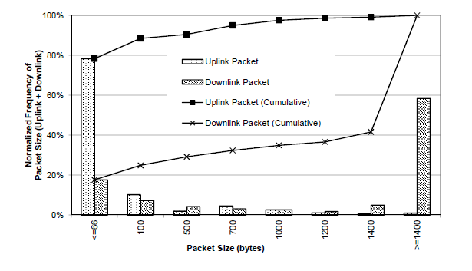
Short packets are highly likely in many applications
For instance, traffic measurement on packet size reveals that packet size is <66B with >75% chance for UL, and <1500B with %40 chance for DL [1]
See Appendix for more details

Slide 4
How well WiFi fits to short packets?
11n/ac have added/extended AMPDU for SU aggregation so MPDUs can be aggregated if they arrive within the same burst, or within some time limit
Measurements on burst size of many applications show that there is high chance even for short bursts
WiFi has large overhead for short payloads
  With wider bandwidth (and a mid-MCS and even SS=1), these short packets would occupy only a few OFDM symbols, and sometimes less than PLCP header
  For max Ethernet packet size of 1500B, with BW=20/40/80MHz, MCS=5/SS=1 the payload occupies 8/4/2 OFDM symbols. PLCP is 5/9/10 OFDM symbols for 11a/g/n/ac
MU aggregation would help in high-density environments, where bursts from multiple STAs could be aggregated in one PPDU

Slide 5
WiFi vs LTE/WiMax on MU aggregation
LTE/WiMax are cellular technologies for licensed bands where a BTS is in charge of airtime/bandwidth assignment
LTE/WiMax are based on MU aggregation on DL and UL. This allows for aggregation of multiple packets to/from various clients in a single DL/UL access, which leads to breaking the overhead
In LTE/WiMax, clients send ACK/NACK in UL, aggregated with other UL packets or ACK/NACKs
WiFi has SU aggregation mechanisms (AMPDU, AMSDU)
DL MU-MIMO is MU aggregation method, but is optional and limited
Clients ACK in individual frames. So even with a DL MU aggregation, sending ACKs individually adds overhead, specially for shorter packets
In WiFi, AP sends ACK/BA in individual frames. It’s possible to aggregate the ACK/BA in a single frame in response to an UL aggregation method.

Slide 6
WiFi and MU aggregation
Compared to LTE, WiFi lacks mandatory MU aggregation mechanisms
Considering application with high likelihood of short packets/bursts, MU aggregation methods help to enhance MAC efficiency and reduce medium access overhead
Lately, WiFi industry has shown interest to add UL/DL OFDMA and/or UL MU to 11ax
This is good news, but for a complete story there should be mechanisms to aggregate ACKs/BAs in the opposite direction
ACK/BA aggregation in DL direction is not available in the spec now, but with some relatively simple changes this can be made available
In next slides various UL ACK aggregation methods are compared

Slide 7
ACK/BA Aggregation
Polled-ACK mechanism was added in 11ac for DL MU MIMO, and it could be reused for DL OFDMA as well
  Sequential-ACK procedures were considered in 11ac but due to error recovery issues none was adopted
While polled-ACK is robust, it reduces the efficiency of the MU aggregation mechanism, particularly for short packets/bursts
DL MU PPDU
80 MHz
BA
BAR
BA
BAR
BA
BAR
BA

Slide 8
ACK/BA Aggregation
While polled-ACK is applicable, it is not an efficient mechanism for short payloads, nor to poll ACK from many STAs in case of DL OFDMA
Introducing a new more efficient and yet robust ACK/BA aggregation enhances the overall efficiency of MU aggregation
UL OFDMA and UL MU might become used in 11ax which are suitable candidates
Considering UL MU for ACK aggregation, while it’s feasible and offers good error recovery, it is less favorable since it is likely to be an optional feature

Slide 9
ACK/BA Aggregation
UL OFDMA is likely to be considered for 11ax. Given that, UL OFDMA can be used for ACK aggregation in UL direction (in response to DL OFDMA/MU), e.g. [7]
However, additional decisions/considerations need to be made on:
  Whether, for sake of compatibility with legacy devices, bandwidth that each ACK/BA takes in UL OFDMA should be 20MHz sub-band
  Error recovery if one or multiple ACK/BAs are missing in the UL OFDMA frame
  How to aggregate several, potentially more than four, ACK/BAs in 80 MHz?
  ….

Slide 10
ACK/BA Aggregation
Another alternative for ACK/BA aggregation in UL direction is to use CDMA-based signaling
While CDMA-based signaling has not been used in recent 802.11 amendments, there has been proposals on using them [5,6]
One advantage of using CDMA-based signaling is the ease of error recovery
Another advantage of CDMA-based signaling is that it can be reused for bandwidth/airtime request for UL aggregation (UL OFDMA/ MU).
  Note that in UL aggregation mechanisms, there need to be an initial exchange between the AP and potential participants STAs in the UL aggregation, so that the AP knows to what STAs to allocate airtime/bandwidth in the upcoming UL OFDMA or UL MU
Use of CDMA-based signaling is also well known in OFDMA-based cellular technologies
  In LTE/WiMax, there are dedicated common channel where STAs can put their request for UL airtime, where such resource is available to all STAs

Slide 11
Conclusion
Short packets/bursts are present with large likelihoods in many applications
Current aggregation mechanisms in WiFi is mostly suited for large packets, and less suited for short packets. To enhance WiFi MAC efficiency, particularly in dense environments, it is important to offer MU aggregation mechanisms in 11ax
Another side of the story of MU aggregation is to have efficient aggregation for ACK/BA. While such aggregation can be made available in DL with some spec changes, there is no efficient ACK aggregation mechanism in UL direction
If UL OFDMA gets adopted in 11ax, it can be used for ACK aggregation. However, consideration needs to be made to make it robust in case of error or missing ACK/BA
CDMA-based signaling would also offer good tradeoffs for ACK aggregation in UL direction, as well as for bandwidth/airtime request which would be necessary for UL OFDMA and UL MU mechanisms)

Slide 12
References
[1] “Anatomy of WiFi Access Traffic of Smartphones and Implications for Energy Saving Techniques”, International Journal of Energy, Information and Communication (IJEIC), 3(1):1-16. February, 2012.
[2] “A First Look at Traffic on Smartphones”, IMC '10 Proceedings of the 10th ACM SIGCOMM conference on Internet measurement
[3] 13/1438r0, “Traffic Observation and Study on Virtual Desktop Infrastructure”
[4] 14/1144r1, “Simplified Traffic Model Based On Aggregated Network Statistics”
[5] 11/1564r1, “Sequence design for parallel acknowledgements”
[6] 14/616r0, “CSMA Enhancement Suggestion”
[7] 14/855r1, “Techniques for Short Downlink Frames”
[8] 14/546r1, “Packet Traffic Measurements Around Boulder, Colorado”

Slide 13
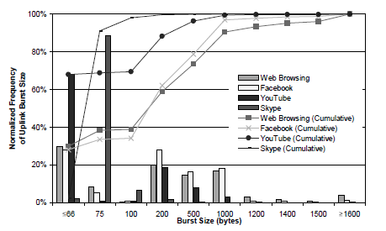
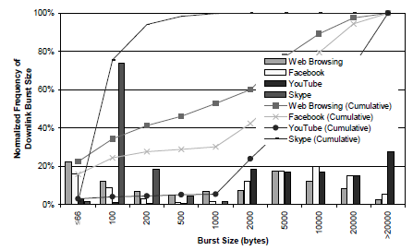
Appendix: Short bursts are also highly likely
To see how effective AMPDU/AMSDU are, we should look at total length of all packets within a burst, i.e. burst size
Reported measurement of [1] shows that the burst size is <1000B with >%80 chance for UL. For DL, excluding video applications, the burst size is <2000B with >%40 chance and varies significantly across applications
UL
DL

Slide 14
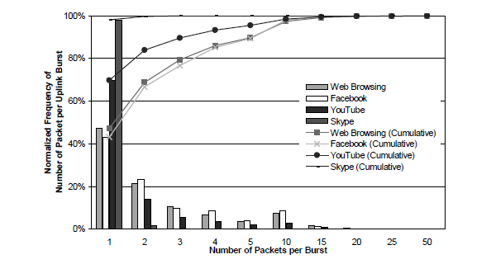
Many applications generate bursts with few packets
Number of packets per burst
  Number of packets per UL bursts is very small, with ~70%/70%/80%/100% of bursts have 1-2 packets for Facebook/Web/YouTube/Skype applications
  For DL, the trend is similar for Web/Skype but YouTube has single packet per burst for 25% of times
UL

