Slide 1
Considerations on CCA for OBSS Opearation in 802.11ax
Date: 2014-09-11
Authors:

Slide 2
Introduction
802.11ax aims at providing good performance in dense environments . This can be achieved by introducing features that mitigate interferences and improve operation in overlapping BSSs (OBSS).
  Various mechanisms based on CCA adjustments have shown good potential for increasing effective area throughput due to increasing simultaneous transmission opportunities[1-8].
In this submission, we present:
  Simulation results from our integrated SLS using CCA adjustment
  Other considerations on CCA

Slide 3
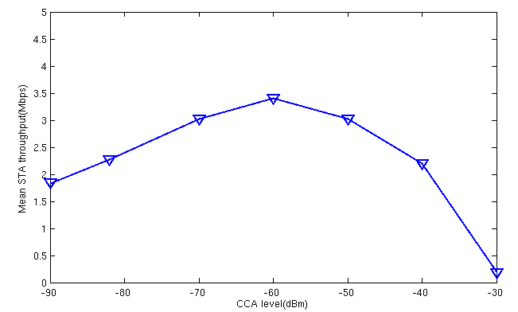
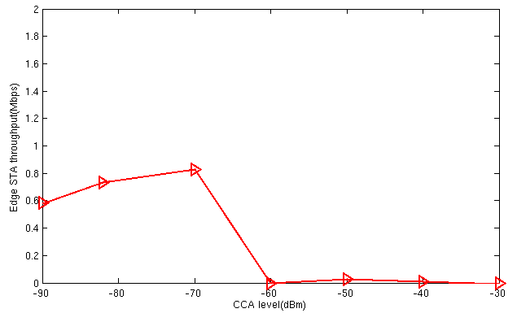
Global CCA Adjustment
  Similar to other contributions[1-8], our simulation results and analysis show that the mean STA throughout varies with global CCA adjustments, but is hard to achieve an optimal CCA setting to improve performance of edge STAs.
Simulation scenario 3: 100 apartments, 20 per floor (2x10), 5 floors. 10x10x3m dimensions;
Frequency: 2.4 GHz, each BSS randomly picks 1 of 3 20 MHz channels; Zero ACI;
Traffic: DL/UL mixed
Mean STA throughput
Edge STA throughput
 | Integrated SS
Optimal CCA for mean | -60
Optimal CCA for 5% | -70
Integrated SLS
Integrated SLS

Slide 4
Further Considerations on CCA(1)
CCA adjustment with AP coordination
  CCA may be influenced by interference level of neighboring BSSs, especially in dense OBSS scenarios
  Coordinated information sharing between APs may improve the performance resulting from CCA adjustment
Complexity of the CCA algorithm
  Per-STA dynamic algorithm may sacrifice the efficiency and increase overhead
  Per-BSS CCA adjustment(e.g. semi-static) may simplify the algorithm and reduce complexity on implementation, compared with per-STA CCA adjustment

Slide 5
Further Considerations on CCA(2)
How to perform CCA in OFDMA BSS?
  In OFDM case, one transmitter and one receiver can clear its channel with RTS/CTS exchange
  OFDMA is now introduced in 11ax. AP winning the channel(e.g. with CTS) can not guarantee all scheduled STAs are clear to transmit or receive.
  CCAs setting mechanism for OFDMA STAs should be investigated and introduced in 11ax.
STA
AP1
AP2

Slide 6
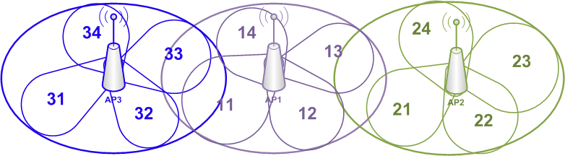
Further Considerations on CCA(3)
For beamforming case, omni-directional CCA may not be accurate for channel assessment
    Directional CCA to assist beamforming
    Different CCA threshold settings for directional CCA
    …

Slide 7
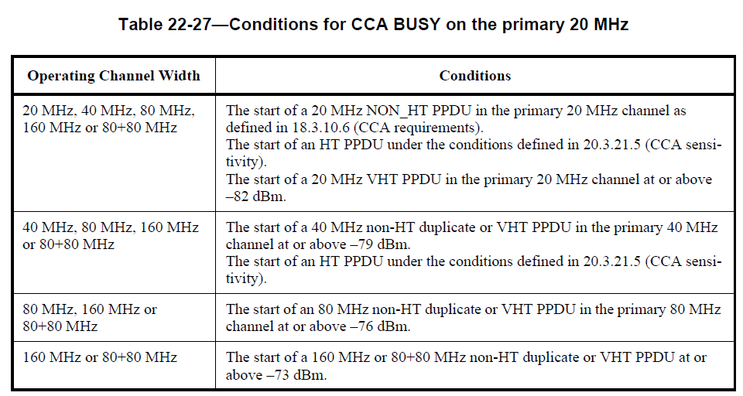
Further Considerations on CCA(4)
How to do CCA on multiple channels?
  Current 11ac CCA detection mechanism based on primary channel is not efficient for large BW transmission[9]
  High efficient and flexible CCA thresholds and mechanism should be designed for 11ax
    can be independent to the CCA of the primary channel
    flexible for large BW channels
    …

Slide 8
Reference
  [1] 11-14/0889, “Performance Gains from CCA Optimization”, Broadcom
  [2] 11-14/0846, “Changing CCA in the Residential Environment”, Qualcomm
  [3] 11-14/0832, “Performance Evaluation of OBSS Densification”, Intel
  [4] 11-14/0523, “MAC simulation results for Dynamic sensitivity control (DSC - CCA adaptation) and transmit power control (TPC)”, Orange
  [5] 11-14/0861, “Impact of CCA adaptation on spatial reuse in dense residential scenario”, Nokia
  [6] 11-14/0833, “Residential Scenario Sensitivity and Transmit Power Control Simulation Results”, InterDigital
  [7] 11-14/0872, “A Protocol Framework for Dynamic CCA”, Realtek
  [8] 11-14/0868, “UL & DL DSC and TPC MAC simulations”, Ericsson
  [9] 11-14/0880, “Increased Network Throughput with TX Channel Width Related CCA and Rules”, Mediatek

