Slide 1
Stadium Measurements
Authors:
Name | Affiliation | Phone | email
Brian Hart | Cisco |  | brianh@cisco.com
Matt Swartz | Cisco
Josh Suhr | Cisco
Matt Silverman | Cisco

Slide 2
Environment Details
US event with ~15k attendees in a tiered stadium
Concert attendees; exciting event – reduced smartphone usage
Free Wi-Fi – reduced need for tethering
Numbers in figures = Type/Subtype field
4 = Probe Request, 5 = Probe Response, 8 = Beacon, 13 = Action; 24 = BAR, 25 = BA, 27 = RTS, 28 = CTS, 29 = Ack, 32 = Data, 36 = Null, 40 = QoS Data
Loading = (TXTIME(PPDU)+SIFS) / measurement time
Visibility = #decoded frames with good FCSs / #captured frames (weighted by TXTIME+SIFS)
#APs – counts each BSSID even if sent by the same HW AP
4 BSSIDs per HW AP
Approx 100 HW APs in the stadium; at 30-40 ft spacing
60 sec captures

Slide 3
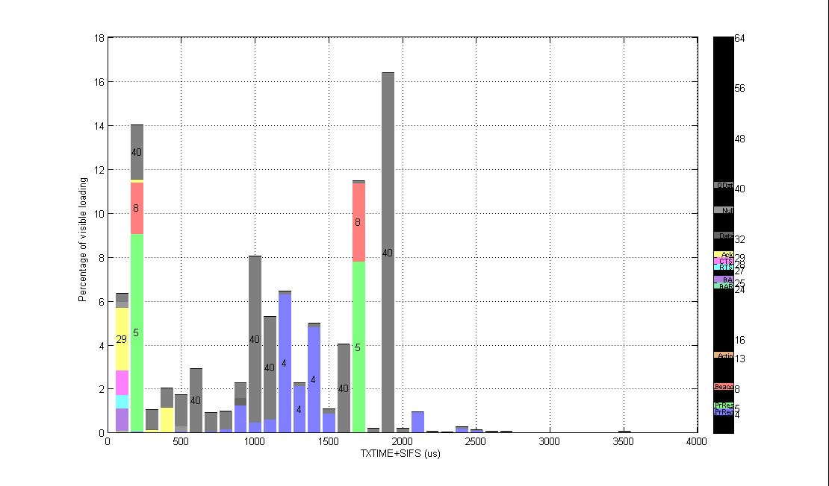
Channel 1 (40% loaded, <70% visibility, 41 APs) Data PPDUs are fairly uniformly distributed up to 2 ms Just 1 mobile AP contributed 12% from 1Mbps Beacons & ProbeResp

Slide 4
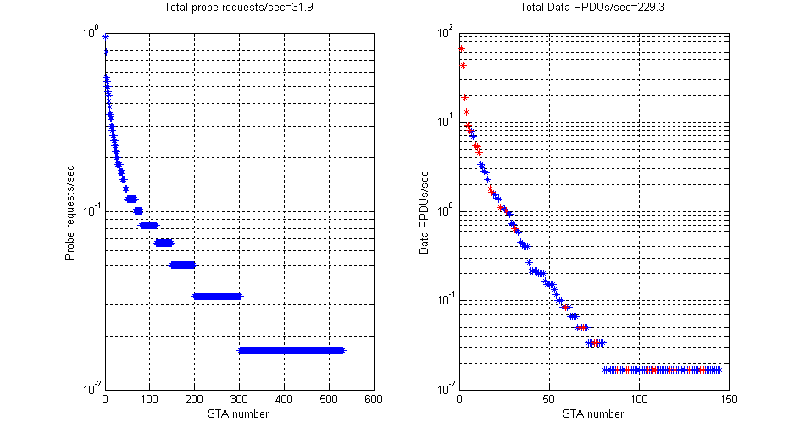
Channel 1 (40% loaded, <70% visibility, 41 APs) Long tails 3x more probe requesters than data clients 80 clients probe requesting > 0.1Hz; 14 clients > 0.3 Hz

Slide 5
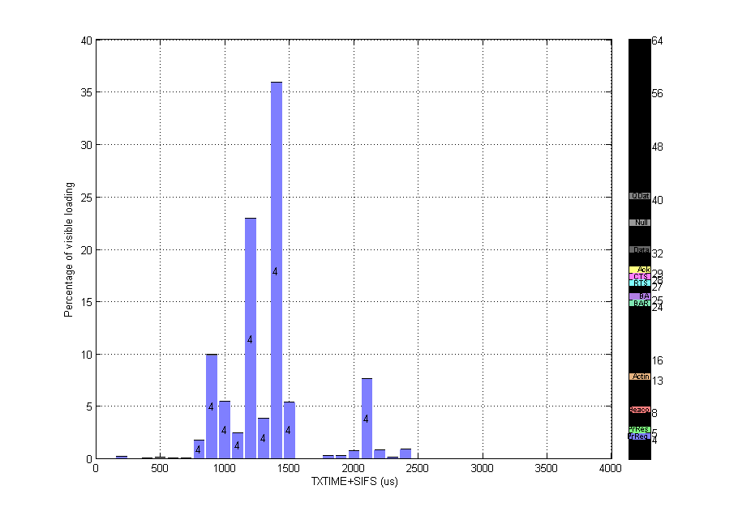
Channel 3 (4% loaded, <42% visibility, 0 APs) Probe requests on unused channels just raise the noise floor for PPDUs on channel 1/6/11

Slide 6
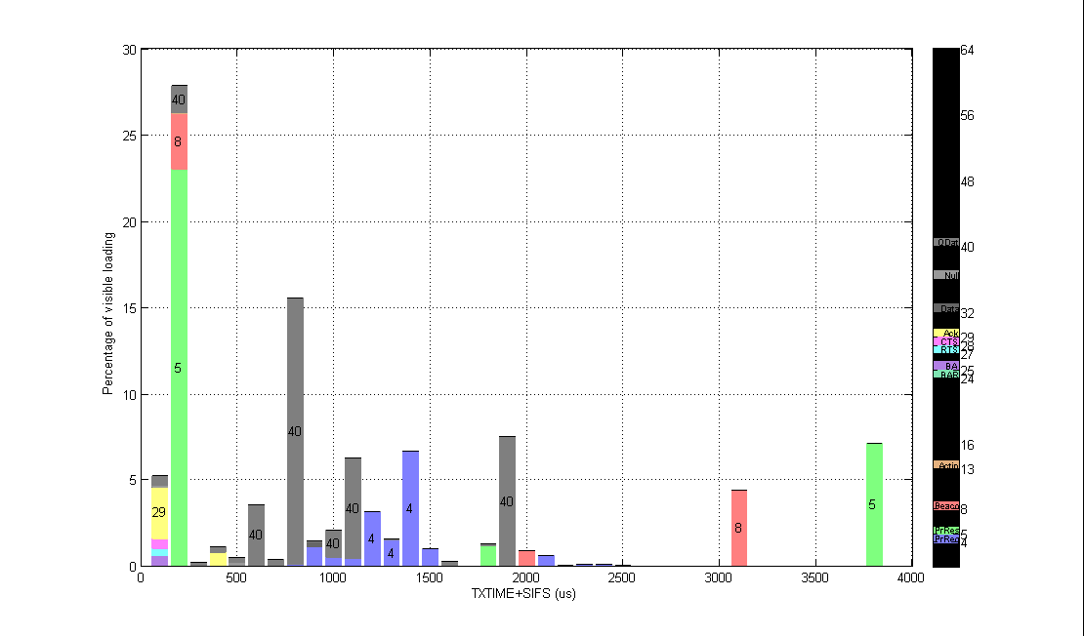
Channel 6 (22% loaded, <72% visibility, 31 APs) Most Data PPDUs <1.2 ms AP Mgmt frame overheads low using higher MCSs – except for 1 AP using 1 Mbps (18%)

Slide 7
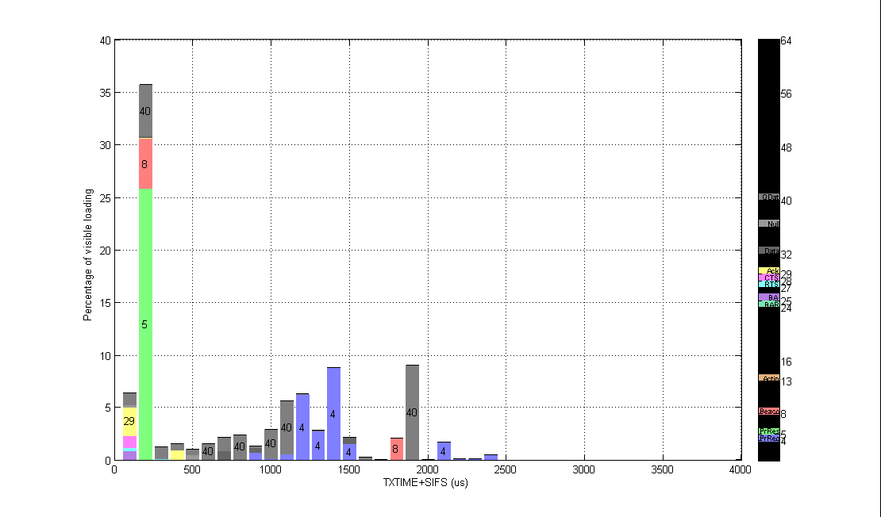
Channel 11 (25% loaded, <80% visibility, 48 APs) Most Data PPDUs <1.2 ms

Slide 8
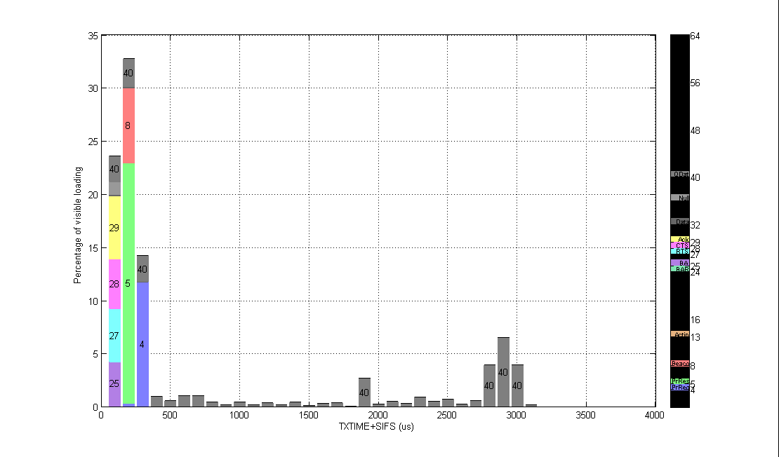
Channel 52 (12% loaded, <78% visibility, 4 APs) Tiny: RTS/CTS/Ack/BA/Null/QosData Very Short: Probe Response/Beacon/QosData Short: Probe Request/QosData PPDU durations fairly uniform up to 3 ms

Slide 9
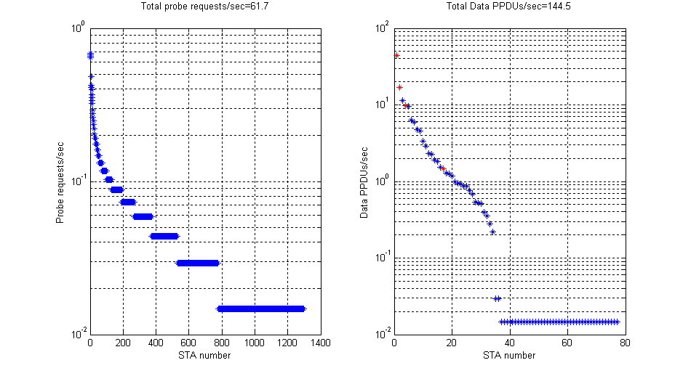
Channel 52 (12% loaded, <78% visibility, 4 APs) Long tails 20x more probe requesters than data clients 100 clients probe requesting > 0.1Hz; 13 clients > 0.3 Hz

Slide 10
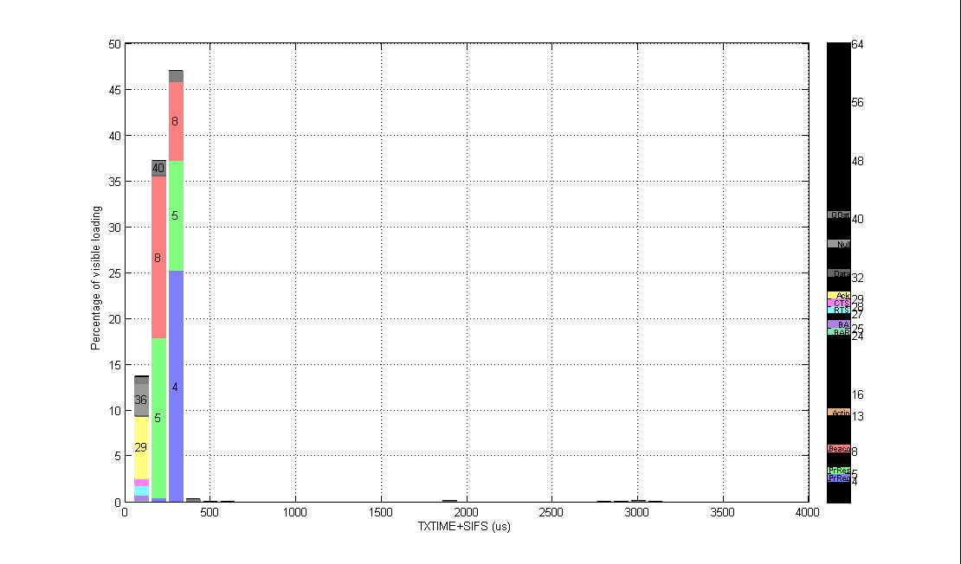
Channel 108 (7% loaded, <95% visibility, 3 APs) Little activity – a great opportunity for clients

Slide 11
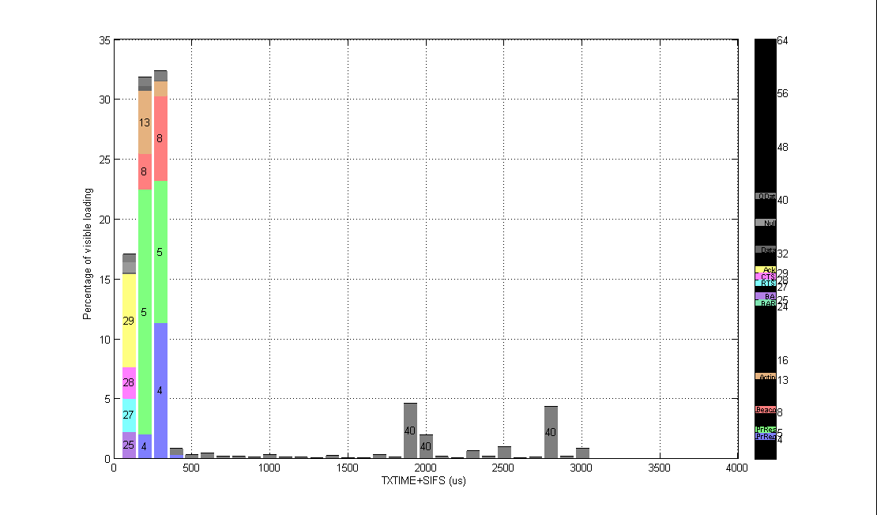
Channel 149 (28% loaded, <85% visibility, 19 APs) 13 = vendor specific action frames PPDU durations fairly uniform up to 3 ms

Slide 12
Summary
Fully loaded queues is a bad assumption: 0-2 ms PPDUs, uniformly distributed, is a better model
Mgmt overheads are non-negligible
Especially of unmanaged APs using 1 Mbps (even just one such AP can consume ~12% of the loading)
Managed APs using 18 Mbps significantly mitigate mgmt overheads; but cannot address low-MCS probe requesting
Number of clients probe requesting at 10 Hz or faster is approx 2x number of associated clients
Many more probe requesting devices than data transferring clients (3x as much of the total in 2.4 GHz; 20x as much of the total in 5 GHz)

