Slide 1
Stadium Measurements
Authors:
Name | Affiliation | Phone | email
Brian Hart | Cisco |  | brianh@cisco.com
Matt Swartz | Cisco
Josh Suhr | Cisco
Matt Silverman | Cisco

Slide 2
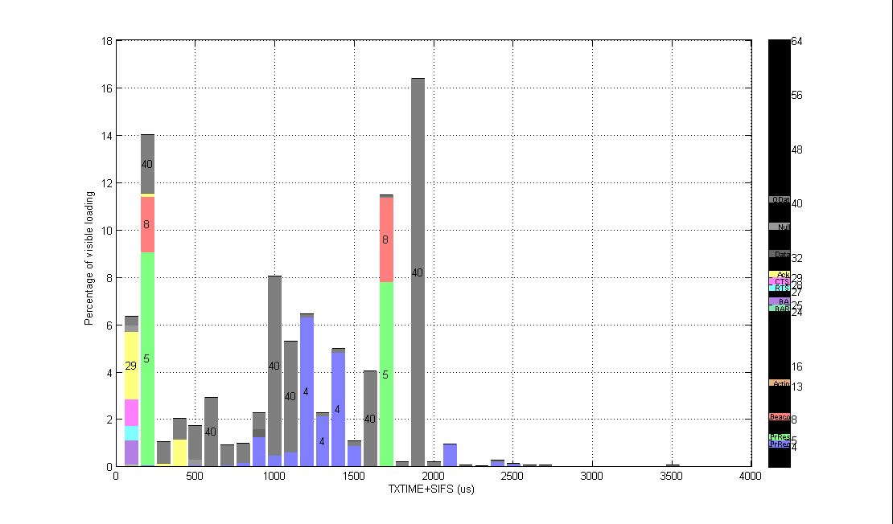
Channel 1 (40% loaded, 70% visibility, 41 APs) Tiny: RTS/CTS/Ack/BA/QosData Very Short: Probe Response/Beacon/QosData Short: Ack/QosData Just 1 mobile AP contributed 12% from 1Mbps Beacons & ProbeResp

Slide 3
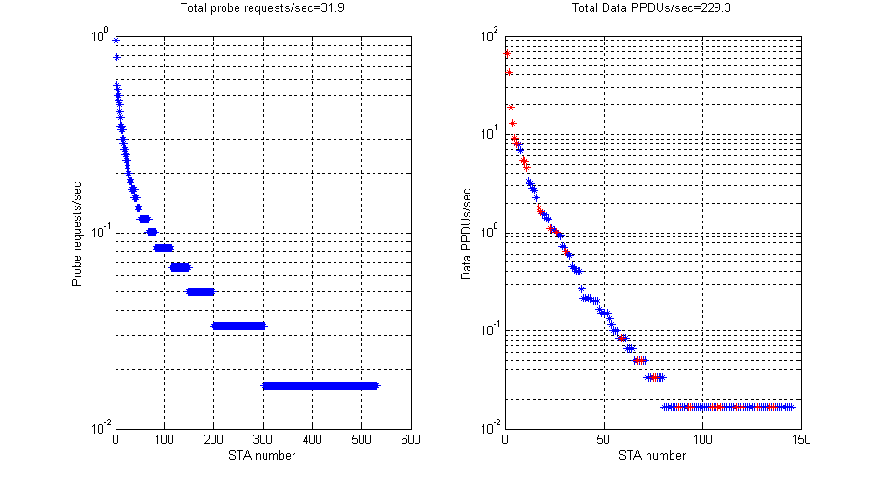
Channel 1 (40% loaded, 70% visibility, 41 APs) Long tails 3x more probe requesters than data clients 80 clients probe requesting > 0.1Hz; 14 clients > 0.3 Hz

Slide 4
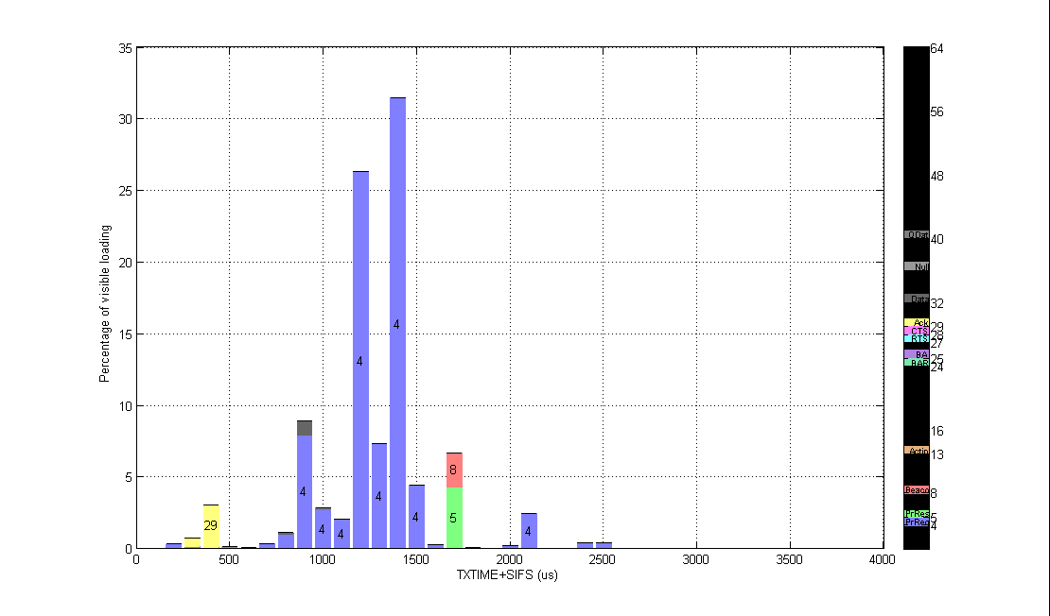
Channel 3 (4% loaded, 42% visibility, 0 APs) Probe requests on unused channels just raise the noise floor for PPDUs on channel 1/6/11

Slide 5
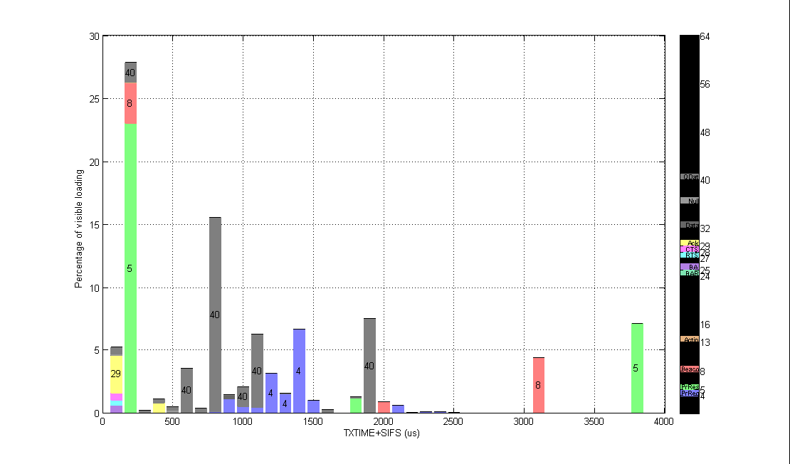
Channel 6 (22% loaded, 72% visibility, 31 APs) Most Data PPDUs <1.2 ms AP Mgmt frame overheads low using higher MCSs – except for 1 AP using 1 Mbps (18%)

Slide 6
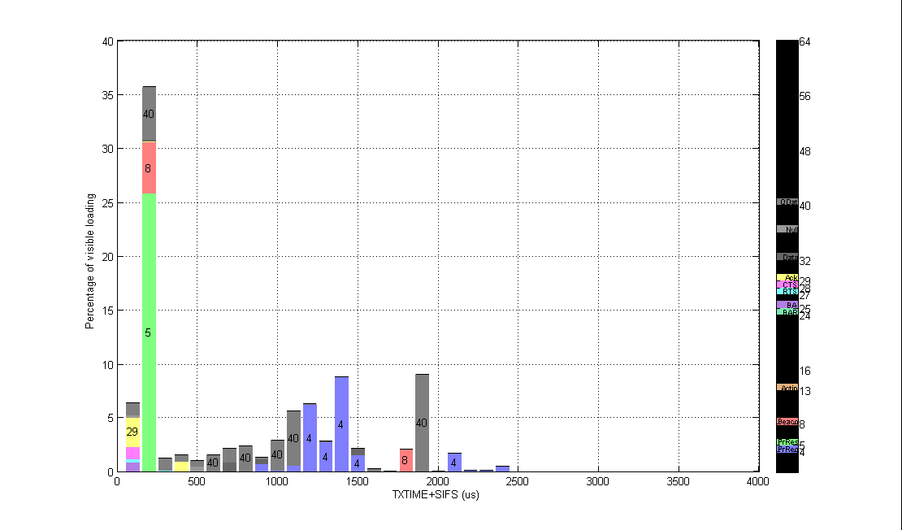
Channel 11 (25% loaded, 80% visibility, 48 APs) Most Data PPDUs <1.2 ms

Slide 7
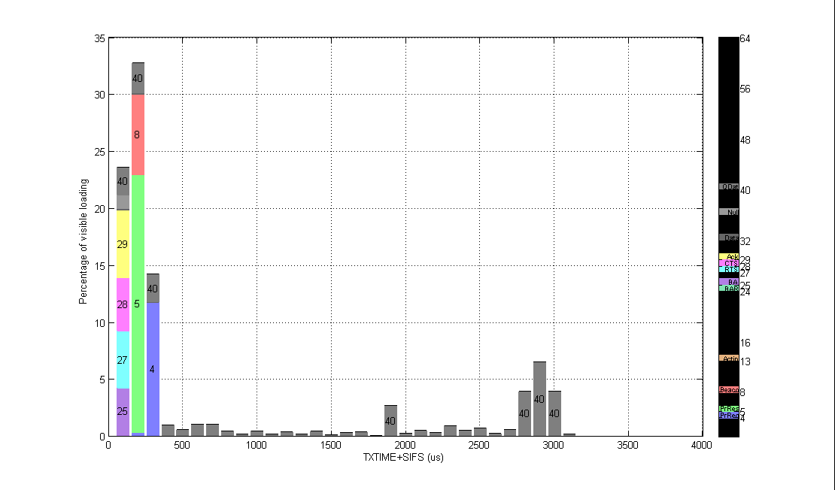
Channel 52 (12% loaded, 78% visibility, 4 APs) Tiny: RTS/CTS/Ack/BA/Null/QosData Very Short: Probe Response/Beacon/QosData Short: Probe Request/QosData PPDU durations fairly uniform up to 3 ms

Slide 8
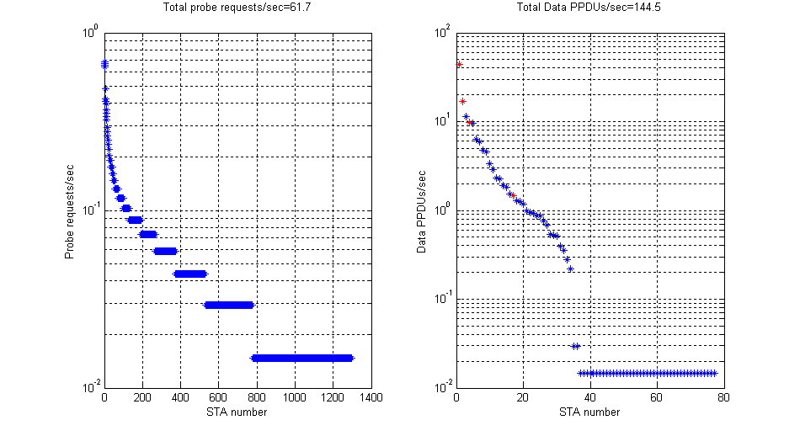
Channel 52 (12% loaded, 78% visibility, 4 APs) Long tails 20x more probe requesters than data clients 100 clients probe requesting > 0.1Hz; 13 clients > 0.3 Hz

Slide 9
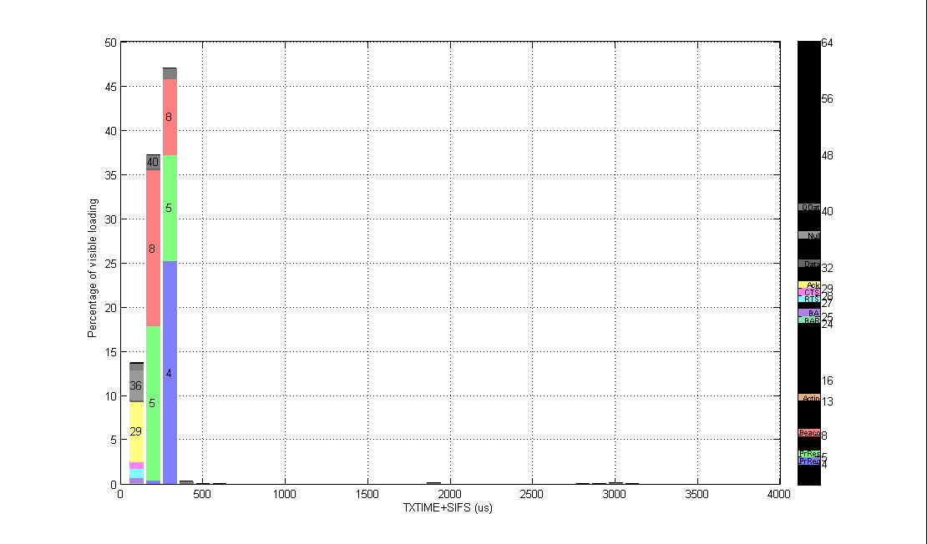
Channel 108 (7% loaded, 95% visibility, 3 APs) Little activity – a great opportunity for clients

Slide 10
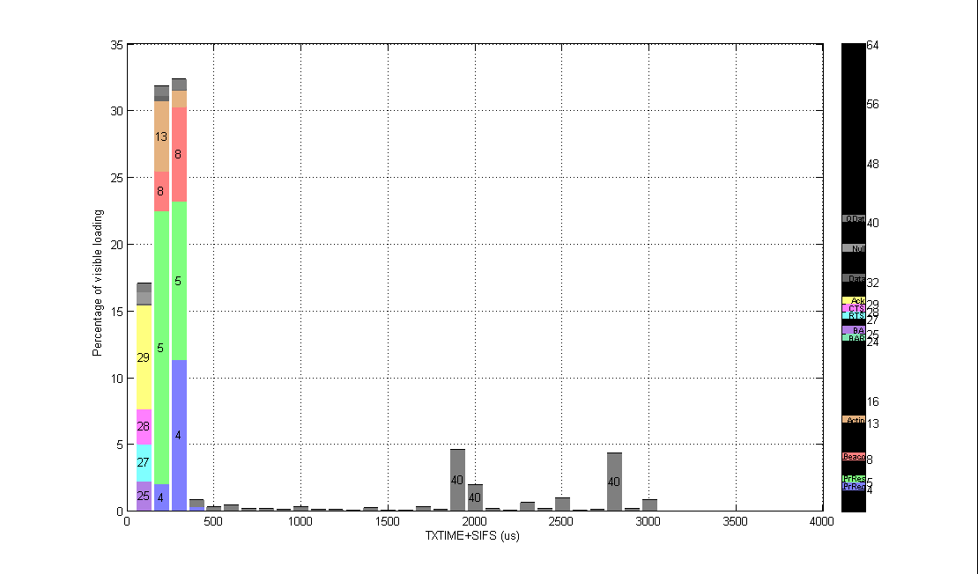
Channel 149 (28% loaded, 85% visibility, 19 APs) 13 = vendor specific action frames PPDU durations fairly uniform up to 3 ms

