Slide 1
Impact of correlated shadowing in 802.11ax system evaluations
Date: 2014-09-15
Authors:

Slide 2
Contents
Background
Uncorrelated vs. Correlated Shadowing
Numerical examples for Box1, Enterprise scenario
  Comparison of companies results for uncorrelated shadowing
  Comparison of uncorrelated and correlated shadowing
Proposal for how to model correlated shadowing
  Correlation Map
  Calculation of link shadowing component
Summary
Straw Poll

Slide 3
Background
In [1], it was argued that i.i.d. shadowing may give unrealistic results. In an attempt to somewhat reduce this issue it was proposed to reduce the variance of the shadowing for LNOS
In [9], i.i.d. is still assumed, and it has been decided not to solve the above issue by changing parameters in well-established models
In [2] significant efforts are made to ensure accurate results. For instance by considering SINR on individual sub-carriers rather than just average pathloss
In this contribution we argue that to justify very detailed modeling of the PHY, it is appropriate to revise the i.i.d. assumption and model the shadowing as correlated. We also propose how to implement this

Slide 4
Uncorrelated shadowing
Point B
The shadow fading for links AC and BC are taken as independent random log-normal variables. This implies no correlation between a node’s gain to different transmitters
Point A
BC
AC
Point C
Mapping
of positions

Slide 5
Correlated Shadowing
Typically, different radio links to the same node are assumed to have correlated radio properties, i.e., the shadow fading models the local environment which should remain constant. For instance, if a node is in a drawer, all its links should be affected.
Two radio links that are very similar in the spatial domain can be expected to experience similar shadowing
Up until now IEEE 802.11 evaluations have assumed uncorrelated shadow fading, i.e., all links to a node have independent radio properties.

Slide 6
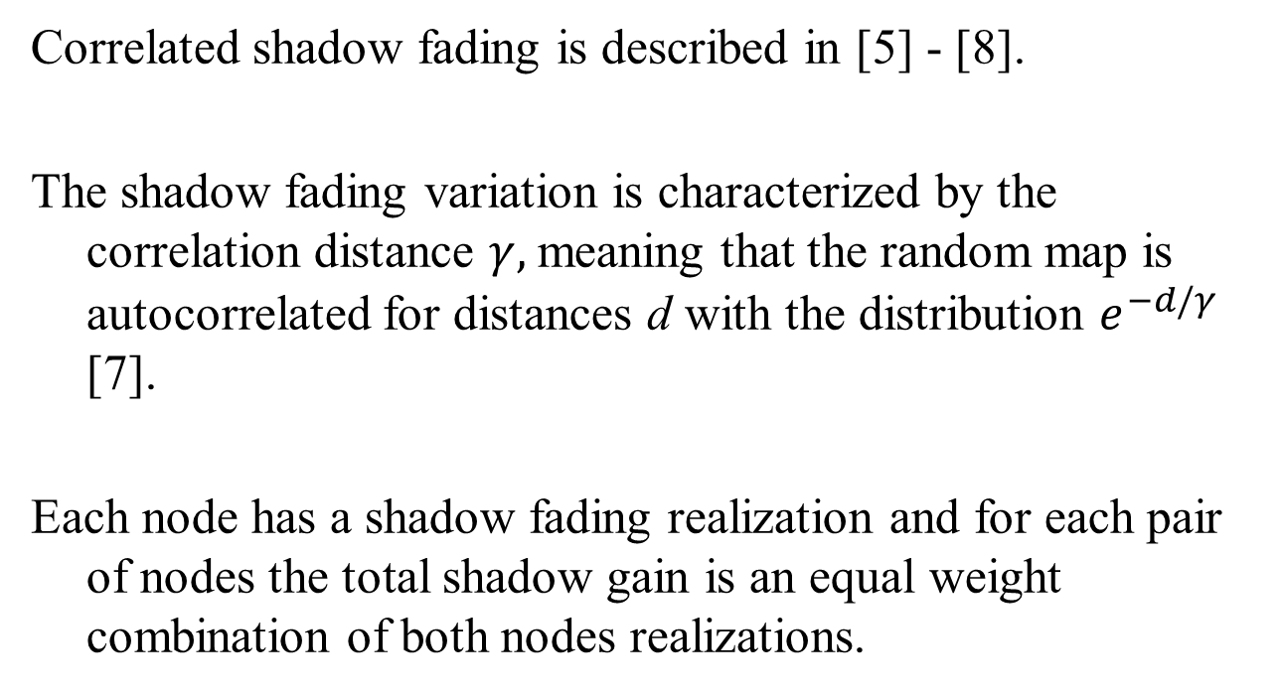
Correlated shadow fading
Correlated shadow fading is described in [5] - [8].
The shadow fading variation is characterized by the correlation distance $γ,$meaning that the random map is autocorrelated for distances d with the distribution $e^{−d/γ}$ [7].
Each node has a shadow fading realization and for each pair of nodes the total shadow gain is an equal weight combination of both nodes realizations.

Slide 7
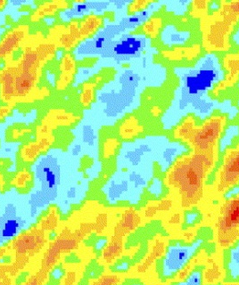
Correlated shadow fading
The shadow fading is taken as a combination of map values for A and C for link AC and B and C for link BC in order to capture correlations. This means less difference between AC and BC
Point B
Point A
BC
AC
Random
log-normal map with correlated values
A
Point C
B
C
Mapping
of positions

Slide 8
Correlated shadow fading – impact on SINR
The reduced variation in gain to different transmitters for a node will result in smaller tails in the SINR distribution, since S and I will vary in the same direction to a larger extent.
To exemplify, we have used a shadowing with a correlation distance γ=1 m and 10 m, representing the range of typical indoor values [7].
The total shadow fading is taken as the equal weighted sum of the values for each pair of nodes.

Slide 9
Numerical examples: Box 1 calibrations
  In our system simulator we have implemented the Enterprise scenario (ss2) [1] and evaluated the five tests specified for the Box 1 calibration as described in [2].
  Results are compared to those from other companies compiled in [3] in case of uncorrelated shadowing.
  The simulations are then redone, but with correlated shadowing to see the impact. For purpose of illustration we have used correlation distance 1m and 10m.

Slide 10
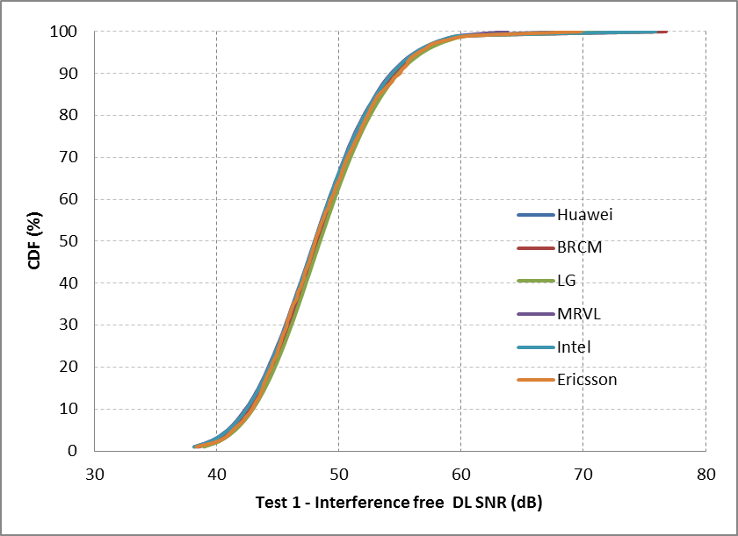
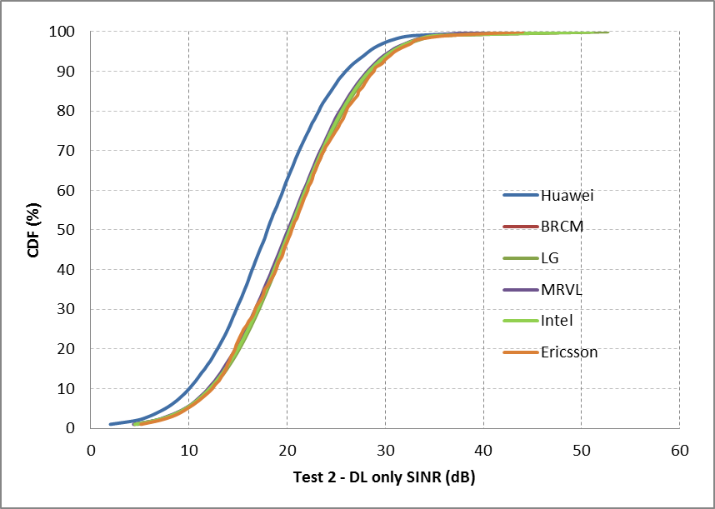
Box 1calibraiton
Test 1
Test 2

Slide 11
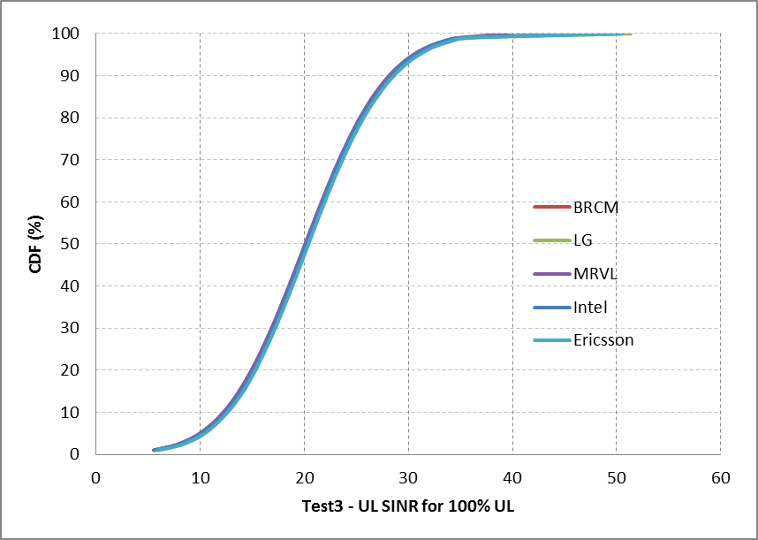
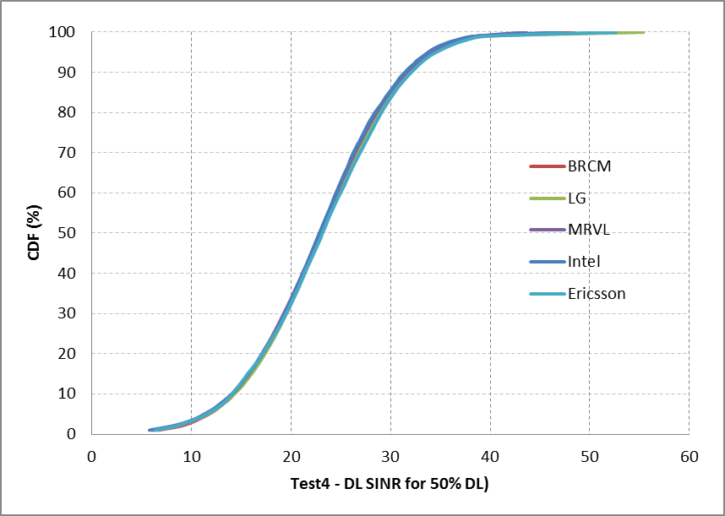
Box 1calibraiton
Test 3
Test 4 DL

Slide 12
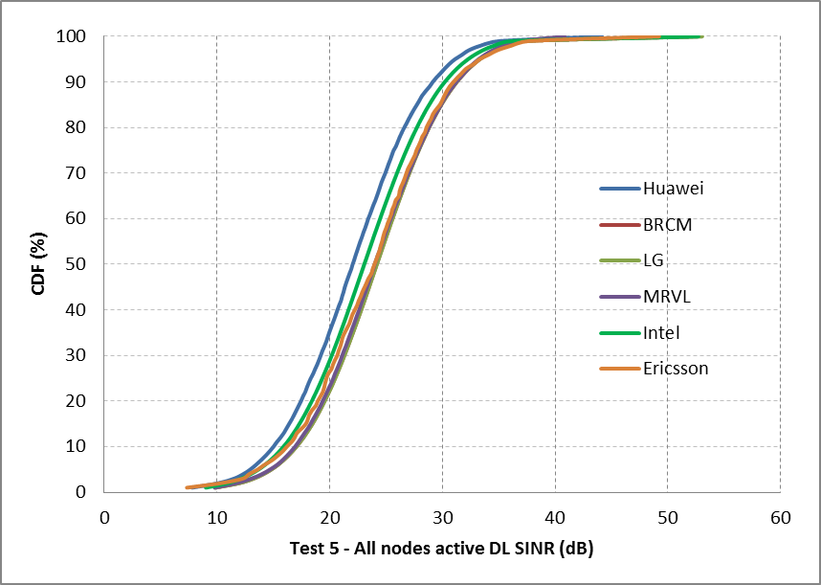
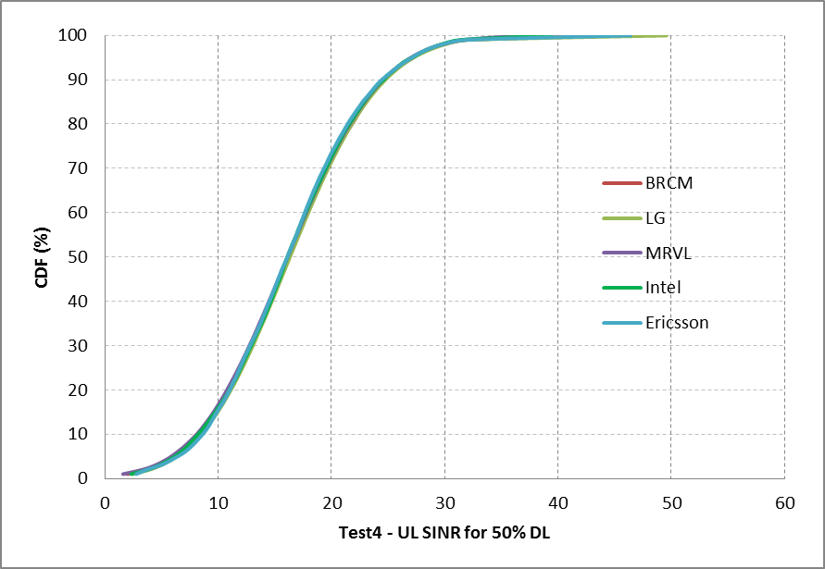
Box 1calibraiton
Test 4 UL
Test 5 DL

Slide 13
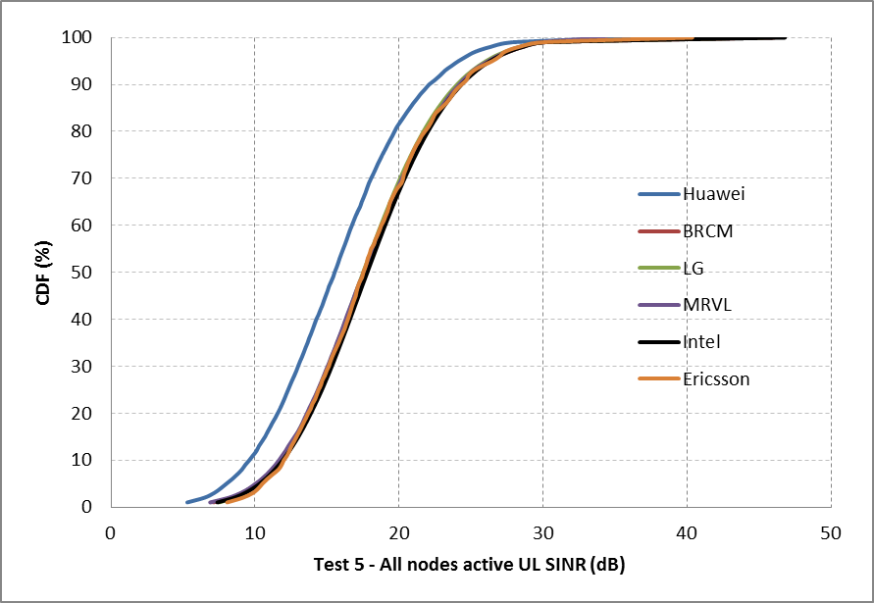
Box 1calibraiton
Test 5 UL

Slide 14
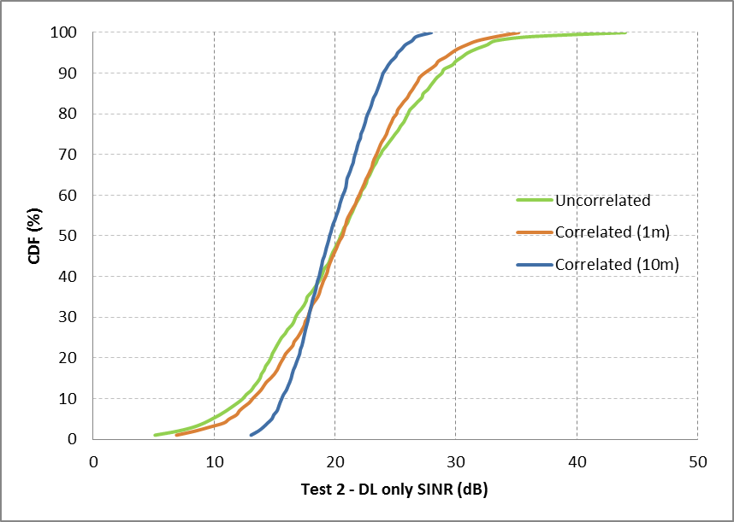
Results for correlated shadow fading
Test 2 – DL only
At the 5th percentile the uncorrelated fading underestimates the SINR up to 5 dB

Slide 15
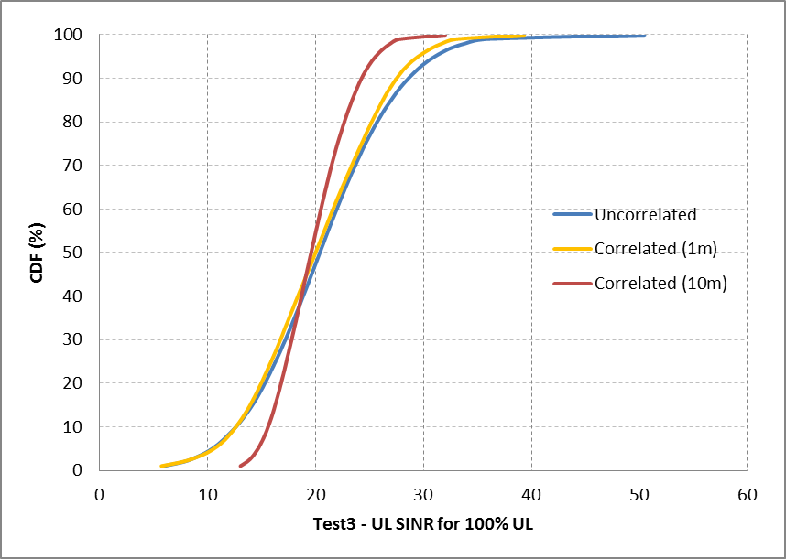
Results for correlated shadow fading
Test 3 – UL only
At the 5th percentile the uncorrelated fading underestimates the SINR up to 4 dB

Slide 16
Proposal
It is proposed to use correlated shadowing in the systems evaluations to better reflect real world conditions
It is proposed to calculated the shadowing for the individual links by:
1) Generating a map for the scenario where a shadowing value is associated with a location, and where the correlation in spatial domain is achieved by filtering
2) For each link calculate the shadowing by the average of the shadowing values as the corresponding nodes
What correlation distance to use is still TBD, and it is expected that different scenarios will need different values

Slide 17
Summary
Considering Box 1 calibration results for the enterprise scenario, we have seen very good agreement between companies
However, when correlated shadow fading is applied, a large difference is seen compared to these aligned results. Especially for edge users.
Given the large impact of shadow correlation, it can not be neglected if we are targeting accurate results
A proposal for how to include correlated shadowing in the system simulations is presented which we believe would substantially improve the accuracy of system simulations

Slide 18
References
[1] “Path loss model for scenario 1”, N. Jindal and R. Porat, IEEE 802.11-14/0577r1
[2] “11ax evaluation methodology”, R. Porat et al., IEEE 802.11-14/0571r3
[3] “Box 1 and Box 2 calibration results”, N. Jindal et al., IEEE 802.11-14/0800r15
[4] “TGax simulation scenarios”, S. Merlin et al., IEEE 802.11-14/0980r0
[5] “Correlation model for shadow fading in mobile radio systems”, M. Gudmundson, Electronic Letters, pp. 2145-2146, November, 1991.
[6] “Further advancements for E-UTRA physical layer aspects”, 3GPP TR-36-814
[7] “Coordinated multi-point operation for LTE physical layer aspects”, 3GPP TR 36.819 v11.0
[8] “Correlation properties of large scale fading based on indoor measurements”, N. Jalden, P. Zetterberg, B. Ottersten, A. Hong, and R. Thomä, IEEE WCNC, March 2007
[9] “IEEE 802.11ax channel model document”, J. Liu et al. IEEE 802.11-14/0882r11

Slide 19
Straw Poll
Do you agree to improve the channel model used for system simulations by including correlated shadowing?

