Slide 1
AP Architectural concepts, and
Distribution System Access Function
Date: 2014-09-15
Authors:

Slide 2
Abstract
Starting from the model presented in 11-14/497, a new concept called the Distribution System Access Function (DSAF) is proposed.
  Following, discussion is provided to start considering concepts from mesh and other relay/forwarding operations.
- Note, the first three slides of this presentation are taken directly from 11-14/497r3. Thanks and credit to the original author of those slides (Norm Finn)

Slide 3
This is an example of a physical network
802.3
802.3
“AP” 1
“AP” 2
Two physical boxes, commonly (but inaccurately) called “APs,” connected by an IEEE 802.3 link.
Two clients of “AP 1” shown, two wireless and one wired clients of “AP 2” not shown.
No VLANs.

Slide 4
Layering
In the ISO layering model, a DATA.request is presented by a higher layer to a lower layer, and a DATA.indication is presented by a lower layer to a higher layer.
In all further diagrams in this deck, the “higher” layer is closer to the top of the slide, and the “lower” layer closer to the bottom.

Slide 5
A standard view of that same network in 802.11 today
MAC
MAC
AP*
AP*
portal
MAC
Distribution System (DS)
MAC
MAC
PHY
PHY
PHY
PHY
PHY
Non-AP STAs
AP 1
AP 2
802.3
This is similar to IEEE 802.11-2012, Figure R-1, but drawn with “request down indication up” rigorously applied.
The DS has three users, two APs and a portal, so is shown passing behind a MAC.
* Correctly, an AP is this component PLUS the STA (MAC and PHY);
currently there is no name for this component

Slide 6
Proposal: Introduce the “Distribution System Access Function”
MAC
MAC
*
*
portal
MAC
Distribution System (DS)
MAC
MAC
PHY
PHY
PHY
PHY
PHY
Non-AP STAs
AP 1
AP 2
802.3
“An access point (AP) is any entity that has STA functionality and enables access to the DS, via the WM for associated STAs.”
So, the logical purpose of the “*” entity is to provide the services beyond the STA services (SSs) that are necessary to provide access to the DS.
Thus, the proposed new term: “Distribution System Access Function (DSAF)” for this entity within an AP.
So, we draw this as …

Slide 7
Proposal: Introduce the “Distribution System Access Function”
MAC
MAC
DSAF
DSAF
portal
MAC
Distribution System (DS)
MAC
MAC
PHY
PHY
PHY
PHY
PHY
Non-AP STAs
802.3
AP 1
AP 2
An AP comprises a STA and a DSAF.
The DSAF is the entity within an AP that provides access to the distribution system for STAs associated to the AP.
Propose to add definition(s) and text to 802.11 to reflect this concept.

Slide 8
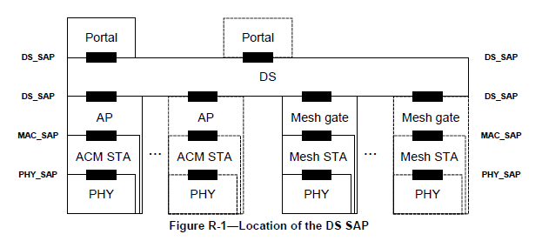
Also, compare with Figure R-1
MAC
MAC
DSAF
DSAF
portal
MAC
Distribution System (DS)
MAC
MAC
PHY
PHY
PHY
PHY
PHY
Non-AP STAs
802.3
AP 1
AP 2
Propose redrawing R-1, like the above:
Up/down “correct”
“AP” (wrong) changed to DSAF
Need Mesh Gate (see next slide)

Slide 9

Mesh definitions are subtly different from AP’s:
mesh station (STA): A quality-of-service (QoS) STA that implements the mesh facility.
mesh facility:The set of enhanced functions, channel access rules, frame formats, mutual authentication
methods, and managed objects used to provide data transfer among autonomously operating stations (STAs).
mesh gate: Any entity that has mesh station (STA) functionality and provides access to one or more distribution systems.
Thus, mesh STAs provide the mesh facility (within the concept of ‘mesh STA’)
This is a problem for Figure 4-9, which shows a “Mesh” function above/outside the STA, as shown at the right:

Slide 10
Do we:
Change (clarify?) mesh definitions to have a concept of the mesh facility outside/above the STA, similar to the DSAF?
OR
Change Figure 4-9 (and similar discussion in text and other figures) to show that a mesh STA is just a STA in a special mode (nothing ‘external’ to the STA)?
Once a direction is chosen, a mesh STA and mesh gate can be drawn in a similar fashion to the AP drawing, and the result can be considered to replace Figure R-1.

Slide 11
Next:
Look at “other” relay type of functions (DMG RDS/REDS, DMG PCP forwarding, 11ah, …)

