Slide 1
NG60 channel model
Date: 2014-09-16
Authors:

Slide 2
Abstract
Channel bonding
MIMO in mmWave
Simulation Example
Channel model for MIMO @ NG60

Slide 3
Channel bonding
Channel bonding is simple technique to multiply the transmission rate
Use of contiguous band is preferred for hardware. Less crowded than 2.4 or 5 GHz, interference and spectral mask issues less pivotal as in 5G
Spatial selectivity higher than in other bands, with higher scattering and diffractions e.g. 2.4G, 5G, hence less in-band interference
Today ADC technology allows implementation of 5.3Gsps 6 bits ADC/DAC with <70mW

Slide 4
MIMO in mmWave
Each antenna can be either:
A separated phased array subassembly
Separated chain within same subassembly
Many MIMO options: SVD,ML,MMSE, etc.
60 GHz MIMO has unique features:
Good separation between subassemblies (>>λ)
Each subassembly is a configurable antenna array
High bandwidth, moderate SNR: robustness to low power interference
RX->TX basic feedback for multi-antenna already defined in the 802.11ad specification

Slide 5
MIMO in mmWave
Consider a 4x4 MIMO in 60GHz system in the frequency domain
At receiver chain 2, the received signal is
$$r_{chain,2}=$$
$$\left({0,θ}_{rx,2},..,0\right)H\left(\begin{matrix}θ_{tx,1} & ⋯ & 0 \\ ⋮ & ⋱ & ⋮ \\ 0 & ⋯ & θ_{tx,4}\end{matrix}\right)\left(\begin{matrix}\begin{matrix}t_{chain,1} \\ t_{chain,2}\end{matrix} \\ \begin{matrix}t_{chain,3} \\ t_{chain,4}\end{matrix}\end{matrix}\right)$$
Where:
$θ_{rx,i}$: the subassembly configuration for RX-chain i,
$θ_{tx,i}$: the subassembly configuration for TX-chain i
$t_{chain,i}$: the signal transmitted through TX-chain i
$H$: the physical channel between each receive and transmit antenna element
#1
#2
#3
#4
#1
#2
#3
#4

Slide 6
MIMO in mmWave
Phased arrays approximated SVD: The RF configurations approximate the singular vectors from the SVD of H
Each TX antenna subassembly sends 1 stream to one RX antenna subassembly Other options such as 1->2 or 2->1 are not effective for multiple antenna subassemblies due to the directivity
Feedback from RX to TX
TX-SS is multiplied by # TX antenna subassemblies
TX-SS extended feedback is multiplied by #TX antenna subassemblies
TX-SS is followed by multiple 802.11ad MIDC
PHY Channel estimation done per stream
MCS/power per stream: TX power limit per subassembly
Notes:
SS – Sector Sweep
MIDC – multiple sector identifier capture(11ad)

Slide 7
Example: simulation
Double channel (3.5 GHz bandwidth)
Using approximated SVD, 4 sector IDs are returned to TX
Each antenna subassembly is made of 16 patch antennas arranged in two lines
4 subassemblies, each turning to different direction (as in the picture in the backup slide)
All rates up to 64QAM are used
Room of 4x5x2.8 [m] with a table of 3x1.2 [m] in the center and a monitor of 0.4x0.4 [m] on top of the table

Slide 8
Example: simulation (cont)
TX remains fixed at the end of the table, RX moves around
3D Ray-tracing simulation, all reflections are considered up to the 2 order reflection, including from ceiling/floor
Simulator was calibrated to real-world measurements and current system parameters
Maximum SINR RF configuration is used. The BB in this example does not include any multi-stream spatial equalizer

Slide 9
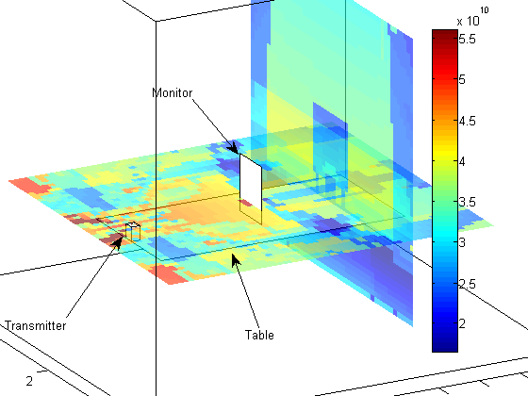
Example: simulation results – rate in bps

Slide 10
Channel model for MIMO @ NG60
Use H’=Θ_{r} H Θ_{t} as the channel model
compact matrix
compresses the false degrees of freedom from H
same approach as MIMO channel models in previous standards (802.11, 3GPP etc.).
Several environments:
Living room, strong reflectors (low ceil, concrete walls)
Cubical, weak reflectors (high ceil, fabric walls)
Large conference room
Outdoor

Slide 11
Channel model for MIMO @ NG60
System options:
Same subassembly, several chains (1,2,3,4)
Several subassemblies with varying number of antennas (1,4,16,32)
Basic array configuration options:
SNR optimal: Just maximum SNR
SINR-optimal: Takes inter chains interference into account
Capacity-optimal: requires a lot of feedback
Will a full-duplex mode be of use ?
The channel model from 802.11ad should be modified for MIMO

Slide 12
Backup

Slide 13
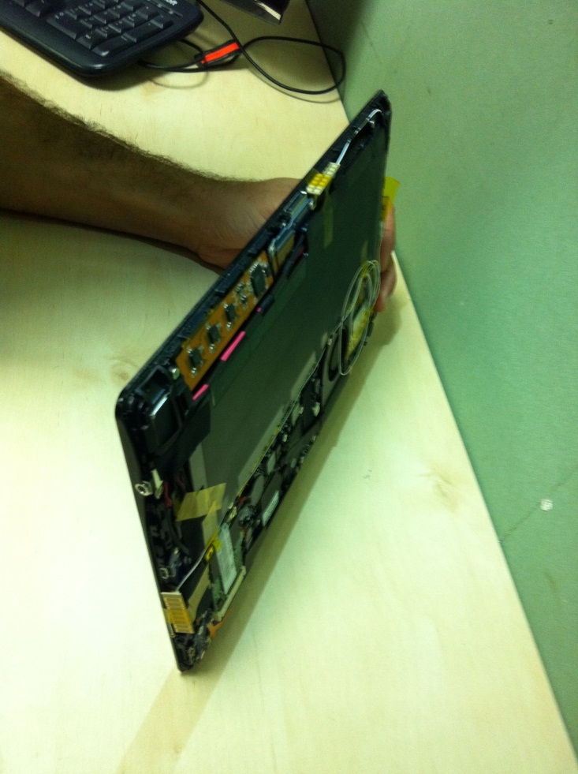
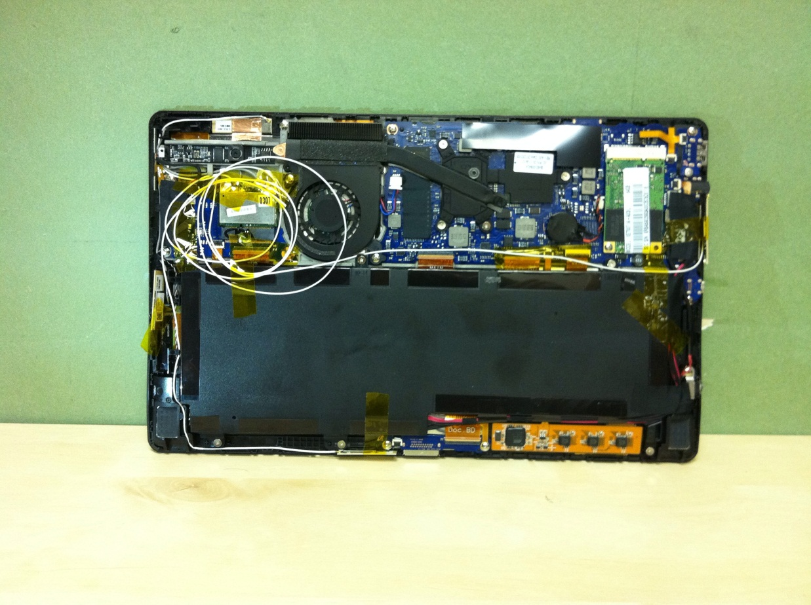
Example: a tablet system

Slide 14
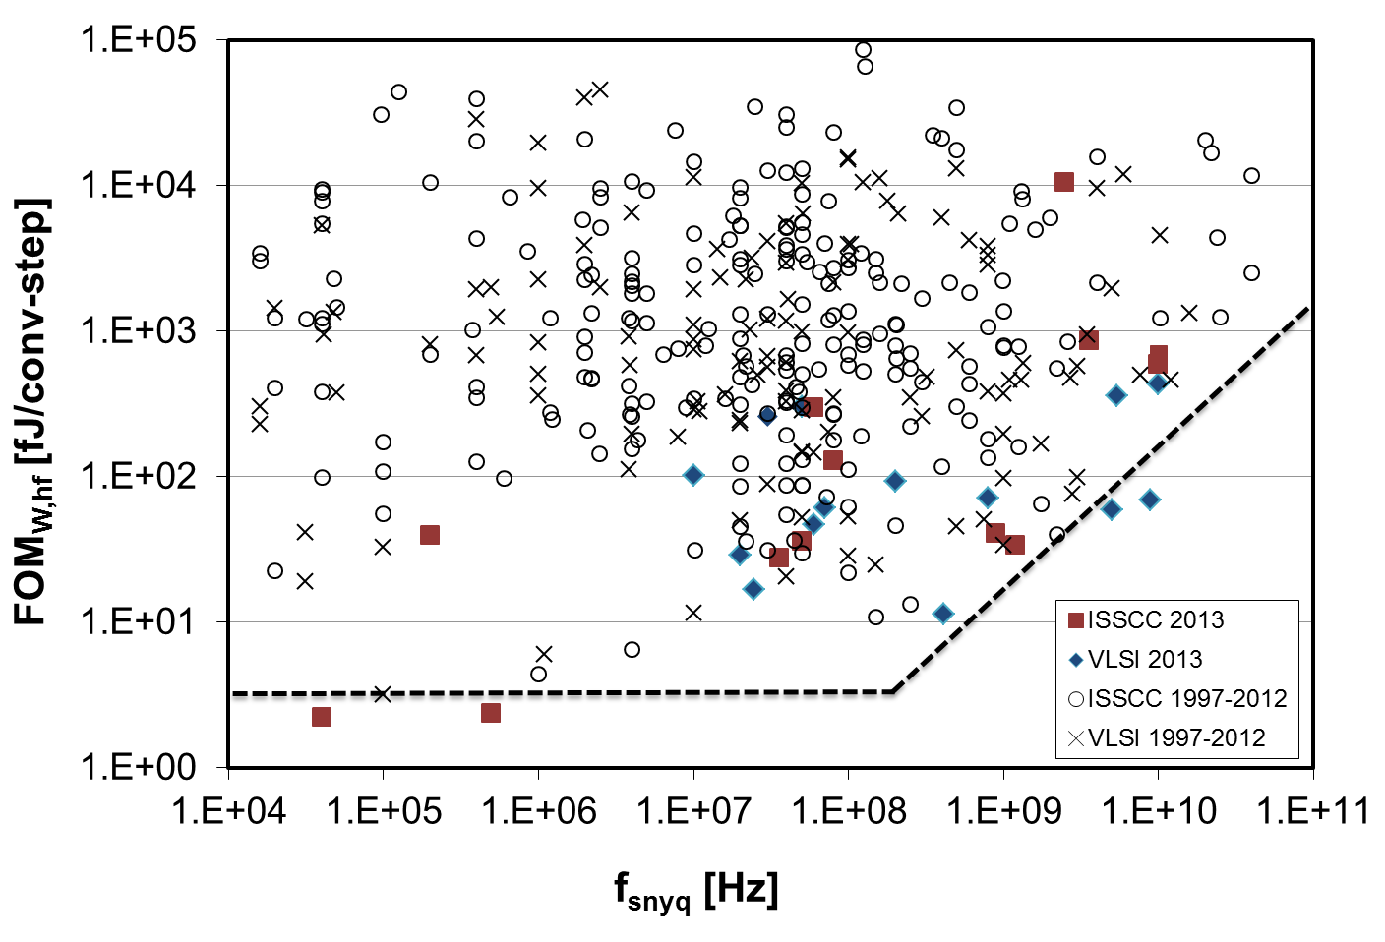
ADC/DAC FOM
ADC/DAC: looking into the literature Figure of merit (FOM)
Digitally assisted ADCs are common in the industry
ADCs running in 5GHz BW, assuming 6 bits
Power estimated is 32 mW

Slide 15
ADC/DAC FOM
A/D Converter Trends: Power Dissipation, Scaling and Digitally Assisted Architectures, B. Murmann Stanford University, Stanford, CA, IEEE 2008 Custom Integrated Circuits Conference (CICC)
ADCsurvey_rev20130629a.xlsx http://www.scribd.com/doc/205265261/ADCsurvey-rev20130629a

