Slide 1
Next Generation Positioning
Beyond Indoor Navigation
Authors:
Name | Affiliation | Address | Phone | Email
Jonathan Segev | Intel |  | +972-54-2403587 | jonathan.segev@intel.com
Carlos Aldana | Qualcomm, Inc |  | +1-408-652-1251 | caldana@qca.qualcomm.com
Naveen Kakani | CSR |  | +1-940-594-5522 | Naveen.Kalani@csr.com
Rolf de Vegt | Qualcomm, Inc |  | +1-408-652-1049 | rolfv@qca.qualcomm.com
Gal Basson | Qualcomm, Inc |  | +972-4-6239107 | bgal@qti.qualcomm.com
Ganesh Venkatesan | Intel |  |  | ganesh.venkatesan@intel.com
Gaby Prechner | Intel |  |  | gaby.prechner@intel.com

Slide 2
Motivation and purpose
Identify usage models for 802.11 based positioning systems and their requirements.
Provide a technological overview of current 802.11 positioning technology (REVmc)
Gap analysis: Evaluate whether the use cases are supported by current 802.11 positioning technology.

Slide 3
Why 802.11 Based Positioning?
Positioning is NOT a standalone service:
  Contextual information is a must (indoor maps, application server connectivity).
  Improved search capabilities, improved social applications experience.
  Data and positioning have symbiotic relations.
802.11 based WLAN has ubiquitous availability.
Building on existing connectivity technology enables reuse of many parts of the technology.
Many of the use cases revolve around the smartphone (already packed with radios, reusing keeps complexity of actual device at check).
Symbiosis relation of data and positioning services
Notes:
Making development effort easier.
time to market shorter which provide an opportunity for cost efficient strong penetration real world products.
Using existing connectivity technology also promotes interoperability as it uses existing SDOs and ITOs.
the Swiss army knife of modern days – the smartphone,
Vendor reluctant to add radios.

Slide 4
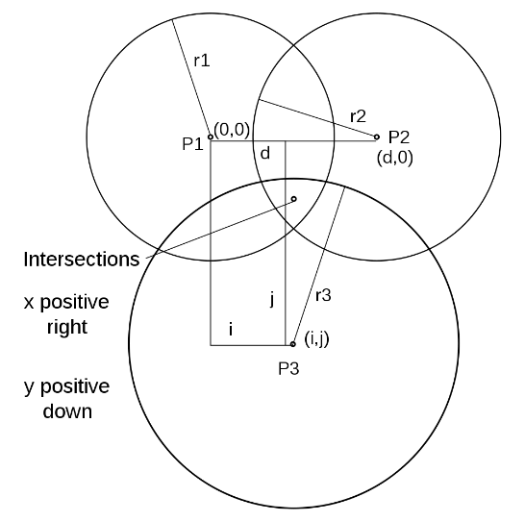
REVmc Location Support
Main items addressed by FTM introduction to REVmc:
  1:N operation:
    AP STA: non AP STA model.
    AP STA has limited resources which it requires to manage and control.
    Non AP STA has limited computation resources.
  Multi channel operation:
    APs STA have a fixed operating channel while non AP STA move between AP STA’s channels.
    Non AP STA has other outstanding PHY and MAC level activities of possibly higher priority.
  Non associated operation mode:
    Multiple ranges require to obtain single fix.
    enables trilateration or multi-lateration.

Slide 5
REVmc Location support (con.)
Main items addressed by FTM introduction to REVmc (con.):
  Support for AP Location DB protocol.
  Power efficiency for non AP STAs in unassociated mode.

Slide 6
REVmc Location support (con.)
To support those requirements we ended up with substantial changes:
  Multi channel operation:
    Fixed periodicity availability Time Windows.
    Trigger frame for asynchronous activities.
    Negotiation protocol for operation in unassociated mode.
  Power and computation:
    The Initiating STA indicates a preferred recurring measurement time windows.
    Consecutive measurements.

Slide 7
What’s Next Then?

Slide 8
Improved accuracy – moving from >1m to >0.1m
  Problem definition:
  1st generation products are focused on indoor navigation but as technology adoption increases so does the demand for performance.
  Micro location becomes of interest, ~0.1m accuracy opens up a new set of usage models:
    Guide me to product on the exact shelf in the aisle of a supermarket (0.1m).
    Identify user preference and offer valuable service (how can I help?).
    Micro geo-fencing: store entrance, how to attract people in, with good offerings, while not burdening visitors crossing inside the store entrance area.

Slide 9
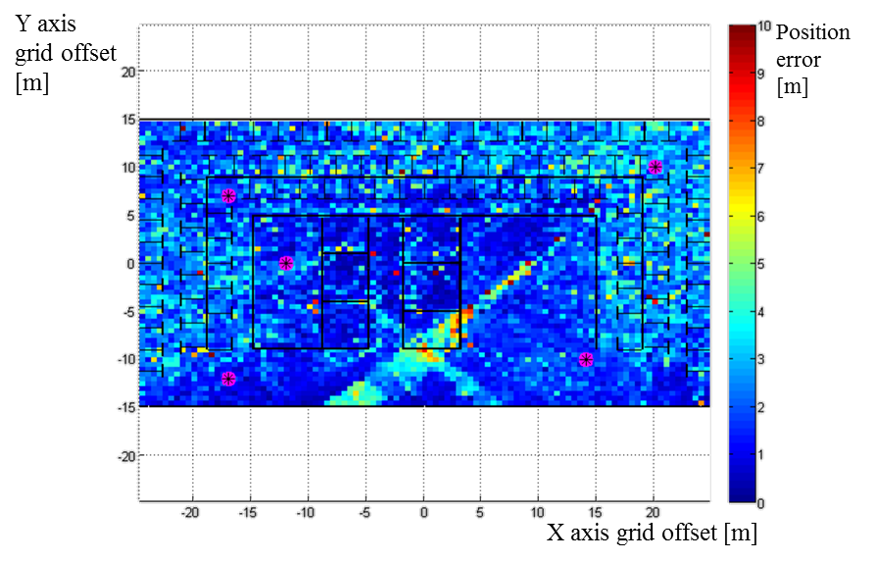
Improved accuracy moving from >1m to >0.1m
  Current std. overview
  Current technology has a theoretical limitation of 0.7m with real world scenarios bringing it to 2-4m depending on environment.
Shown:
  Current technology.
  Ray trace simulation.
  40Mhz BW.
  5 APs
  Mix of dry walls, wood and metal frames.
  No MIMO (1x1 antenna scheme).
  Basic trilateration – no outlier handling.
  Simulated thermal and receive noise
Notes:
-91dbm thermal and -20db receiver.

Slide 10
Improved accuracy moving from >1m to >0.1m
  Possible solutions Gap analysis:
  Larger BW in pursuit of higher channel resolution.
  MIMO techniques – suggests the ability to overcome some of the channel effects (e.g. multipath, obstructions), currently not supported in the spec.
  NG60 – offers a much higher channel BW (up to 8Ghz) and shorter frame durations, hindered by reflection and technological aspects such as antenna directionality, which requires studying.

Slide 11
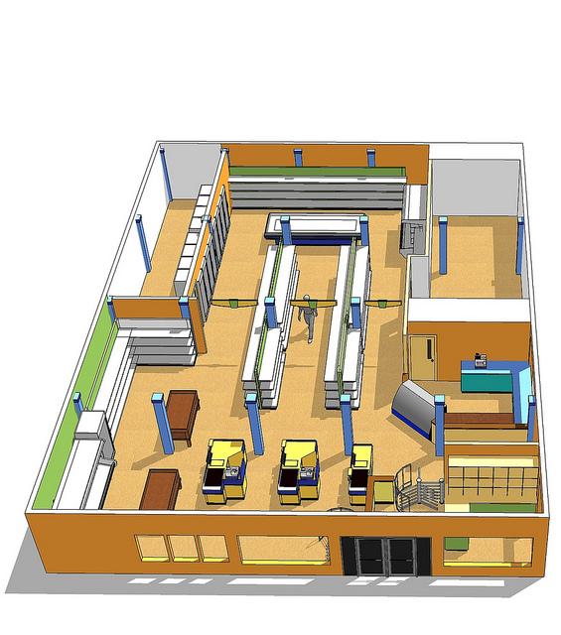

Direction finding
Problem definition:
  People visiting a museum/store would like to:
    Get guidance on exhibits in an exhibition, to articles on a high shelve.
    Exhibits may not be accessible but there’s a LoS between user and object. A human behavior might be to point to that article (reference via direction).
  A manager in a store would like to:
    Provided additional information to clients as they’re entering the store.
    Not if they simply pass through entrance area both from inside and outside the store.

Slide 12
Direction finding
Possible technologies and gap analysis:
  No existing directionality support in current spec; adding Angle Of Arrival (AoA) and/or Angle of Departure (AoD) positioning support to 802.11.
  With NG60:
    AoA/AoD can be easily derived since directional communication is used.
    Shorter frames suggests much lower clock drift and hence smaller distance inaccuracy and ambiguity.
  Both STA:STA and AP STA:STA models makes sense.
Notes:
With NG60 we could have better accuracy up with to 8 GHz of BW.
Allows for ~1 cm accuracy in LOS cases
May need to define a Very Fine Timing Measurement (VFTM) Parameter IE.
We can redefine t1 and t2 definition to be at the end of the frame in 802.11REVmc to reduce clock drift effect by a factor of ~4.
AoA can be easily derived since directional communication is used

Slide 13
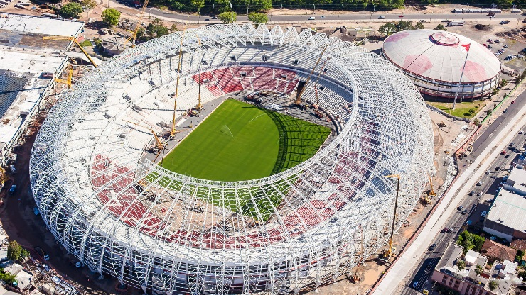
Improving scalability and reducing overhead
Problem definition:
  People would like to get directions to their seat in the stadium, their gate at an airport.
  Current protocol requires ~4-6 frames exchanges per fix, per STA, possibly using basic rate (limited link adaptation, trilateration).
  Some work have been done on assessing* medium usage.
  Heavily crowded scenarios showed substantial* impact on medium.
  * 11-12-1249-04-000m-802-11-2012-cid-46-47-48 by Carlos Aldana et-al.
  * 11-13-0072-01-000m-client-positioning-using-timing-measurements-between-access-points by Erik Lindskog, Naveen Kakani et-al.

Slide 14
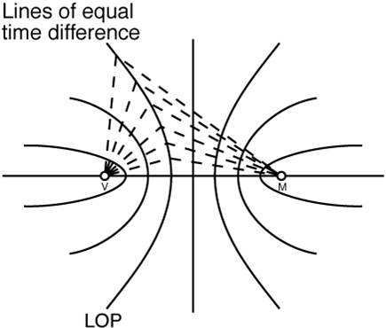
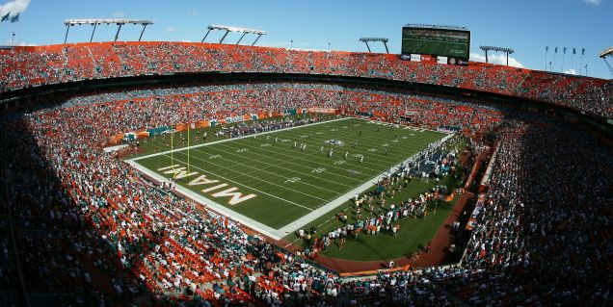
Improving scalability and reducing overhead
Possible technologies – and their support in 802.11 spec:
  Hyperbolic navigation – partial support in REVmc.
  One way directional methods (AoD/AoA) – no support in current spec.
  Moving FTM from 1:1 to 1:N model.
  Adaptation to 802.11ax – natural progression.
  * 11-12-1249-04-000m-802-11-2012-cid-46-47-48 by Carlos Aldena et-al.
  * 11-13-0072-01-000m-client-positioning-using-timing-measurements-between-access-points by Erik Lindskog, Naveen Kakani et-al.
Notes:
Higher protocol efficiency: higher rates, shorter frames, multiple anttenas.

Slide 15


High Accuracy Positioning
Problem definition:
  I’d like to play augmented reality on my gaming machine possibly connected to my WLAN.
  Possibly wearing special glass and there are sensors on my wearable devices.
  Centimeter accuracy required for new age user experience.
  LOS environment usage scenario is possible.

Slide 16
High Accuracy Positioning
Possible technologies:
  802.11ad for centimeter accurate positioning.
  VHT MIMO support for positioning.
  Both STA:STA and AP STA:STA models.

Slide 17

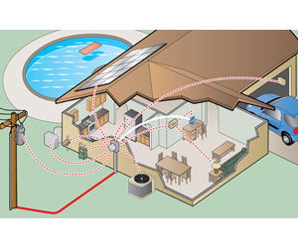
Enable the use of FTM <1 GHz frequency bands
Example of usage and benefits of FTM in Sub 1 GHz WLAN:
  Reduce cost of operation when logging Sub 1 GHz enabled smart meter installation locations*
  Smart meters can do trilateration with Access Points to have automated location logging and avoid human errors.
  Use of Sub 1 GHz enabled tags can be used both for indoor and outdoor locationing Pets, children, spouses
*15-14-0391-00-004r-technical-guidance-document-input-for-ami.pptx

Slide 18
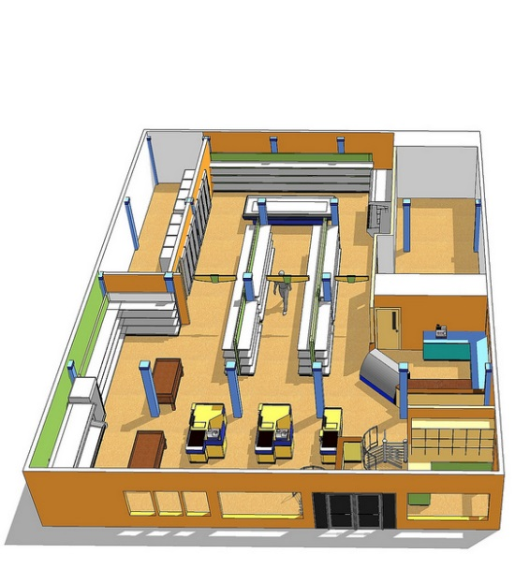
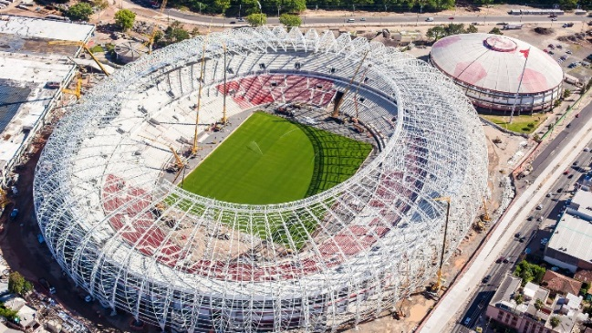
Summary
Current spec. support for positioning is focused on indoor navigation usage model where ~2-3m accuracy is good enough.
As the technology penetrates new usages, emerges and micro positioning, directionality and scalability are needed for next generation usages.
This is an opportunity for 802.11 based products.

Slide 19
Back Up

Slide 20
REVmc Location support (con.)
To support those requirements we ended up with substantial changes to the original 802.11v Timing Measurement protocol:
  Multi channel operation:
    Fixed periodicity availability Time Windows.
    Trigger frame for non-deterministic Initiating STA (non AP STA) operation.
    Negotiation protocol for operation in unassociated mode.

Slide 21
Recap Using RTT for Positioning
  A geometrical methods.
  By measuring half the Round Trip Time (RTT) a range from STA1 to STA2 may be calculated using the signal propagation properties.
  Multipath highly effects the result
  Distance (i.e. PWR or path loss) is of 2nd importance.
  Modulation, BW and other factors play a part as well.
RTT = (t4-t1) – (t3-t2)
Range = C * RTT/2
  * Note non standard protocol for illustration purposes.

Slide 22
Recap Using RTT for Positioning
  A geometrical methods.
  By measuring half the Round Trip Time (RTT) a range from STA1 to STA2 may be calculated using the signal propagation properties.
  Multipath highly effects the result
  Distance (i.e. PWR or path loss) is of 2nd importance.
  Modulation, BW and other factors play a part as well

Slide 23

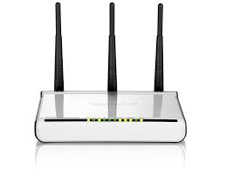
Using AoA/AoD for Positioning
Having AoA//AoD information has the potential advantage of reducing the number of frames that are needed to be transmitted to find a position (distance + angle).
Possibly combine the two measurements.
y
x

Slide 24
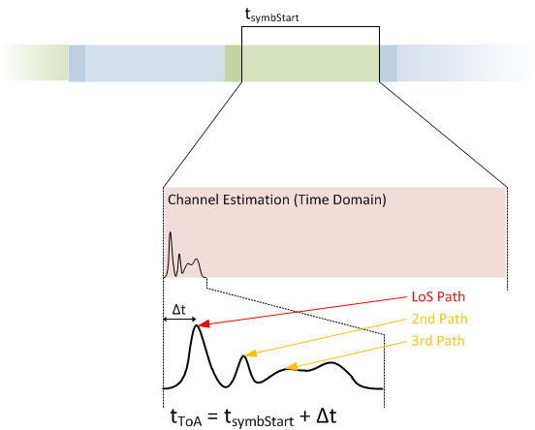
An accurate measurement is essential as measurement error of 1nsec translates to 0.3m range error.
Hindered by NLOS (None Line Of Sight) or NNLOS (Near NLOS) channel conditions giving a wrong sense of range.
The NLOS negative effect can be subsided using a Multiple Signal Classification algorithm (MUSIC).
Outlier detection and over sampling of AP may also be used to identify the best LOS or NNLOS.

Slide 25
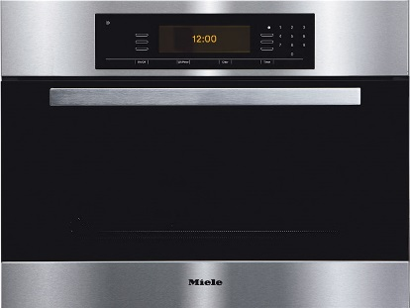
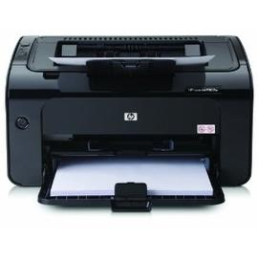


STA to STA and IoT
IOT and Social applications:
  I’d like to get an indication when a friend of mine is 20m away, while we both use our smartphones and using local applications.
  I’d like to have an office printer let me know my print job is waiting to print when I walk past it, the print job was sent from my UB to cloud based spooler.

Slide 26
STA to STA and IoT
IOT and Social applications:
  My kitchen oven pings me to check on the cake/casserole as I pass by it.
  Lights turn on as I walk into a room in an unfamiliar house.

Slide 27
STA to STA and IoT of things
Limitations of existing standard:
  The FTM procedure was conceived with AP STA:STA model as the lead usage:
    Not optimized for power conscious devices with a STA:STA usage models (same channel, M:N).
    Higher medium efficiency requirement as devices may have denser deployment and higher usage rate for positioning service.

Slide 28
Time Of Flight – Hyperbolic positioning
A variant of the ToF trilateration methods hyperbolic positioning/navigation is a multilateration method.
Measuring the time difference of STA to known a pair of synchronized APs provides a curve of equal distances or Line Of Position (LOP).

Slide 29
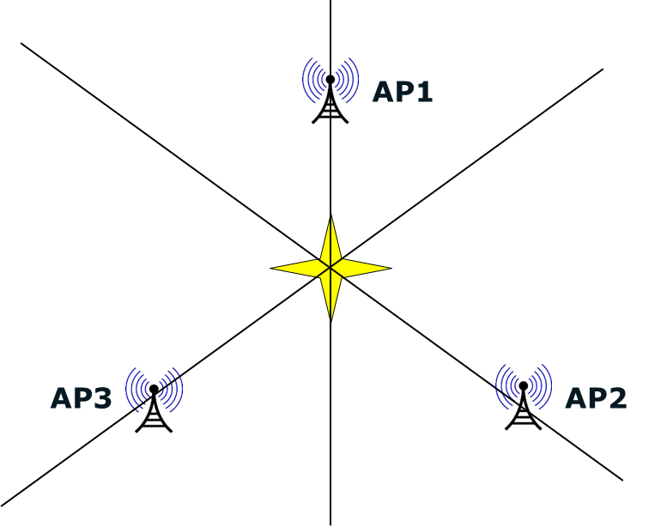
Time Of Flight – Hyperbolic positioning
The STA positioning is obtained from the intersection of multiple hyperbolic curves also called multilateration.
In the case of time difference 0 the curve becomes a straight line

Slide 30
Time Of Flight – Hyperbolic positioning
To overcome the need for high accuracy local oscillator synchronization and the limitation of shared medium, CSR suggested a variant of the US naval Loran C system where a delay is inserted.
D₁₂ = C* ( t_{cd1} – (t_{cd2} - (t₄-t₁ – ToF)))

