Slide 1
Lifecycle management
Date: 2014-09-13
Authors:

Slide 2
Introduction
Research and inventions identify new technological opportunities. Sometimes revolutionary new ideas overthrow existing technologies. Sometimes evolutionary improvements require existing solutions to fade out. In any case, technology constantly changes.
It is no surprise that also the IEEE 802.11 standard has evolved. It has grown from 450 pages to more than 3000 pages. Many features and functions have been added. However, it seems that there is no well defined process to review, discuss, deprecate, and remove obsolete features from the standard.

Slide 3
Example 802.11 features
Frequency bands
  TVWS, [2.4, 3.65, 4.9, 5, 5.9, 60] GHz
Bandwidths
  [5, 6, 7, 8, 10, 12, 14, 16, 20, 24, 28, 32, 40, 80, 160, 6+6, 7+7, 8+8, 12+12, 14+14, 16+16, 80+80] MHz
Quality of Service
  Robust AV
Radio measurements
Security
  WEP, TKIP, CCMP, GCMP, SAE, protected management frames, faster roaming
Direct link and mesh communication
External networks
Substantial growth of the standard
  Number of pages doubling every six years?

Slide 4
Complexity
REVmc/D3.1
Even once simple ideas can become difficult to handle if many cases need to be considered
  Different aspects
  Many conditions to observe
  A standard is a living thing that needs to be managed
802.11-1999

Slide 5

Interdependencies
Many amendments added interdependencies
  “If A and B, then shall not use X. If only A use Y, otherwise use Z.”
Complexity of 802.11 standard increases
  Should a newbie read 802.11REVmc/D3.1 to understand the 802.11 standard?
  Or would you recommend to start with 802.11-1997/1999?

Slide 6
Deprecation
IEEE 802.11 has deprecated various elements of its standard
  WEP, TKIP
  Dual CTS protection
  Phased Coexistence Operation
  PCF, RIFS
  IR & FHSS PHY
  Formal MAC description (SDL)
Often, debates about abandoning a mechanism are controversial
  Conflicting interests
Sometimes no consensus can be achieved
  E.g., Quality of Service Enhancements Study Group (2007) discussing to align 802.11e with Wi-Fi Multimedia (WMM)

Slide 7

Can we learn from others?
How are other bodies & entities evolving their technologies?
Let’s have a look at how technology changes
Picture from [1]

Slide 8
Examples of technological change
Abandoned and withdrawn technologies

Slide 9
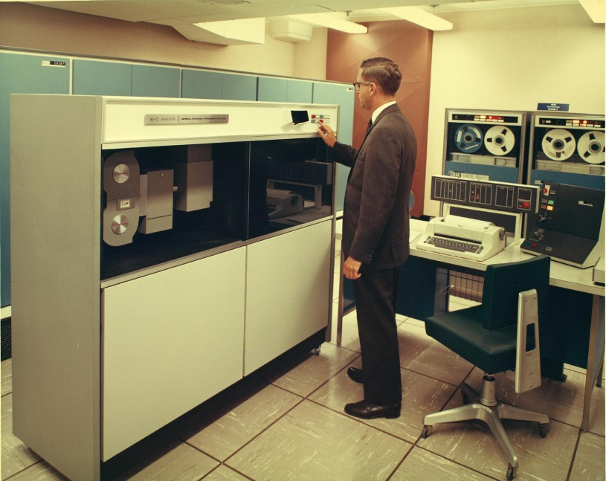
Technological advances
Even once dominant technologies can quickly disappear
  Sometimes without any immediate successor
Examples
Video Tape Recorders
  Video Home System (VHS), Super VHS (S-VHS), Video 2000, Video 8, Hi8, Digital8, MiniDV
Cathode ray tube (CRT) monitors
Internal & external peripherals
  RS-232, PS/2, IEEE 1284 printer port, SCSI, IDE/ATA, ISA, EISA, PCI bus
Digital audio media
  MiniDisc, Digital Audio Tape (DAT), Digital Compact Cassette (DCC)
Photographic film
  Polaroid instant film cameras
Picture from [3]

Slide 10
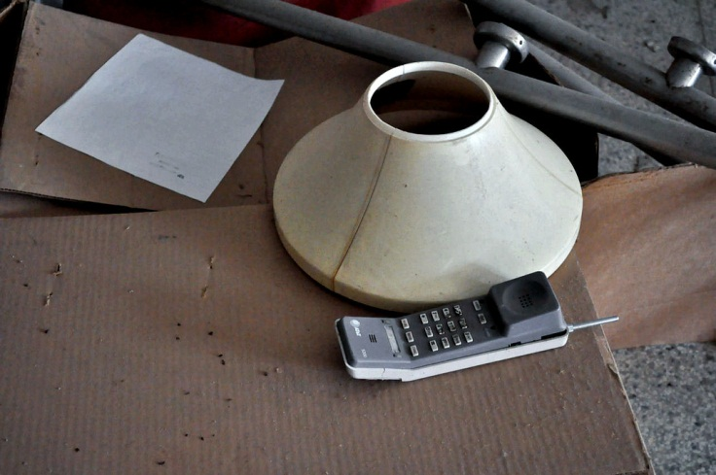
Decisions by different entities
Entities may decide to deprecate a technology
  Governments
  International bodies (e.g. ITU)
  Regulatory authorities
  Commercial
  SDOs
Permission to operate a technology might be limited
Examples
Government
  Leaded fuel ban
    Even banned in Nascar (2008) …
  Analogue TV turned off
  CT1+ & CT2 cordless phones banned in Germany from 2009
  FCC limits GMRS licenses to 5 years
  EU banned incandescent light bulbs
IEEE 802.11
  WEP, TKIP, IR PHY etc.
IEEE 802
  Token Bus (802.4), Token Ring (802.5), Cable Modem (802.14) etc.
Picture from [4]

Slide 11
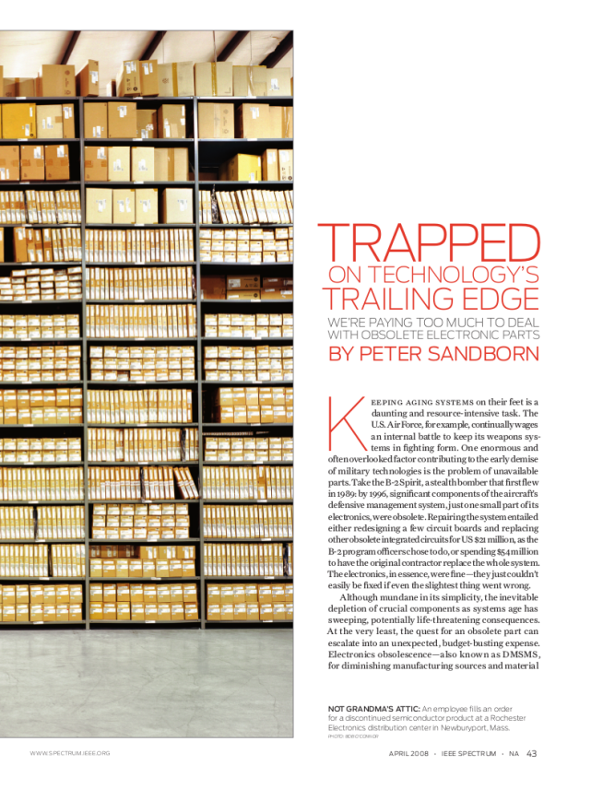
Economical decisions
Competition might cause companies to abandon a technology
Companies may cease to exist
  Can cause severe customer problems
Examples
HD-DVD
MultiMediaCard (MMC), SmartMedia
Windows XP support discontinued after twelve years
Discontinuation of electronic components
[5]

Slide 12
Way Forward?
Consequences for 802.11

Slide 13
Task Group m (TGm)
Careful chairmanship and an experienced TGm membership have substantially improved 802.11
  Cautious integration of amendments
  Corrections and enhanced text
TGm has addressed several “legacies” related topics
  Debates often were highly controversial
  How could we avoid such controversies?
Management of the standard is a case by case process
  TGma → TGmb → TGmc
Could we pro-actively manage the 802.11 standard?

Slide 14


Lifecycle management
What is lifecycle management?
Professional products have a well defined lifecycle
  End of sale notice period
  End of sale announcement
  Last order date
  End of support
  End of development
  End of life (EOL)
It is good practice to recommend a replacement product/technology for EOL products

Slide 15

Benefits of lifecycle management
Lifecycle plans educate customers
  Customer can plan his investments
  Customer and supplier on equal terms
  Transitioning recommendations help customers
  Chances to leave legacies behind
A lifecycle plan stimulates customer feedback
  Potentially leading to a modified schedule
Build trust in supply chain
  No surprises, no disappointments
  Mission critical applications need predictability

Slide 16
Conclusion
As a matter of fact, every technology is aging
As a matter of fact, technologies are withdrawn or abandoned
Abandoning a technology is a double edged sword
  Makes room for new
  Legacies might cause trouble
It is necessary to decide on a case by case basis
  Compare gains vs. investment into new equipment, cost for training, installation, disposing of old equipment etc.
Consequences for 802.11
802.11 isn’t only “big business”
  2,600,000,000 802.11 chipsets expected to ship in 2014 [2]
  Another 18 × 10⁹ expected to ship from 2015 until 2019 [2]
802.11 has tremendous responsibility
  802.11 is part of our infrastructure, far from being just a gadget
Thus, we believe that 802.11 and the industry would highly benefit from 802.11 providing a lifecycle schedule

Slide 17
References
Tkgd2007, “Human evolution,” Jul. 14th, 2008, file is licensed under the Creative Commons Attribution-Share Alike 3.0 Unported license. [Online]. Available: http://commons.wikimedia.org/wiki/File:Human_evolution.svg
ABI Research, “Wi-Fi Chipset Shipments will near 18 Billion Chipsets during the Next Five Years,” May 5th, 2014. [Online]. Available: https://www.abiresearch.com/press/wi-fi-chipset-shipments-will-near-18-billion-chips
San Diego Air and Space Museum Archive, “Convair/General Dynamics Plant and Personnel Corporation,” Catalog #10_0012052. [Online]. Available: https://www.flickr.com/photos/sdasmarchives/8126348190
acurt14, “The first cordless phone,” Feb. 2nd, 2013, file is licensed under the Creative Commons Attribution-NonCommercial-NoDerivs 2.0 Generic License. [Online]. Available: https://www.flickr.com/photos/acurt14/8442428103
Sandborn, P., “Trapped on Technology's Edge,” Spectrum, IEEE, vol. 45, no. 4, Apr. 2008. [Online]. Available: http://www.ieeeexplore.com/xpl/articleDetails.jsp?tp=&arnumber=4476445

