Slide 1
The Effect of Preamble Error Model on MAC Simulator
Date: 2014-09-11
Name | Affiliations | Address | Phone | Email
Po-Kai Huang | Intel |  |  | po-kai.huang@intel.com
Robert Stacey | Intel |  |  | robert.stacey@intel.com
Rongzhen Yang | Intel |  |  | rongzhen.yang@intel.com
Qinghua Li | Intel |  |  | qinghua.li@intel.com

Slide 2
Abstract
The Wi-Fi transmission is asynchronous.
The receiver relies on the preamble to detect the start of a packet, determine the packet duration, decode desired transmission, and defer for undesired transmission.
This contribution focuses on using the MAC simulator to understand the performance of different preamble error model and shows that there could be different.
  Propose to model the preamble error correctly to evaluate the performance gain of OBSS techniques

Slide 3
Background for CS/CCA
In IEEE Std 802.11-2012 clause 18.3.10. 6, we have the following description for CS/CCA with 20 MHz channel spacing
The start of a valid OFDM transmission at a receive level equal to or greater than the minimum modulation and coding rate sensitivity (–82 dBm for 20 MHz channel spacing,…) shall cause CS/CCA to indicate busy …. If the preamble portion was missed, the receiver shall hold the CCA signal busy for any signal 20 dB above the minimum modulation and coding rate sensitivity (–62 dBm for 20 MHz channel spacing, …).
Further, in clause 18.3.12, we have
If…the SIGNAL field is completely recognizable and supported), …, the OFDM PHY shall ensure that the CCA indicates a busy medium for the intended duration of the transmitted frame…
If the indicated rate in the SIGNAL field is not receivable, … The PHY shall … hold CCA busy for the calculated duration of the PPDU.

Slide 4
Summary of CS/CCA for 20 MHz
If the signal strength of a Wi-Fi transmission is above -82 dBm, receiver can start to detect the signal.
  If the SIG field of the preamble is correct, the receiver can choose to
    defer for the entire transmission duration
    or decode the entire packet
  If the SIG field of the preamble has errors, the receiver uses -62 dBm to determine if the medium is busy

Slide 5
Preamble Error Model (PEM)
For all models,
  If the signal strength is above -82 dBm, receiver can detect the signal.
  If the SIG field of the preamble is correct, the receiver can choose to
    defer for the entire transmission duration
    or decode the entire packet based on SINR
The difference occurs when preamble has errors (, i.e., SIG field has errors)
  Correct model
    the receiver uses -62 dBm to determine if the medium is busy
  PEM model 1
    Assume that STA can still defer for the entire transmission duration
    If the packet is for the STA, all MPDU have errors
  PEM model 2 (excluded by MAC test 2b)
    Assume that STA can still defer for the entire transmission duration
    If the packets is for the STA, decode each MPDU based on the SINR
We will only compare PEM model 1 with Correct Model

Slide 6
Packet Early Termination
In 11ah, a mechanism called color bits is introduced
  If the transmission is from other BSSs, then the RX can terminate the reception process.
Packet early termination can also be done if MAC header can be decoded.
Adopt the assumption of color bits in our MAC simulator, so the STA can terminate the reception process if the packet is from other BSSs.
Packet Early Termination frees the receiver to decode the desired packet if possible.

Slide 7
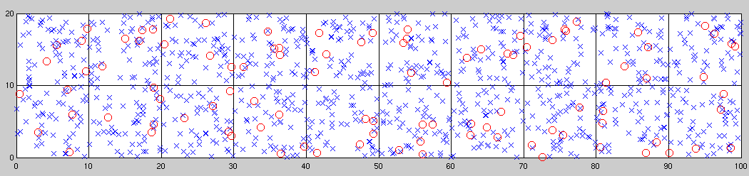
Simulation Setup – Scenario 1 [1]
2.4GHz with 20 MHz bandwidth
TXOP: 4ms
Path loss with 5 dB shadowing
1x1, STA antenna gain -2 dB
Full buffer traffic
MSDU size: 1500 bytes
Three channels (random selection per AP)
Simulation Time: 30s
10 STAs per apartment
Power of STA: 15 dBm
Power of AP: 20 dBm
Genie MCS selection
MPDU error based on SINR to PER mapping from LLS for channel D
Preamble error if SINR≤0 dB
(Note that this figure is presented in 2D mode.)

Slide 8
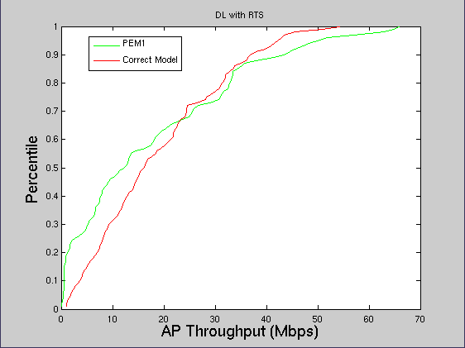
DL Transmission with RTS/CTS

Slide 9
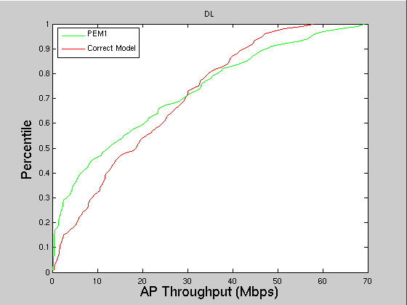
DL Transmission without RTS/CTS

Slide 10
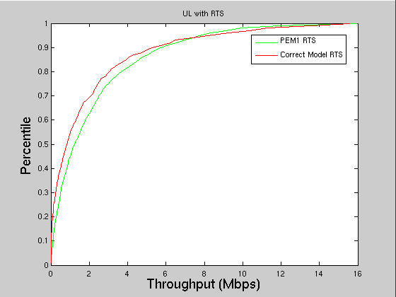
UL Transmission with RTS/CTS

Slide 11
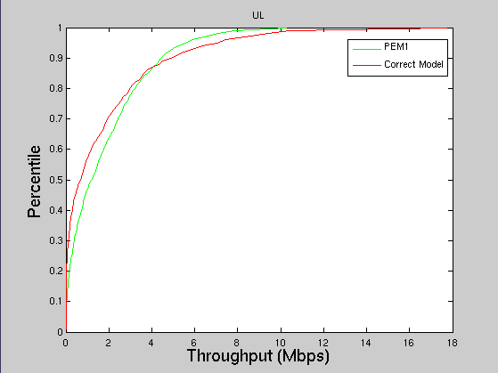
UL Transmission without RTS/CTS

Slide 12
Discussion
STA1
STA2
STA3
Suppose STA1 and STA3 can not sense each other
Assume that STA1 has higher power level than STA3
to STA2
Consider the following situation
Under PEM model 1, STA2 defers for both STA1 PPDU and STA3 PPDU, which leads to different throughput performance
STA2 Operation
under correct model
Defer for STA1 PPDU
Backoff
Transmit on top of STA3 PPDU
STA2 Operation
under PEM1
Defer for STA1 PPDU
Defer for STA3 PPDU
Backoff
Transmit
-67 dBm
STA1 PPDU
Power Level
To STA2
-72 dBm
STA3 PPDU
Time

Slide 13
Conclusion
Different preamble error models can lead to different throughput performance.
  Propose to model the preamble error based on the 802.11 spec to evaluate the performance gain of OBSS techniques.

Slide 14
Reference
11-14-0980-02, Simulation Scenarios
11-14-0800-17, Box 1 and Box 2 Calibration Results

Slide 15
Appendix - MAC Simulator Calibration
PHY Calibration
  Results for Box1 are aligned with most of the companies [2]
MAC Calibration
  Results are shared with the MAC calibration thread.

Slide 16
Appendix - MCS table for Channel D with impairments
MPDU size = 1500 bytes
MCS | 0 | 1 | 2 | 3 | 4 | 5 | 6 | 7 | 8
SINR(dB) | 10.2 | 13.5 | 17.5 | 19 | 23.5 | 27 | 29.5 | 31.5 | 35

Slide 17
Appendix – Genie MCS Selection
Before a TX transmits packet, it checks the interference at the RX and uses the value to select the best MCS with 10% PER.

