Slide 1
Comparisons of Simultaneous Downlink Transmissions
Date: 2014-09-12
Authors:

Slide 2
Abstract
Downlink simultaneous transmissions is an important candidate technology and may be required to achieve improved spectral efficiency in dense network environments.
We perform a comparison of transmission overhead for downlink MU-MIMO, OFDMA, and single user transmissions in IEEE 802.11.

Slide 3
Downlink Simultaneous Transmissions (DST)
Downlink MU-MIMO
Spatial domain multiple user separation (ZF, MMSE etc)
First introduced in IEEE 802.11ac
Requires multiple transmit antennas
Requires high precision CSIT
Downlink OFDMA
Frequency domain multiple user separation
Has been discussed as a possible technology in several contributions [1-5]
Relaxed requirement for multiple antennas
No need for CSIT

Slide 4
DST Channel Access
Same ‘example’ channel access scheme for MU-MIMO/OFDMA
DL MU-MIMO/OFDMA
MPDU + BA + BAR + BA exchange
Control frames (BA, BAR) are transmitted over the entire bandwidth
Motivation for this example:
To enable a high level comparison between the transmission methods
This may be considered a worst case example (e.g. control frame design could be more efficient)

Slide 5
Comparison Methodology
Link level PER simulation results
MU-MIMO: ZF transmit beamforming per subcarrier
OFDMA/SU: Single user transmit beamforming per subcarrier
Comparison methodology
For each SNR point, consider the maximum MCS which satisfies the PER constraint: PER<=1%
Determine the TXOP duration by taking into account the maximum MCS which is supported including the overhead:
BA, BAR, SIFS, DIFS, ACK, etc.
Throughput= Data Packet Size/TXOP duration * (1-PER)

Slide 6
Comparison Methodologies Cont’d
For simplicity, we assume
Same channel access scheme for MU-MIMO/OFDMA
Same single stream transmission per user
Same number of transmit antennas
A four transmit antenna example: MU-MIMO supports four users simultaneously with 4x1x4 ZF transmit beamforming, OFDMA supports four users individually with 4x1 transmit beamforming per user
Same number of simultaneous users for MU-MIMO/OFDMA
Allowing different simul. users for MU-MIMO/OFDMA is possible
Similar comparison trend is expected
Fixed random backoff overhead
A more rigorous analyis following [7] indicates that it is network dependent
CSI feedback overhead not included

Slide 7
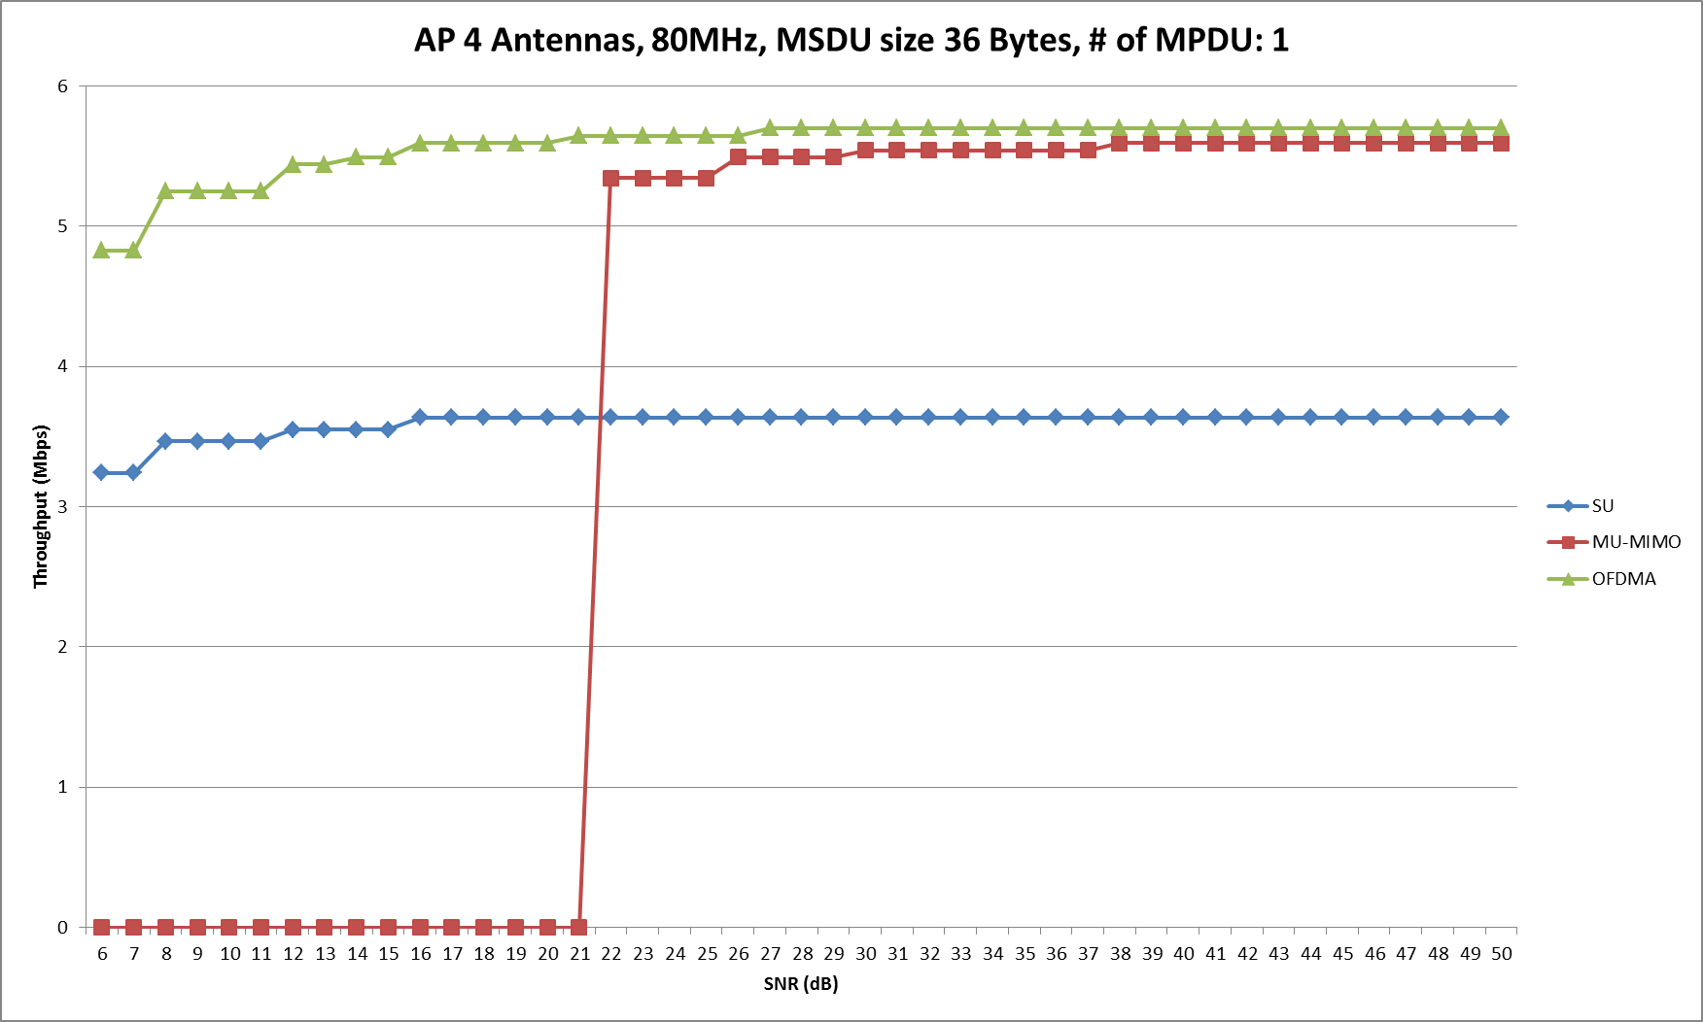
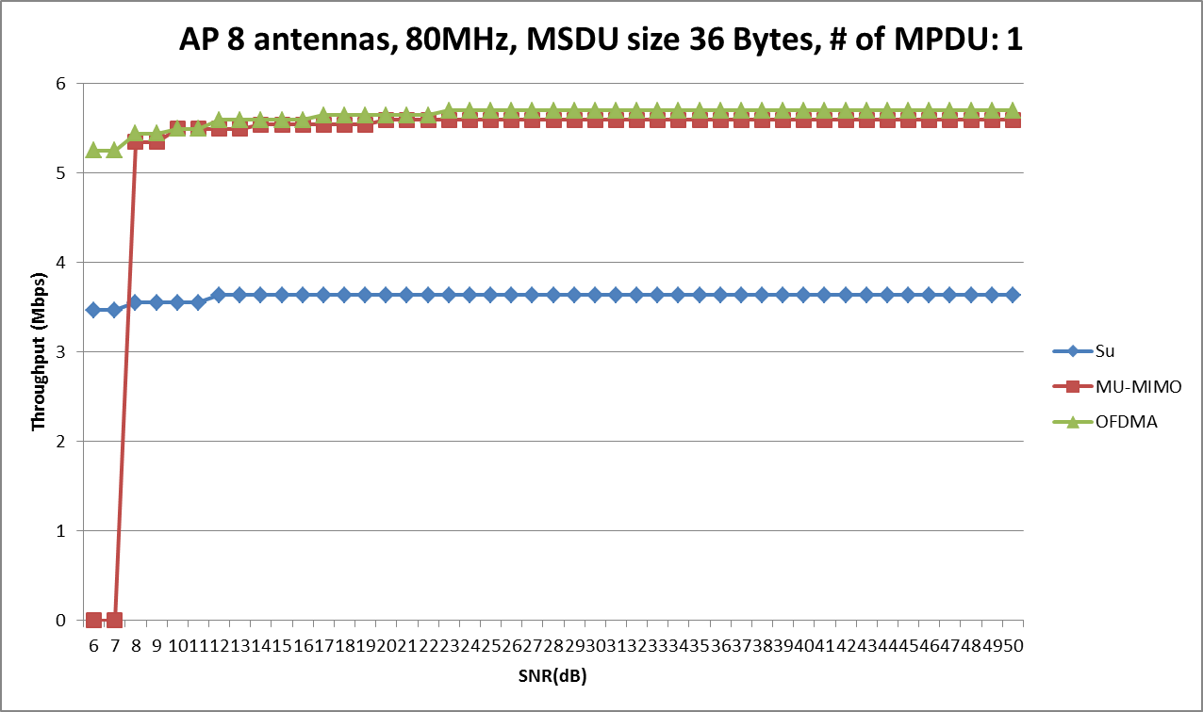
80 MHz BW, Small Packet 36 Bytes
Small packet of 36 bytes (voice MSDU IPV4 [6])
DL OFDMA shows an advantage over the entire SNR operation range
DL MU-MIMO performance is better for high SNR operation
With realistic channel impairments and limited number of antennas, DL MU-MIMO may suffer more significantly than DL OFDMA

Slide 8
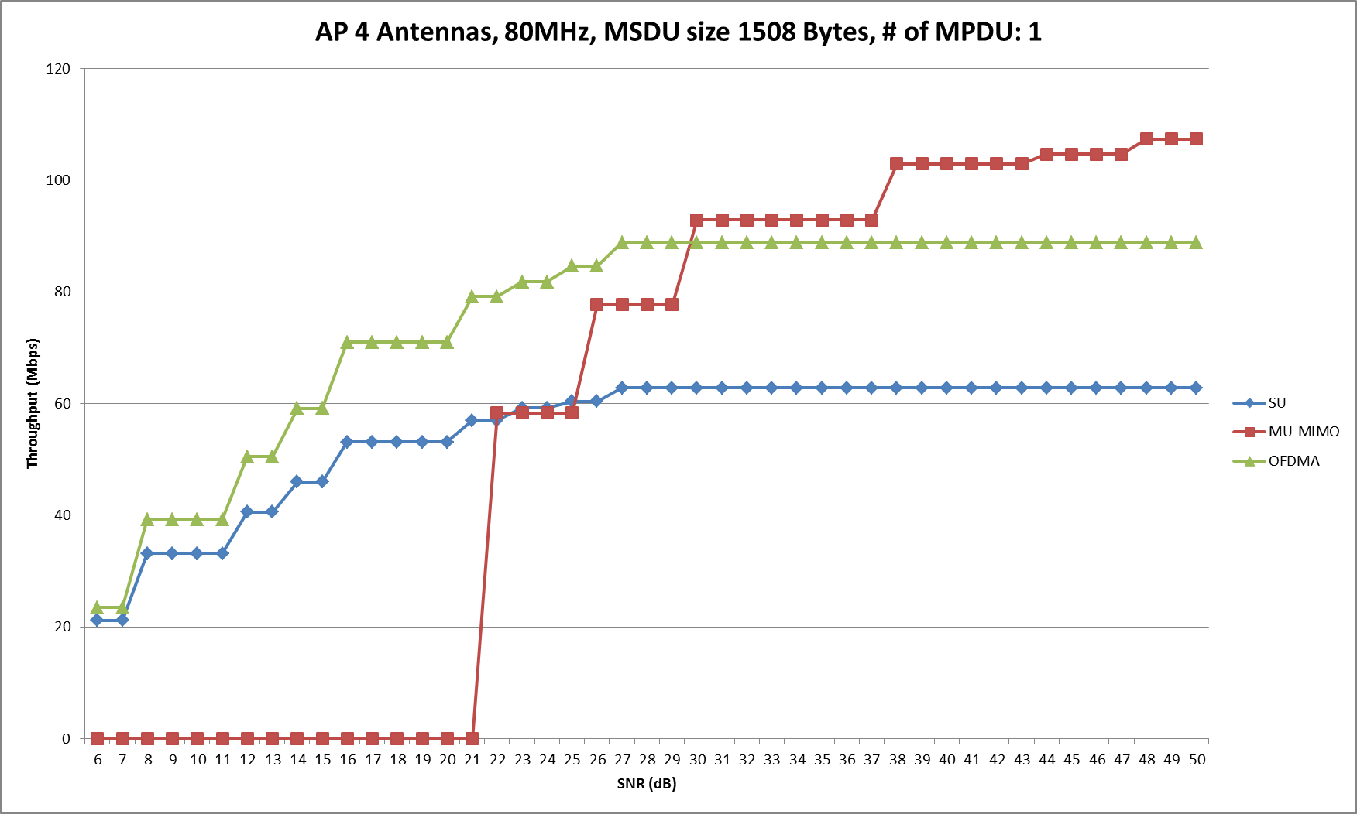
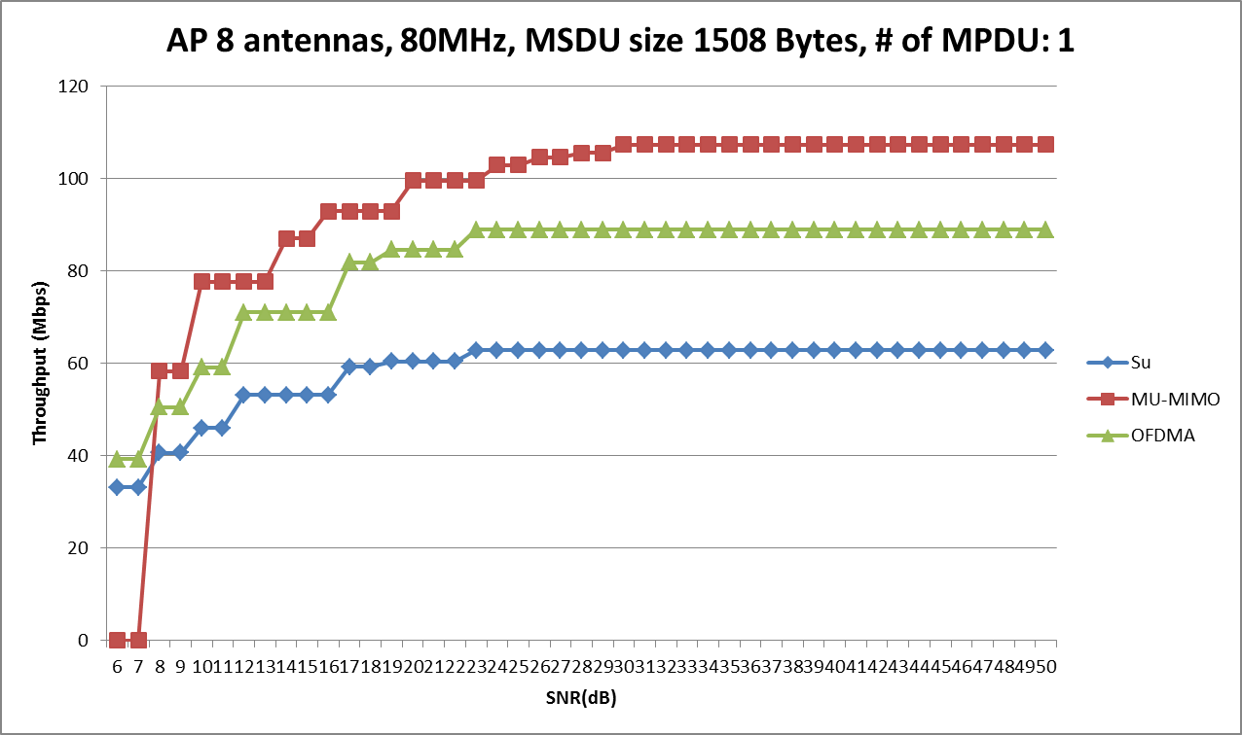
80 MHz BW, Large Packet 1508 Bytes
Large packet size 1508 bytes [8]
OFDMA shows an advantage for low to medium SNR operation
MU-MIMO performs much better for high SNR operation
With realistic channel impairments and limited number of antennas, DL MU-MIMO may suffer more significantly than DL OFDMA

Slide 9
Throughput Improvement Ratio
 |  | OFDMA vs SU |  | MU-MIMO vs SU
 |  | 20 dB | 30 dB | 20 dB | 30 dB
Small packets | 4 Tx | l.6 | 1.6 | 0* | 1.5
 | 8 Tx | 1.6 | 1.6 | 1.5 | 1.5
Large packets | 4 Tx | 1.4 | 1.4 | 0* | 1.5
 | 8 Tx | 1.4 | 1.4 | 1.7 | 1.7
OFDMA
Demonstrates an advantage for transmission of small packets
Performance using large packets is acceptable
DL MU-MIMO
Suitable for high SNR scenarios and large packet payloads
May be sensitive to CSI quality
*: this SNR point is not high enough to support ZF beamforming with PER < 1%

Slide 10
Summary
DL OFDMA
Demonstrates an advantage for transmission of small packets
Low overhead, robust performance
Performance using large packets is acceptable
Observations for improvements over single user
Overhead savings are the primary contribution to improvements
A larger improvement may be observed if a more efficient control frame design (e.g. simultaneous ACK) is considered
DL MU-MIMO
Suitable for high SNR scenarios and large packet payloads
May be sensitive to quality of CSI

Slide 11
References
IEEE 802.11-14/0839r1, Discussion on OFDMA in IEEE 802.11ax, Yonsei University, July 2014.
IEEE 802.11-13/1382r0, Discussion on OFDMA in HEW, LG, November 2013.
IEEE 802.11-14/0804r1, Envisioning 11ax PHY Structure - Part I, LG, July 2014.
IEEE 802.11-14/0801r0, Envisioning 11ax PHY Structure - Part II, LG, July 2014.
IEEE 802.11-13/1395r2, Simultaneous Transmission Technologies for HEW, NTT, November 2013.
IEEE 802.11-14/0571r3, Evaluation Methodology, Broadcom et. al, July 2014.
G. Bianchi, Performance analysis of the IEEE 802.11 distributed coordination function, IEEE JSAC, vol. 18, no. 3, August 2000.
IEEE 802.11-14/0980r2, Simulation Scenarios, Qualcomm et. al, July 2014.

Slide 12
Appendix

Slide 13
Analysis Parameters
Number of simultaneous users: 4
Four/Eight transmit antennas (AP)
One receive antenna (STA)
MSDU size: 36/1508 bytes [6]
Number of MPDUs in AMPDU: 1
Operation Bandwidth:
20 MHz total BW and 5 MHz per user for OFDMA
Or, 80 MHz total BW and 20 MHz per user for OFDMA
Average backoff time: 3 time slots (27 μs)
Control frame: MCS 0
MCS selection based on ideal conditions without channel impairments
Parameters | Value
BA (bytes) | 32
BAR (bytes) | 24
ACK (bytes) | 14
DIFS (μs) | 34
SIFS (μs) | 16
MCS | 0~8
PPDU format | VHT

Slide 14
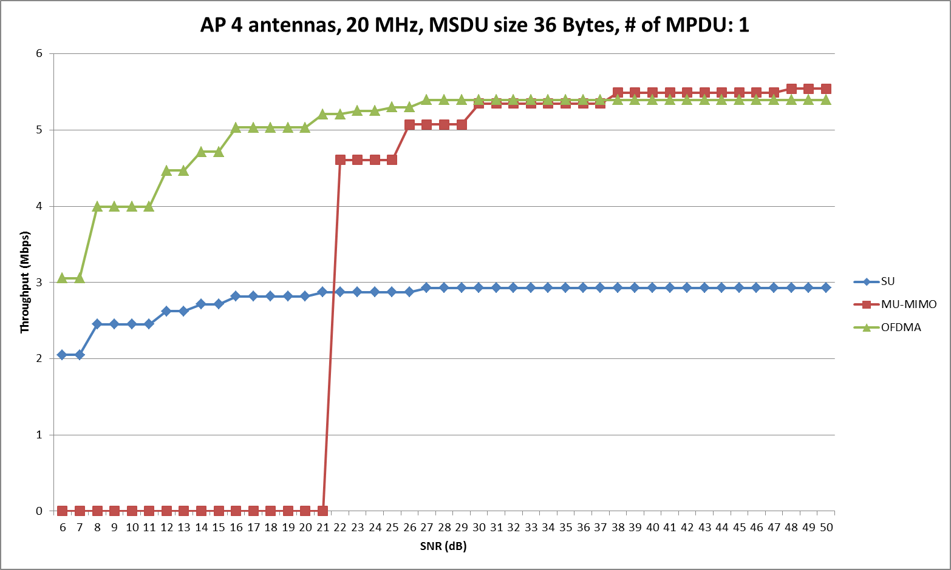
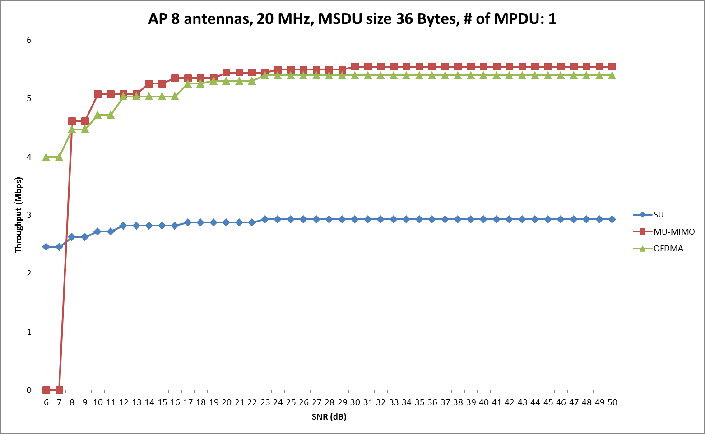
20 MHZ BW, Small Packet 36 Bytes
Small packet @ 20 MHz
DL OFDMA shows advantage in the entire SNR range vs the others
Lower overhead, robust performance
DL MU-MIMO performance good at high SNR

Slide 15
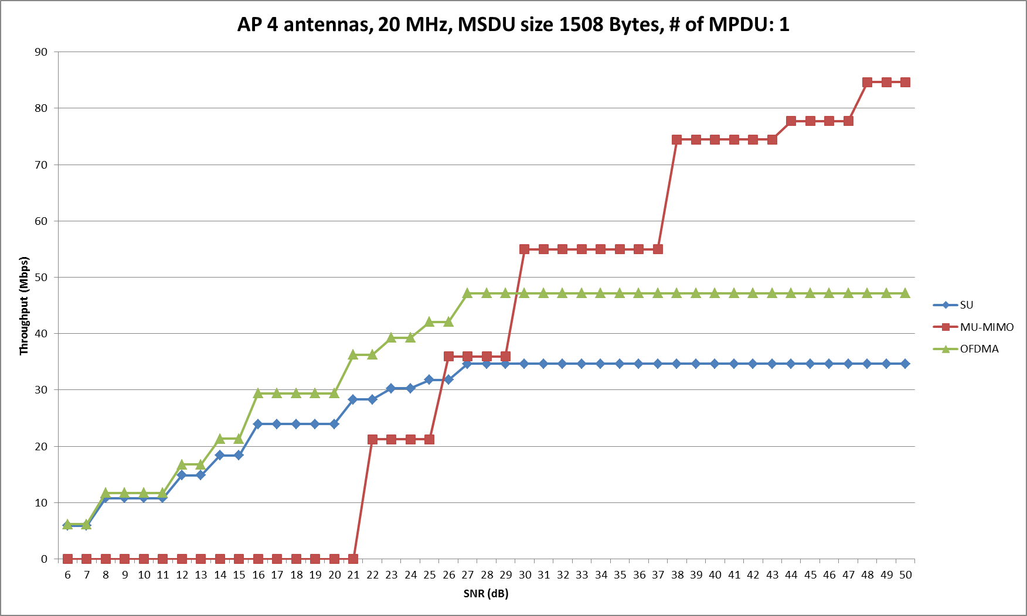
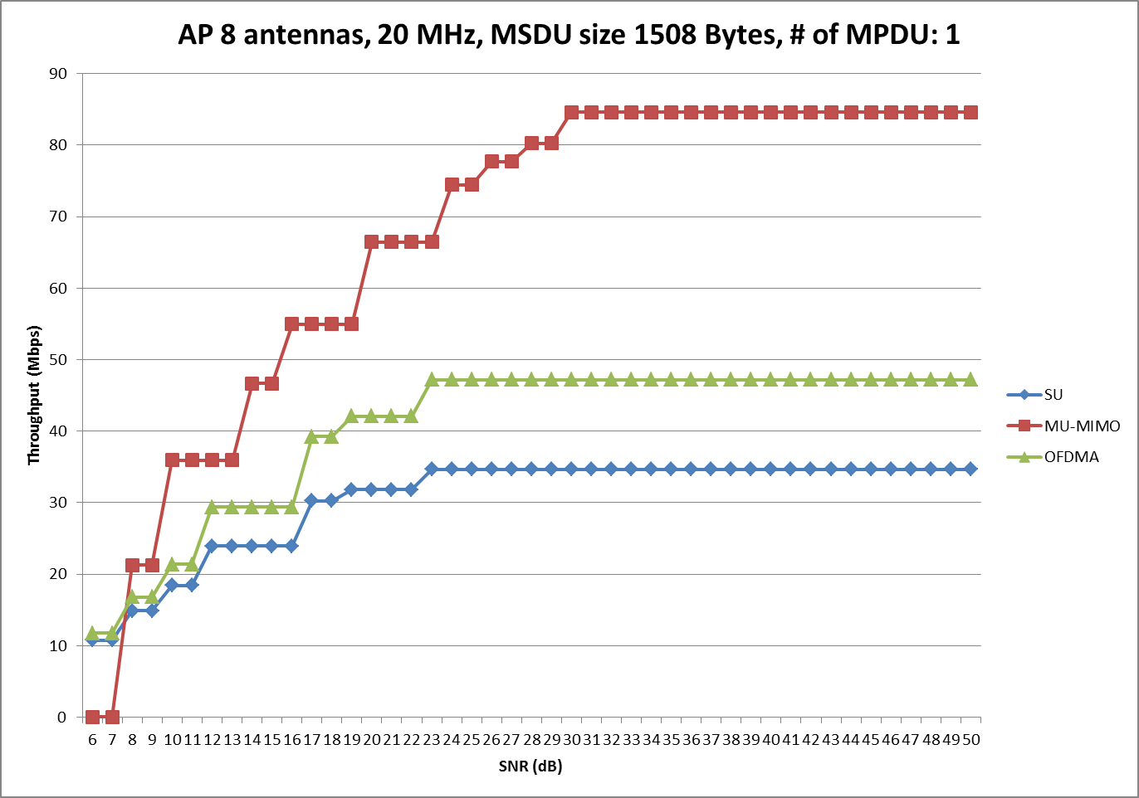
20 MHz BW, Large Packet 1508 Bytes
Large packet @ 20 MHz
OFDMA shows advantage in low/medium SNR
MU-MIMO best in high SNR
With realistic channel impairments and limited number of antennas, DL MU-MIMO may suffer more significantly than DL OFDMA
OFDMA is Saturated at high SNR due to the limitation of one receive antenna

