Slide 1
NG 60 Usage Models
Date: 2014-08-13
Authors:

Slide 2
Abstract
This document discuss the use cases for NG60

Slide 3
Usage Model 1: Data Center NG60 Inter-Rack Connectivity
Pre-Conditions:
Data Center employs the NG 60 interfaces as the secondary/tertiary interfaces in lieu of fiber optics failure. The Data Center is fully operational with high demands of 99.999% of reliability and availability
Application:
The ToR switch can transmit /receive via the NG 60 interface to reach the EoR switch or through Relay interfaces (multiple hops). The EoR switch can reach the hub switch through the NG60 interfaces. The data being stored transfers at ~40 Gbps, disruption tolerance is <100msec, PER<10E-2 [1].
Environment:
Devices are operating in specialized environments with sustainable temperature, humidity and other physical quality of air flow. Transmissions are mostly LOS. Distances between adjacent racks are standard rack width and distance between adjacent rows are ~4’
Traffic Conditions:
Potential interference from environmental factors and noise.
Use Case:
The main fiber 10GEthernet interface is down
The ToR switch quickly detects the failure and wakes up the dormant NG 60 interface ASAP
Data continuously flows over the NG60 interface to the next EoR switch within 100ms
No administrator’s intervention to restore the Network

Slide 4
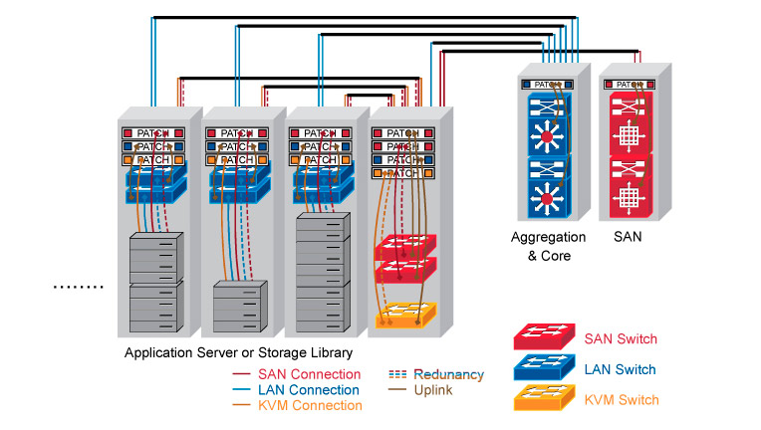
Usage Model 1: Data Center
Links | Link Capacity | Link Description | PER< [1] | Distance | Link Setup time | Security (Confidentiality/Integrity)
A<->B | >10Gbps | ToR connects to EoR | 10^-2 | 20’’ [3] | <100ms | C/I
A<->C | >10Gbps | ToR connects to EoR | 10^-2 | 40’’ | <100ms | C/I
A<->D | >10Gbps | ToR connects to EoR | 10^-2 | 60’’ | <100ms | C/I
A<->E | >40Gbps | EoR to Aggregated Switch (Relay Link) | 10^-2 | 4 ‘ | <100ms | C/I
E<->F | >40Gpbs | Aggregated Switch to SAN switch | 10^-2 | 4’ | <100ms | C/I
E
F
D
C
B
A
NG60 interfaces are best suit for backup interfaces when the fiber links are failed during emergency or network devices maintenances,
As back up interfaces, no active link up are needed all the time but when the failure is occurred, the backup links are required to be quickly setup (<100 msec [2] setup time)
Some of NG60 interfaces function as Relay links, i.e A<->E
[1]: The PER is based on requirements of 11ad, sub-clause 21.3.3.8
[2]: The average CISCO Catalyst switch over time is between 35msec to 280msec,
http://www.cisco.com/c/en/us/products/collateral/switches/catalyst-6500-series-switches/prod_white_paper0900aecd801c5cd7.html
[3] IEC 60297 mechanical structures for electronic equipment with 19’’ cabinet plus some spacing

Slide 5
Usage Model 2: Augmented Reality and Virtual Reality
Pre-Conditions:
AR/VR wearable devices are equipped with NG60 interface to stream video into the goggles.
Application:
User plays high close-reality game which needs to involves more body movements, the gaming console streaming the videos needs to be able to tolerate the low mobility of the gamers’ movements
The data transfers at ~20 Gbps, Latency <5msec, jitter <5 msec, PER<10E-2.
Environment:
Devices are operating in room such as a living /media room. Transmissions are mostly LOS. Distance between far corners of the room are <10 ft.
Traffic Conditions:
Potential interference from environmental factors and obstruction of the LOS.
The devices might be stationary or might be used with low-mobility during usage.
Use Case:
Gamer is wearing his goggle to start the COD games on a platform.
He is constantly moving left and right and crouching from time to time to simulate the battle scenes.
Video is non-disruptively streamed down to the goggle from the gaming console which is about 8 feet in front of him.

Slide 6

Usage Model 2: AR and VR
AR and VR is touting close-to- reality user experience with 3D video and 7.1 audio.
  The wearable device is subject to low mobility movement (Neck roll, pitch, yaw etc)
  The Video quality can support up to 3D 4K
  The operating environment is usually indoor <=10ft
Applications:
  Sony HMZ-T3
  VR goggles by Oculus
Features | Requirements | Notes
Distance | 10ft | Sony HMZ T1 supports up to 7ft Wireless HD
Video Quality | 3D 4K [1] | HDMI 2.0
Range of Motion | Neck Roll [2] | 0.17 (s/60deg)
 | Neck Pitch[2] | 0.14(s/60deg)
 | Neck Yaw[2] | 0.13 (s/60deg)
[1] The projected resolution is based on 2013 CES.
[2] http://www.wpi.edu/Pubs/ETD/Available/etd-050112-072212/unrestricted/Fitzpatrick.pdf
Table 1: Serve Moto Speeds Obtained from output Link speeds

Slide 7
Usage Model 3: Mobile Offloading and Tri-band offloading
Pre-Conditions:
Mobile devices are equipped with Cellular interface and WiFi interfaces
Mobile devices are equipped with multiple WiFi bands (2.4Ghz,5Ghz and 60Ghz)
Application:
Mobile device is capable of off-load the video traffic from cellular interface to the high throughput 60Ghz interface. In tri-band scenario, offloading can also occur with traffic being switched to higher throughput 60Ghz band for band efficiency.
The data transfers at ~30 Gbps, with some low mobility (5km/h etc) Handoff disconnection <100ms, PER<10E-2.
Environment:
Devices are operating in both outdoor and indoor environment with some potential LOS obstruction objects or interference from other sources. Transmissions are mostly LOS. Distance between far corners of the room are <100m
Traffic Conditions:
Potential interference from environmental factors and obstruction of the LOS.
The devices might be stationary or might be used with low-mobility during usage.
Use Case:
User is using his smart phone to join a video conference over the cellular interface
He walks into an Mobile Hotspot which has the NG60 interface
By auto-detecting the mobile hotspot in proximity, his smart phone automatically initiate the offloading.
Without even noticing the smooth transition, user is able to keep his video conference going without any disruption.
-----
User is using his tablet within office building to retrieve some large documents
His device is equipped with tri-band wifi chips
His device initiates the SFTP connectivity through the 11ac interface
But the device automatically switch to the NG60 at the best range to speed up the file downloading.
When file downloading is finished, NG60 interface is put as idle state.

Slide 8



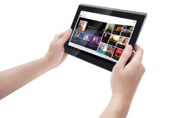
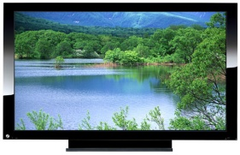
Usage Model 3– Mobile Offloading and Tri-band offloading
WiFi Offloading
Based on an analysis [1], by the end of 2013 there exist about 1.4-billion smart phones and 420-million tablets used worldwide.
Mobile devices like smart phones and tablets may operate multiple functions (call, internet access, data transfer and/or video streaming etc.) simultaneously, some of which require very high data rate transmission.
WiFi can offload high-speed data through the 60 GHz band and relatively low-speed data through the 2.4/5 GHz bands.
Individual mobile users require good user experience with low mobility and/or a change of gesture.
Cellular
Offloading (60GHz)
Offloading (2.4/5GHz)
Mobile Display
3D, HD
Uncompressed video
[1] http://www.businessinsider.com/smartphone-and-tablet-penetration-2013-10

Slide 9
Usage Model 4: Wireless Backhaul
Pre-Conditions:
The NG 60 interfaces are employed for the inter-building communication in order to save the cost of fiber optics installation
Application:
The Wireless Backhaul could be used for WAN/MAN deployment in lieu of expensive fiber networks to inter-connect offices, data centers and many other IT applications. However the NG60 backhaul link is subject to many environmental and distance constraints
The data transfers at ~30 Gbps with link aggregation, High reliability (99.99%) and availability
Environment:
Devices are operating in outdoor environment with LOS. Distance between buildings are <500m
Traffic Conditions:
Potential interference from environmental factors and obstruction of the LOS, beam unalignment
Use Case:
Company A has multiple tenant office in downtown where they need to get the IT operation as regular LAN business, and getting the fiber optics are prohibitively expensive
They install the NG 60 antennas on the roof tops to form a point to point wireless backhaul as the MAN connectivity.
In case of rain or snow or somehow one link is disconnected, without any manual restoration of the links, the NG 60 backhaul automatically find alternative link

Slide 10


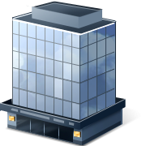



Usage Model 4: Wireless Backhaul
Building to Building in LOS (Line of Sight) and the NG60 based antenna installed on the roof tops and aligned precisely.
Requirements
- Provides full rate 30+Gbps , less than 300m
@60Ghz band
-Low latency <50usec
- Highly secure
- All outdoor installation is subject to the environmental effects (rain/fog/snow) and altitude /temperature effects
- Quick auto re- connectivity in response to the obstructions in LOS (trees, light poles, birds etc)
- 99.999% of high availability
- Complies with FCC regulations
Applications
  High Capacity WAN/MAN from POPs to nearby building
  Campus LAN between buildings for low cost
  Centralized IT, VPNs, Video Conferencing
  As backup path for Fiber connectivity.
[1] FCC Part 15

Slide 11
Usage Model 5: Video Kiosk
Pre-Conditions:
Movie and Music rental is becoming more popular but the length of waiting time for a downloading is not really ideal for the passengers at the airport or train station which has very little time to wait
Application:
Passengers tend to download a couple of UHD movies to his/her tablet/laptop before boarding. As the service kiosk, it has to support multiple user simultaneous downloading
The data transfers at ~30 Gps with link aggregation, the downloading time <1sec
Environment:
Devices are operating in indoor / outdoor environment in proximity with the devices. Distance between buildings are <10m
Traffic Conditions:
Potential interference from environmental factors and obstruction of the LOS.
The devices might be stationary or might be used with low-mobility during usage.
Use Case:
Passenger A is ready to board and realizes he wants to get some UHD movies and music for the next 15 hours of flight
The Multimedia Kiosk is just 5 meters from him, he just tap the connect with the Kiosk and searched the titles
He decides to download 5 movies
Also in his back, another passenger B is also using the same service.
Once the movie download is finished in 1sec, he is ready to hop on to the plane.

Slide 12
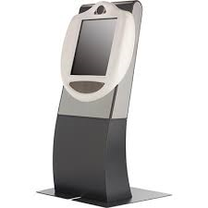




Usage Model 5: Video Kiosk @ Airport
Multimedia Kiosk for super-fast HD Movie/ music downloading and streaming
Kiosk are for the passengers who is short of time for waiting for the movie downloading before boarding
Requirements
- Provides full Super HD (4K) movie and HD music downloading /streaming at speed of 30+ Gbps for less than 1 sec
- Fast association and authentication for “Tap-and –Go” user experience.
- Distance should be of 0-10 meters range with multiple (>=2) simultaneous downloading. (Over a single beam or collections of beams)
- Highly secure to protect user’s privacy (Payment, Contents etc)
Applications
  Redbox Movie Rental
  Airport , Train station Video/music/ebook kiosk

Slide 13
Usage Model 6: Video/Mass-Data Distribution/Video on Demand System
Pre-Conditions:
The NG60 interfaces are deployed in ceilings of large room/space.
Multiple users have NG60 connectivity between user-devices (fixed or portable) and The NG60 interfaces.
Application:
The HD video/mass-data information can be distributed to the individual users simultaneously (broadcast). For example, there are multiple screens that show the same video in a exhibition or gymnasium. Students watch the same courseware on the screen of their own device.
Users can use VOD system to watch moves/videos in which they are interested.
Environment:
Environment can be highly variable, e.g. crowded public place, classroom, waiting room at train station/airport, in flight, train, ship, bus, exhibition, gymnasium, etc.
A ceiling installation for NG60 AP is recommended because the mm-wave links might be easily blocked by obstacles such as furniture, human body on the floor.
The device can be a potable or mobile device, or can be fixed deployed such as large-screen TV, touch screens in the back of the seat in flight/train, etc.
Transmissions can be LOS or NLOS. Distance between far corners of the room are <100m.
Traffic Conditions:
One or more devices can access to a NG60 interface to form a service set. Multiple links and data streams have varying QoS, reliability, and throughput requirements, some with simply best-effort rates (downloading), others with a certain data rate and QoS requirements(video, VoIP, etc.)
Data steam can be broadcast (one point to multiple point).
The devices might be stationary or might be used with low-mobility during usage.
Use Case:
One or more communication links are set up between user devices and NG60 interfaces.
Users receive the same video/massive-data in broadcast mode or request video/video gaming/audio via VOD system respectively.
Rob Sun, Huawei

Slide 14
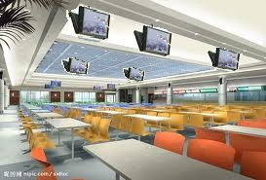
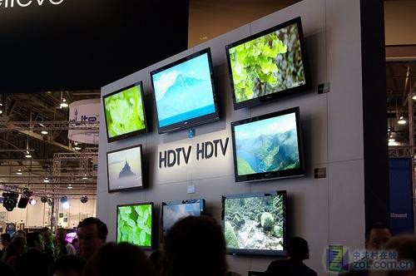
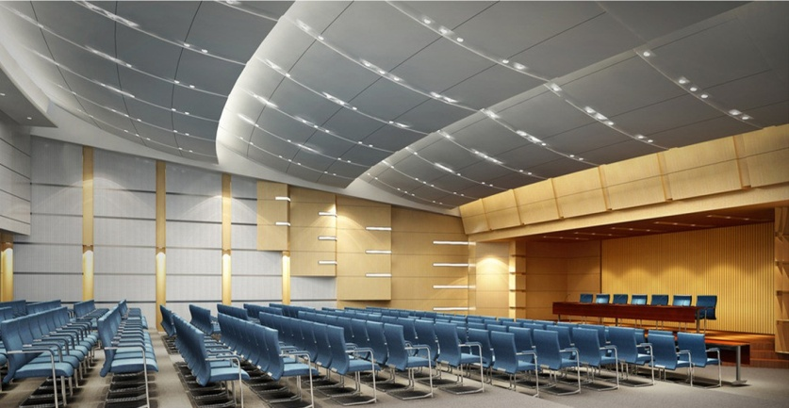
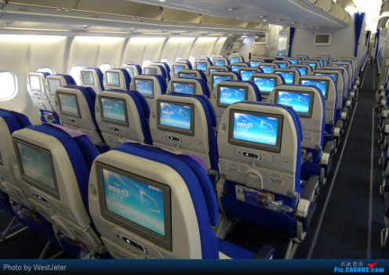
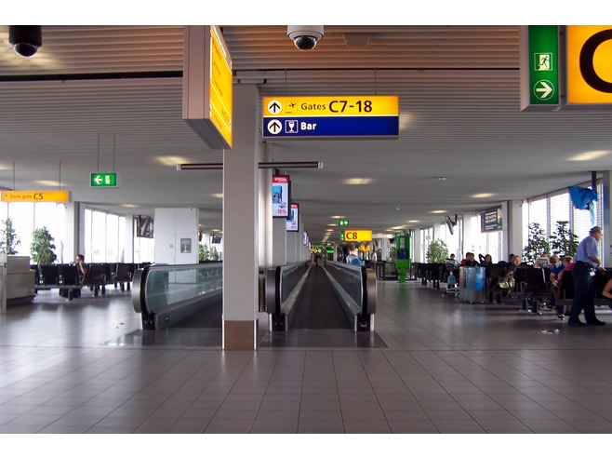
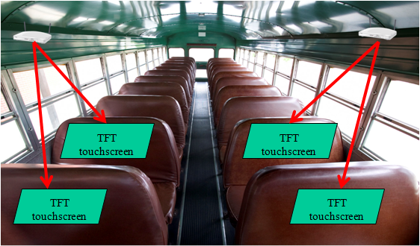
Usage Model 7: Video/Mass-Data Distribution/Video on Demand System
APs are located in ceilings and seats.
Users interact with AP through touch screens in front of them or wireless controllers.
Video streaming, VOD, video gaming, audio, downloading courseware in classroom, etc.
HD-Video distribution in dining-hall, exhibition etc.; in-Flight/Train/Ship/Bus entertainment.[1]
[1] https://mentor.ieee.org/802.11/dcn/14/11-14-0606-00-0wng-next-generation-802-11ad.pptx
Dining-Hall
Exhibition
NG60 AP
Conference Hall
Flight
NG60 AP
Airport Lounge
Bus
Rob Sun, Huawei

Slide 15
Usage Model 7: Wireless Access with roaming devices
Pre-Conditions:
A number of NG60 APs forms a cluster of dense small cells to provide indoor/outdoor users with high throughput access for temporary users.
Application:
Users in an outdoor environment can access some online multimedia services when waiting in a bus stop, or wandering in a tour street/plaza through NG60 AP in the surrounding. A number of users can simultaneously access network to download large size files in a large indoor room.
The data transfers at ~30 Gbps, the coverage of each AP is up to 50m.
Environment:
Devices are operating in both outdoor and indoor environment with some potential obstruction objects or interference from other sources.
Traffic Conditions:
Potential interference from environmental factors and obstruction of the LOS
Use Case:
A is a taxi driver whose car is equipped with the smart device which supports both Cellular and WiFi through the NG60 interface to playback the real time TV/movie/news to the passengers
In most of the driving speed, the streaming contents are through the cellular interface.
When the taxi is idled/parked or slow driving through some small cell coverage area (i.e under a light pole), the smart device will cut off the traffic and switch to the NG60 interface in order to utilize the higher throughput to be able to cache more contents for playback smoothly.

Slide 16
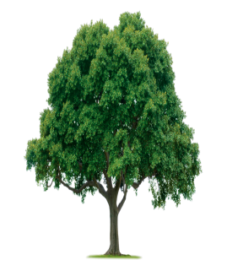


Usage Model 7: Wireless Access with roaming devices
Scenario:
A number of NG60 APs are co-located with public facilities to form a cluster of dense small cell. A typical scenario is a tour street with lots of lamp poles deployed on the side in an urban city.
The AP is co-located with street lamp pole to provide access for users, the access channel with AP could be LOS or N-LOS
The backhaul link between APs is connected by 60GHz via LOS channel.
The distance between APs is less than 100m.
The potential N-LOS impediment may come from foliage, cars, pedestrians, etc.
Backhaul @60GHz
NG60 AP
NG60 AP
N-LOS Access
LOS Access
BUS STOP
Outdoor Scenario

Slide 17
Video Requirements Summary
Video Compression |  | Description | Rate, Mbps | Packet Error Rate | Jitter, ms | Delay,ms
Uncompressed | 720p | (RGB): 1280x720 pixels, 24bits/pixels,60frames/s | 1300 | 1e-8 | 5 | 5
 | 1080i | (RGB): 1920x1080/2pixels, 24bits/pixels,60frames/s | 1300 | 1e-8
 | 1080p | (YCrCb): 1920x1080 pixels, 12bits/pixels,60frames/s | 1500 | 1e-8
 | 1080p | (RGB): 1920x1080 pixels, 24bits/pixels,60frames/s | 3000 | 1e-8
4K UHD (Uncompressed) | 2160p | (RGB) 3840x2160 pixels 24 bits/pixels, 60frames/s | 6000 | 1e-8
8K UHD (Uncompressed) | 4320p | (RGB) 7680x4320pixels 24 bits/pixels, 60frames/s | 12000 | 1e-8
Lightly Compressed |  | Motion JPEG2000 | 150 | 1e-7 | 10 | 10
Compressed |  | Blu-ray™ | 50 | 1e-7 | 20 | 20
 |  | HD MPEG2 | 20 | 3e-7 | 20 | 20
17

