Slide 1
Measurements on A-MPDU performances under various channel conditions
Date: 2014-09-15
Authors:

Slide 2
Motivations for A-MPDU Experiments
SK Telecom is operating approx. 130,000 Wi-Fi hotspots in Korea
Severe throughput degradation is observed in some hotspots installed at crowded sites,
  even though AP-STA has a good channel condition (i.e., high RSSI, Line-of-Sight)
On those hotspots, we could increase throughputs by reducing the max A-MPDU aggregation size below 64
In this contribution, we evaluate performances of A-MPDU under various channel conditions. Also, several observations regarding interplay of parameters and algorithms around A-MPDU aggregation are provided.

Slide 3
A-MPDU
Channel
Contention
PHY HDR
DATA1
DATA2
DATA1
DATA2
Block Ack
ACK
ACK
BA
SIFS
SIFS
Normal DATA/ACK exchange
A-MPDU/BA exchange
(Implicit BA policy)
A-MPDU increases MAC efficiency by sending multiple aggregated MPDUs when the channel is acquired
A-MPDU can aggregate up to 64 MPDUs
  All MPDUs are addressed to the same receiver and modulated with the same MCS
  MPDU delimiter is added to each MPDU with self-CRC protection
  Receiver acknowledges each subframe with one Block Ack message

Slide 4
A-MPDU’s Maximum Limits in 11ac [1]
4B
MAC HDR
(A-)MSDU
FCS
4B
0~3B
MPDU
delimiter
MPDU
Pad
Max MPDU Length: (11,454B)
- 3895, 7991, or 11,454
- limited by FCS’s error detecting capability
MPDU Length
PHY HDR
MPDU
subframe 1
MPDU
subframe 2
…
MPDU
subframe N
Max A-MPDU Aggregation : (64)
- limited by Block Ack’s window limit
A-MPDU Length/Duration
Max A-MPDU Duration: (5.46ms)
- for protection of A-MPDU from legacy STAs
- limited by L-SIG Rate/Length field
Max A-MPDU Length: (1,048,575B)
- 8191, 16383, 32767, 65535, 131071, 262143, 524287, or 1,048,575
In our experiments,
  we changed the Max A-MPDU aggregation size (N) as the tuning knob,
  and the maximum A-MPDU size that we generated was around 100 KB,
  and each A-MPDU’s airtime reached the max duration (5.46ms) in many cases.

Slide 5
Experiment Settings
Experiment Settings
  Place-1: RF Shield Room @SKT
  Place-2: Seoul Railway Station
  Access Point
    802.11 ac @5GHz
    20/40/80MHz
    20dBm TX power
  STA (Galaxy S 4)
    802.11ac @5GHz
  Traffic
    Chariot Server, TCP DL full buffer
    Most MPDU’s size was 1590 Bytes
    For each traffic capture file, analysed the middle 18 sec traces
  Traffic Capture: Wireshark 10.8.2
  IEEE 802.11
    1x1 SISO
    No A-MSDU
    RTS/CTS ON
    AP’s TX Max A-MPDU aggregation size was changed
    (no changes on STA side)
Parameters | Shield Room | Seoul Railway Station
RSSI | High (~ -40dBm) | Mid (~ -50dBm)
 | Low (~ -65dBm)
Population Density | - | High
 |  | Low
BW | 20, 40, 80 | 20*
Max A-MPDU Aggregation (N) | 1, 8, 16, 32, 64 | 1, 8, 16, 32, 64
*could not secure clear 40/80 MHz BW due to many OBSS 11ac APs

Slide 6
Shield Room - High RSSI (20/40/80MHz)
trace analysis
on the next slide
Experiments
  Inside shield room, AP-STA are located close to each other (-35~-40 dBm RSSI on STA)
  Measured STA’s DL throughput by changing AP’s Max A-MPDU aggregation (N) under 20/40/80 BW
Results
  Throughput was maximized when N is limited to 16 @20/40/80 MHz
  Analysis of throughput changes on N=16, 32 @80MHz is provided in the next slide

Slide 7
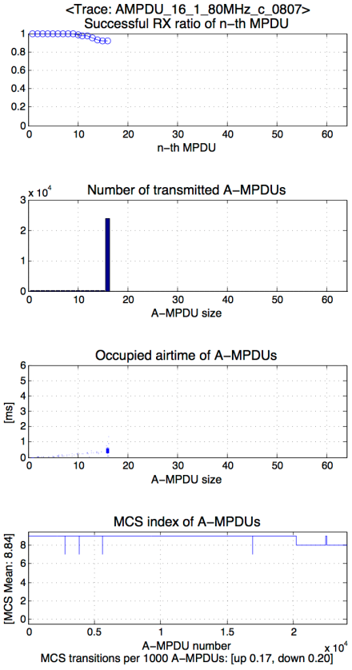
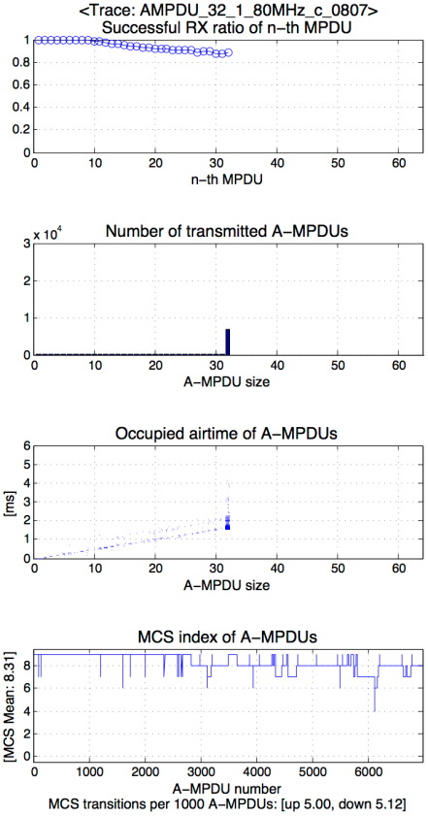
Shield Room – High RSSI (N=16, 32 @80MHz)
N=16
N=32
Within A-MPDU, the latter MPDUs had higher RX failure ratio
Most A-MPDUs were transmitted with the max aggregation size
(16, 32 was the limiting factor)
MCS Mean decreased with bigger max aggregation size (N)
MCS fluctuated with bigger max aggregation size (N)

Slide 8
Shield Room – Low RSSI (20/40/80MHz)
trace analysis on the next slide
Experiments
  Inside shield room, AP’s equipped with attenuator to lower TX power (-60~-65 dBm RSSI on STA)
  Measured STA’s DL throughput by changing AP’s Max A-MPDU aggregation (N) under 20/40/80 BW
Results
  Throughput was maximized when N is limited to 16@20/80MHz, and to 32@40MHz
  Analysis of throughput changes on N=16, 64@80MHz is provided in the next slide

Slide 9
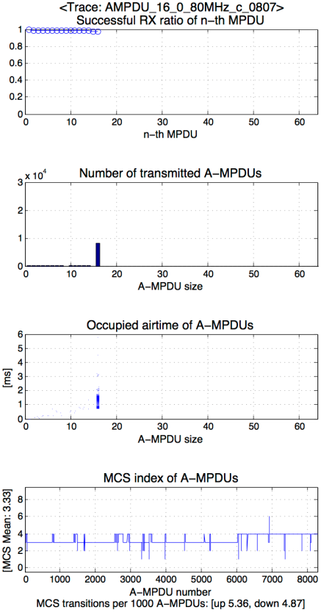
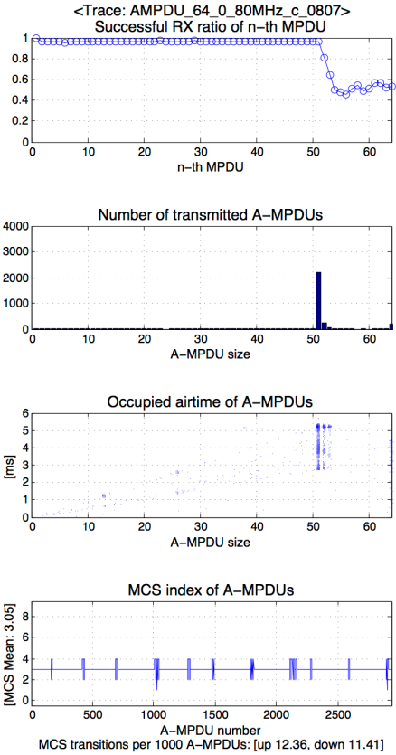
Shield Room – Low RSSI (N=16, 64@80MHz)
N=16
N=64
Within A-MPDU, the latter MPDUs had higher RX failure ratio
(more severe in Low RSSI)
[N=16] Most A-MPDUs were transmitted with the max aggregation size
(16 was the limiting factor)
[N=64] Many A-MPDUs occupied similar airtime with the max duration
(5.46ms was the limiting factor)
MCS Mean decreased with bigger max aggregation size (N)
MCS fluctuated with bigger max aggregation size (N)

Slide 10
Observations for Throughput degradations
Observation. 1 – Unequal MPDU subframe error rate
  Within A-MPDU, the latter MPDUs had higher error rate
  Preamble-based channel estimation may not perform well for the latter MPDUs
  We may need to study how to protect transmission of longer frames for 11ax
Observation. 2 – MCS affected by the max aggregation size
  MCS decreased with the bigger max aggregation size (N)
  MCS fluctuated with the bigger max aggregation size (N)
  From the Observation 1, more aggregated A-MPDUs will have higher chance of receiving Block Acks with partial bitmap
  The partial bitmap (any “0” in bitmap) can trigger link adaptation algorithm on sender STA to lower MCS
  This explains why limiting the aggregation size could increase throughputs by limiting excessive link adaptations in some cases

Slide 11
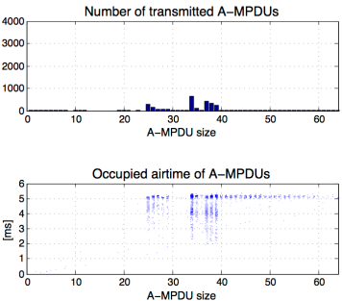
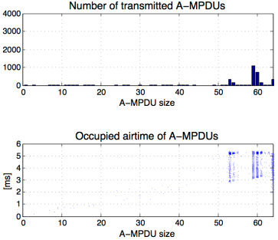
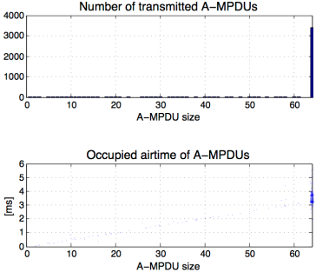
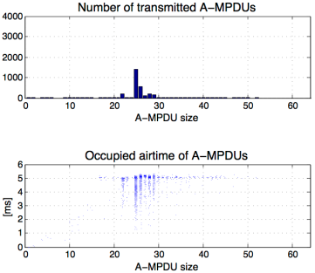
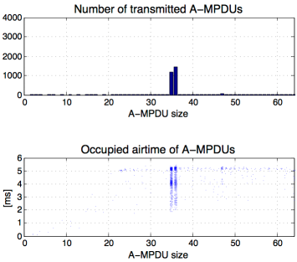
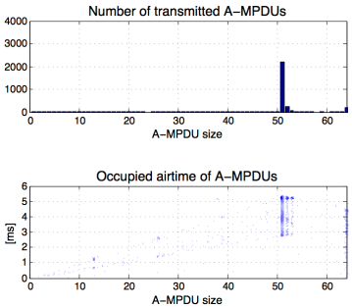
Shield Room – Comparisons (N=64)
High RSSI, 20MHz
High RSSI, 40MHz
High RSSI, 80MHz
Duration (5.46ms)
-limited
Duration (5.46ms)
-limited
AMPDU
(N=64)
-limited
Low RSSI, 20MHz
Low RSSI, 40MHz
Low RSSI, 80MHz
Duration (5.46ms)
-limited
Duration (5.46ms)
-limited
Duration (5.46ms)
-limited

Slide 12
Observations for A-MPDU’s limiting factor
Observation. 3 – Max 64 aggregation was the limiting factor at high rates
  Under High RSSI and Wide BW, throughput was limited by the 64 aggregations
  In this case, enabling A-MSDU on top of A-MPDU is helpful
  (11ax’s simulation scenario[2] does not enable A-MSDU)
  We may need to study increasing the max MPDU aggregation sizes for 11ax
Observation. 4 – Max 5.46ms duration was the limiting factor at low rates
  Under Low RSSI and Narrow BW, throughput was limited by the 5.46ms duration
  This is the hard-limit calculated from L-SIG’s rate/duration field (legacy effect)
  Under frequency division multiple access, each STA would require longer frame duration within a narrow subband
  We may need to study increasing the max MPDU duration for 11ax

Slide 13


Railway Station – Population Density (P/D)
AP
AP
Population density variation
`
STA
5m
STA
1.5m
11m
Low Population Density example
Low Population Density
  Normal status between train arrivals
High Population Density
  After a train arrives at the platform, we could obtain continuously high population density for 1~2 minutes
  Due to the height of the AP, it is noted that LoS path bet’n AP-STA was secured even with high population density.
AP
High Population Density example

Slide 14
Railway Station – Low & High P/D (20MHz)
trace analysis
on slide 15
trace analysis
on slide 16
Experiments
  AP-STA are located 11 meters away with dynamic population density (-50~-55 dBm RSSI on STA)
  Measured STA’s DL throughput by changing AP’s Max A-MPDU aggregation size under 20MHz BW
Results
  Throughput degraded with high population density while RSSI values were not changed much
  Throughput was maximized when N=8, but it was sharply decreased with bigger N in High P/D

Slide 15
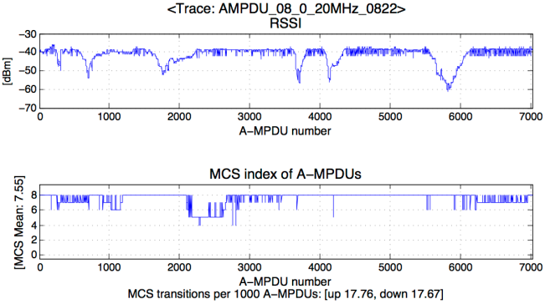
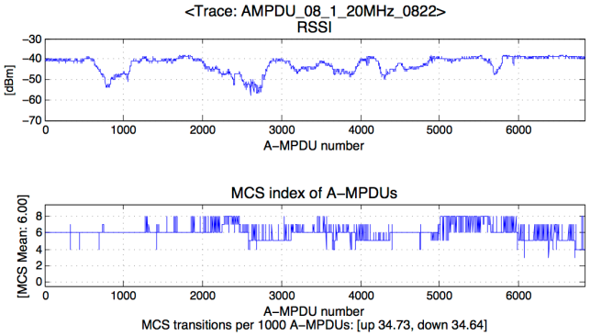
Railway Station – Population density effect
RSSI
Low P/D
Observation. 5 – Population density effect
  High population density incurs more channel variations, which result MCS fluctuations
  Our result complements [2][3] in that high population density can still affect performances even without direct human body blockages.
High P/D

Slide 16
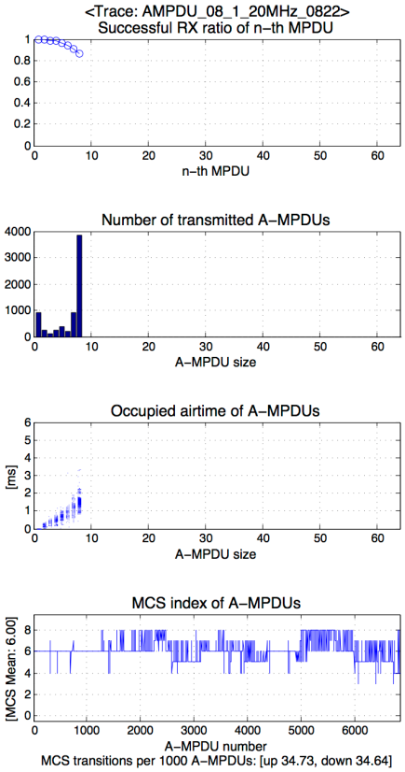
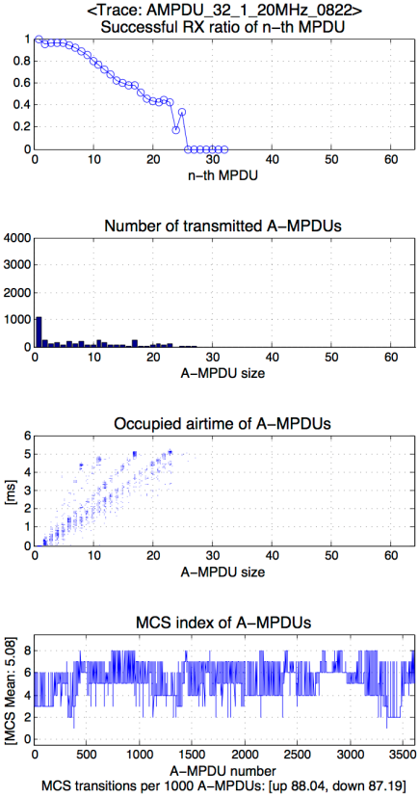
Railway Station – High P/D (N=8, 32 @20MHz)
N=8
N=32
Within A-MPDU, the latter MPDUs had higher RX failure ratio
(more severe in High P/D)
[N=8] Most A-MPDUs were transmitted with the max aggregation size
(8 was the limiting factor)
[N=32] Many A-MPDUs occupied airtime up to the max duration
(5.46ms was the limiting factor)
MCS Mean decreased with bigger max aggregation size (N)
MCS fluctuated with bigger max aggregation size (N)

Slide 17
Conclusions
In this contribution, we provided measurements of A-MPDU performances under various channel conditions, bandwidths, and population densities.
The more MPDUs are aggregated, the more frequent link adaption is triggered, due to higher error rates in the latter MPDUs.
Under high traffic volumes that 11ax should support,
  “64 MPDU aggregation” and “5.46ms duration” could play as the limiting factor in wide band and narrow subband respectively.
Like 11n and 11ac, 11ax should also enhance the frame aggregation feature considering both the current limitations and the new requirements.

Slide 18
Straw poll
Do you agree that 11ax should enhance the current frame aggregation feature?
  Y
  N
  A

Slide 19
References
[1] 11-10/1079r1 Max Frame Sizes
[2] 11-10/0980r2 Simulation Scenarios
[3] 11-14/0112r1 Wi-Fi interference measurements in Korea – Part II
[4] 11-14/0113r1 Modeling of additional channel loss in dense WLAN environments

