Slide 1
Measurements on A-MPDU performances under various channel conditions
Date: 2014-09-15
Authors:

Slide 2
Motivations for A-MPDU Experiments
SK Telecom is operating approx. 130,000 Wi-Fi hotspots in Korea
Severe throughput degradation is observed in some hotspots installed at crowded sites,
  even though AP-STA has a good channel condition (i.e., high RSSI, Line-of-Sight)
On those hotspots, we could increase throughputs by reducing the max A-MPDU aggregation size below 64
In this contribution, we evaluate performances of A-MPDU under various channel conditions. Also, several observations regarding interplay of several parameters and algorithms around A-MPDU aggregation are provided.

Slide 3
A-MPDU
Channel
Contention
PHY HDR
DATA1
DATA2
DATA1
DATA2
Block Ack
ACK
ACK
BA
SIFS
SIFS
Normal DATA/ACK exchange
A-MPDU/BA exchange
(Implicit BA policy)
A-MPDU increases MAC efficiency by sending multiple aggregated MPDUs when the channel is acquired
A-MPDU can aggregate up to 64 MPDUs
  All MPDUs are addressed to the same receiver and modulated with the same MCS
  MPDU delimiter is added to each MPDU with self-CRC protection
  Receiver acknowledges each subframe with one Block Ack message

Slide 4
A-MPDU’s Maximum Limits in 11ac [1]
4B
MAC HDR
(A-)MSDU
FCS
4B
0~3B
MPDU
delimiter
MPDU
Pad
Max MPDU Length: (11,454B)
- 3895, 7991, or 11,454
- limited by FCS’s error detecting capability
MPDU Length
PHY HDR
MPDU
subframe 1
MPDU
subframe 2
…
MPDU
subframe N
Max A-MPDU Aggregation: (64)
- limited by Block Ack’s window limit
A-MPDU Length/Duration
Max A-MPDU Duration: (5.46ms)
- for protection of A-MPDU from legacy STAs
- limited by L-SIG Rate/Length field
Max A-MPDU Length: (1,048,575B)
- 8191,16383,32767,65535,131071,262143,524287, or 1,048,575
In the following experiments, we found that reducing the Max A-MPDU Aggregation (N) below 64 could increase throughputs in some cases.
With analysis on packet traces, we provide our observations on possible reasons for that.

Slide 5
Experiment Settings
Experiment Settings
  Place-1: RF Shield Room @SKT
  Place-2: Seoul Railway Station
  Access Point
    802.11 ac @5GHz
    20/40/80MHz
    20dBm TX power
  STA (Galaxy S 4)
    802.11ac @5GHz
  Traffic
    Chariot Server, TCP DL traffic only, 18sec duration
  Traffic Capture: Wireshark 10.8.2
  IEEE 802.11
    RTS/CTS ON
    1x1 SISO
    AP’s TX Max A-MPDU aggregation size was changed
    (no changes on STA side)
Parameters | Shield Room | Seoul Railway Station
RSSI | High (~40dBm) | Mid (~50dBm)
 | Low (~65dBm)
Population Density | Zero | High
 |  | Low
BW | 20, 40, 80 | 20*
Max A-MPDU Aggregation (N) | 1, 8, 16, 32, 64 | 1, 8, 16, 32, 64
*could not experiment 40/80 MHz BW
due to many 11ac APs in Seoul station

Slide 6
Shield Room - High RSSI (20/40/80MHz)
trace analysis on the next slide
Experiments
  Inside shield room, AP-STA are located close to each other (-35~-40 dBm RSSI on STA)
  Measured STA’s DL throughput by changing AP’s Max A-MPDU aggregation (N) under 20/40/80 BW
Results
  Throughput was maximized when N is limited to 16 @20/40/80 MHz
  Analysis of throughput changes on N=16, 32 @80MHz is provided in the next slide

Slide 7
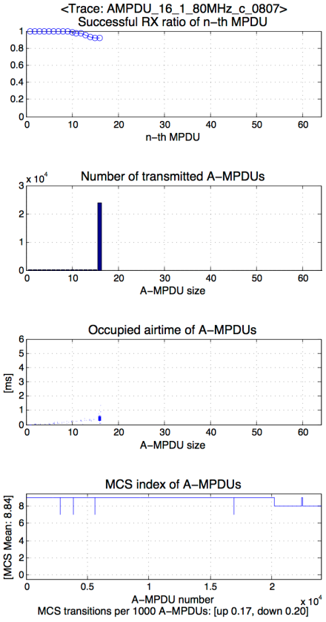
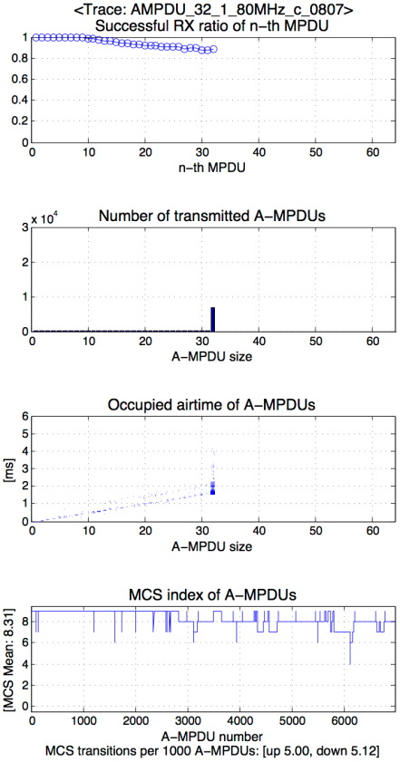
Shield Room – High RSSI (N=16, 32 @80MHz)
Within A-MPDU, the latter MPDUs had higher RX failure ratio
Most A-MPDUs were transmitted with the max aggregation size
(16, 32 was the limiting factor)
A-MPDUs occupied smaller airtime than the max duration
MCS Mean decreased with bigger max aggregation size (N)
MCS fluctuated with bigger max aggregation size (N)

Slide 8
Shield Room – Low RSSI (20/40/80MHz)
trace analysis on the next slide
Experiments
  Inside shield room, AP’s equipped with attenuator to lower TX power (-60~-65 dBm RSSI on STA)
  Measured STA’s DL throughput by changing AP’s Max A-MPDU aggregation (N) under 20/40/80 BW
Results
  Throughput was maximized when N is limited to 16@20/80MHz, and to 32@40MHz
  Analysis of throughput changes on N=16, 64@80MHz is provided in the next slide

Slide 9
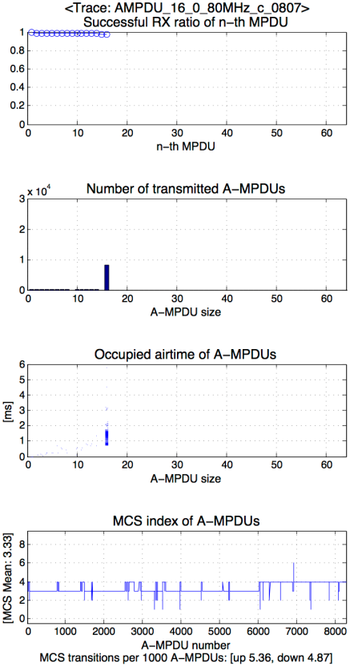
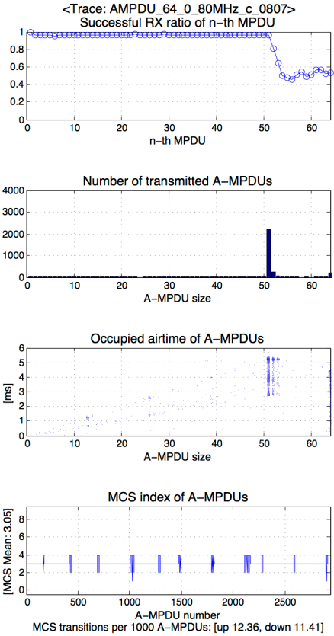
Shield Room – Low RSSI (N=16, 64@80MHz)
Within A-MPDU, the latter MPDUs had higher RX failure ratio
(more severe in Low RSSI)
(N=16) Most A-MPDUs were transmitted with the max aggregation size
(16 was the limiting factor)
(N=64) Most A-MPDUs were transmitted with smaller sizes than the max aggregation size
(N=16) A-MPDUs occupied smaller airtime than the max duration
(N=64) Many A-MPDUs occupied similar airtime with the max duration
(5.46ms was the limiting factor)
MCS Mean decreased with bigger max aggregation size (N)
MCS fluctuated with bigger max aggregation size (N)

Slide 10
Observations for Throughput degradations
Observation 1 – Unequal MPDU subframe error rate
  Within A-MPDU, the latter MPDUs had higher error rate
  Preamble-based channel estimation may not perform well for the latter MPDUs
Observation 2 – MCS varies with aggregation size
  MCS decreased with bigger max aggregation size (N)
  MCS fluctuated with bigger max aggregation size (N)
  From the Observation 1, more aggregated A-MPDUs will have higher chance of receiving Block Acks with partial bitmap
  The partial bitmap (any “0” in bitmap) can trigger link adaptation algorithm on sender STA to lower MCS
  Also, it can trigger exponential backoff at sender STA
  Therefore, limiting the aggregation size may increase throughputs in some case

Slide 11
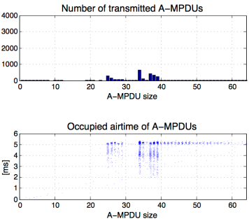
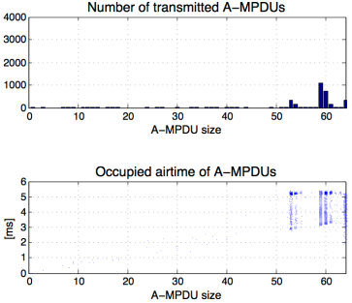
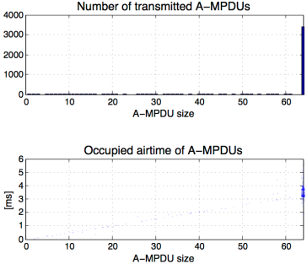
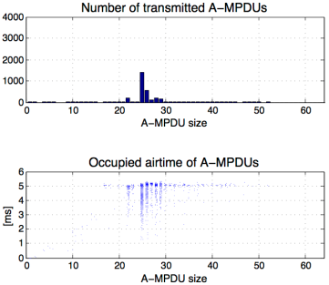
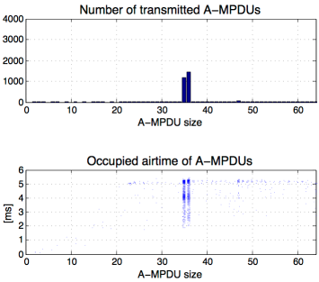
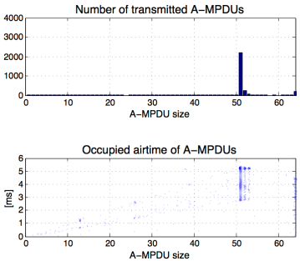
Shield Room – Comparisons (N=64)
High RSSI, 20MHz
High RSSI, 40MHz
High RSSI, 80MHz
Duration (5.46ms)
-limited
Duration (5.46ms)
-limited
AMPDU
(N=64)
-limited
Low RSSI, 20MHz
Low RSSI, 40MHz
Low RSSI, 80MHz
Duration (5.46ms)
-limited
Duration (5.46ms)
-limited
Duration (5.46ms)
-limited

Slide 12
Observations for A-MPDU’s limiting factor
Observation 3 – Max 64 aggregation was the limiting factor at high rates
  Under High RSSI and Wide BW, throughput was limited by the max 64 aggregations
Observation 4 – Max 5.46ms duration was the limiting factor at low rates
  Under Low RSSI and Narrow BW, throughput was limited by the 5.46ms duration

Slide 13


Railway Station – Population Density (P/D)
AP
AP
Population density variation
`
STA
5m
STA
1.5m
11m
Low Population Density example
Low Population Density
  Normal status between train arrivals
High Population Density
  After a train arrives at the platform, we could obtain continuously high population density for 1~2 minutes
  From the height of the AP, it is noted that LoS path bet’n AP-STA was secured even with high population density.
AP
High Population Density example

Slide 14
Railway Station – Low & High P/D (20MHz)
analysis on the slide 15
analysis on the slide 16
Experiments
  AP-STA are located 11 meters away with dynamic population density (-50~-55 dBm RSSI on STA)
  Measured STA’s DL throughput by changing AP’s Max A-MPDU aggregation size under 20MHz BW
Results
  Throughput maximized when N is limited to 8 @ Low & High P/D
  Analyses of throughput changes according to P/D and N are provided in the next slides

Slide 15
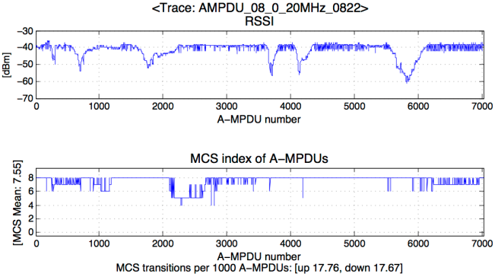
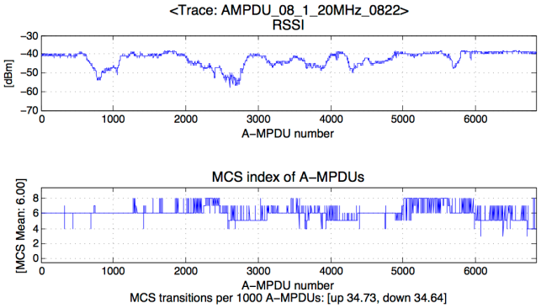
Railway Station – Population density effect
RSSI
Observation 5 – Population density effect
  High population density incurs more channel variations, which incur MCS fluctuations
  Our result complements [2][3] that population density can still affect performances even without direct human body blockages.
Low
P/D
High
P/D

Slide 16
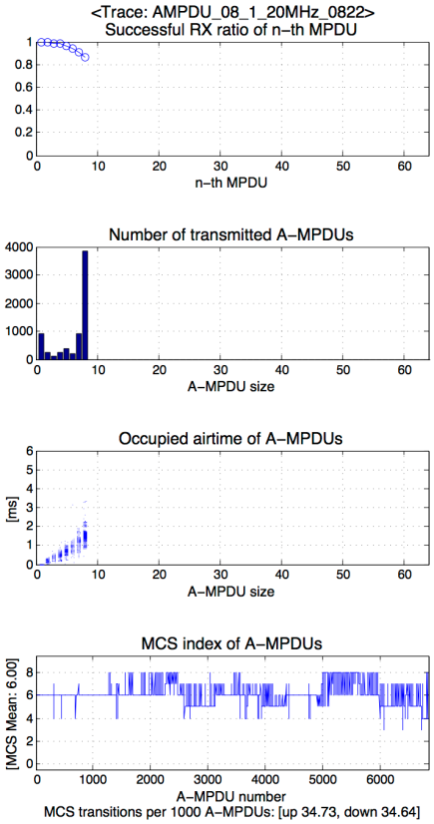
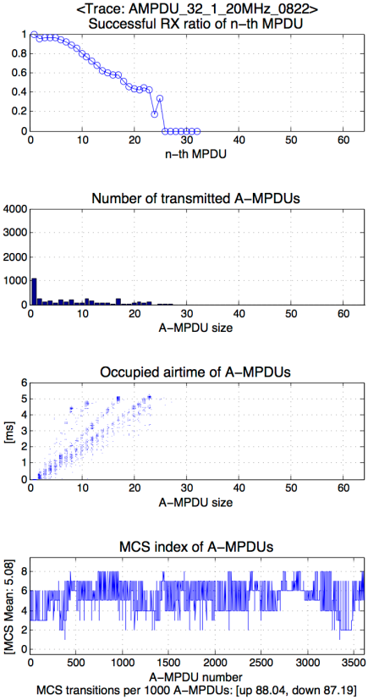
Railway Station – High P/D (N=8, 32 @20MHz)
Within A-MPDU, the latter MPDUs had higher RX failure ratio
(more severe in High P/D)
(N=8) Most A-MPDUs were transmitted with the max aggregation size
(8 was the limiting factor)
(N=32) Most A-MPDUs were transmitted with smaller sizes than the max aggregation size
(N=8) A-MPDUs occupied smaller airtime than the max duration
(N=32) Many A-MPDUs occupied airtime up to the max duration
(5.46ms was the limiting factor)
MCS Mean decreased with bigger max aggregation size (N)
MCS fluctuated with bigger max aggregation size (N)

Slide 17
Conclusions
In this contribution, we provided performance measurements of A-MPDU under various channel conditions, bandwidths, and population densities.
When many MPDUs are aggregated, we observed that frequent link adaption is triggered from the partial bitmap Block ACK which lowers throughputs.
Also, it is noted that “64 aggregation” and “5.46ms duration” could play as the limiting factor in high and low rate transmissions respectively.
Like 11n and 11ac, 11ax should also enhance the frame aggregation feature considering both the current limitations and the new requirements.

Slide 18
References
[1] 11-10/1079r1 Max Frame Sizes
[2] 11-14/0112r1 Wi-Fi interference measurements in Korea – Part II
[3] 11-14/0113r1 Modeling of additional channel loss in dense WLAN environments

