Slide 1
Discussions on Interference between TD-LTE & WLAN around 2.4GHz Band
Date: 2014-09-15
Authors:
Name | Affiliation | Address | Email
Meng Yang | CATR |  | yangmeng1@catr.cn
Bo Sun | ZTE |  | sun.bo1@zte.com.cn
Dapeng Liu | China Mobile |  | liudapeng@chinamobile.com
Zhenqiang Sun | China Telecom |  | sunzhq@ctbri.com.cn
Dong Zhao | China Telecom |  | zhaodong@ctbri.com.cn
Feng Li | CATT |  | lifeng@catt.cn
Ying Zhu | CATR |  | zhuying@catr.cn
Xiang Yun | CATR |  | yunxiang@catr.cn
Zhendong Luo | CATR |  | luozhendong@catr.cn
Jiadong Du | CATR |  | dujiadong@catr.cn

Slide 2
Motivation
There is interference issue between TD-LTE system and WLAN system around 2.4GHz$.^{[1]}$ Interference from TD-LTE system gives rise to the WLAN performance degradation.
This contribution presents the initial testing results of the interference between WLAN AP (in band 2400-2483.5MHz) and TD-LTE BS (in band 2370-2390MHz) to the 802.11ax TG for consideration.

Slide 3
Outlines
Background
Deterministic analysis of MCL (minimum coupling loss)
Interference testing
Analysis of test results
Conclusions

Slide 4
Background
The frequency band 2300-2400 MHz:
is identified to IMT by ITU on a global basis (WRC-07)
specified for TDD mode
licensed for indoor usage (TD-SCDMA/TD-LTE) in China
It causes the interference issue when WLAN and TD-LTE are simultaneously operating.
Too Close!!
2300
2400
2483.5
IMT (TDD mode for indoor usage)
WLAN & other ISM
f/MHz

Slide 5
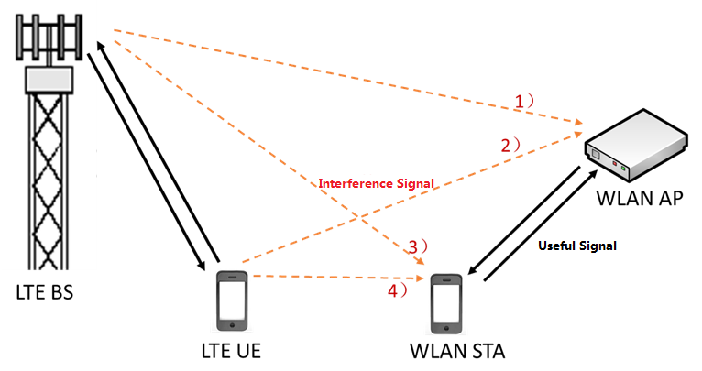
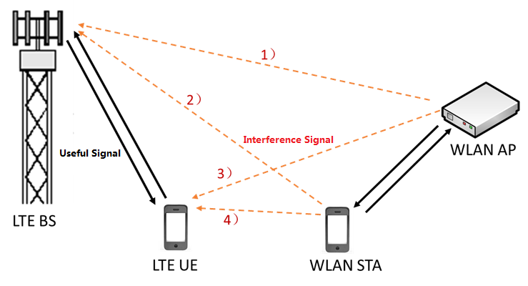
Basic Interference model
Our Testing Item
Interference from TD-LTE to WLAN
Our Testing Item
Interference from WLAN to TD-LTE

Slide 6
Possible causes of interference
Spurious Emission
Unwanted emissions falling in the receiving bandwidth of the victim receiver, which is determined by the spectrum emission mask of the interfering transmitter.
Blocking Interference
Generated by a strong interference signal out of the receive band that makes the receiver work in saturation status and overdrives the receiver to work in non-linear status or even worse, which is determined by the victim receiver.

Slide 7
Testing Conditions
Testing frequency band:
WLAN: 2400-2483.5MHz
TD-LTE: 2370-2390MHz
Testing Scope:
Interference from TD-LTE downlink to WLAN uplink, i.e. TD-LTE BS → WLAN AP
Interference from WLAN downlink to TD-LTE uplink, i.e. WLAN AP → TD-LTE BS
Testing method:
Deterministic analysis on MCL
Interference Testing
Testing scenarios:
Indoor (the operating mode of TD-LTE is indoor distribution)

Slide 8
Deterministic analysis of MCL
The isolation between the coexistence systems is usually expressed as the minimum coupling loss (MCL). MCL is the path loss from interfering transmitter to victim receiver, including antenna gain and feeder loss.
Consider on the impacts of spurious emission
${MCL}_{emission}$=$P_{emission}$- $I_{max}$
Consider on the impacts of blocking interference
${MCL}_{blocking}$=$P_{o}$- $P_{b}$
Consider on the impacts of spurious emission and blocking interference
MCL ≥ Max (${MCL}_{emission}, {MCL}_{blocking}$)
$P_{emission}$: emission of the interfering transmitter
$I_{max}$: maximum interfered level of victim receiver
$P_{o}$: transmitter power of interfering system
$P_{b}$: receiver blocking level of victim system

Slide 9
Parameters for Calculation
TD-LTE BS [4]
TD-LTE UE [3]
Parameters | Value
TX Power (dBm) | 46 (macro cell)
Bandwidth (MHz) | 20
Emission (10MHz) (dBm/MHz) | -15 (macro cell)
Blocking level (dBm) | -43 (macro cell)
Noise figure (dB) | 5
PN (dBm/MHz) | -109
Interference threshold (dBm/MHz) | -116 (I/N = -7dB)
Parameters | Value
TX Power (dBm) | 23
Bandwidth(MHz) | 20
Emission (10MHz) (dBm/MHz) | -13
Blocking level(dBm) | -44
Noise figure（dB） | 9
PN (dBm/MHz) | -105
Interference threshold (dBm/MHz) | -105 (I/N = 0dB)
WLAN AP [2][3]
WLAN STA [2][3]
Parameters | Value
TX Power (dBm) | 27
Emission (10MHz) (dBm/MHz) | -20
Blocking level (dBm) | -40
Interference threshold (dBm/MHz) | -109.4
Parameters | Value
TX Power (dBm) | 20
Emission (10MHz) (dBm/MHz) | -27
Blocking level (dBm) | -40
Interference threshold (dBm/MHz) | -105 (I/N = 0dB)
Note: There is no WLAN Blocking requirements in the standard specifications, the value of blocking level is from vendors.

Slide 10
MCL between LTE BS and WLAN AP
Interference from TD-LTE BS to WLAN AP:[2][3][4][5]
Interference from WLAN AP to TD-LTE BS:[2][3][4][5]
In the indoor distribution scenario, LTE BS and WLAN AP will be not interfered by each other when MCL is ≥65dB, isolation distance is ≥18m.
${MCL}_{emission}$ = -15dBm - (46dBm - 15dBm) - ( -109.4dBm) = 63.4dB
${MCL}_{blocking}$ = 15dBm - ( -40dBm) = 55dB
${MCL}_{emission}$ = -20dBm - ( -116dBm + 46dBm - 15dBm) = 65dB
${MCL}_{blocking}$ = 27dBm - ( -43dBm + 46dBm - 15dBm) = 39dB
LTE BS → WLAN AP | 63.4dB | 55dB
WLAN AP → LTE BS | 65dB | 39dB
Note: In the indoor distribution scenario, consider the output power of the indoor antennas is about 15dBm, the loss of indoor distribution link is 46dBm-15dBm=31dB.

Slide 11
Interference Testing Block Diagram
TD-LTE
Center Frequency: 2380MHz
Bandwidth: 20MHz
WLAN
Center Frequency: 2412MHz (CH1)
Bandwidth: 20MHz
Note: a set of typical TD-LTE and WLAN equipment were chose for testing.

Slide 12
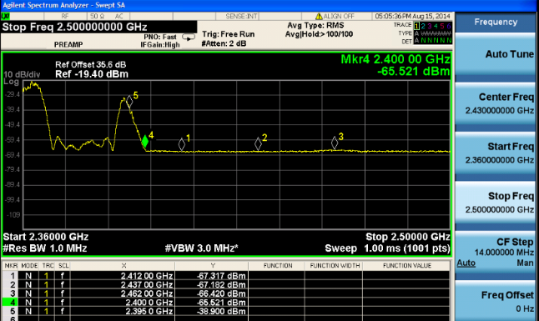
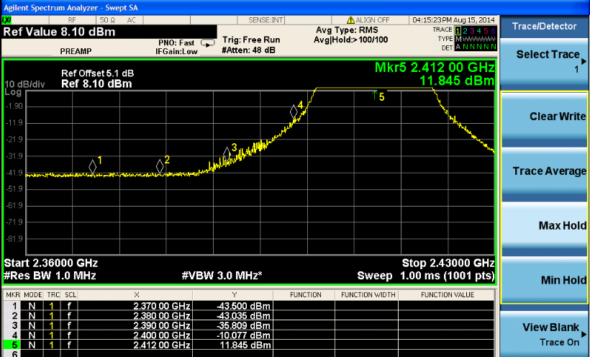
DUT RF performance testing
TD-LTE BS emission
WLAN AP emission
Max $P_{LTE emission}$= -65.5 dBm/MHz in band 2400-2483.5 MHz
Max $P_{WLAN emission}$= -35.8 dBm/MHz in band 2370-2390MHz (CH1)
Blocking level of WLAN AP DUT is around -39dBm.
The testing results of BS and AP DUT RF performance are better than the specification requirements.

Slide 13
Interference Testing Results
Interference from TD-LTE downlink to WLAN uplink (TD-LTE BS → WLAN AP)
WLAN AP will be impacted by TD-LTE BS at the lowest channel of 2.4GHz band. The interference can be avoided only when the distance between LTE BS and WLAN AP is ≥ 7m.
Interference from WLAN downlink to TD-LTE uplink (WLAN AP → TD-LTE BS)
WLAN does not impact TD-LTE system which works in band 2370-2390MHz, even though it works at CH1.

Slide 14
Analysis of Testing Results
Based on the analysis of the interference testing results, the main reason WLAN is affected by interference is blocking in our test.
1
${MCL}_{emission }$= $P_{emission}$- $I_{max}$ = -65.5 dBm -31dB- (-109.4dBm/MHz) = 12.9dB
${MCL}_{blocking}$= $P_{o}$- $P_{b}$ = 15dBm - ( -39dBm) = 54dB
${MCL}_{blocking}$ ˃ ${MCL}_{emission}$
2
Practical testing
Standard requirements
Max $P_{LTE emission}$= -65.5 dBm/MHz (in band 2400-2483.5 MHz)
<<
-15 dBm/MHz (Macro cell)
Notes:
In the case of blocking interference, the required MCL is relatively large.
The spurious emission of TD-LTE is very low, the interference from TD-LTE emission is relatively small.

Slide 15
Conclusions
In the TD-LTE indoor distribution scenario, based on the practical testing results and the deterministic analysis,
the interference will impact WLAN performance at the lowest channel of 2.4GHz band (10MHz Guard Band and MCL˂57dB)
the main reason WLAN is affected by interference is blocking, which is determined by the WLAN receiver
Consider the following solutions
adding blocking requirements in 802.11ax (difficult to evaluate; cost increased)
using other channels (CH6, CH11) or 5GHz Band (spectrum wasted)
This contribution is to trigger discussions on interference of WLAN from TD-LTE systems, further testing and simulations are still in progress. Your contributions on the mechanism for reducing blocking interference is welcome.

Slide 16
References
11-13-1370-00-0hew-oob-emission-issue
IEEE Std 802.11-2012, IEEE Standard for Information technology—Telecommunications and information exchange between systems Local and metropolitan area networks—Specific requirements, Part 11: Wireless LAN Medium Access Control (MAC) and Physical Layer (PHY) Specifications
YDC 079-2009《Technical Specifications and Testing Methods of Wireless LAN for Mobile Terminals》
3GPP 36.101 Table 6.6.2.1.1-1, Table 7.6.1.1-2
3GPP 36.104 Table 6.6.3.2.1-6, Table 6.6.3.2B-3, Table 7.6.1.1-1, Table 7.6.1.1-1b

Slide 17
Backup

Slide 18
2300~2400MHz Allocations
Country | Freq. portion | Status | Application | Duplex method | Block size (MHz)
China | 2300-2400 | Licensed for indoor usage | IMT (TD-SCDMA/TD-LTE) | TDD | -
Korea | 2300-2400 | Commercial roll out | Mobile WiMAX | TDD | 27, 30
Malaysia | 2300-2400 | Commercial roll out | BWA (Mobile WiMAX) | TDD | 30
Singapore | 2300-2350 | Commercial roll out | BWA | TDD | 30/20
Thailand | 2300-2400 | Preparing license award | BWA | TDD
Vietnam | 2300-2400 | Preparing auction | Mobile Network | TDD | 30
New Zealand | 2300-2400 | Licensed | Mobile WiMAX | TDD | 35/25
India | 2300-2400 | 20 + 20MHz: Auction completed | BWA | TDD | 20
Indonesia | 2300-2400 | 30MHz auction Completed 60MHz in preparation for mobile applications | Fixed WiMAX (30MHz) | TDD | 15

