Slide 1
DSC Simulation Results for Scenario 3
Date: 2014/9/15
Authors:

Slide 2
Abstract
Performance improvement and impact on legacy STA of Dynamic Sensitivity Control (DSC) techniques are evaluated under Simulation Scenario 3
Condition to effectively obtain the DSC gain is also analyzed
Some additional techniques to avoid loss of Rx opportunity should be used

Slide 3
Introduction
Dynamic Sensitivity Control (DSC) is an attractive candidates against OBSS interference
Some contributions have shown the improvement and/or the impact to the performance of Legacy STA when DSC techniques are used [1-16]
We have also presented some results in very simplified scenario (2-cell, AMPDU disabled) [17]
In this contribution, simulation results are presented for defined sim. scenario 3 (19-cell, A-MPDU enabled)
And also effects of some additional feature are evaluated
DSC at recipient STA
If DSC is used by only a transmitting STA and the recipient STA don’t use the DSC, how does it affect to gain?

Slide 4
Simulation Conditions
Scenario-3
19-cell model with wrap-around (R=10m, Reuse=3)
Traffic model
10 uplink UDP Flows/BSS (Full-buffer condition)
No downlink traffic
MCS selection
Goodput maximizing MCS based on SINR by training[18]
Sensitivity control algorithm
Beacon RSSI based algorithm[1]
Parameters
Preamble detection threshold
-82dBm ~ -52dBm
See backup slide for details
ICD=30m
R
[NOTE] Definitions in this material
“Preamble detection threshold” means
Min level to be “CCA=busy” for 802.11 signals. (aka Rx sensitivity level)
“CCA threshold” means
Min level to be “CCA=busy” for any signals. (-82dBm + 20dB)

Slide 5
Adopted DSC Algorithm
STA
Beacon RSSI based algorithm
Simplified algorithm of DSPG’s contribution [1]
Toggle ON/OFF based on RSSI of most recent received Beacon from associated AP
Compare the RSSI with “Trigger Threshold” and if exceed the threshold, toggle DSC to ON. Otherwise toggle DSC to OFF
In this time Trigger Threshold is set to -41dBm
Preamble detection threshold during DSC-OFF is fixed to -82dBm
Preamble detection threshold during DSC-ON is a parameter (A dbm)
CCA threshold is always -62dBm
AP
Fixed
AP’s preamble detection threshold is always set to A dBm.
CCA threshold is always -62dBm
AP
Beacon
Beacon
Beacon
Beacon
time
-40dBm
-50dBm
-38dBm
-40dBm
DSC=ON
DSC=OFF
DSC=ON
STA

Slide 6
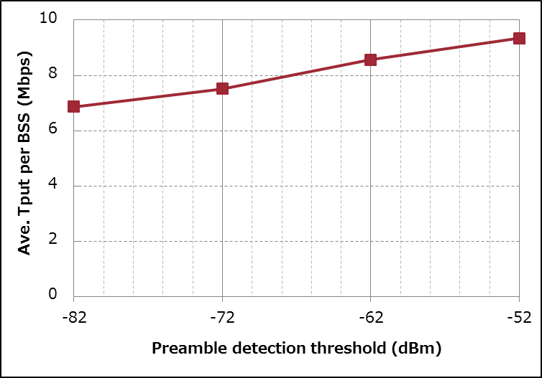
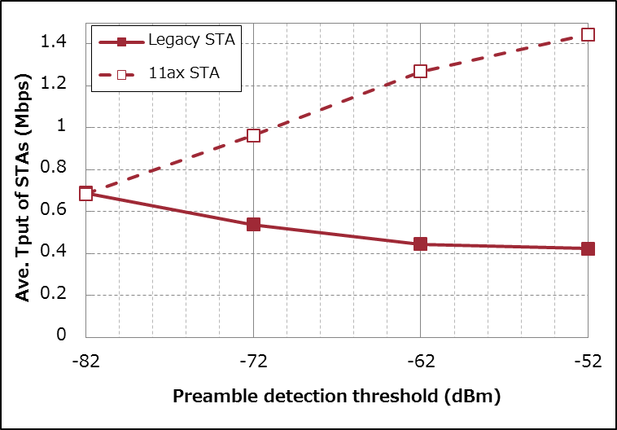
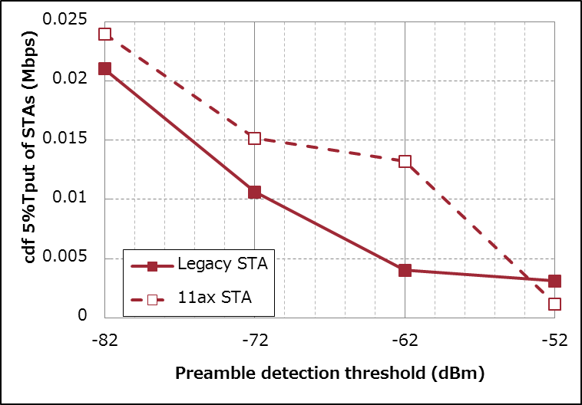
Simulation Results (Scenario3)
BSS Total
-System gain was confirmed in Scenario 3
-Degradation of Legacy STAs was also confirmed
36%
Up
[NOTE] 11ax STA CDF5% TP is also degraded.
This can be due to algorithm of DSC. (See slide#5)
DSC of 11ax STA isn’t always enabled and
they behave as Legacy STA during DSC is disabled.
per STA
Ave.
per STA
CDF 5%
38%
Down
94%
Down

Slide 7
Impact of DSC at Recipient STA
DSC has two aspects
One is increasing opportunity of Tx
Another one is avoiding undesired weak packet and increasing chance to Rx a stronger desired packet
If DSC is used by only transmitting STA of packets, system gain may be small
w/o DSC
at Recipient STA
Interference Packet from OBSS
Detect ->
start Rx
AP
(Recipient STA)
Rx Interference Packet
time
ｘ
Cannot receive no matter how large the SINR is !
STA
(Transmitting STA)
Not detect due to DSC ->
can transmit simultaneously
Tx to AP
time
w/ DSC
at Recipient STA
Not detect due to DSC ->
can wait stronger packet
Interference Packet from OBSS
AP
(Recipient STA)
Rx desired Packet
time
Not detect due to DSC ->
can transmit simultaneously
STA
(Transmitting STA)
Tx to AP
time

Slide 8
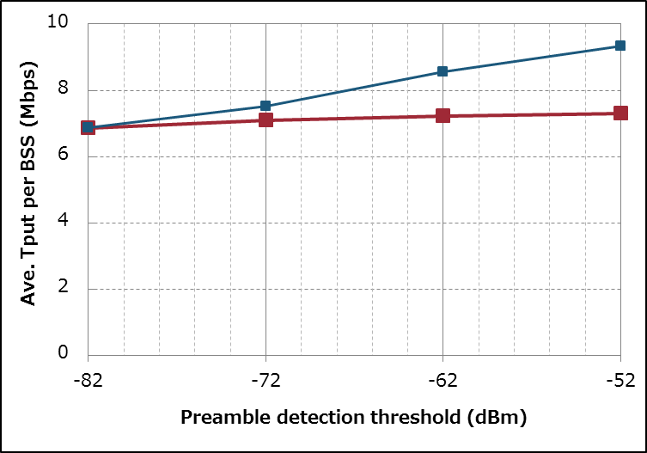
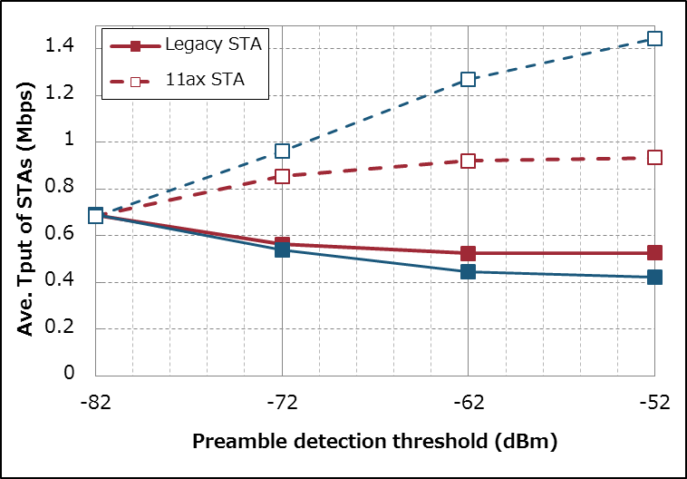
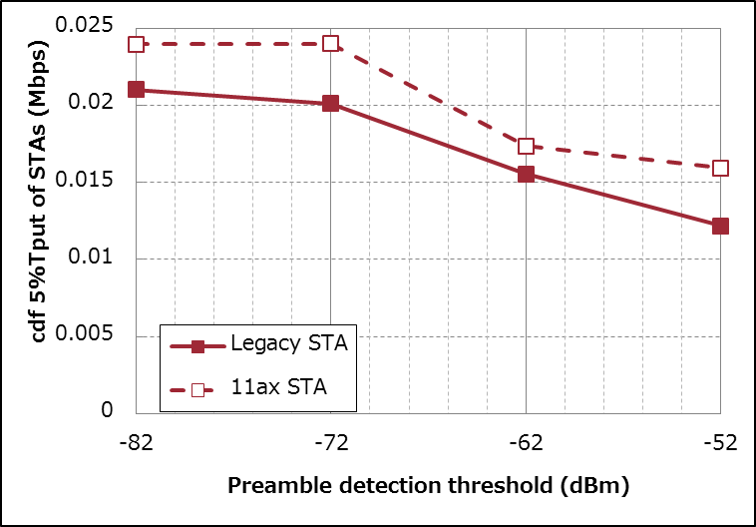
Simulation Results (If Recipient STA does not use DSC)
BSS Total
(36%
Up)
- Scenario 3
- 10 Uplink Flows/BSS
- No Downlink Flow
- 8KB AMPDU
- No RTS
- AP doesn’t use DSC
(ref) Both 11axSTAs/AP uses DSC
6%
Up
-If DSC is used by only the transmitting STA and the Recipient STA (i.e. AP in this case) don’t use DSC, there is small system gain
per STA
Ave.
per STA
CDF 5%
(ref) Both 11axSTAs/AP uses DSC
24%
Down
42%
Down
(38%
Down)

Slide 9
Summary
System gain and the impact for legacy devices of DSC are confirmed in Scenario 3
Some additional techniques to avoid loss of Rx opportunity should be used together to effectively obtain the DSC gain
For example;
Using DSC at recipient STA together
Switching/overriding receiving packet when a stronger packet comes during reception

Slide 10
Backup

Slide 11
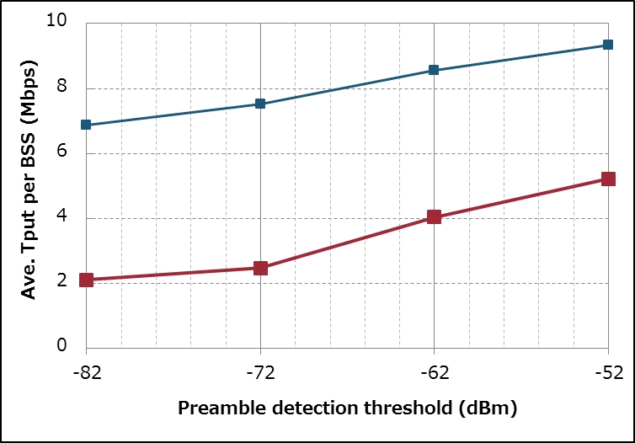
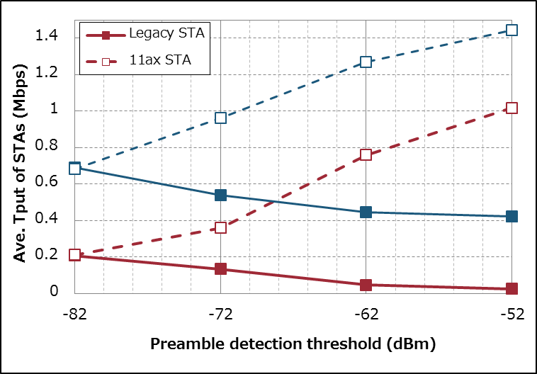
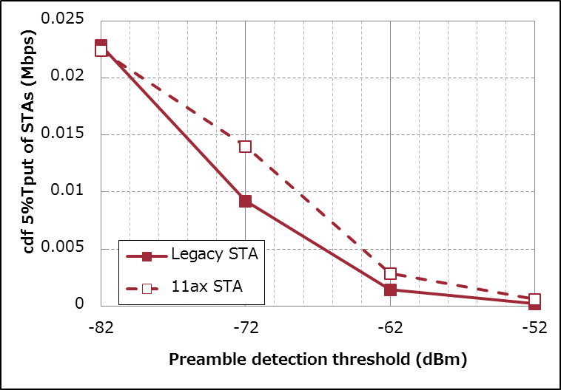
Simulation Results (AMPDU vs no-AMPDU)
BSS Total
- Scenario 3
- 10 Uplink Flows/BSS
- No Downlink Flow
- No RTS
- No AMPDU
(ref) 8KB AMPDU case
(36%
Up)
148%
Up
-When AMPDU isn’t used, the system gain of DSC is more than AMPDU enabled case.
-The impact for Legacy STA is also more than AMPDU case.
per STA
Ave.
per STA
CDF 5%
(ref) 8KB AMPDU case
(38%
Down)
99%
Down
87%
Down

Slide 12
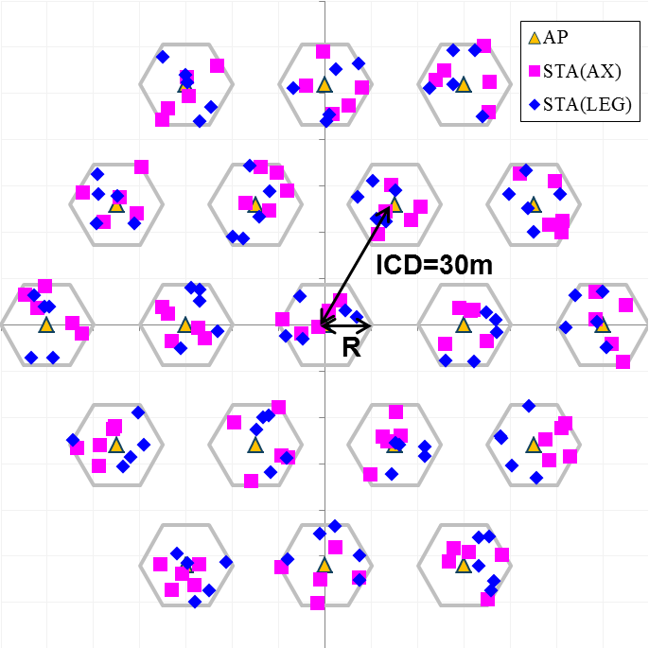
Simulation Setup details
Node | (AP x 1, STA x 10) x 19
Num of Drops [times] | 5
Traffic Model & Load | Uplink CBR UDP 30Mbps (from all STA -> Full Buffer condition)
Traffic Duration [sec] | 20
Access Category | AC_BE CWmin=15, CWmax=1023, AIFSN=3, TXOP limit=0
Tx Power [dBm] | AP:+20dBm(2 antennas), STA:+15dBm(1 antenna)
MCS Selection | Goodput maximizing MCS based on Training result (MCS0 ~ MCS7)
Packet Length [byte] | (MPDU, MSDU, APP)=(1030, 1000, 972) Fixed
L2 Retry | 10
Ack Rate | MCS0
RTS/CTS | Parameter (OFF)
Max Aggregation Size | (A-MPDU, A-MSDU)=(0 or 8KB, NA)
NF [dB] | 7
Channel | TGn Channel D (pathloss, shadowing, fading)
Preamble Detect Th. [dBm] | Parameter (-82 ~ -52: on 11ax-STAs & APs , -82 on Legacy-STAs)
CCA Th [dBm] | -62 (Fixed)
Channel Setting [MHz] | (CenterFreq, BW)=(2412, 20)
Det. Cancel on PLCP err | Enable
DSC algorithm | See slide #5
[NOTE] Definitions in this material
“Preamble detection threshold” means
Min level to be “CCA=busy” for 802.11 signals. (aka Rx sensitivity level)
“CCA threshold” means
Min level to be “CCA=busy” for any signals. (-82dBm + 20dB)

Slide 13
Impact of RTS/CTS to DSC gain
Any difference on gain when it is enabled?
General effect of RTS/CTS protection
(Pro) Reduce the probability of collision and reduce the wasted time of retransmit PPDU
If PPDUs are longer, the benefit become larger
(Con) Increase the overhead of frame exchange
(Con) Sometimes force to honor NAV unnecessarily at many STAs in dense environment
DSC should reduce C), so it is expected that the performance can be improved

Slide 14
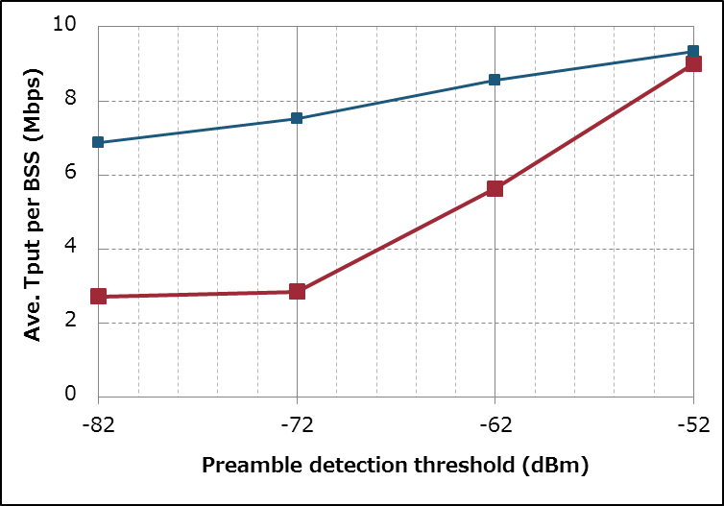
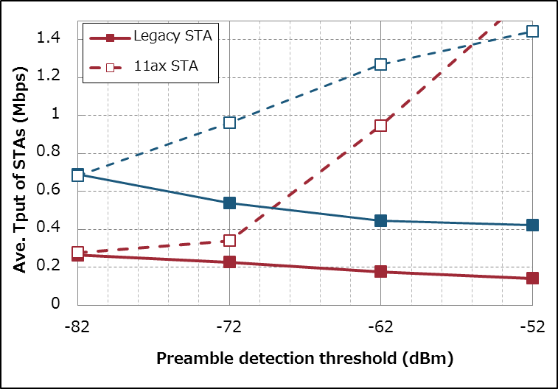
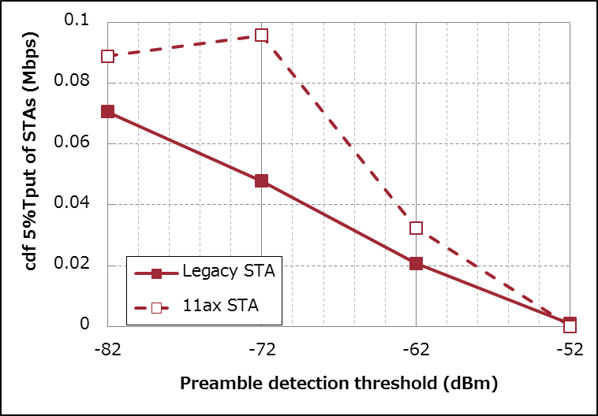
Simulation Results (no-RTS vs RTS)
BSS Total
- Scenario 3
- 10 Uplink Flows/BSS
- No Downlink Flow
- 8KB AMPDU
- with RTS
(36%
Up)
(ref) no RTS case
231%
Up
-When RTS is used with DSC, the system gain is more remarkable than no-RTS case.
-But the absolute value of Tput never exceeded the no-RTS case.
per STA
Ave.
per STA
CDF 5%
(ref) no RTS case
(38%
Down)
98%
Down
44%
Down

Slide 15
Consideration of DSC+RTS Sim. Result
General effect of RTS/CTS protection (again)
(Pro) Reduce the probability of collision and reduce the wasted time of retransmit PPDU
If PPDUs are longer, the benefit become larger
(Con) Increase the overhead of frame exchange
(Con) Sometimes force to honor NAV unnecessarily at many STAs in dense environment
The result was worse than no-RTS case
In scenario-3 condition, the degradation of C) may outstrip the improvement of A) even if DSC is used

Slide 16
References
Graham Smith, DSP Group, 11-13-1290-01 Dynamic Sensitivity Control for HEW
Graham Smith, DSP Group, 11-13-1487-02 Dense Apartment Complex Capacity Improvements with Channel selection and Dynamic Sensitivity Control
Graham Smith, DSP Group, 11-13-1489-05 Airport Capacity Analysis
Graham Smith, DSP Group, 11-14-0045-02 E-Education Analysis
Graham Smith, DSP Group, 11-14-0058-01 Pico Cell Use Case Analysis
Ron Porat, Broadcom, 11-14-0082-00 Improved Spatial Reuse Feasibility - Part I
Nihar Jindal, Broadcom, 11-14-0083-00 Improved Spatial Reuse Feasibility - Part II
Graham Smith, DSP Group, 11-14-0294-02 Dynamic Sensitivity Control Channel Selection and Legacy Sharing
Graham Smith, DSP Group, 11-14-0328-02 Dense Apartment Complex Throughput Calculations
Jinjing Jiang, Marvell, 11-14-0372-00 System level simulations on increased spatial reuse
Imad Jamil, Orange, 11-14-0523-00 Mac Simulation Results for DSC and TPC
Frank LaSita, InterDigital, 11-14-0578-00 Residential Scenario CCA/TPC Simulation Discussion
John Son, WILUS Institue/SK Telecom, 11-14-0628-00 Measurements on CCA Thresholds in OBSS Environment
Graham Smith, DSP Group, 11-14-0365-01 Dynamic Sensitivity Control Implementation
James Wang, MediaTek, 11-14-0637-00 Spatial Reuse and Coexistence with Legacy Devices
Graham Smith, DSP Group, 11-14-0779-00 Dynamic Sensitivity Control Practical Usage
William Carney, Sony, 11-14-0854-00 DSC and Legacy Coexistence
Gwen Barriac, Qualcomm, 11-14-0851-02-00ax-rate-control-for-mac-and-integrated-system-simulations

