Slide 1
Functional Requirements Discussion on Coexistence with Legacy STAs
Date: 2014/9/15
Authors:

Slide 2
Abstract
Contributions have shown that techniques for BSS densification (e.g. DSC) may cause unfairness among STAs (especially for legacy STAs) [1-4]
Suggest to add description to FRD about maintaining fairness among STAs

Slide 3
Introduction
Effects of DSC to legacy STAs have been shown in some contributions[1-4]
The impact on fairness with legacy STAs should be evaluated when evaluating proposed techniques

Slide 4
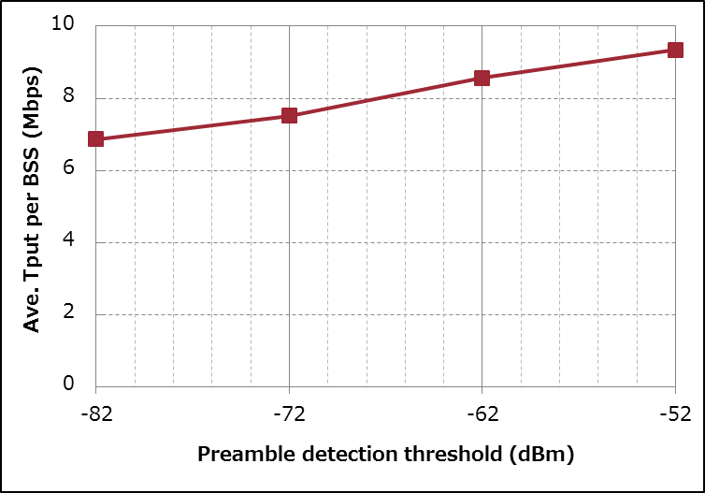
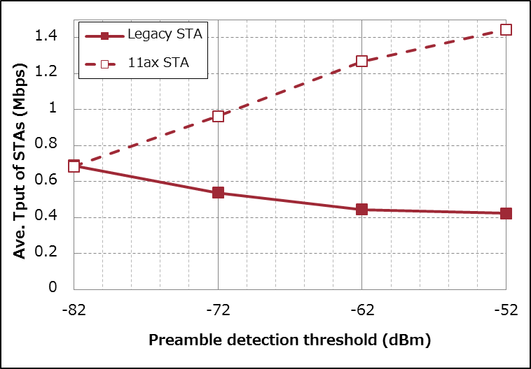
Example of Simulation Results
- Scenario 3 (19 cell, reuse=3, wrap around enabled)
- max AMPDU size=8KB
- 10 UL Flows/BSS, no DL Flow
Throughput [Mbps] | All STAs are Legacy | Half of STAs use DSC
System Total | 130.5 | 177.4
DSC Total (per STA) | - | 137.3 (1.26)
Legacy Total (per STA) | 130.5 (0.69) | 40.2 (0.42)
36% Up
38% Down
See 11-14/1171r0 for more detail

Slide 5
Proposal to Consider Fairness
There has been no requirement about maintaining fairness in Functional Requirement Document yet
It is necessary to extend the FRD (11-14/0567r7) to consider fairness among STAs (especially with legacy STAs)

Slide 6
Coexistence?
Quote from 11-09/00451r13 (TGac Functional Requirements and Evaluation Methodology)
2.3 Coexistence with 802.11a/n devices operating in 5 GHz
Refer to the IEEE Std. 802.15.2-2003, section 3.1 for the definitions of coexistence
TGac R5: The TGac amendment shall provide mechanisms that ensure coexistence between TGac and legacy IEEE802.11a/n devices
Quoted definition in IEEE802.15.2-2003
Coexistence: The ability of one system to perform a task in a given shared environment where other systems have an ability to perform their tasks and may or may not be using the same set of rules.
TGax may introduce some techniques, e.g., DSC, to enhance performance with changing basic CSMA/CA behavior
Simply saying “coexistence” would not prevent us from bringing significant impact on legacy STAs

Slide 7
Existing Functional Requirement
2.4 Backward Compatibility and Coexistence
TGax R14) The 802.11ax amendment shall enable backward compatibility with legacy IEEE 802.11 devices operating in the same band.
TGax R15) The 802.11ax amendment shall enable coexistence with legacy IEEE 802.11 devices operating in the same band.

Slide 8
Proposed Amendment
2.4 Backward Compatibility and Coexistence
TGax R14) The 802.11ax amendment shall enable backward compatibility with legacy IEEE 802.11 devices operating in the same band.
TGax R15) The 802.11ax amendment shall enable coexistence with legacy IEEE 802.11 devices operating in the same band maintaining fairness of transmission opportunity among STAs

Slide 9
Straw Poll
Do you agree to add requirement of maintaining fairness among STAs to FRD?
Y/N/A

Slide 10
Reference
Jinjing Jiang, Marvell, 11-14-0372-00 System level simulations on increased spatial reuse
Imad Jamil, Orange, 11-14-0523-00 Mac Simulation Results for DSC and TPC
James Wang, MediaTek, 11-14-0637-00 Spatial Reuse and Coexistence with Legacy Devices
William Carney, Sony, 11-14-0854-00 DSC and Legacy Coexistence

Slide 11
Backup

