Slide 1
Consideration of asynchronous interference in OBSS environment
Date: 2014-9-16
Authors:

Slide 2
Background
There have been some discussions on simultaneous transmission techniques, e.g., receiving (Rx) sensitivity control, for throughput improvement in OBSS environment [1]-[3].
In OBSS environment, asynchronous interference from OBSS is one of the crucial factors in the throughput/PER performance of simultaneous transmission.
This document discusses behaviors relative to asynchronous interference from OBSS at receiver and suggests two possible solutions, i.e., Rx sensitivity control and BSS color, to address the asynchronous interference from OBSS.

Slide 3
Asynchronous interference types
There are three types of arrival timing difference between desired and interference frames [4],[5].
  Type-1: the interference signal arrives prior to the desired signal.
  Type-2: both the interference and desired signals arrive same timing.
  Type-3: the interference signal arrives after the arrival of the desired signal.
Each type provides different influence against the desired signal.
Power
Power
Power
Desired signal
Desired signal
Desired signal
Interference signal
Interference signal
Interference signal
time
time
time
(a) Type-1
(b) Type-2
(c) Type-3

Slide 4
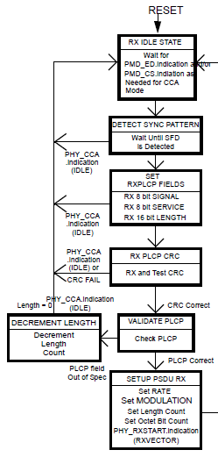
Influence on PER performance of current 802.11 devices
In the case of “Type-1”:
  PER becomes one when interference signal power is larger than receiving range and the header of the interference signal can be decoded.
    A receiver locks on to the interference signal regardless of power of the interference signal and its state becomes “busy” until the end of interference frame.
  PER depends on SINR when interference signal power is smaller than receiving range.
    A receiver can NOT locks on to the interference signal its state becomes “idle”.
In the cases of “Type-2” and “Type-3”:
  PER depends on SINR.
    A receiver can correctly capture the header of the desired frame and carry out decoding process of the desired signal.
Fig. 17-9 PLCP receive state machine [6]
In dense environment, the influence of asynchronous interference such as type-1 is increased, resulting in the throughput degradation.

Slide 5
Candidate schemes to address asynchronous interference issue
BSS color in 11ah [7]-[10]
  Each BSS has own BSS color number and receiver checks BSS color of SIG for each received frame.
  Receiver checks BSS color of SIG for each received frame.
    If BSS color is equal to the one in the own BSS, the receiver continues to decode the frame.
    If not, the receiver stop decoding the frame.
Rx sensitivity control scheme (e.g., DSC) [1]-[3]
  Rx sensitivity threshold which is the minimum signal power the receiver can decode is controlled at each AP/STA.
    When Rx sensitivity threshold is larger than the interference signal power from OBSS, the receiver does not lock on to the frame from OBSS.
Others
  Beamforming/precoding scheme avoiding the interference from OBSS
  Decoding scheme robust for asynchronous interference signals

Slide 6
Comparison between BSS color and Rx sensitivity control
 | Features | Issues
BSS color | Influence from OBSS can be reduced without any parameter control. | Header needs to be decoded correctly. If BSS color is not equal to the one in the own BSS, the receiver needs to not only stop decoding the frame but also change the state to “idle” to decode the desired signal although the receiver cannot in 11ah. The receiver cannot determine if the received signal is the desired one or not until SIG with BSS color is decoded. More bits may be required in 11ax compared to that in 11ah to support large number of OBSSs. There is no effect in case of the coexistence with legacy devices.
Rx sensitivity control | There is no overhead. Header needs not to be decoded. | Some parameters such as Rx sensitivity threshold and MCS need to be adequately controlled. (e.g., higher Rx sensitivity threshold may fail to detect the desired signal and increase the interference.) Influence on legacy devices is considerable.

Slide 7
Summary
This presentation focuses on asynchronous interference from OBSS in dense WLAN environment.
  PER/throughput depends on the arrival timing difference between the desired signal and interference one.
  Especially, PER becomes one when the interference signal arrives prior to the desired one.
Besides, above problem needs to be addressed by some techniques proposed in 11ax.
  Both BSS color and Rx sensitivity control are attractive candidates against OBSS interference although there are still some issues remaining.

Slide 8
Straw poll
Do you think asynchronous interference issues should be addressed in TGax?
  Y/N/A = 63/1/8

Slide 9
References
[1] R. Porat (Broadcom), “Improved spatial reuse feasibility –Part I,” doc: IEEE 802.11-14/0082r0.
[2] G. Smith (DSP Group), “Dynamic sensitivity control implementation,” doc: IEEE 802.11-14/0635r1.
[3] L. Cariou (Orange), “MAC simulation results for DSC and TPC,” doc: IEEE 802.11-14/0523r0.
[4] J. Zhu (Intel), et al., “Adaptive CSMA for scalable network capacity in high-density WLAN: a hardware prototyping approach,” in Proc. IEEE INFOCOM, 2006.
[5] H. Ma, et al., “On loss differentiation for CSMA-based dense wireless network,” IEEE Commun. Lett., vol. 11, no. 11, pp. 877-879, Nov. 2007.
[6] IEEE Std 802.11™-2012 .
[7] M. Fischer (Broadcom), “CID 205 BSSID Color Bits,” doc: IEEE 802.11-13/1207r1.
[8] J. Son (WILUS Institute), “Further Considerations on Enhanced CCA for 11ax,” doc: IEEE 802.11-14/0847r1.
[9] S. Choudhury (Nokia), “Impact of CCA adaptation on spatial reuse in dense residential scenario,” doc: IEEE 802.11-14/0861r0.
[10] IEEE P802.11ahTM/D2.0.

Slide 10
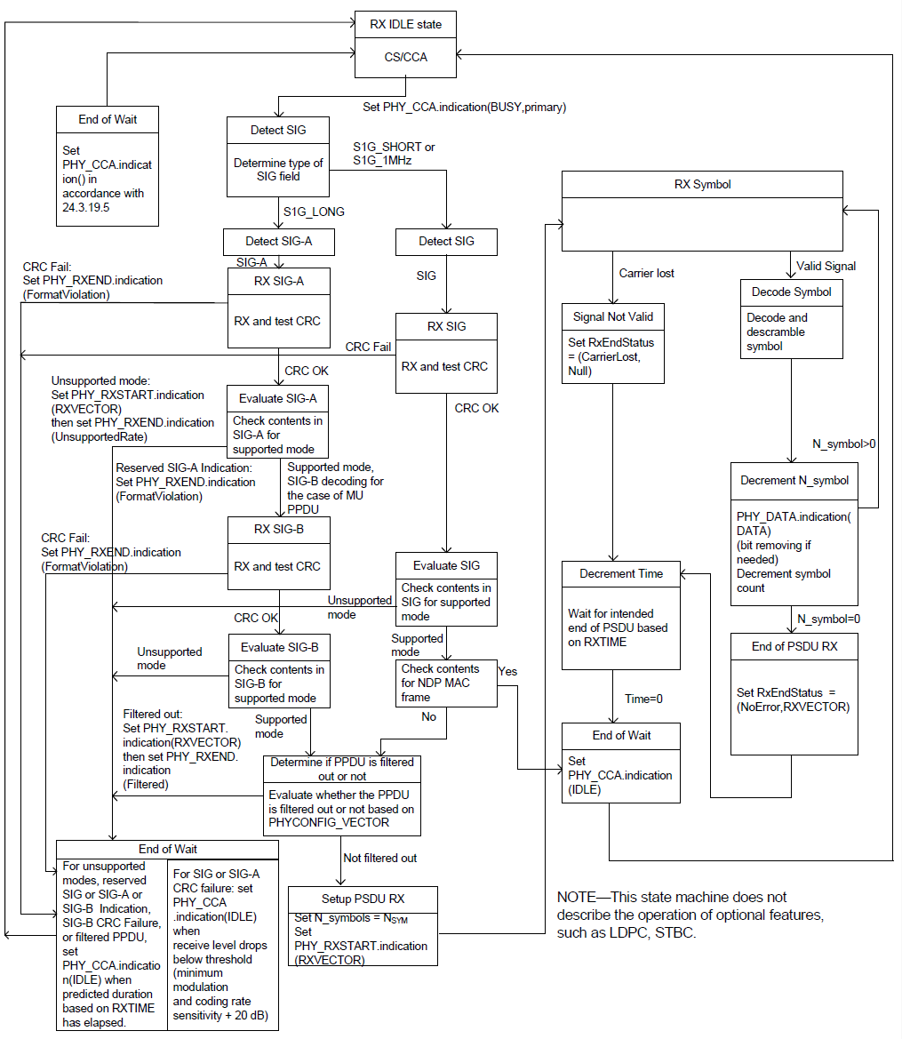
(Ref.) PHY receive state machine [10]
Fig. 24-54 PHY receive state machine [10]

