Slide 1
MAC Simulator Calibration Results
Date: 2014-09-10
Authors:

Slide 2
Summary
Scenarios for MAC simulator calibration are defined in [1] and some calibration results have been shown [2]-[4]
This document provides the results of NTT’s MAC simulator with following calibration scenarios.
Test 1: overhead tests
MAC overhead with A-MPDU and block ACK
[Test 1a] w/o RTS/CTS
[Test 1b] w/ RTS/CTS
Test 2: Deferral tests
[Test 2a] APs defer when they should
[Test 2b] APs don’t defer when they shouldn’t
Test 3: NAV deferral
The results of Test 1a, 1b and 2a are well matched with [2], [3]. However test 2b is difficult to match because the assumptions are complicated compared to other scenarios.
For scenarios with hidden terminals like test 2b, we should accommodate some assumptions (e.g., Frame error of A-MPDU, procedure for A-MPDU retransmission, ACK frame error)
NTT’s assumptions are described in slide 10

Slide 3
Test 1a: MAC overhead w/o RTS/CTS
■Scenario
Should be MCS0 minus overhead
Assumption is that PER is 0
Mac features | RTS/CTS | BACKOFF | AGGREGATION | RATE CONTROL
ON/OFF | OFF | ON | ON | OFF (FIXED to MCS 0 or MCS 8)
1 m
STA 1
AP1
Test Items | Check points | Standard definition | Matching?
A-MPDU duration | Tcp2-Tcp1= | ceil((FrameLength*8)/rate/OFDMsymbolduration) * OFDMsymbolduration + PHY Header | ○ (3.844 ms)
SIFS | Tcp3-Tcp2=16 us | 16 us | ○
ACK duration | Tcp4-Tcp3= | ceil((ACKFrameLength*8)/rate/OFDMsymbolduration) * OFDMsymbolduration + PHY Header | ○ (68 μs)
Defer & backoff duration | Tcp5-Tcp4= | DIFS(34 us)+backoff (CWmin) =34us+n*9us | ○
BA Frame Format @ 24Mbit/s

Slide 4
Results of Test 1a
MSDU size , MCS index | Simlated throughput by NTT [Mbit/s] | Simlated throughput by Qualcomm [Mbit/s] | Simulated throughput by Nokia [Mbit/s] | Calcurated throughput (by Nokia) [Mbit/s]
500 bytes, mcs index = 0 | 5.25 | N/A | 5.29 | 5.32
1500 bytes, mcs index = 0 | 5.84 | 5.83 | N/A | N/A
2000 bytes, mcs index = 0 | 5.75 | N/A | 5.74 | 5.78
500 bytes, mcs index = 8 | 62.7 | N/A | 63.85 | 64.06
1500 bytes, mcs index = 8 | 69.7 | N/A | N/A | N/A
2000 bytes, mcs index = 8 | 70.0 | N/A | 70.73 | 70.91

Slide 5
Test 1b: MAC overhead w/ RTS/CTS
■Scenario
Should be MCS0 minus overhead
Assumption is that PER is 0
Mac features | RTS/CTS | BACKOFF | AGGREGATION | RATE CONTROL
ON/OFF | ON | ON | ON | OFF ( FIXED to MCS 0 or MCS 8)
1 m
STA 1
AP1
6 Mbit/s
Test Items | Check points | Standard definition | Matching?
RTS duration | Tcp2-Tcp1= | ceil((RTSFrameLength*8)/rate/OFDMsymbolduration) * OFDMsymbolduration + PHY Header | ○ (52 μs)
CTS duration | Tcp4-Tcp3= | ceil((CTSFrameLength*8)/rate/OFDMsymbolduration) * OFDMsymbolduration + PHY Header | ○ (44 μs)
Frame duration | Tcp6-Tcp5= | ceil((FrameLength*8)/rate/OFDMsymbolduration) * OFDMsymbolduration + PHY Header | ○ (3.844 ms)
6 Mbit/s

Slide 6
Results of Test 1b
MSDU size , MCS index | Simlated throughput by NTT [Mbit/s] | Simlated throughput by Qualcomm [Mbit/s] | Simulated throughput by Nokia [Mbit/s] | Calcurated throughput (by Nokia) [Mbit/s]
500 bytes, mcs index = 0 | 5.07 | N/A | 5.15 | 5.12
1500 bytes, mcs index = 0 | 5.66 | 5.65 | N/A | N/A
2000 bytes, mcs index = 0 | 5.49 | N/A | 5.52 | 5.49
500 bytes, mcs index = 8 | 60.6 | N/A | 61.94 | 61.73
1500 bytes, mcs index = 8 | 67.5 | N/A | N/A | N/A
2000 bytes, mcs index = 8 | 67.9 | N/A | 68.76 | 68.45

Slide 7
Test 2a: Deferral Test 1
■Scenario
AP1 and AP2 should defer to each other
The only packet loss is due to collisions when backoff end at the same time
Compare PER and TPUT metrics
AP1
d1=1m
AP 2
d2=1
STA 2
STA 1
d2=1
(AP1 and STA2 are essentially co-located)
Mac features | RTS/CTS | BACKOFF | AGGREGATION | RATE CONTROL
ON/OFF | ON or OFF | ON | ON | OFF (FIXED to MCS 0)

Slide 8
Results of Test 2a
MSDU size , RTS/CTS | Simlated throughput by NTT [Mbit/s] | Simlated throughput by Qualcomm [Mbit/s] | Simulated throughput by Nokia [Mbit/s]
500 bytes, Off | 4.96 | N/A | 5.04
1500 bytes, Off | 5.55 | 5.53 | N/A
2000 bytes, Off | 5.51 | N/A | 5.50
500 bytes, On | 5.08 | N/A | 5.18
1500 bytes, On | 5.67 | N/A | N/A
2000 bytes, On | 5.50 | N/A | 5.56

Slide 9
Test 2b: Deferral Test 2
■Scenario
AP1 and AP 2 should not defer to each other
Because received signal from other AP is < -82dBm
Compare PER and TPUT metrics
STA 2
d2=60m
AP 2
AP1
d2=60m
STA 1
The distance between AP and STA is shorter than the scenario in [1]. It is suitable for the assumptions described in the next slide.
It can set the same value as the scenario in [1] if we complete PHY abstraction.
Simulation runs time = 100sec, the number of realizations = 6
Mac features | RTS/CTS | BACKOFF | AGGREGATION | RATE CONTROL
ON/OFF | OFF | ON | ON | OFF (FIXED to MCS 0)

Slide 10
Test 2b: Deferral Test 2
■Assumptions
Basic PER
If an A-MPDU is interference free, it can be decoded without frame error.
Influence of collision
If the PHY header is overlapped with collision frame, the reception of an A-MPDU fails
If the PHY header is interference free and an A-MPDU subframe is overlapped with collision frame, only the reception of the corresponding A-MPDU subframe fails
ACK frame error
Even if an ACK frame is overlapped with collision frame, it is successfully received when SINR is large enough to regard BER is zero.
In this scenario, the reception of an ACK frame at both APs can be always regarded as interference free. (i.e., the collision of the ACK frame at AP1 is caused by only data frames from AP2.)
Retransmission
If no Block ACK is received within timeout duration and retry counter is under the retry limit, AP retransmit the A-MPDU.
If a Block ACK is received and it shows that one or more A-MPDU subframes are not successfully received, AP retransmit only the failed A-MPDU subframes.
CW size
The min and max CW sizes follow the EDCA parameters as AC_BE
The min CW size is 15, The max CW size is 1023

Slide 11
Results of Test 2b
MSDU size , RTS/CTS | Simlated throughput by NTT [Mbit/s] | Simlated throughput by Qualcomm [Mbit/s]
1500 bytes, Off | 1.27 | 1.28

Slide 12
Test 3: NAV deferral
■Scenario
Same as test 2b, but with RTS/CTS on
Simulation runs time = 100sec, the number of realizations = 6
STA 2
d2=60m
AP 2
AP1
d2=60m
STA 1
Mac features | RTS/CTS | BACKOFF | AGGREGATION | RATE CONTROL
ON/OFF | OFF | ON | ON | OFF (FIXED to MCS 0)
■Results
MSDU size , RTS/CTS | Simlated throughput by NTT [Mbit/s]
1500 bytes, On | 5.36

Slide 13
Conclusions
We have conducted simulation works for MAC calibration and the results are basically aligned with the results of other companies.
For the Test 2b and Test 3, details of the MAC parameters should be specified in order for the simulation results by different companies to be aligned.

Slide 14
Reference
[1] 11-14-0967-05-00ax-proposed-mac-calibration-text
[2] 11-14-0600-00-00ax-mac-simulator-calibration
[3] 11-14-0892-00-00ax-mac-calibration-test-to-simulation-scenario
[4] 11-14-0869-00-00ax-mac-calibration-results

Slide 15
Appendix

Slide 16
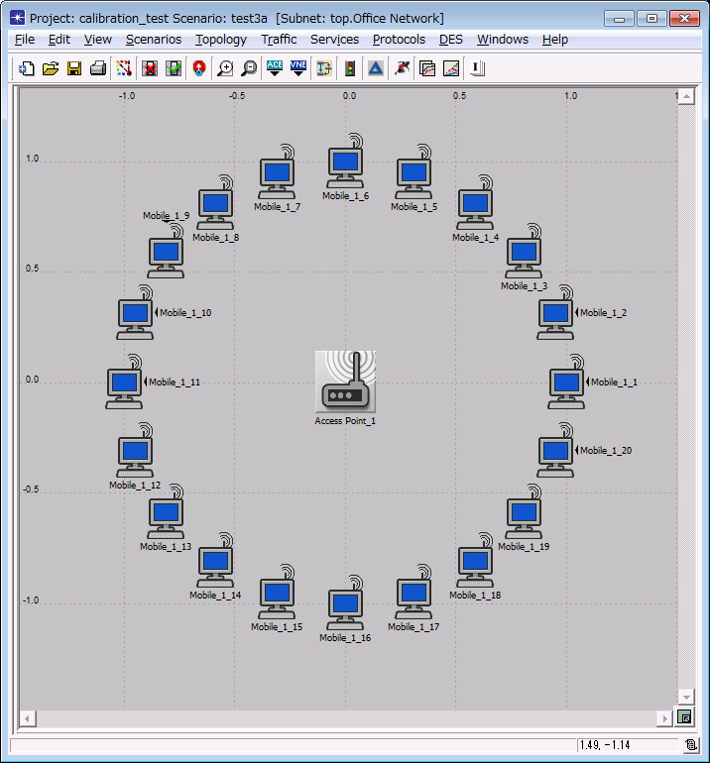
Backoff procedure, N=20
■Scenario
d=1m
All nodes can decode each others packets, if not collisions occur; collisions are always destructive.
Number STAs = 20
Uplink Only
Mac features | RTS/CTS | BACKOFF | AGGREGATION | RATE CONTROL
ON/OFF | OFF | ON | ON | OFF FIXED MCS 0 to start
■Result of Throughput
NTT： 4.27 Mbit/s
Qualcomm: 4.31 Mbit/s

