Slide 1
A response to the re-channelization proposal
Authors:
Date: September 5, 2014

Slide 2
Authors (continued):

Slide 3
Preface
The DSRC community:
  Remains committed to a good faith investigation into the question of if and how unlicensed devices can share DSRC spectrum without harmful interference, including eventual testing
  Has engaged positively with the Wi-Fi community in the Tiger Team and other venues, including delivering tutorials, supplying test data, giving feedback, and providing information about harmful interference, channel models, test beds, and DSRC bands outside the US.
  Has indicated that the CCA-based sharing concept (11-13-0994/r0) has potential, and has suggested it be fully developed

Slide 4
Conclusion
For the reasons cited here, the authors of this submission:
consider the proposal in 11-13-1276/r1 and 11-14-0819/r0 inconsistent with the DSRC mission for which the FCC allocated the 5.9 GHz band
conclude that the proposal is not viable as a U-NII sharing technology that will protect DSRC services
encourage the Tiger Team to focus resources on developing a proposal that has the potential to protect DSRC services and garner broad-based stakeholder support

Slide 5
Outline
Incorrect premise: Critical DSRC traffic fits in 2 channels
Incorrect premise: Proposal requires no new research or testing
False equivalence between U-NII and DSRC interference
Proposal calls for degraded DSRC performance
Proposal is inconsistent with FCC NPRM
Proposal offers no in-band protection
Proposal is Wi-Fi specific
Proposal is US-specific
Proposal stifles DSRC innovation

Slide 6
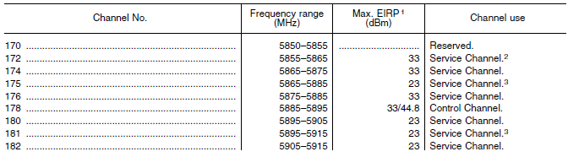
Critical DSRC Traffic
Some DSRC facts that are sometimes misunderstood:
  Fact 1: Every channel is a service channel, except Ch. 178
  There are no “non-safety” channels
CFR47 90.377: Note channels 172 and 184 are service channels with special designations

Slide 7
Critical DSRC Traffic
Fact 2: Every channel will likely carry critical traffic
While Ch. 172, 178, and 184 have restrictions, the other channels do not.
They can all be expected to carry critical traffic. Some will carry non-critical traffic as well.
Specific QoS (including latency, priority, range) will vary by application. Each channel can be expected to carry traffic with low loss and low latency requirements.

Slide 8
Critical DSRC Traffic
Fact 3: Many DSRC applications impact safety
Most will use channels other than Ch. 172 or 184. Examples:
Pre-crash mitigation
Work Zone Warning
Cooperative Adaptive Cruise Control
Automated driving
Platooning
Security: Certificate renewal
Pedestrian Safety
Disabled vehicle alert
Cooperative merge
Dynamic Routing of Emergency Vehicles
Queue Warning
Incident zone
Dangerous road conditions
Bicycle Safety
Curve speed warning
Tracked vehicle safety
Security: CRL distribution
Left-turn assist
Stop-sign assist
Excess speed advisory
R.E.S.C.U.M.E.
Evacuation
Automated Advanced Crash Notification
Other I2V safety …
Note: this is not a comprehensive list

Slide 9
Critical DSRC Traffic
Fact 4: Many DSRC applications have real-time requirements
Even among those that are not strictly safety apps. Examples:
Open road tolling
Commercial vehicle in-motion inspection
Mileage based user fee
Speed harmonization
Transit signal priority
Connected Eco-driving
Commercial services
Due to high mobility of DSRC stations, service delivery presumptively has low latency requirements
IEEE 802.11p supports low latency requirements

Slide 10
Critical DSRC Traffic
Illustrative DSRC Application-Channel Usage Map
5.850
5.855
5.865
5.875
5.885
5.895
5.905
5915
5.925
172
SCH
174
SCH
176
SCH
178
Control Channel
180
SCH
182
SCH
184
SCH
.
Pre-crash mitigation, Vulnerable road user safety, Advanced crash notification, CRL, Real-time comm. services
Exclusively for high-power, longer-distance communications to be used for public safety apps involving safety of life & property, including road intersection collision mitigation
Exclusively for vehicle-to-
vehicle safety communications for accident avoidance and mitigation, and safety of life and property applications
Curve speed warning, Queue warning, Left turn assist, stop sign assist, Intersection violation, Disabled vehicle
Automated driving, Distribution of remote sensor data, Platoon control, Cooperative adaptive cruise control, Coop. merge
Work zone, Incident zone, Tolling, Speed advisory, Commercial inspection, Dangerous road conditions, GPS corrections
Guard Band
This is illustrative. Actual channel used will vary with time and location for many applications. A given application may be offered on more than one channel.

Slide 11
Critical DSRC Traffic: Conclusion
The re-channelization proposal calls for all safety-critical traffic to move to the upper 2 or 3 channels of band.
Compressing 7 channels of critical traffic into 2 or 3 creates excess packet loss and latency, degrading application performance.
The re-channelization proposal is inevitably associated with harmful interference to safety-critical communication.

Slide 12
DSRC Rulemaking Requires Stability
“NHTSA will then begin working on a regulatory proposal that would require V2V devices in new vehicles in a future year”
– US DOT Sec. Foxx, Feb. 3, 2014
“Communication technology for safety applications must be secure, low latency, mature, stable, and work at highway speeds.”
– US DOT Principles for a Connected Vehicle, April 8, 2012
US DOT decision follows:
  100s of millions of dollars invested by industry and government
  More than a decade of productive research
  Development of a suite of stable, harmonized international standards
  Large scale Safety Pilot Model Deployment field trial
  all producing the requisite technical maturity and stability
Early deployments assume current DSRC channelization (see 11-14-0728/r0)

Slide 13
DSRC Rulemaking Requires Stability
The re-channelization proposal raises a host of questions that a DSRC rule-making process would need to contemplate:
  Precise allocation of V2V safety messages among Channels 180, 182, and 184?
  For each allocation choice, what interference would V2V safety communication receive from:
    Other DSRC communication (co-channel and cross-channel), including messages that otherwise would not be as spectrally close to V2V communication. Of particular concern is interference from very high power public safety communications on Ch. 184.
    Other primary and secondary users of the band, especially Fixed Satellite Services.
    Devices operating above 5.925 GHz
    Raised noise floor from U-NII devices operating up to 5.895 GHz
    (Continued next slide)

Slide 14
DSRC Rulemaking Requires Stability
Questions for regulators posed by re-channelization (continued):
  Implications for other critical services that would also be compressed into these channels?
  Changes needed in the DSRC standards?
  Implications for international harmonization of V2V safety?
Qualcomm’s FCC NPRM 13-22 comments: allowing unlicensed devices to share Ch. 172 “would invalidate previous testing results and necessitate additional rounds of interference studies.” (Sec. I.B.)
The proposal’s re-channelization of Ch. 172 traffic has the same issues, and will, despite the wishes of the proposers, lead to considerable delay in the rule-making process and deployment of V2V safety.
33,561 traffic fatalities in 2012: We all agree that this proceeding should not delay DSRC deployment.

Slide 15
Comparing sources of interference
  Consider:
    CRF 47 §15.5: “Operation of an intentional, unintentional, or incidental radiator is subject to the conditions that no harmful interference is caused …” (emphasis added)
  CFR 47 §95.1511 “All licensees shall cooperate in the selection and use of channels in order to reduce interference” (emphasis added)
  The requirement for U-NII devices is strict and absolute
  Any implied equivalence between interference standards is flawed
  Sharing solutions developed by the Tiger Team should not:
    Expect or depend on cooperation from DSRC devices
    Expect DSRC devices to accept higher interference from licensed devices
  The fact that DSRC already operates in challenging environment only heightens need for U-NII to avoid contributing interference

Slide 16
Comparing sources of interference
The re-channelization proposal places safety-critical DSRC traffic closer to:
    interfering FSS signals
    high power DSRC Public Safety communication (Ch. 184)
The Tiger Team should consider potential solutions that do not have these weaknesses
  11-14-0819/r0 states:
    “cross-channel interference has always been a problem between existing service channels and high-avail channels; the proposed channelization does not increase the interference” [from one DSRC to another] – slide 9 (emphasis added)
    This is incorrect
    Ignores increased interference from high power Ch. 184 into Ch. 180 and Ch. 182
    Ignores increased interference due to loss of flexibility in assignment of applications to channels, Tx power, spreading V2V on non-adjacent channels, etc.

Slide 17
Proposal calls for degraded DSRC performance
Already seen:
  Packing 7 channels’ critical traffic into 2 or 3 degrades performance
  Placing Basic Safety Messages near High Power Ch. 184 degrades performance
  Removing flexibility in assignment and operation degrades performance
In addition, using 20 MHz channels degrades performance (next slide)

Slide 18
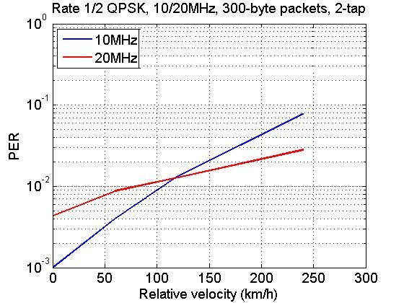
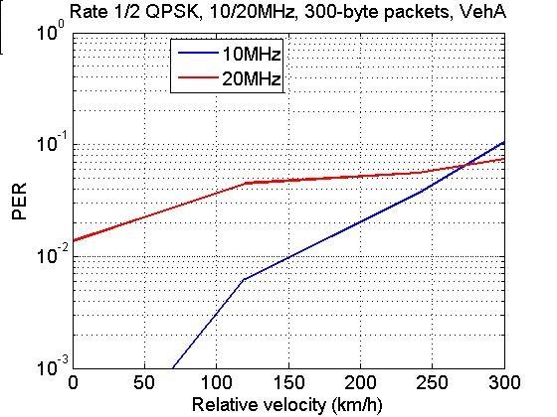
Proposal calls for degraded DSRC performance:
20 MHz DSRC Channels
10 MHz PER lower up to 110 km/hr relative velocity
10 MHz PER lower up to 270 km/hr relative velocity
Maximum excess delay: 0.5us
Maximum excess delay: 2.5us
From 11-13-1276/r1
10 MHz PER is better than 20 MHz PER, especially when weighted with relative velocity probability density
10 MHz has lower noise floor, greater range
10 MHz has better immunity to large outdoor delay spreads

Slide 19
Proposal calls for degraded DSRC performance:
20 MHz DSRC Channels
  11-14-0819/r0 states: “20MHz DSRC service-channel operation → would allow for more effective detection of the DSRC signals” (emphasis added)
  This is incorrect.
  10 MHz detectors are more sensitive, greater range
  10 MHz detectors are commercially available; no new design needed
    Used in all current DSRC chipsets and some Wi-Fi chipsets
  The reality is that the proposal seems to suggest 20 MHz DSRC channels primarily for convenience of U-NII device

Slide 20
Proposal is inconsistent with NPRM
“I think ITS has envisioned that it would have the entire 75 MHz and has been planning for that, so we did not tee up the question of whether we should change the allocation. And, generally with unlicensed it shares on a non-interference basis, so [the Qualcomm proposal] would be a completely different direction than was teed up in the Commission’s notice.” (emphasis added)
- Julius Knapp, US Federal Communications Commission
Hearing of House Energy and Commerce Subcommittee on Communication Technology – Nov. 15, 2013

Slide 21
Proposal is inconsistent with NPRM
“For the study, NTIA assumed that the FCC’s existing U-NII TPC and DFS regulations would be extended to the U-NII-2B and U-NII-4 bands, and that the Federal agencies will not have to alter their systems or operations to accommodate U-NII devices.” (emphasis added)
- FCC NPRM 13-22, paragraph 104 (2/20/13), ET Docket 13-49

Slide 22
Proposal is inconsistent with NPRM
“the Qualcomm proposal is inconsistent with the premise of the spectrum sharing concept proposed in the FCC’s NPRM”
- Jim Arnold, US Dept. of Transportation
IEEE 802.11 Tiger Team meeting 5/30/14

Slide 23
Proposal offers no in-band protection
CFR47 Part 15 does not recognize channels of unlicensed operation within a band
CFR47 Part 15 does not impose transmit spectral masks on unlicensed devices
The proposal allows simultaneous DSRC and unlicensed device operation in the band
  e.g. 802.11ac on Ch. 177 and DSRC on Ch. 173
A rule allowing such simultaneous operation could not protect DSRC from harmful interference
In order to develop a potentially workable rule, the Tiger Team should focus on proposals that vacate the entire band upon detection of DSRC devices

Slide 24

Proposal assumes unlicensed device technology is Wi-Fi
U-NII Detects Primary
Unlicensed Device
Primary Device
Primary does not need to know about U-NII
Traditional Sharing Philosophy
Wi-Fi Device
Mutual Detection
DSRC Device
DSRC needs to know U-NII technology, must be Wi-Fi
Proposed Philosophy: U-NII must be Wi-Fi

Slide 25
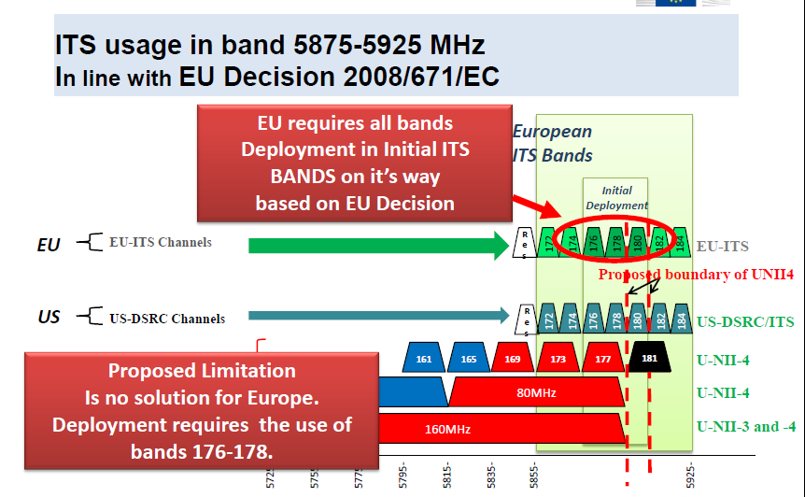
Proposal is US-Specific:
European Frequency Regulation (from 11-14-0550/r0)
September 2014

Slide 26
Proposal Stifles DSRC Innovation
Communication technologies (e.g. Wi-Fi) typically undergo extensive evolution
DSRC is in “early days” and can be expected to experience a similar evolution
DSRC offers great potential for entrepreneurs and innovators
For DSRC, 5.850-5.925 GHz is not “yet another” band. It is the only band where DSRC innovation can occur.
The re-channelization proposal imposes significant constraints on how DSRC uses the band. This will tend to stifle the innovation that could unleash DSRC’s full potential
The Tiger Team should avoid approaches like the
re-channelization proposal that stifle innovation

Slide 27
Review
Proposal is inconsistent with ITS plans to use the entire band for safety-critical communication
Proposal will delay DSRC deployment, with attendant costs
Proposal calls for degraded DSRC performance
Proposal is inconsistent with FCC NPRM
Proposal offers no in-band protection
Proposal is Wi-Fi specific
Proposal is US-specific
Proposal stifles DSRC innovation

Slide 28
Conclusion
For the reasons cited here, the authors of this submission:
consider the proposal in 11-13-1276/r1 and 11-14-0819/r0 (“the proposal”) inconsistent with the DSRC mission for which the FCC allocated the 5.9 GHz band
conclude that the proposal is not viable as a U-NII sharing technology that will protect DSRC services
encourage the Tiger Team to focus resources on developing a proposal that has the potential to protect DSRC services and garner broad-based stakeholder support

