Slide 1
1st Vice Chair Report September 2014 – Athens, Greece
Date: 2014-09-14
Authors:
Slide 1
Jon Rosdahl, CSR

Slide 2
Abstract
IEEE 802.11 1st Vice Chair agenda Items for the September IEEE 802 Wireless Interim in Athens, Greece.
Slide 2
Jon Rosdahl, CSR

Slide 3
Monday Agenda Items
  3.3 – Other WG meeting plans
  3.4 – Meeting Room locations
  3.5 – Next meeting Reminder
  3.6 – Meeting registration
  3.7 – Recording Attendance
  3.8 – File Server
  3.9 – Breakfast, Breaks, Social Logistics

Slide 4
3.3 Other WG Meeting Plans
802.15: https://mentor.ieee.org/802.15/dcn/14/15-14-0500-00-0000-september-2014-802-15-wg-agenda-graphic.xlsx
802.19: https://mentor.ieee.org/802.19/dcn/14/19-14-0060-01-0000-sept-2014-wg-agenda.xls
802.21: https://mentor.ieee.org/802.21/dcn/14/21-14-0135-00-0000-joint-wireless-opening-plenary.pptx
802.22: https://mentor.ieee.org/802.22/dcn/14/22-14-0113-00-0000-september-interim-working-group-agenda.xls
802.24: not available

Slide 5
3.4 WG Meeting Locations
802.11
Convention level: Terpsichore AB; Terpsichore C-Monday
Convention level: Terpsichore A and Terpsichore B – Tues-Thurs
Pool Level: Thalia 4; Thalia 3 -- Mon-Thurs
Convention Level: Hesperides - Friday
802.15
Convention Level: Hesperides
Mezzanine: Santorini 1&5; Santorini 2&4; Patmos
802.19 -- Tues-Thurs Terpsichore C – Convention Level
802.21 – Santorini 6 - Mezzanine
802.22 – Thalia 1 – Pool Level
802.24 – Thalia 2 – Pool Level
802.1cf (OmniRAN) – Kos – Mezzanine
Jon Rosdahl, CSR

Slide 6
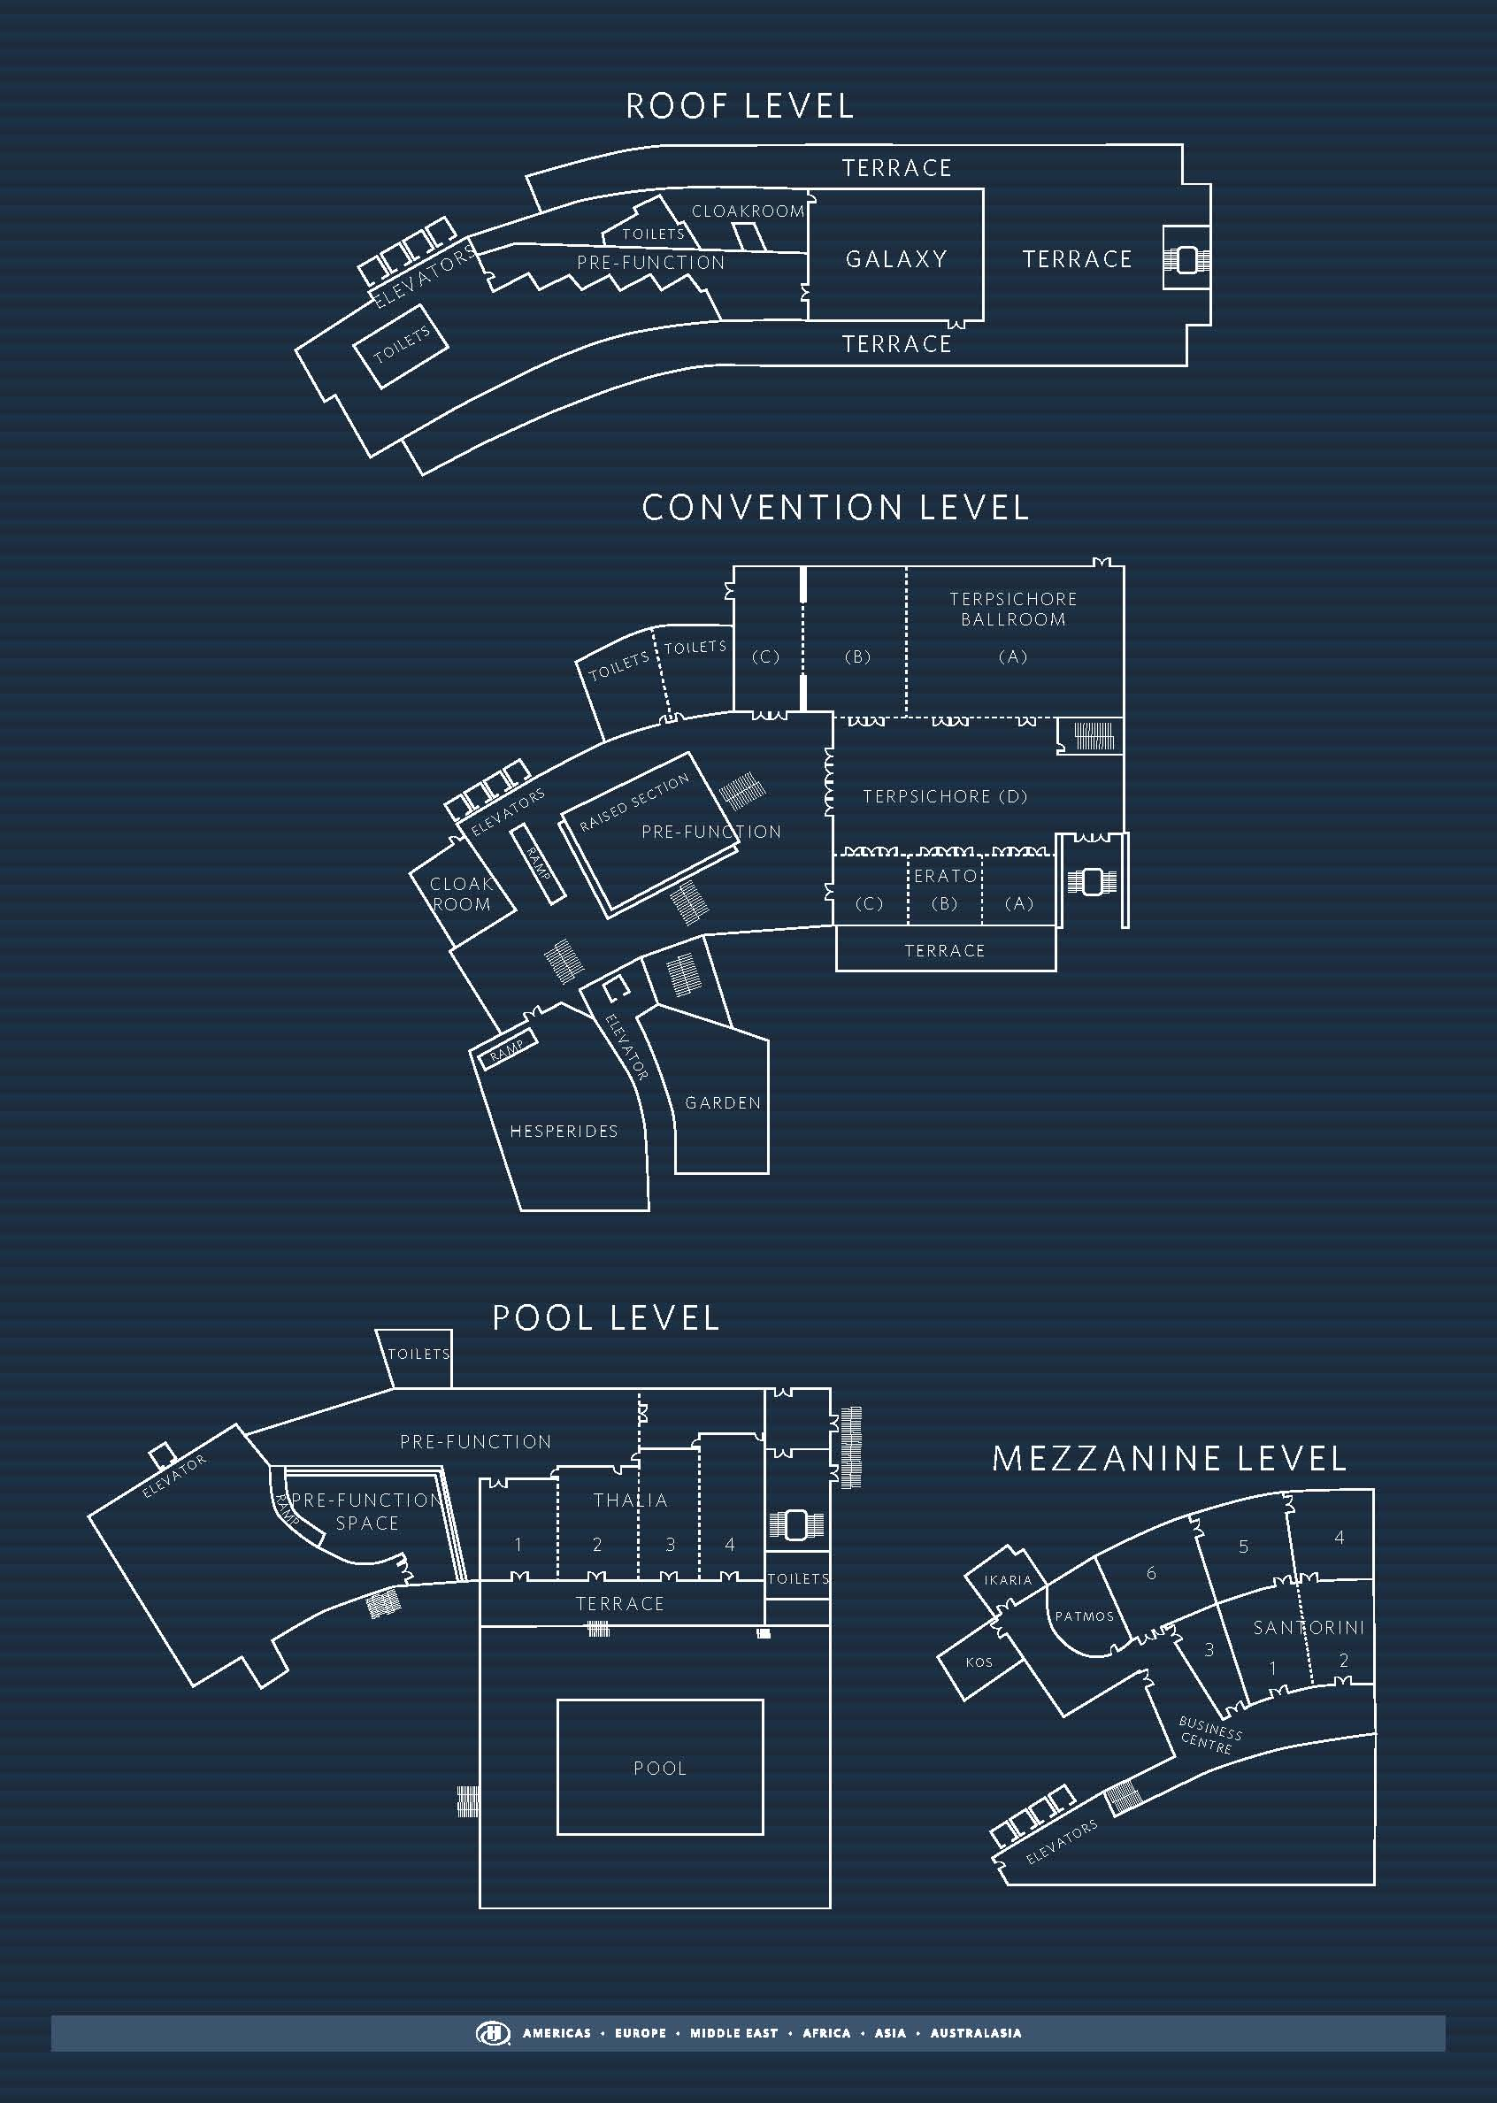
Jon Rosdahl, CSR

Slide 7
3.5 Next Meeting – IEEE 802 Plenary
November 2-7, San Antonio, TX, USA
  At the Hyatt Regency
  Meeting Registration and Hotel Registration are open
  Standard registration deadline: October 24th 2014.
  Hotel reservation deadline: October 18th.
For information and registration links, see http://www.ieee802.org/11/Meetings/Meeting_Plan.html

Slide 8
3.7 Recording Attendance
It is a requirement that attendees record their participation at an 802.11 session and declare their affiliation. This record is usually made using the IMAT attendance system.
  If you wish to participate without recording attendance, send an email per session to the WG 1st vice chair declaring your participation and affiliation. You cannot gain or maintain 802.11 voting membership using this method.
You must record 75% attendance of eligible 802.11 slots in a session for that session to count towards gaining or maintaining 802.11 voting membership
  You need a single IEEE-SA web account
    The IEEE SA web account requires a working email address
    do not remove your email address from the account
  Use the email address associated with that web account when registering attendance
    If you change email addresses, update the web account, don’t create a new web account, or your membership status may not be calculated properly
  Record attendance using this URL: https://imat.ieee.org/attendance
Jon Rosdahl, CSR

Slide 9
Session Graphic – Sept 2014
118 Normal Slots
4 extra Slots:
75% Attendance requires - 14
Closing plenary requires only 1 registration for 2 slot credit

Slide 10
3.8 File Server & Documentation

Slide 11
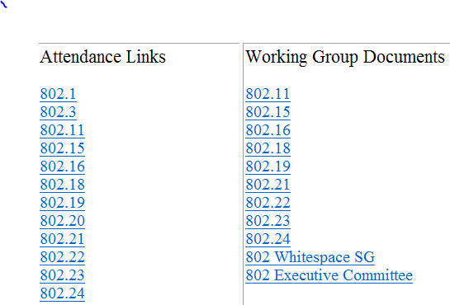
Local File Document Server information
Local FTP server: ftp://griffin.events.ieee.org (anonymous)
External Document Server https://mentor.ieee.org/802.11/documents

Slide 12
Synchronizing while at the meeting
Particularly important when external bandwidth is limited and unreliable
Use anonymous ftp
  Host: ftp://griffin.events.ieee.org
  User: anonymous
  Password: <your-email-address-here>
  Destination directory: /802.11/13
Freeware tools are available, for example search for “syncback free” **
** Other tools are available. The IEEE does not endorse the use of any particular tool.

Slide 13
Email Reflectors
There is an email reflector for the working group, plus one for each task group.
Write access to the reflectors allowed for those who are members with status: aspirant, nearly-voter, potential-voter, voter.
To make a request, visit the reflector request page:
http://www.ieee802.org/11/Reflector.html
  Gathers information and sends an email to Vice Chair
If you change email address – please let me know. I will perform a global change to the list servers.
Public read access to all reflectors is available via the 802.11 home page http://www.ieee802.org/11 on the “WG Email” menu.

Slide 14
Online Calendar
This session’s meetings are also shown on the 802.11 calendar on the 802.11 home page (http://www.ieee802.org/11).
This is a Google calendar “802_11_calendar@ieee.org”
There are multiple ways of accessing this information, for example from a cell-phone, or as a remote calendar.
Note: the schedule on this calendar will be updated, but any room changes will probably not be. Room changes will be posted on rooms.

Slide 15
Meals
- Breakfast is included in your room rate if you booked via the IEEE link with the Hilton
- Morning and Afternoon tea will be served in the foyer areas
- Lunch (1200 – 1330) will be at the Terpischore Ballroom –Convention Level
Jon Rosdahl, CSR

Slide 16
Wednesday Evening Social Function
Athens Orientation Tour, Acropolis Visit and Dinner
Date: Wednesday 17 September 2014
Time: 5.30pm - 9.30pm
Venue: Athens Tour and Dinner at Taverna Stamatopolous
Ticket cost: US$95 (ticket price includes Athens tour, entrance fees, guides, dinner and tips at dinner) –
due to capacity of the dinner venue, tickets are limited
Dress code: Casual (Reminder to wear comfortable shoes)
Dinner is included, however drinks are not so please bring cash to purchase drinks, credit cards are not accepted
Buses depart at 17:30 -- please meet in the hotel foyer at 17:20
Questions please see Sara or Daniel on the registration desk.
Notes:
http://www.arinex.com.au/ieee2014/schedule.php

Slide 17
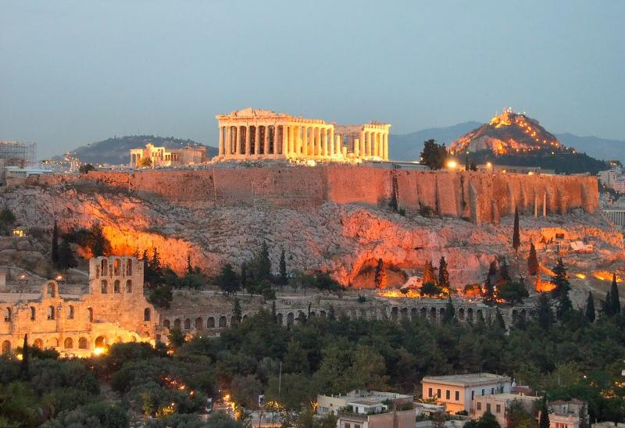
IEEE 802 WIRELESS INTERIM
WEDNESDAY EVENING SOCIAL
17 SEPTEMBER 2014
ATHENS ORIENTATION TOUR, GUIDED ACROPOLIS TOUR,
AND DINNER IN A LOCAL TAVERNA

Slide 18
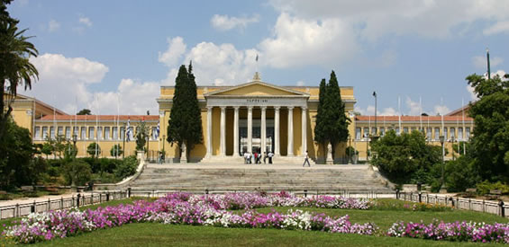
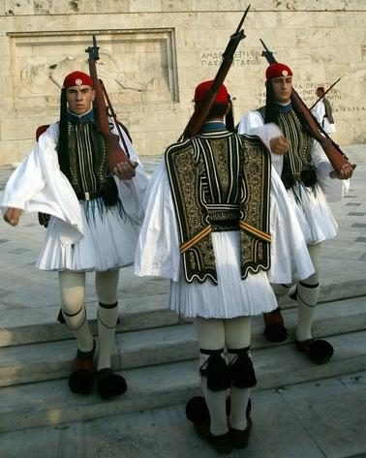
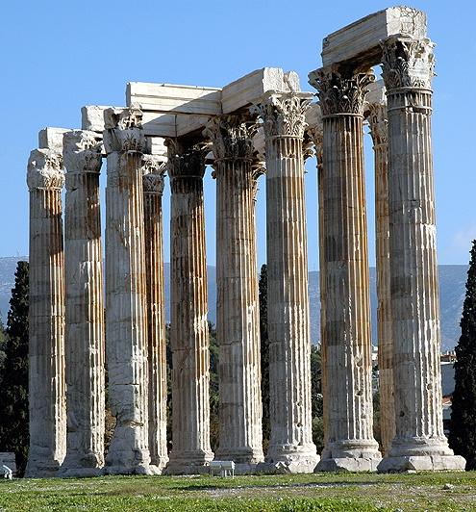
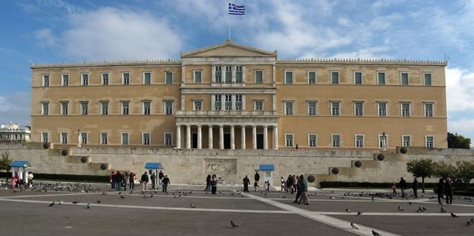
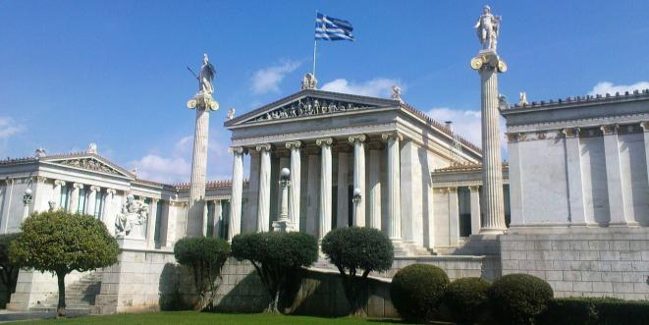
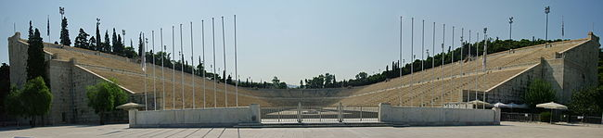
ATHENS ORIENTATION TOUR & ACROPOLIS VISIT
The tour starts with an orientation to the modern city of Athens during which guests will view the most important sites and buildings of the city.
Among the most memorable is the Greek House of Parliament, a neoclassical structure overlooking the Tomb of the Unknown Soldier where the traditional Changing of the Guard takes place and the Marble Stadium where the first modern Olympics took place in 1896. Also viewed on the tour are the National Garden with the Zappeion Mansion, the Academy, the University, the National Library, Iliou Melathron, the former home of the celebrated archaeologist Heinrich Schliemann and Hadrian’s Arch.

Slide 19
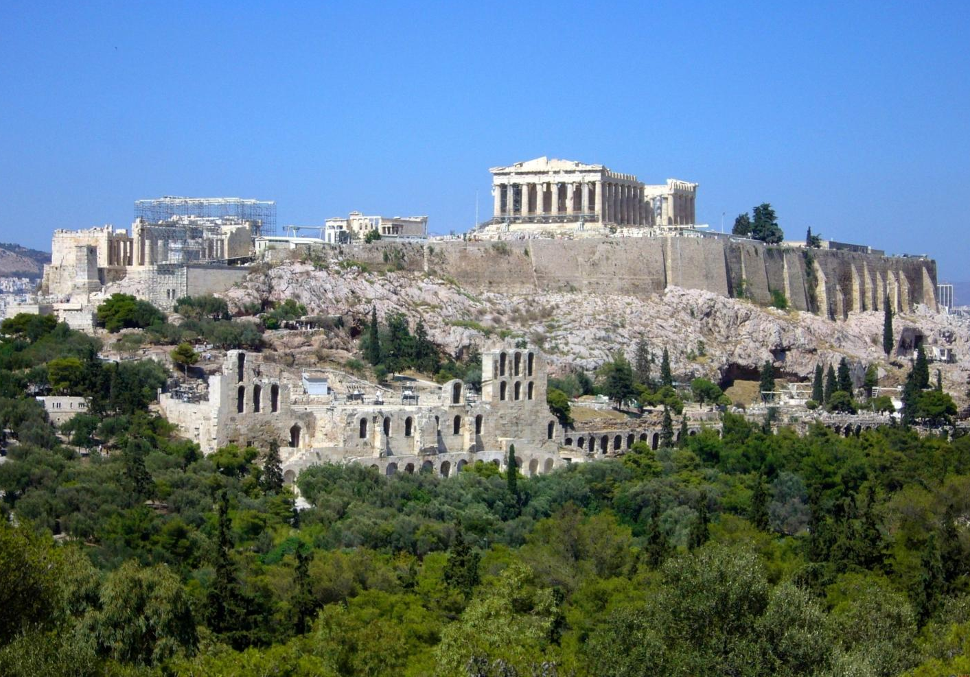
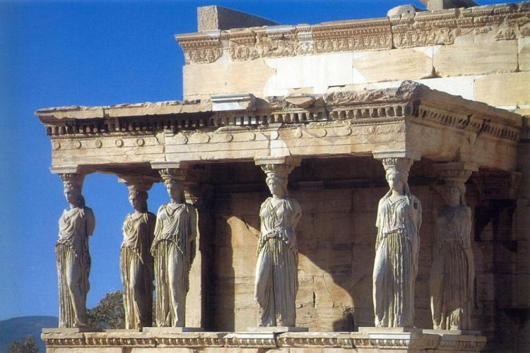
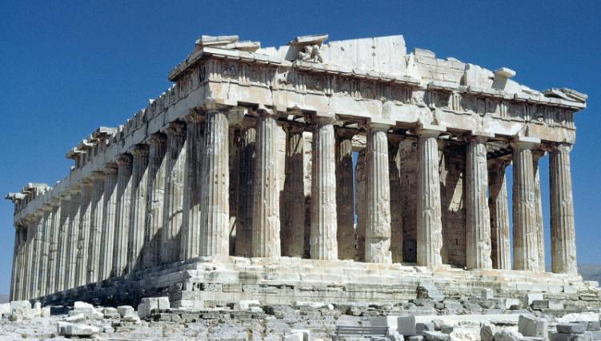
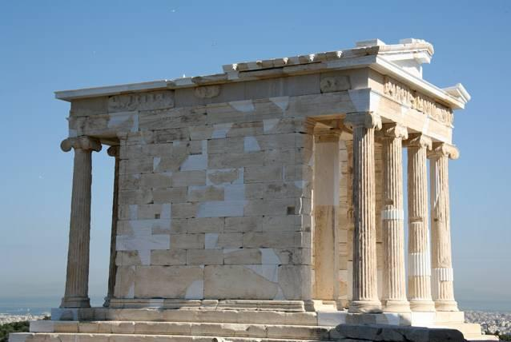
ACROPOLIS VISIT
Following the orientation tour, participants will drive to the base of the Acropolis, where a series of steps invite them to ascend to the top of this sacred rock. Upon reaching the top they will pass through the Propylaea, the stately entrance to the magnificent structures inside, which is flanked by the small ionic temple of Athena Nike and will be greeted by a spectacular view of the city and the entire basin of Attica.
Once inside, they will immediately see the Parthenon, by far the best known and most awe-inspiring of the structures on the Acropolis. To the north of the Parthenon is the Erechtheion, another well-recognized structure with its graceful porch of Caryatids.

Slide 20
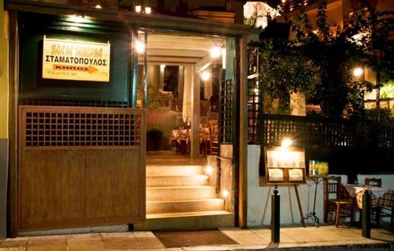
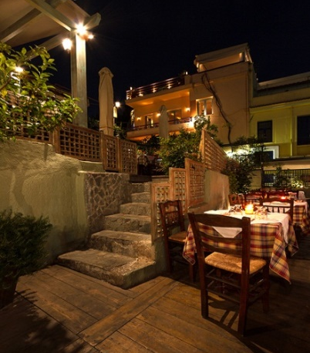
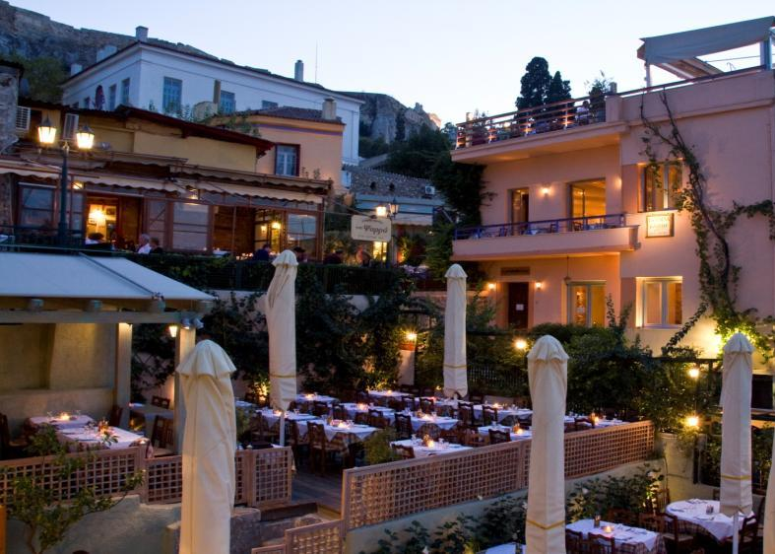
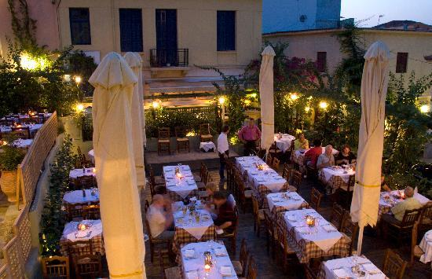
DINNER AT TAVERNA STAMATOPOULOS
TAVERNA STAMATOPOULOS
Following the Acropolis visit, a short walk will bring guests to “Taverna Stamatopoulos”, a traditional tavern located in the heart of Plaka, almost at the foot of the Acropolis, with very cozy atmosphere.
The Old Tavern of Stamatopoulos operates since 1882, at the north east of the sacred rock of the Acropolis. In the indoors section there are wall paintings with scenes of the early 20th century life in Athens. Very popular with locals and tourists alike, it offers excellent greek food and friendly service, with live Greek music every night.

Slide 21
SCHEDULE FOR ATHENS TOUR AND DINNER
Below is an approximate schedule of the orientation tour, acropolis visit and dinner on Wednesday 17 Approximate schedule of the orientation tour, acropolis visit and dinner on Wednesday :
5:30 pm Depart from Hilton hotel via coach
5:30 - 6:00 pm Athens orientation tour by coach
6:00 - 7:30 pm Guided tour of the Acropolis
7:30 - 7:45 pm Walk with the guides to “Taverna Stamatopoulos”
7:45 - 9:30 pm Dinner (set menu)
9:30 - 9:40 pm Walk to the pick-up point of the coaches
9:55 pm Arrive at the hotel

Slide 22
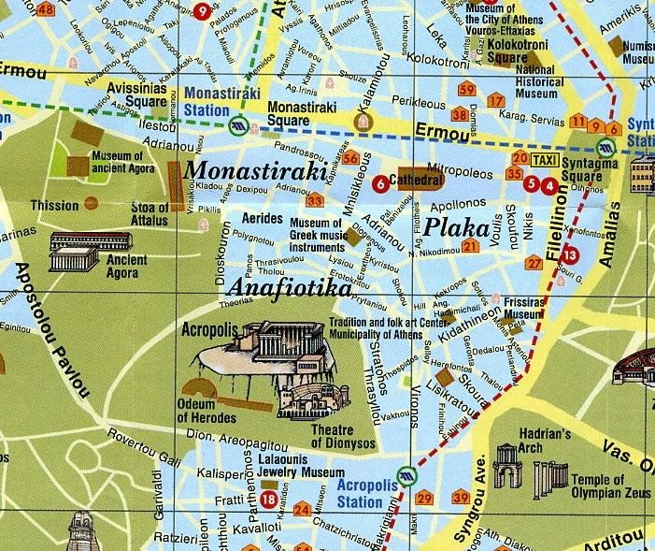
STAMATOPOULOS TAVERN
DROP-OFF FOR ACROPOLIS VISIT
BUS PICK-UP POINT AFTER DINNER
(Stamatopoulos)

Slide 23
Suggestions for Restaurants
- for suggestions for restaurants in the area, please visit the registration desk for a list of restaurant ideas
- Please note, most local restaurants only accept cash, particularly the smaller ones
Jon Rosdahl, CSR

Slide 24
IEEE 802 Wireless Interim Network Access
A wireless network and wired cafe will be available in the meeting space for all IEEE 802 Wireless Interim Session attendees.
For more in depth Network assistance please visit the Verilan Help Desk.
IEEE 802 Secure Wireless Network Access
Wireless Encryption Protocol: WPA2-PSK
SSID: Verilan-secure
Password: ieeeieee
Meeting Information Portal & Documents: http://newton.meeting.verilan.com

Slide 25
Meeting resource Summary
Wireless Network
  IEEE 802.11 a/g coverage in all meeting rooms
  SSID: Verilan-secure
  WPA2 PSK Password: ieeeieee
Links to Document DOWNLOADS
  http://newton.meeting.verilan.com
Document UPLOADS and document control numbers ONLY
  https://mentor.ieee.org
Attendance
  https://imat.ieee.org
Verilan Network Help Desk is located at the Registration Desk.
  Please visit for ALL network related questions

Slide 26
Hotel Network Access
Public Areas of the Hotel:
SSID: hhonors-public
Key: free2guest
Hotel Room:
SSID: hhonors – 20 Euro per day
Hilton Gold or Platinum free

