Slide 1
Discussion on 802.11ax functional requirements
Date: 2014-09-15
Authors:

Slide 2
Summary
System efficiency is one important metric in the approved PAR for 802.11ax for indoor and outdoor dense deployment scenarios [1].
There have been discussions in the HEW study group [2][3][4] and 11ax task group [5] for a functional requirements document.
A Functional Requirement document draft derived from the PAR document is proposed in [6], which highlights key scope concepts of IEEE 802.11ax. System efficiency is an important aspect covered in the function requirement draft.

Slide 3
Highlights of TGax PAR related to spectrum efficiency
Improve Average Throughput Per Station in dense deployment scenarios
4 times improvement for at least one mode of operation (measured at the MAC data SAP)
Target 5-10 times improvement
Define operations in frequency bands between 1 GHz and 6 GHz
Focus on the 2.4 GHz and the 5 GHz frequency bands and relative improvement to previous IEEE 802.11 amendments (IEEE 802.11n in 2.4 GHz and IEEE 802.11ac in 5 GHz ).
May add additional bands between 1 GHz and 6 GHz as they become available.

Slide 4
Key Aspects to System Spectrum Efficiency Improvement from PAR [1]
Improve WLAN efficiency in some objectives:
The increase in average throughput per station is not limited to four times improvement. Improvement values in the range of 5-10 times are targeted, depending on technology and scenario.
Make more efficient use of spectrum resources in scenarios with a high density of STAs per BSS.
Significantly increase spectral frequency reuse and manage interference between neighboring overlapping BSS (OBSS) in scenarios with a high density of both STAs and BSSs.
This project may include the capability to handle multiple simultaneous communications in both the spatial and frequency domains, in both the uplink (UL) and downlink (DL) direction.

Slide 5
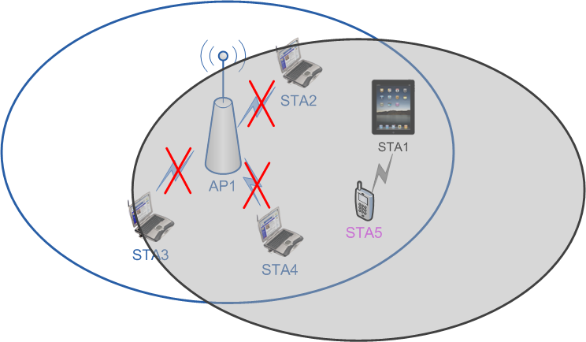
Identify Problem: Low spectrum efficiency for transmission between non-AP STAs of 802.11n&ac
Especially in dense deployment environment, one TDLS peer may block the whole BSS due to AP and about half number of STAs in BSS restricted from transmittal according to CSMA mechanism.
Current restriction may be excessive as TDLS may not need high transmission power since TDLS peers may be closely located.

Slide 6
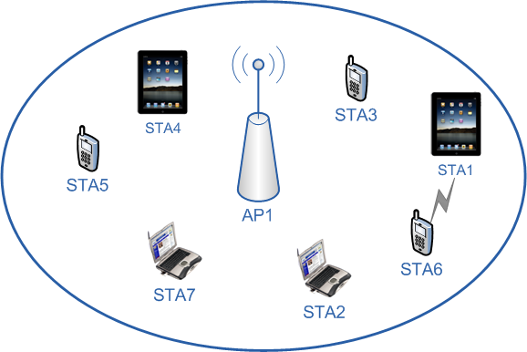
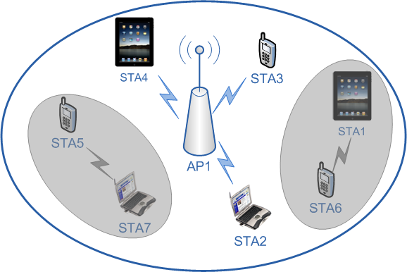
Example of 11ax spectrum efficiency enhancement
Existing legacy TDLS
Low spectrum efficiency since the transmission between non-AP STAs may block AP transmission, and further block the whole BSS .
Examples of transmission between non-AP STAs for 11ax
Allow multiple simultaneous communication links
Improve spectrum efficiency and management of interference

Slide 7
Extraction from PAR document [1]
*Source from PAR[1]
improve WLAN efficiency in some objectives:
The increase in average throughput per station is not limited to four times improvement. Improvement values in the range of 5-10 times are targeted, depending on technology and scenario.
Make more efficient use of spectrum resources in scenarios with a high density of STAs per BSS.
Significantly increase spectral frequency reuse and manage interference between neighboring overlapping BSS (OBSS) in scenarios with a high density of both STAs and BSSs.
This project may include the capability to handle multiple simultaneous communications in both the spatial and frequency domains, in both the uplink (UL) and downlink (DL) direction.

Slide 8
Extraction from current FR document discussion [6]
*Source from FR document[6]
Improve WLAN spectrum efficiency
The TGax amendment shall provide a mechanism to increase spectral efficiency of 20 MHz and larger channels in scenarios with high density of 11ax STAs with and without the presence of legacy STAs.
The TGax amendment shall provide a mechanism to increase spectral frequency reuse and manage interference between neighboring overlapping BSS (OBSS) in scenarios with a high density of STAs per BSS or a high density of both STAs and BSSs.
The description of spectrum efficiency improvement in the PAR is not fully addressed by [6]

Slide 9
A Proposal of FR amendment
In order to address the improve WLAN efficiency requirement in the PAR, we propose the following functional requirement in 2.2.1 (spectrum efficiency) in [6]
The 802.11ax amendment shall provide a mechanism to improve frequency reuse efficiency and manage interference in the deployment scenarios with high density of 11ax STAs and with the presence of transmission between non-AP STAs

Slide 10
Motion
To instruct the Editor to add the following text to the draft FRD document 11-14-1009-01-00ax-proposed-802-11ax-functional-requirements, in subclause 2.2 Spectrum Efficiency, page 4 as:
TGax Rn The 802.11ax amendment shall provide a mechanism to improve frequency reuse efficiency and manage interference in the deployment scenarios with high density of 11ax STAs and with the presence of transmission between non-AP STAs
Moved: Phillip Barber
Seconded:
Yes No Abstain
[Outcome of Motion]

Slide 11
Reference
[1] 11-14-0165-01-0hew-802-11-hew-sg-proposed-par
[2] 11-14-0306-00-0hew-discussions-on-hew-functional-requirements
[3] 11-13-1411-00-0hew-from-par-to-functional-requirements-of-hew
[4] 11-13-0524-00-0hew-discussions-on-functional-requirements
[5] 11-14-0636-00-00ax-discussion-on-functional-requirement
[6] 11-14-0567-03-00ax-proposed-tgax-functional-requirements
[7] 11-14-1009-01-00ax-proposed-802-11ax-functional-requirements

