Slide 1
In-Cabin WiFi Channel Channel:
Preliminary Ray Tracing Simulations
Date: 14-July-2014
Authors:
* The contributors were with Carnegie Mellon University when the research project was conducted.

Slide 2

Wireless on the go
Source: http://www.internet-go.com/

Slide 3
Motivation
In-cabin wireless networks are attractive
Enable passengers to use their own devices during road trips
Important to obtain information about the wave propagation in the vehicle cabin
In-cabin use cases and corresponding scenarios should be considered for next-generation WiFi design.

Slide 4
Challenges of In-cabin WiFi environments
Confined spatial extents
Coupled with objects inside the cabin
Communication systems are required to operate without making drastic modifications to the environment

Slide 5
This work
Measures the RSSI values of WiFi channel (operated at 2.4 GHz) native to a mid-sized vehicle cabin enclosure
Studies the wireless channel using ray-tracing mechanism
Presents a simple simulation approach
Validates simulations by comparison with measurements

Slide 6
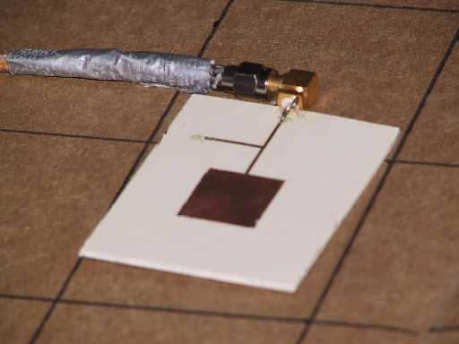
Transmit: Patch Antenna
Flat – easy to attach to roof/dash/seat, etc
Radiates Perpendicular to Antenna – place on flat surface without loosing signal
Simple Design
  Easy to produce
  Unobtrusive

Slide 7
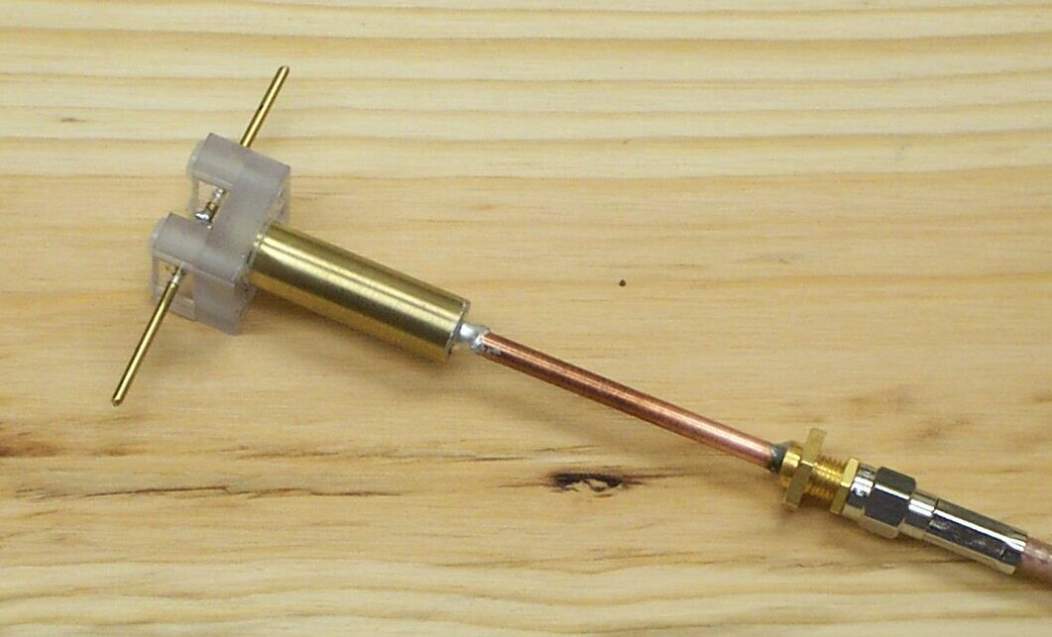
Receive: Dipole Antenna
Radial – Easy to capture single polarization
Vertical Design – ability to “probe” within the vehicle
Simple Design
  Easy to Prototype

Slide 8
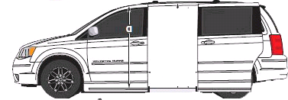
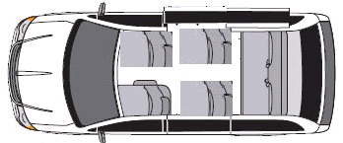
Test Vehicle: a mid-size vehicle

Slide 9
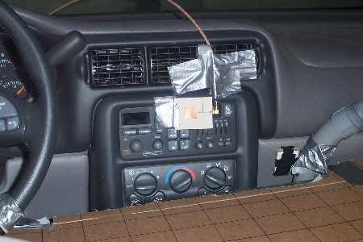
Test Vehicle Setup
Transmitting antenna:
Patch antenna placed on dashboard
Empty vehicle

Slide 10
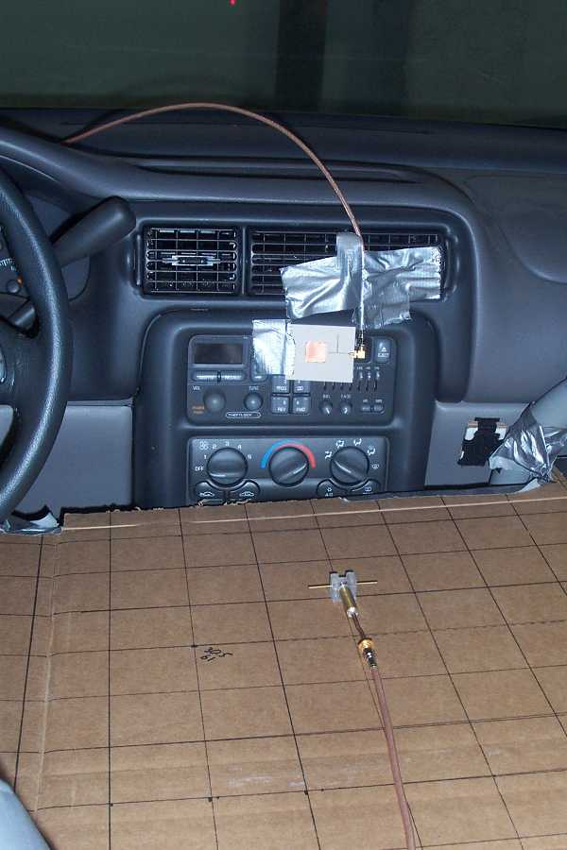
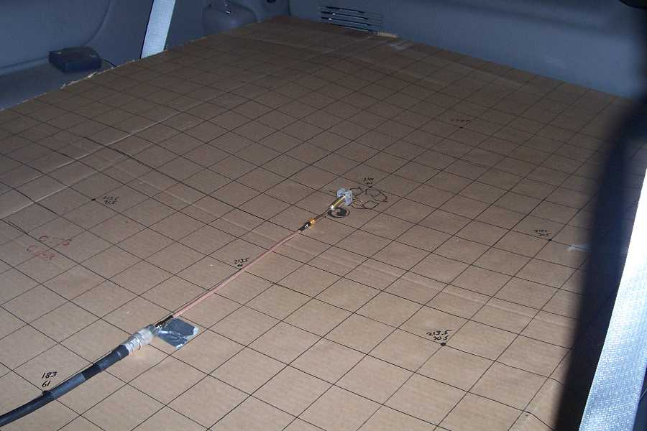
Test Procedure
Measured power received throughout the vehicle on a planar grid using a dipole antenna
Measurements made every half wave-length
Dipole can be oriented differently to observe the X, Y, and Z components of the field

Slide 11
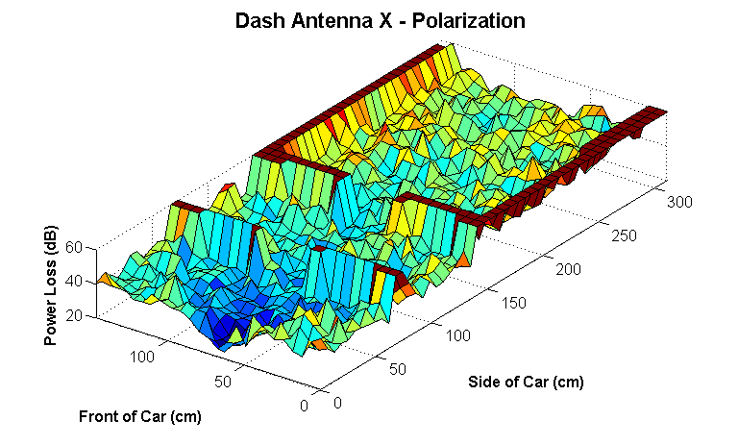
Dashboard Transmitter: Power loss (dB)
Notes:
11

Slide 12
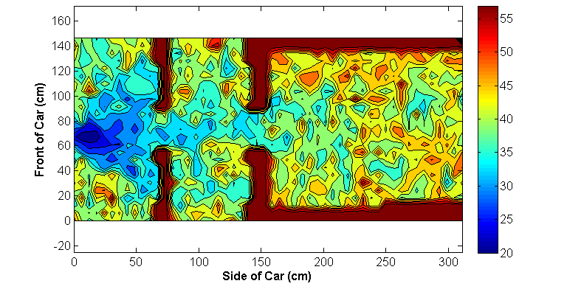
Dashboard Transmitter:
Notes:
12

Slide 13
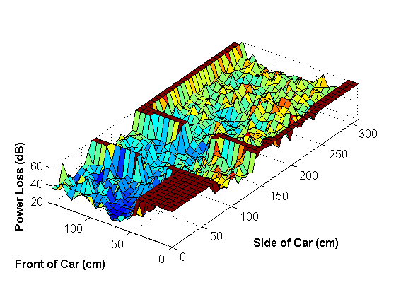
Dashboard Transmitter with Driver:
Power loss (dB)
Notes:
13

Slide 14
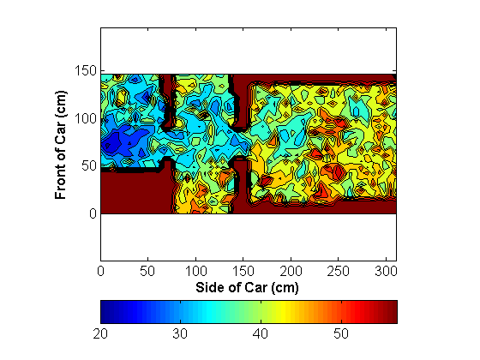
Dashboard Transmitter with Driver:
Notes:
14

Slide 15
This preliminary study considers
Dashboard transmitter
In-cabin geometry as a rectangular prism
Model the existence of dominant reflections for various in-cabin surfaces (up to 5 rays)
Image-based Ray-tracing method
  Simplest model: angle independent antennas
  More realistic: patch on dashboard with mobile dipole

Slide 16
Representative Mid-Size Vehicle Example
A mid-size vehicle

Slide 17
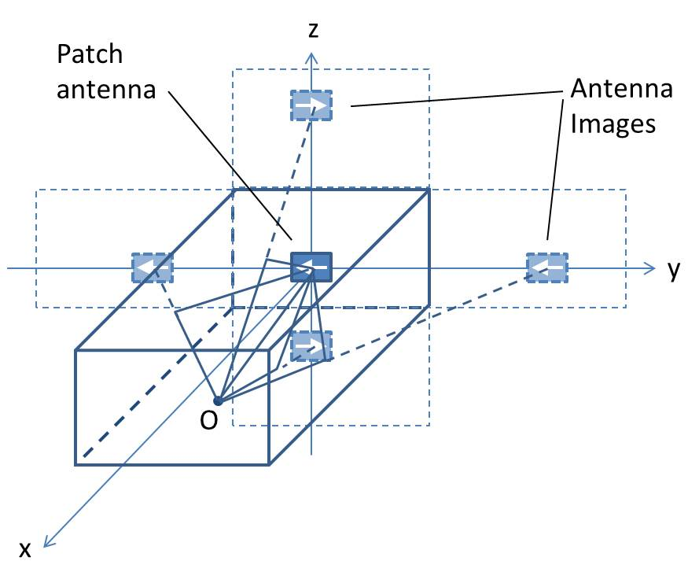
Geometry

Slide 18
Simplest Model: Angle-independent
Assume gains of both dash and mobile antennas do not depend on angle
  Product of gains taken to be adjustable parameter
Keep signs of images, but otherwise take reflection coefficients to be adjustable parameters
Keep only specular reflections from sides, bottom, and top
Assume always polarization matched

Slide 19
Simulation Example
The model is capable of generating the dB loss for any point in the cabin
Example: consider deploying receiving devices at 2.4 GHz on a 52 by 25 grid with half-wavelength separations. This results in 1300 (52 by 25) grid locations
Using the 1-ray(5-ray) model, we simulated the dB loss at these locations and generated a contour plot interpolated based on these simulated values

Slide 20
Comparison of 1-ray with measurements
Measurement: Patch & dipole polarized along Y
Measurement plane 10 cm below patch
Gain product giving best LMS match to data: 2.4 dB
RMS residual: 5.28 dB

Slide 21
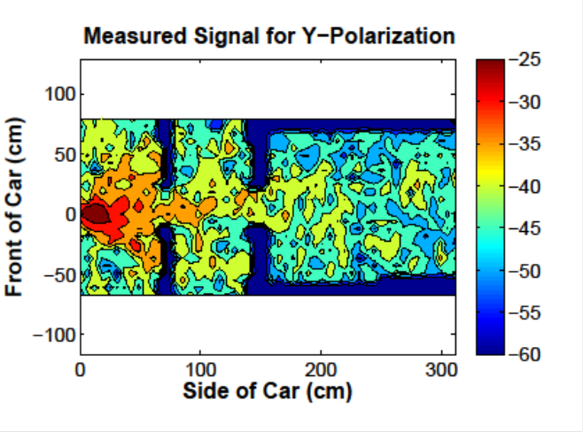
Add Reflections to obtain same RMS residual with 1-ray
R=0.66
RMS = 5.28 dB
RMS=5.26 dB

Slide 22
More Realistic Model: Patch + Dipole
Use actual fields from Y-polarized patch on dashboard
Use vector effective length of dipole mobile antenna
As before use gain-product and reflection coefficients as adjustable parameters
Consider three orthogonal polarizations

Slide 23
Comparison of 1-ray with measurements
Measurement: Patch & dipole polarized along Y
Measurement plane 10 cm below patch
Gain product giving best LMS match to data: -0.4 dB
RMS residual: 4.71 dB

Slide 24
Add Reflections to obtain same RMS residual with 1-ray
R=0.66
RMS = 4.7 dB
RMS=4.71 dB

Slide 25
X Polarizations

Slide 26
Summary and Conclusions
Despite the multipath in the cabin, 1-ray (direct path) models perform reasonably well for co-polarized component (RMS error ~ 5dB)
Crude model with angle-independent gain only about ½ dB worse RMS error than using actual fields from patch & dipole
Single specular reflections can be used to generate fluctuations with similar RMS values and distributions as those measured
Empirically, it appears depolarization from scattering dominates much of the region of interest for cross-polarized components, so specular-reflection models are less useful.

Slide 27
References
[1] M. Peter, R. Felbecker, W. Keusgen, J. Hillebrand "Measurement-based investigation of 60 GHz broadband transmission for wireless in-car communication." Vehicular Technology Conference Fall (VTC 2009-Fall), 2009 IEEE 70th. IEEE, 2009.
[2] P. Smulders, "Exploiting the 60 GHz band for local wireless multimedia access: prospects and future directions, " Communications Magazine, IEEE, vol.40, no.1, pp. 140-147, 2002.
[3] M. Peter, W. Keusgen, and M. Schirrmacher, "Measurement and analysis of the 60 GHz in-vehicular broadband radio channel, " in Vehicular Technology Conference, 2007. VTC 2007-Fall. 2007 IEEE 66th, Sep.-Oct. 2007.
[4] P. Wertz, D. Zimmermann, FM Landstorfer, G. Wolfle, and R. Hoppe, "Hybrid ray optical models for the penetration of radio waves into enclosed spaces," in IEEE Vehicular Technology Conference, 2003, vol. 1, pp. 109-113.
[5] M. Heddebaut, V. Deniau, and K. Adouane, "In-vehicle WLAN radio- frequency communication characterization," Intelligent Transportation Systems, IEEE Transactions on, vol. 5, no. 2, pp. 114-121, 2004.
[6] O. Delangre, S. Van Roy, P. De Doncker, M. Lienard, and P. Degauque, "Modeling in-vehicle wideband wireless channels using reverberation chamber theory," IEEE Vehicular Technology Conference, pp. 2149-2153, 2007.
[7] F. Bellens, F. Quitin, F. Horlin, and P. De Doncker, "UWB channel analysis within a moving car, " The 9th International Conference on Intelligent Transport Systems Telecommunications (ITST), 2009. IEEE, pp. 681-684.
[8] Y. Katayama, K. Terasaka, K. Higashikaturagi, I. Matunami, and A. Kaji- wara, "Ultra-wideband impulse-radio propagation for in-vehicle wireless link," IEEE Vehicular Technology Conference, VTC-2006 Fall. 2006.
[9] Y. Nakahata, K. Ono, I. Matsunami, and A. Kajiwara, "Performance evaluation of vehicular ultra- wideband radio channels, " IEEE Vehicular Technology Conference, 2008. VTC 2008-Fall, pp. 1-5.
[10] J. Mar, Y.-R. Lin, and Y.-co Yeh, "Ultra-wide bandwidth in-vehicle channel measurements using chirp pulse sounding signal," IET Sci. Meas. Technol., vol. 3, iss. 4, pp.271-278, July 2009.
[11] T. Kobayashi, "Measurements and characterization of ultra wideband propagation channels in a passenger-car compartment," IEEE ISSTA 2006, pp.228-232, Aug. 2006.
[12] M. Schack, J. Jemai, R. Piesiewicz, R. Geise, I. Schmidt and T. Kurner, "Measurements and analysis of an in-car UWB channel," Proc. IEEE Vehicular Technology Conference 2008-Spring, pp.459-463, May 2008.

