Slide 1
Performance Gains from CCA Optimization
Date: 2014-07-15
Authors:

Slide 2
Overview
Earlier IEEE contributions [1][2] provided PHY system simulation results showing performance gains (mean and 5% per-STA throughput) from CCA optimization, for simulation scenario 1
Here we provide results showing significant CCA optimization gains for simulation scenarios 1, 2, and 3, with a focus on scenario 2

Slide 3
Simulation Parameters
26 dBm AP, 18 dBm STA
  All results are for 1x1
    Chose above numbers to reflect 4 antenna AP with 20 dBm per AP antenna and 2 antenna STA with 15 dBm per antenna
Downlink only
5 GHz, 80 Mhz channels
  NF = 7 dB -> noise floor of -88 dBm
Effective SNR computed using Shannon capacity
  Essentially equal to geometric mean of SNR (i.e., linear average of per-tone dB SINR)
Genie MCS, with following required SNR’s per MCS:
MCS | 0 | 1 | 2 | 3 | 4 | 5 | 6 | 7 | 8 | 9
SNR (dB) | 3.2 | 7.0 | 9.6 | 11.8 | 15.5 | 18.8 | 20.4 | 21.9 | 25.0 | 27.0

Slide 4
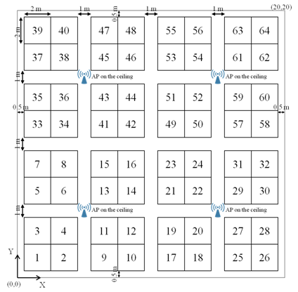
Scenario 2: Wireless Office
8 offices in 4x2 configuration, and each office has 4 AP’s (uniformly spaced) and 128 STAs (2 STAs per cube, 64 cubes per office)
5 GHz, 80 MHz, 4 channels with fixed channelization pattern per office
  11nD PL + 11nD NLOS multipath + 4 dB iid shadow + 7 dB wall
4x2 office layout
Office layout (4 AP’s, 64 cubicles)

Slide 5
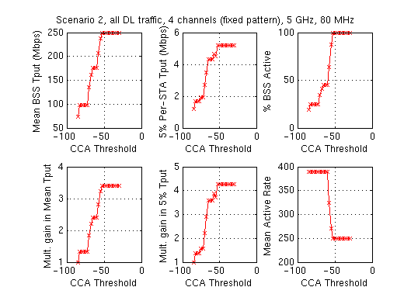
S2: Performance vs. CCA (AWGN, no shadow)
Mean and 5% throughput monotonically increase with CCA, and see gains of 3.5X and 4X, respectively

Slide 6
S2: Geometry
20m
4
1 2
4
1 2
4
1 2
4
1 2
20m
4
1 2
4
1 2
4
1 2
4
1 2
Due to fixed channelization and fixed AP locations, distance between co-channel AP’s is 20m (+ 7 dB/wall) -> 84 dB PL
  1 wall separated APs: -58 dBm, Diagonally separated: -70 dBm
  2 wall: -76 dBm, 2 wall + diagonal: -84.6 dBm
  3 wall: -89 dBm, 3 wall + diagonal: -97 dBm
Distance from STA to nearest AP ranges from 2.1m to 6.67m
  Vertical distance is always 1.5m due to AP on ceiling (3m) versus STA at 1m
  Corresponding PL range is 53 dB to 63 dB, so RX power range is -27 dBm to -37 dBm
4 distinct CCA regimes with 18.75%, 25%, 45%, and 100% of AP’s on
  Worst-case SINR with all AP’s on is 14.4 dB

Slide 7
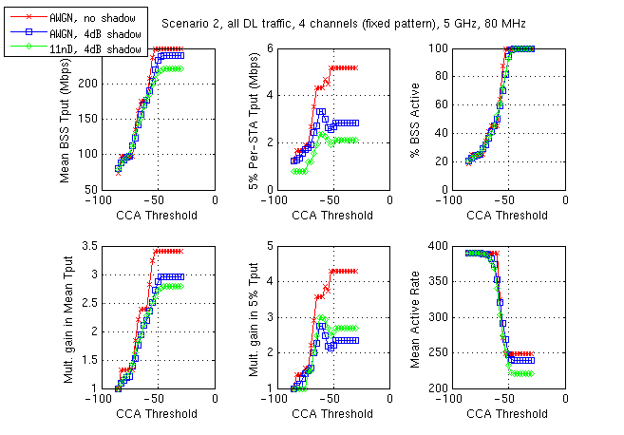
S2: Effect of Shadowing and Fading
Shadowing and fading smooth out curves, but trends are similar to AWGN no shadowing
  Key difference is in 5% tput: for no shadowing increases monotonically with CCA, whereas with shadowing/fading see a peak in 5% tput around -70 dBm
  Shadowing rather than fading is the big difference maker

Slide 8
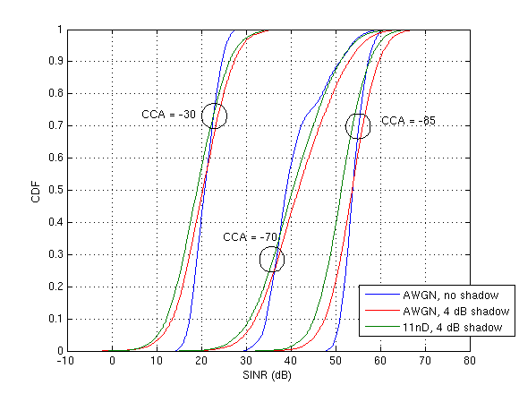
S2: SINR CDF’s
Shadowing significantly widens distribution of active link SINR, which reduces 5% per-STA throughput at CCA levels > -70 dBm
Introduction of fading mostly shifts CDF curve, rather than widening distribution
Fixed channelization yields good effective SINR’s even with all AP’s on (CCA = -30 dBm)
  Median: 19 dB, 5% point: 10 dB

Slide 9
Scenario 3: Indoor Small BSS
Hexagonal cells with ICD = 17.32 m (R = 10m)
11nD PL (bp = 10m) + 11nD NLOS multipath + 4 dB iid shadowing
  Identical to S2
Reuse 3 and reuse1
BSS
BS
BSS
BSS
BSS
BSS
BSS
BSS
BSS
BSS
BSS
BSS
BSS
BSS
BSS
BSS
BSS
BSS
BSS
Reuse 3
Reuse 1

Slide 10
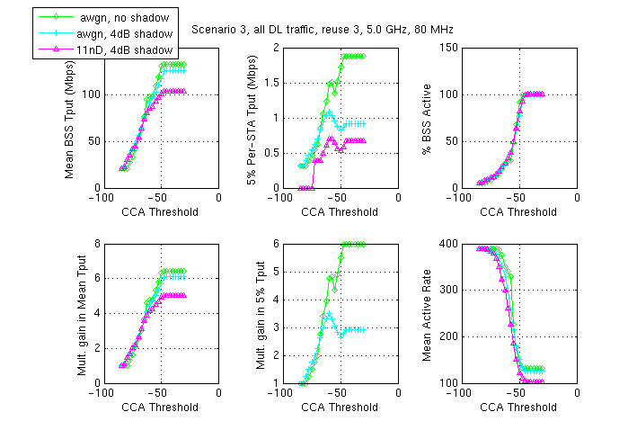
S3 (reuse 3): Performance vs. CCA
Similar to S2, AWGN no shadowing displays monotonically increasing mean and 5% tput, but the addition of shadowing/fading leads to 5% tput peaking around -70 dBm
  Both S2 and S3 (reuse3) have fixed reuse patterns that lead to a guaranteed (in absence of shadowing) high SINR at cell edge

Slide 11
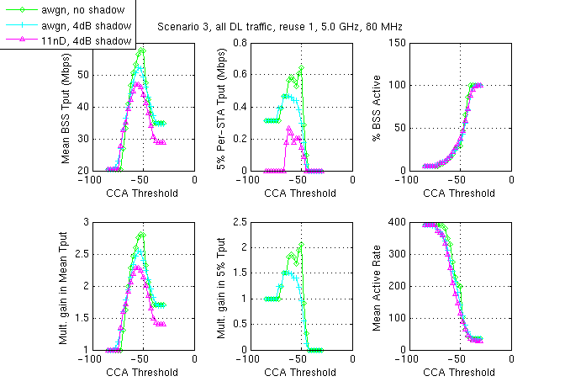
S3 (reuse 1): Performance vs. CCA
>2X gains in mean tput, but smaller gain in 5% tput
5% tput drops to zero for very aggressive CCA threshold

Slide 12
Scenario 1 - Residential
100 apartments, 20 per floor (2x10), 5 floors. 10x10x3m dimensions
5 GHz, each BSS randomly picks 1 of 3 80 MHz channels
One AP and 10 STA’s per apartment
  STA always associates to AP inside same apartment
  Every device randomly located within apartment
11nB PL + 11nD NLOS multi-path + 4 dB iid shadow
  5 dB loss per wall (linear sum), 18.3 dB/floor (nonlinear sum)

Slide 13
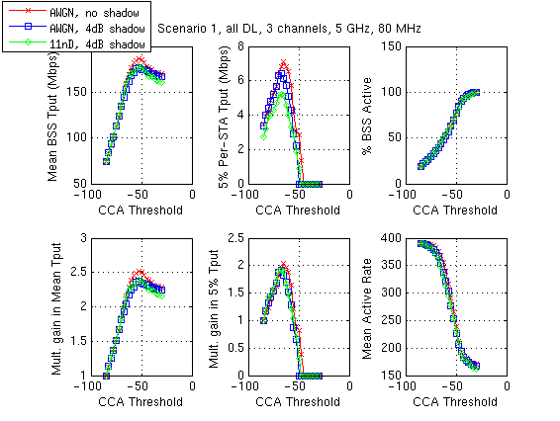
S1 with 3 channels: Performance vs. CCA
Mean tput peaks with CCA around -55 dBm, whereas 5% tput peaks at ~ -70 dBm

Slide 14
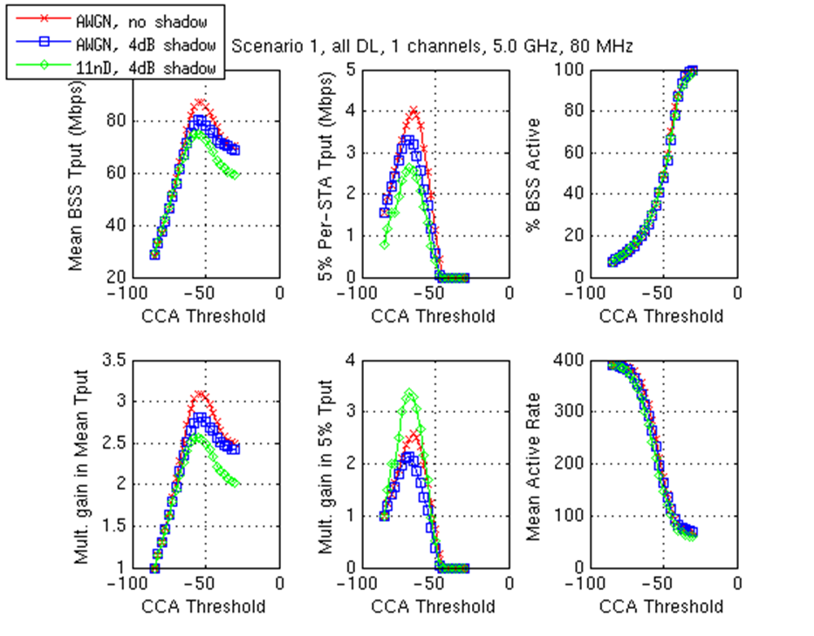
S1 with 1 channel: Performance vs. CCA
Similar trends as 3 channel S1, but even larger gains

Slide 15
Summary
CCA optimization provides very significant gains for simulation scenarios 1, 2, and 3, in terms of mean and 5% throughput
  2X or greater feasible in many scenarios
  Scenario 4 still under investigation, although expect smaller gains due to large cell size
Dynamic CCA threshold selection still an open problem
PHY system simulations showing (considerably) larger gains from CCA optimization than MAC simulations – what does this mean?
  Indicates large opportunity to improve performance
  An appropriately modified MAC should be able to achieve all/much of this gain – especially in scenarios where “simple” network behavior provides large gains
    E.g., Scenario 2 – turning all AP’s on dramatically increases mean and 5% throughput

Slide 16
References
[1] “Improved Spatial Reuse Feasibility – Part I”, IEEE 802.11-14/0082r0
[2] “Improved Spatial Reuse Feasibility – Part II”, IEEE 802.11-14/0083r0

