Slide 1
Security and Privacy Enhancements for 802.11
Date: 2014-07-15
Authors:

Slide 2
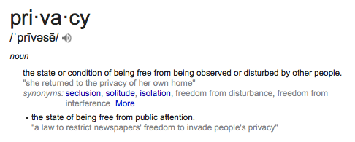
Security and Privacy

Slide 3
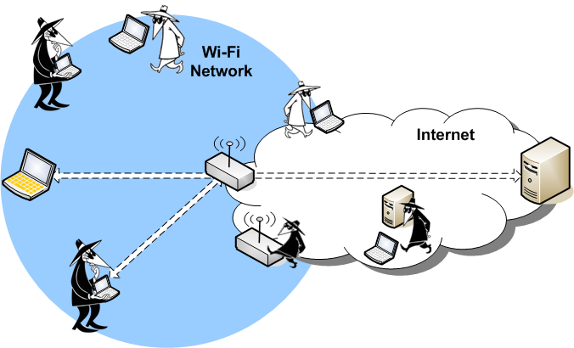
Wireless Threats for 802.11 Communications
The location and capabilities of an attacker in the network is a useful way to categorize vulnerabilities.

Slide 4
802.11 Security – What Could be Improved
Wireless security is hard to setup and use in consumer devices
Passwords are still the dominate way consumer products setup 802.11 security
Why are
Open, WEP and TKIP are still being used
WEP and TKIP should be removed from 802.11
Opportunistic Security could eliminate Open
802.11 lacks adequate support for peer-to-peer authentication

Slide 5
Opportunistic Security
“In contrast to the established approach of delivering strong protection some of the time, opportunistic security strives to deliver at least some protection most of the time. The primary goal is therefore broad interoperability, with security policy tailored to the capabilities of peer systems.”
http://datatracker.ietf.org/doc/draft-dukhovni-opportunistic-security

Slide 6
Strong Device-to-Device Authentication
IEEE 802.11 does not have a “good” solution for device-to-device authentication
Preshared keys are problematic:
Difficult to install
Poor authentication (can be reshared)
EAP based methods are designed to use a remote server
Difficult to configure
Few APs have built in server (one approach for perr-to-peer)

Slide 7
Device-to-Device Authentication Possible Use Cases and Benefits
Simplified secure device discovery
All devices have an provable identity
Enables good peer-to-peer security
Easy device enrollment and installation
Provable identity greatly simplifies installation process
Simplified installation of headless devices (sensors, etc)
Cost and complexity reduced for systems needing centralized authorization

Slide 8
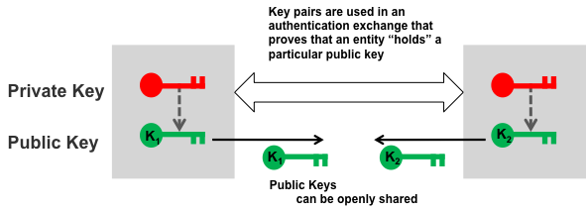
Peer-to-Peer Identity Framework
Every device has a public / private key
hash of public key is used as identity
True peer-to-peer (either side can initiate)
Preassociation key exchange
based on well defined cryptographic standards (ECDH, etc.)
Used to simplify user experience for device enrollment

Slide 9
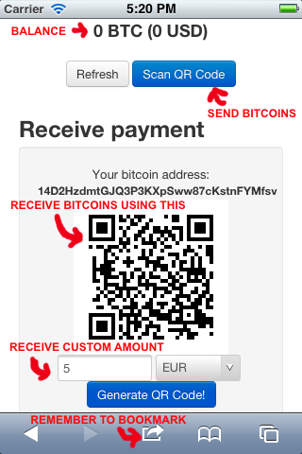
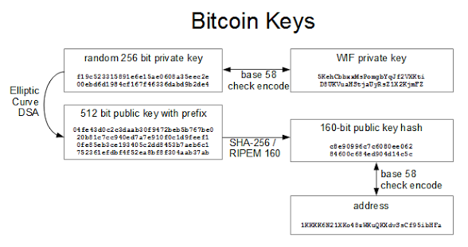
Examples of Hash Based Cryptographic Identifiers
Bitcoin
e.g. 1HB5XMLmzFVj8ALj6mfBsbifRoD4miY36v
IPv6 and HIP (RFC 5201)

Slide 10
Simple Device Enrollment
Devices have a identity out-of-the box
Self generated key pair
Binding of wireless authentication to a specific device
Label based on public key (truncated readable hash)
Remote enrollment based on knowing identity
Enrollment authentication may be facilitated by
QR code, NFC, Bluetooth
Human label validation

Slide 11
Scalable Access Authorization
Can I₂ enter network?
K₁
K₂
I₁
I₂
K_{i} is device unique public key
Access control servers do NOT need to hold any secrets
I_{i} is device unique identifier from hash of K_{i}, Cipher Suite

Slide 12
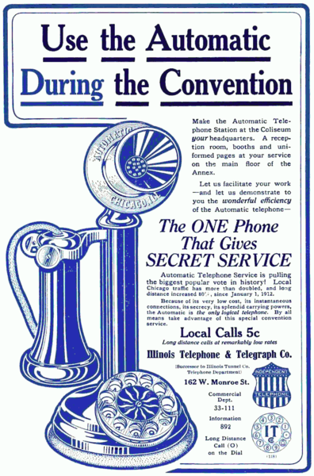
Communication privacy is not a new issue.
Privacy was an important selling point for dial based phones (1912) since they did not require an operator.
http://en.wikipedia.org/wiki/Privacy

Slide 13
Wi-Fi Privacy Concerns
Seattle Police Deactivate Wi-Fi Spy Grid After Privacy Outcry (Nov 2013)
A DHS and Seattle police network collecting location information
CreepyDOL WiFi surveillance project debuts at Blackhat/DEFCON (Aug 2013)
DIY surveillance with low-cost Wi-Fi based sensors that capture MAC addresses
Wi-Fi Trashcans Now Silently Tracking Your Smartphone Data (Aug 2013)
... the company boasted that the cans, which included LCD advertising screens, "provide an unparalleled insight into the past behavior of unique devices"—and hence of the people who carry them around
"Technopanic" mounts over Google's Wi-Fi Privacy violations (Mar 2013)
A DHS and Seattle police network collecting location information

Slide 14
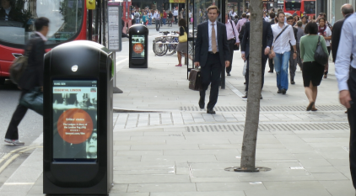
But wait – Wi-Fi “location” is also a service!
Location-based Wi-Fi services can add immediate value to Wi-Fi deployments (Oct 2013)
“Knowing where someone is can be important because you are then in a better position to do something for or with them.”
In-Location Alliance (Nov 2013)
“There are countless uses for accurate indoor positioning ...”
Renew - Wi-Fi based market information (Nov 2013)
The Renew Network extends to over three million professionals in the City of London everyday. Our units have been strategically placed to achieve optimum viewing time, enabling our clients to receive a constant and continuous space to accommodate commercial campaigns.

Slide 15
Privacy Threats
Source of Threats:
Hackers, private investigators, stalkers, paparazzi
Marketing firms and retail outlets
Police, Government Agencies
Non-threats:
Marketing firms and retail outlets (with user approval)
Personal home automation (of home user)
... Etc.
It is very important to identify ways to enable tracking when it is a “service”, but prevent unauthorized tracking

Slide 16
What we should avoid as a 802.11 privacy solution
From one system vendor:
“Participation in Wi-Fi location services is completely up to the customer or visitor - they can opt out simply by turning off their Wi-Fi signal.”

Slide 17
Privacy versus other Security Services in 802.11
Privacy protection is provided by encryption and authentication
But this just protects the disclosure “data”
Good security (e.g. RSN) is a first step and is not the subject of this analysis and is assumed as a starting point
Privacy of identity and location must consider other information in 802.11 frames that can be used to track a device
the MAC address
Active probing and SSIDs

Slide 18
Where can 802.11 privacy be improved?
MAC Addresses are unique per device
Enable detailed tracking by passive capture
MAC addresses may be used in IPv6 addresses and carried beyond the WLAN and will directly identify the connecting device
SSIDs are sometimes unique
Enable tracking when used in probe requests and indicate a devices commonly used APs
The profile of multiple SSIDs used in probing are a good fingerprint of a users identity
802.11u is unprotected and may indicate user interests
Others?

Slide 19
Passive Scanning and Monitor APs
The primary scenarios to consider that are a “threat” and not “services” are passive monitoring and APs used for monitoring

Slide 20
Possible Technical Solutions for Privacy
Ephemeral MAC Addresses
use local addresses that change occasionally
Limit active scanning
Define alternate ways to discover “services” and Aps
Capability bits to indicate “willingness to be tracked”
Others?

Slide 21
Ephemeral MAC Addresses
Virtual STAs could be defined that allow a device to have a different MAC address for each BSSID
What happens to DHCP allocation and routing tables?
Rapid changes are a problem, occasional changes are enough to prevent correlation of a device to a human
Not easy to change with an active association
But could only change on new connections
Roaming and fast handoff might be impacted
But MAC addresses could remain the same for roaming and only change when not actively associated
Careful use of Ephemeral MAC Addresses would provide significant improvements in 802.11 address privacy!

Slide 22
A few Proposals for 802.11 Privacy Enhancements
2002 - Temporary MAC Addresses for Anonymity
2004 - Anonymous MAC Addresses
2008 - SlyFi-Enhancing_80211_Privacy
2013 - Service Discovery Proposal
2013 - 802.11 Privacy
2014 - random-macs-for-privacy
2014 - Privacy Enhanced Wireless
IEEE 802.11-14/0367r2 Privacy Enhanced Wireless
“When a STA is not a member of a BSS it should periodically change its MAC address to a random value. “
IEEE 802.11 should adopt 802.11-14/0367r2

