Slide 1
Unified Traffic Model on
Enterprise Scenario
Date: 2014-07-14
Authors:

Slide 2
Abstract
This presentation provides a unified traffic model for scenario 2 - Enterprise scenario, integrating the multiple traffic types used in Enterprise scenario. The unified Enterprise traffic model is intended to be used for Systems Simulation on Enterprise scenario only.
Notes:
doc.: IEEE 802.11-08/1101r3
September 2008
John R. Barr, Motorola, Inc.
Page 2

Slide 3
Motivation
There are many traffic types in Enterprise scenario (scenario 2) [1][2]. It is complicated for the system simulation to implement each traffic model in actual simulation.
A unified traffic model can simplify the traffic implementation and be convenient to provide common configuration of the traffic.
Notes:
doc.: IEEE 802.11-08/1101r3
September 2008
John R. Barr, Motorola, Inc.
Page 3

Slide 4
Modeling Scope
Video conference, Teleconference using VoIP, Training based internet streaming, and VDI are four typical services in Enterprise scenario.
A unified Enterprise traffic model based on the configuration in the table below is provided in this proposal.
Traffic name | Percent of STAs in Test Population (%)
Buffered Video Streaming | 5 (training)
Video Conferencing | 10 (video conference)
Virtual desktop infrastructure | 100
Voice (VoIP) | 15
Notes:
doc.: IEEE 802.11-08/1101r3
September 2008
John R. Barr, Motorola, Inc.
Page 4

Slide 5
Modeling Scheme
Assuming there are a certain number of STAs (e.g. 100), each STA generates traffic of identified service according to the traffic model schedule for the test interval (e.g. 50 seconds); 40 STAs active simultaneously at any point in time during the test interval.
Acquire simulation sample data including size of each packet and packet generation time.
Develop statistics on the data: plot the CDF curve of packet arrival interval, and CDF curve of packet size, for downlink and uplink.
Notes:
doc.: IEEE 802.11-08/1101r3
September 2008
John R. Barr, Motorola, Inc.
Page 5

Slide 6
Model Abstraction
Common parameters are abstracted according to the assumptions and observations:
Packet arrival interval
  Model as an exponential distribution
  Parameter is estimated by maximum likelihood estimation
Packet size
  Model as a mixed distribution
Notes:
doc.: IEEE 802.11-08/1101r3
September 2008
John R. Barr, Motorola, Inc.
Page 6

Slide 7
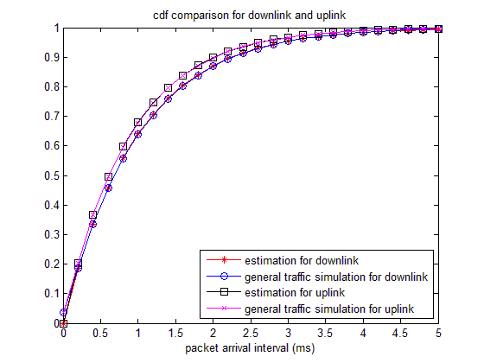
Parameter of Packet Arrival Interval
 | Uplink | Downlink
Mean (ms) | 0.876 | 0.977
Packet arrival interval is modeled as exponential distribution, whose pdf as
Lambda is the parameter of the exponential distribution.
Both packet arrival interval distributions, for uplink and downlink, are modeled as exponential distributions
Notes:
doc.: IEEE 802.11-08/1101r3
September 2008
John R. Barr, Motorola, Inc.
Page 7

Slide 8
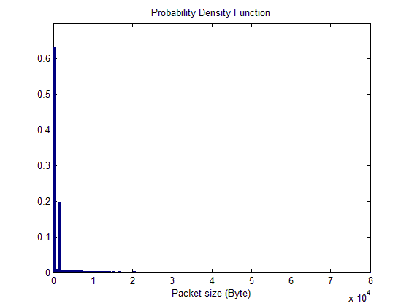
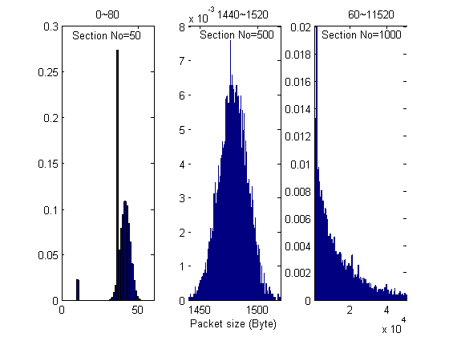
Distribution of Downlink Packet Size
Packet size (Byte) | 0~60 | 1140~1520 | others
Percentage (%) | 62.30 | 19.13 | 18.57
Fitting Distribution | Normal | Normal | Exponential
Mean | 39.04 | 1478.37 | 15635.22
Standard Deviation | 5.76 | 11.73 | N/A
Notes:
doc.: IEEE 802.11-08/1101r3
September 2008
John R. Barr, Motorola, Inc.
Page 8

Slide 9
Packet Size Model for Downlink
Probability Density Function (PDF) is modeled as:
Notes:
doc.: IEEE 802.11-08/1101r3
September 2008
John R. Barr, Motorola, Inc.
Page 9

Slide 10
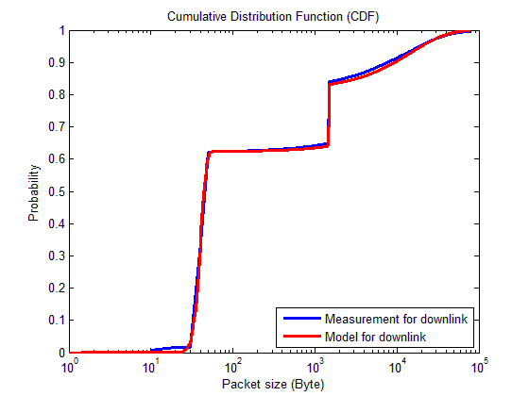
CDF of Downlink Packet Size
Notes:
doc.: IEEE 802.11-08/1101r3
September 2008
John R. Barr, Motorola, Inc.
Page 10

Slide 11
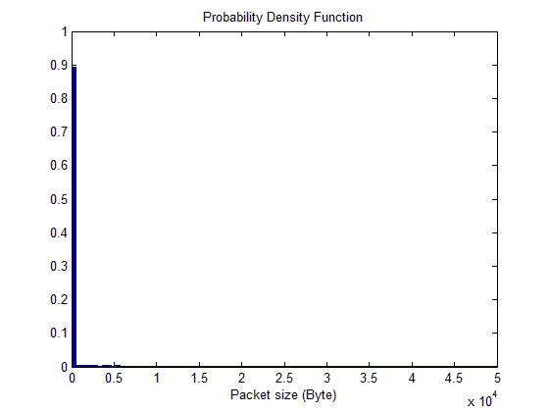
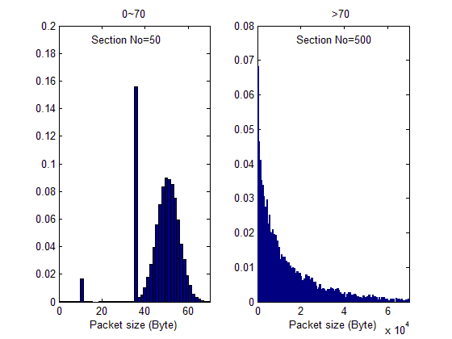
Distribution of Uplink Packet Size
Packet size (Byte) | 0~70 | >70
Percentage (%) | 88.74 | 11.26
Fitting Distribution | Normal | Exponential
Mean | 47.63 | 15601.42
Standard Deviation | 8.60 | N/A
Notes:
doc.: IEEE 802.11-08/1101r3
September 2008
John R. Barr, Motorola, Inc.
Page 11

Slide 12
Packet Size Model for Uplink
Probability Density Function (PDF) is modeled as:
Notes:
doc.: IEEE 802.11-08/1101r3
September 2008
John R. Barr, Motorola, Inc.
Page 12

Slide 13
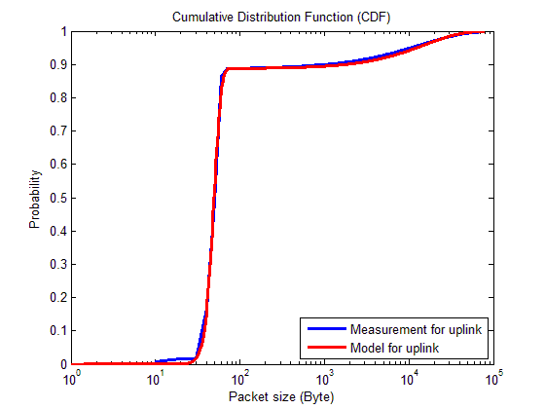
CDF of Uplink Packet Size
Notes:
doc.: IEEE 802.11-08/1101r3
September 2008
John R. Barr, Motorola, Inc.
Page 13

Slide 14
Summary
The packet arrival interval is modeled as exponential distribution for downlink and uplink.
The packet size is modeled as mixed distribution for of downlink and uplink.
Slide 14
Slide 14
Notes:
doc.: IEEE 802.11-08/1021r0
July 2008
Peter Loc
Page 14
doc.: IEEE 802.11-08/1101r3
September 2008
John R. Barr, Motorola, Inc.
Page 14

Slide 15
References
[1] 11-14-0571-02-00ax-evaluation-methodology
[2] 11-14-0621-04-00ax-simulation-scenarios
Slide 15
Slide 15
Notes:
doc.: IEEE 802.11-08/1021r0
July 2008
Peter Loc
Page 15
doc.: IEEE 802.11-08/1101r3
September 2008
John R. Barr, Motorola, Inc.
Page 15

