Slide 1
UL & DL DSC and TPC MAC simulations
Date: 2014-07-14
Authors:

Slide 2
Abstract
In this presentation we share system simulations results obtained from the evaluation of a Dynamic Sensitivity Control (DSC) mechanism (for both UL and DL) as well as results evaluating the potential of Transmission Power Control (TPC)

Slide 3
Context
DSC [1], [2] has been shown to provide performance improvements in UL
However, the majority of the traffic is still in DL direction; hence DL optimization techniques need also be considered
Transmit Power Control (TPC) is another proposed feature that shows promising results

Slide 4
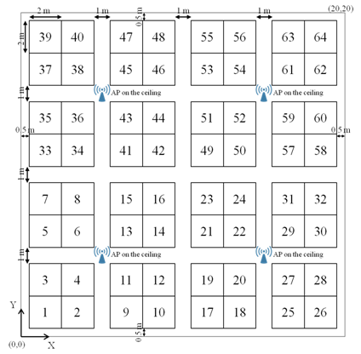
Simulation scenario 2:
Enterprise
“Enterprise Scenario” as defined in [3]
  8 offices, 64 cubicles per office, 2 STAs per cubicle
    (8 x 64 x 2) / 32 = 32 STA/AP
  4 x 20MHz channels (8 APs on the same channel)
    32 x 8 = 256 STAs on the same channel
  COST231 propagation model
Web-browsing and local file transfer AP<->STA
No P2P links included

Slide 5
Simulation assumptions
MAC layer simulator
802.11n
Tx Power AP = 20dBm
Tx Power STA = 20dBm
Antennas AP: 2Tx, 2Rx
Antennas STA: 2Tx, 2Rx
Reference CCAT = -82dBm

Slide 6
Traffic assumptions
Files arrive independently in the buffers of the STAs(UL) and the APs (DL, files labelled with a receiver STA)
Arrival process is a Poisson process
Arrival intensity of DL and UL files has ratio 80/20
Different system loads are modelled by varying arrival intensity, the file size is kept constant
Sample file size is 1MB

Slide 7
Definitions
Packet throughput = packet size / packet delay
Packet delay = time from packet arrives in buffer until time the last ACK is received
User throughput = average of packet throughputs for a user
Served traffic = Sum of all successfully received packets / simulation time
Served traffic ~ system arrival intensity * packet size

Slide 8
UL:
Dynamic sensitivity control
The DSC mechanism evaluated in this work consists of each STA autonomously setting their respective Rx sensitivity threshold as:
RxSensT= RSSI – MAR
  RSSI is received signal strength from AP
  MAR is a parameter that controls how aggressive the algorithm is
CCA threshold (CCAT) is set as:
  CCAT = max(CCAT_default, RxSensT)
In these evaluations MAR = 15dB

Slide 9
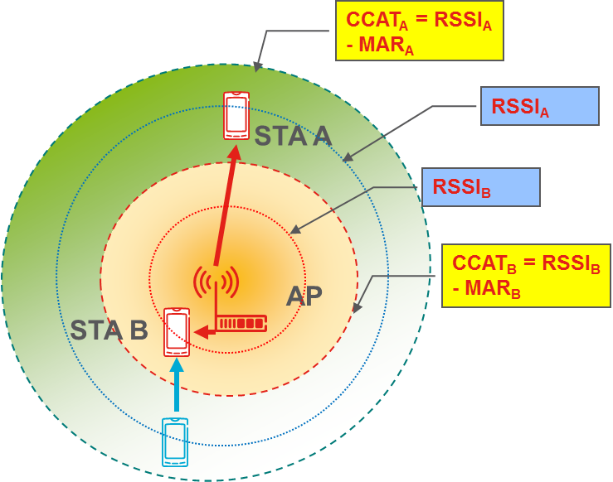
DL:
AP per-link CCAT adaptation
The AP per-link CCAT evaluated in this work consists of the AP setting an individual CCAT for each STA:
CCAT_{A} = max(CCAT_{Default}, RSSI_{A} – MAR_{A} )
CCAT_{B} = max(CCAT_{Default}, RSSI_{B} – MAR_{B} )
  RSSI_{A, B} are the received signal strength for
  STAs A and B respectively
  MAR_{A, B} are parameters that controls
  how aggressive the algorithm is
In these evaluations
MAR_{A} = MAR_{A} = 15dB

Slide 10
Enterprise scenario:
Sensitivity control
Some gains from DSC in user throughput for all links (left figure), mainly impacts the UL (right figure)
DSC in combination with AP per-link CCAT shows great potential, improves both DL & UL user throughput

Slide 11
SINR and Delay time
DL SINR is reduced but still very high
Queuing time is reduced

Slide 12
Enterprise scenario:
Combined results
Capacity for 20Mbps user throughput requirement (95%)

Slide 13
Transmit power control (TPC)
DL power reduction: DL power is set to reach a target SNR at the potential STA location with highest pathloss
  Time-varying DL TPC where the associated STA with highest pathloss is used to set the power could also be investigated.
  Link-dependent DL TPC could also be investigated
UL power control: UL power is set to reach a target SNR at the AP
Target SNR DL & UL is 30dB

Slide 14
Enterprise scenario:
Power control
Ref: DL: 20dBm, UL: 20dBm
DL Pwr: Adjust AP DL power to get target SNR at STA with highest pathloss
UL PC: Adjust STA UL power to get target SNR at AP
77%
30%

Slide 15
Conclusion
DSC improves performance in UL
Setting the CCAT at AP (for transmission in DL) gives improvements in DL
Combining DSC and DL CCAT setting gives a well balanced UL & DL performance.
TPC gives system capacity gains

Slide 16
References
[1] 11-14-0779-00-00ax-dsc-practical-usage
[2] 11-14-0523-00-00ax-mac-simulation-results-for-dsc-and-tpc
[3] 11-14-0621-04-00ax-simulation-scenarios

