Slide 1
Traffic modeling and system capacity performance measure
Date: 2014-07-14
Authors:

Slide 2
Abstract
In this presentation we present a simple traffic modelling method as well as system capacity evaluation methodology

Slide 3
Traffic model:
File transfer & Web browsing
STA positions from the simulation scenario document [1] are considered as tentative STA locations, i.e., STAs are not connected/active all the time, just when they have data in the buffer
Files arrive independently in the buffers of the STAs(UL) and the APs (DL, files labelled with a receiver STA)
Arrival process is a Poisson process
Arrival intensity of DL and UL files has ratio, e.g, 80/20 (parameter to be agreed on)
Different system loads are modelled by varying arrival intensity, the file size is kept constant
Sample file size is 1MB

Slide 4
Traffic model:
Video streaming
Similar approach may be applied for video streaming traffic
Randomly select which users are streaming the video
Introduce the packets in the buffer regularly instead of randomly (i.e., CBR)
The load will be determined by how many users are doing streaming

Slide 5
System capacity evaluation:
Definitions
Packet throughput = packet size / packet delay
Packet delay = time from packet arrives in buffer until time the last ACK is received
User throughput = average of packet throughputs for a user
Served traffic = Sum of all successfully received packets / simulation time
Served traffic ~ system arrival intensity * packet size

Slide 6
System capacity evaluation:
Delay terminology
The packet delay can be further divided into:
  Queuing time – waiting while someone else uses the medium
  Contention time – backoff and deferrals
  Transmission time – transmitting
  Collision time – transmission time for failed transmissions
Data
arrives
Backoff
expires
Backoff
expires
Collision
Queuing
time
Contention
time
Transmission
time
Collision
time

Slide 7
System capacity evaluation:
Example
Consider 1 AP
Arrival intensity 1 packet / second
Packet size 1MByte = 8Mbit
AP load is 8Mbps
During 100s there will on average be 100 packets
These will all have different packet throughput
Assume the average packet throughput is 40 Mbps
→ average delay is 0.2s → 80s out of 100s there are no ongoing transmissions in the AP
Packet tpt
P2
P3
Served traffic volume =
100 packets x 8Mbit = 800Mbit
Served traffic load = 800Mbit/100s.
= 8Mbps
64 Mbps
P1
P100
32 Mbps
8 Mbit
8 Mbit
8 Mbit
8 Mbit
1/4 s.
3/4 s.
1/8 s.
1 s.
100 s.

Slide 8
System capacity evaluation:
Example graph
Decreased user experience
Increased file arrival intensity

Slide 9
System capacity evaluation:
Performance measurements
As system load (traffic intensity) increases, the delay times in accessing the channel, and the interference probability, will increase → lower user throughput
We define the system capacity as the maximum load the system can handle, while still providing sufficient performance
The “sufficient performance” criterion may be defined as “95% of the time, the users should experience throughput above 20 Mbps”, i.e., 5th percentile throughput > 20 Mbps

Slide 10
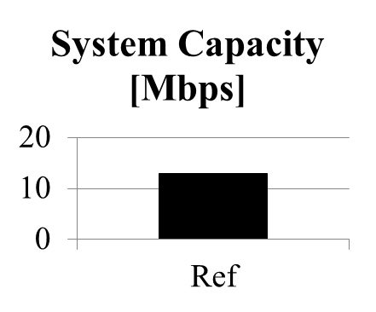
System capacity evaluation:
Sample performance
Performance
requirement
(e.g., 20Mbps)
System capacity: 13 Mbps/AP

Slide 11
Conclusion
Traffic modeling is not related to how many STAs per BSS there are, but rather how much traffic load there is in a certain scenario (i.e., certain area)
System capacity should be measured by the amount of traffic that the system can handle, maintaining a certain level of user experience
Proposals:
  Model file transfer, web browsing and video streaming using the proposed method
  Evaluate system capacity using the proposed methodology

Slide 12
References
[1] 11-14-0621-04-00ax-simulation-scenarios

