Slide 1
ACI and AACI for 802.11ax System Simulations
Date: 2014-07-16
Authors:

Slide 2
Summary
Impact of Adjacent channel interference (ACI) or alternative adjacent channel interference (AACI) needs to be taken into consideration in system simulation
  Scenarios where overlap BSS working in adjacent channel or alternative adjacent channel have significant ACI and AACI problems, which are necessarily to be evaluated to determine its impact on system performance.
Two types ACI impairments and their impact on system performance
  For blocker modeling in RX side, ACI is more in the form of band selection filter/blocker rejection filter residue and its negative impact also strongly associated with anti-aliasing filter. (ACI/AACI from RX perspective)
  AC/AAC leakage increases neighboring channel noise floor level, degrading CCA level detection sensitivity and receiver performance. The modeling is derived from SM and EVM specified in the standard at TX side and would be major theme of this slide. (ACI/AACI from TX perspective, plus the path loss, converted to essential impact/noise level in the RX)
Yu Cai, Huawei Technologies

Slide 3
ACI/AACI due to OOB Emission
We focus on the calculation of OOB emission based on SM and EVM table shown in the following slide.
  Calculation in TX side only needs to know the signal waveform in TX side.
  Signal waveform might also be irregular. Fortunately, standard of 802.11 specify Spectrum Mask (SM) and relative constellation error (RCE=EVM). Arbitrary signal (MCSx) waveform can be derived from SM+EVM table based on the model proposed in this slide.
Calculation of ACI/AACI due to OOB Emission based on arbitrary signal waveform in TX side + effect of wireless channel can results in its impact on the receiver noise floor.

Slide 4
OOB Emission and PA non-linearity
OOB Emission normally comes from non-linearity of PA, we also called it as out of band leakage.
Normally we can used adjacent channel power ratio (ACPR) and alternative adjacent channel power ratio (AACPR) to evaluate it. But it also needs to calculate ACI and AACI. Then ACPR=Channel Power/ACI, AACPR=Channel Power/AACI.
The other simple way of evaluating OOB Emission is through SM, which can give us qualitative impression how bad the ACI, AACI is. Normally SM represents the worst case of tolerable signal waveform.
Rapp model can be used to evaluate how non-linearity of PA exert its impact on signal waveform. We can control the shape of signal waveform by changing backoff value from P1dB to adjust PA’s non-linearity and its OOB Emission and ACI, AACI. The effect is shown in the next slides.

Slide 5
PA non-linearity vs. backoff value and its impact on ACP [2] (Rapp model p=3)
Backoff
from Full
Saturation
P = 3
backoff=3.4dB
backoff=4.6dB
backoff=8.1dB
backoff=12.0dB
backoff=16.0dB

Slide 6
Example: Simulation scenarios and path loss (PL) calculation
TX₁
ch₂
TX₂
P_{TX2}=20dBm
P_{TX1}=17dBm
ch₁
Path loss can be calculated in terms of channel D path loss model.
MCS₀,
d₁=15m,
40MHz
MCS₃,
d₂=20m,
80MHz
P_{RX1}=P_{TX1}-PL(15)=-49.27dBm
P_{RX2}=P_{TX2}-PL(20)=-50.64dBm
RX
PL(d)=LFS (d_{BP})+35*log10(d/ d_{BP})+SF d> d_{BP} =10m for Channel D
SF=0,
L_{FS} (d)=20*log10(d)+20*log10(f)-147.5 f=2.4*10^9 Hz
PL(d)= 20*log10(f)-147.5 +35*log10(d)-15*log10( d_{BP})
f=2.4*10^9 Hz, d_{BP}=10m
PL(d₁)=66.27dB
PL(d₂)=70.64dB

Slide 7
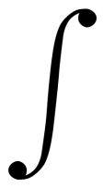
Example: ACI and AACI calculation with 2 adjacent channel bandwidth of 40MHz
ch₁
ch₂
ACPR|[chx,chy](dB)= Pch_{x}(dB)-ACI|[chx,chy](dB)
AACPR|[chx,chy] (dB)=P|chx(dB)-AACI|[chx,chy](dB)
ACI calculation is by integrating all the signal power which leak to the adjacent band.
ACPR|[chx,chy] is the adjacent channel power ratio between the signal in channel x and the leakage from the signal in channel x to channel y.
Signal waveform in RX in CH1
Signal waveform in RX in CH2
-100MHz
-60MHz
-20MHz
20MHz
60MHz
Noise floor
AACI
ACI
P
-20MHz
20MHz
P_{ref}|ch₁ =
PSDch₁
P_{ref}|ch₂ =
PSDch₂
-60MHz
-20MHz
20MHz
-20MHz
ACI|[ch₁,ch₂] =
PSDch₁
ACI|[ch₂,ch₁] =
PSDch₂
-20MHz
-60MHz
60MHz
-60MHz
AACI|[ch₁,ch₂] =
PSDch₁
AACI|[ch₂,ch₁] =
PSDch₂
20MHz
-100MHz

Slide 8
AC/AAC leakage in TX + Path Loss = Additive noise impact in RX
Since it is assumed that signal waveform won’t change due to different channels, the only difference of ACI/AACI between TX and RX is PL (Path Loss)
ACI|[ch₁,ch₂]=P_{RX}-ACPR
=P_{TX}-PL(d)-ACPR
=P_{TX}-ACPR-PL(d)
AACI|[ch₁,ch₂]=P_{RX}-AACPR
=P_{TX}-PL(d)-AACPR
=P_{TX}-AACPR-PL(d)
where, ACI|[ch₁,ch₂] means ACI from ch₁ to ch₂

Slide 9
Calculation complexity due to two adjacent channels with different bandwidth and MCS
Bandwidth of major signal band (BW₀) might not be equivalent to the bandwidth of the adjacent band (BW_{adj}) or alternative adjacent band (BW_{aadj}).
  For example, BW₀ =40MHz, BW_{adj} =20MHz, BW_{aadj} =80MHz
MCS of major signal band might not be equivalent to the MCS of the adjacent band (BW_{adj}) or alternative adjacent band (BW_{aadj}).
  For example, Major band=MCS3, Adjacent band=MCS5, Alternative adjacent band=MCS0.
  3. In order to cover all these scenarios, signal waveform (SM function) scalability and quantization needs to be introduced.

Slide 10
SM Scalability (40MHZ to 80MHz)
PSD
PSD
0dBr
0dBr
f(x/2)
-20dBr
-20dBr
-28dBr
-28dBr
-40dBr
-40dBr
-60
-40
-21
-19
19
40
60
-120
-80
80
120
21
39
41
-42
-41
-39
-38
38
42
Scaling of 40MHz piecewise SM is not equivalent to 80M SM.
40MHz SM
80MHz SM
f_{40MHz}(x/2)

Slide 11
Stepwise SM Scaling (40MHZ to 80MHz)
PSD
PSD
0dBr
0dBr
f_{step}(x/2)
-20dBr
-20dBr
-28dBr
-28dBr
-40dBr
-40dBr
-60
-40
-21
-19
21
40
60
-120
-80
80
120
19
39
41
-20
20
-42
-41
-39
-38
38
42
-40
-40
Scaling of 40MHz piecewise SM is not equivalent to 80M SM.

Slide 12
SM Quantization----Due to piecewise line and scalability
CH1
0dBr
-10dBr=[0+(-20)]/2
SM function normally is piecewise line function and on which integration for system simulator is not straightforward. We simplified it as step line function which makes life easier.
-24dBr =[(-20)+(-28)]/2
-20dBr
-34dBr=[(-28)+(-40)]/2
-28dBr
-40dBr
-40dBr
-30MHz
-10MHz
10MHz
30MHz
100MHz
Noise floor
20MHz SM function, quantized from green piecewise line SM function f(x) to step line function, f_{step}(x)
a_{ref,MCS0}=0dBr
0<|x|<=10MHz
f_{step}(x)=
a_{0,MCS0}=-24dBr
10MHz<|x|<=20MHz
Arbitrary bandwidth SM function: f_{step}(x/N0)
For example, SM|_{160MHz}=f_{step}(x/8);
a_{1,MCS0}=-34dBr
20MHz<|x|<=30MHz
a_{2,MCS0}=-40dBr
30MHz<|x|

Slide 13
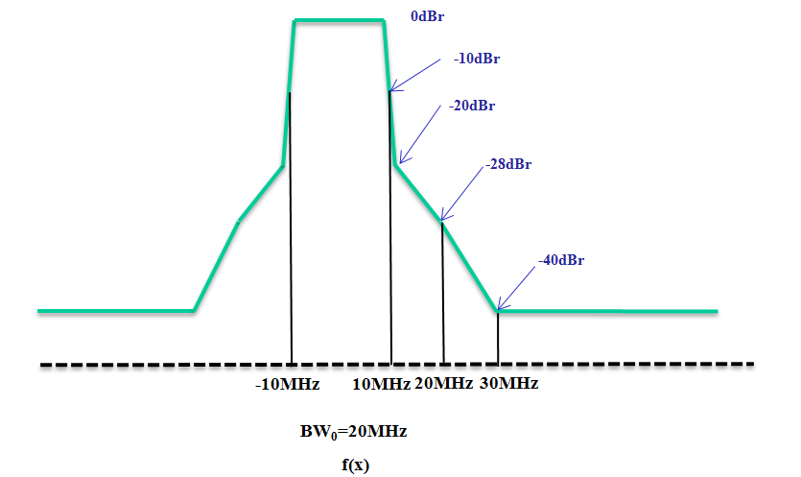
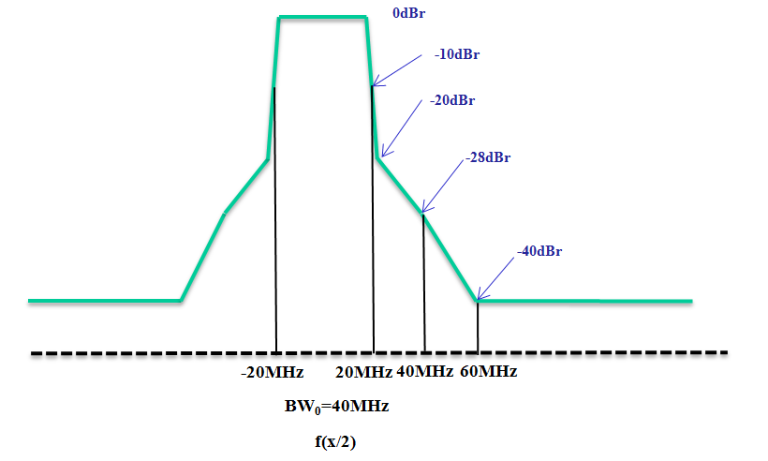
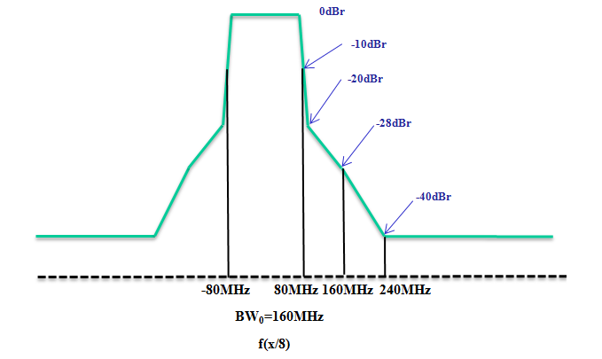
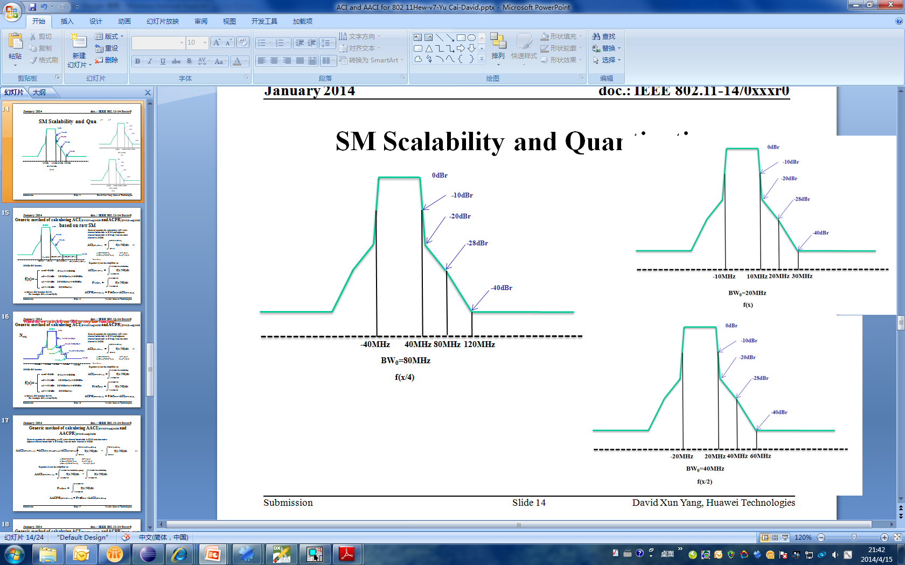
Stepwise SM Scalability ( from 20MHz to 160MHz)
f_{step}(x/2)
where, f_{step}(x) is the function of SM @ 20MHz
f_{step}(x/4)
f_{step}(x/8)

Slide 14
OOB Emission for 2 adjacent channel with arbitrary bandwidth
-------based on stepwise line integration
CH1
0dBr
Note: Main channel bandwidth is BW₀, adjacent channel bandwidth is BWadj, Alternative channel bandwidth is BWaadj. Here SM function f(x) at 20MHz used to represent MCS0 case. If major channel bandwidth is more than 20MHz, f(x/N0) is scaled to fit the scenarios, where N0 is the times of 20MHz. Nadj and Naadj represent times of adjacent, alternative adjacent channel channel to 20MHz.
-20dBr
-28dBr
-40dBr
P_{ref}|_{BW0}
ACI|[BW₀,BW_{adj}]
AACI|[BW₀,BW_{adj}]
-BW₀/2
BW₀/2
BW₀/2+BW_{adj}
BW₀/2+BW_{adj}+BW_{aadj}
Noise floor
Equation (1) can be simplified as
BW0/2+BWadj
10MHz*N0
ACI|[BW₀,BW_{adj}] =
f_{step}(x/N0)dx
P_{ref}|BW₀ =
f_{step}(x/N0)dx
BW₀/2
(1)
-10MHz*N0
a) BW₀=20M*N₀, N₀=1,2,4,8
b) BW_{adj}=20M*N_{adj}, N_{adj}=1,2,4,8
c) BW_{aadj}=20M*N_{aadj}, N_{aadj}=1,2,4,8
10MHz*N0+10MHz*2Nadj
ACI|[BW₀,BW_{adj}] =
f_{step}(x/N0)dx
10MHz*N0
where, [BW₀,BW_{adj}] means interference from BW₀ to BW_{adj}, vice versa.
ACPR|[BW0,Bwadj] = Pref|BW0 -ACI|[BW0,Bwadj]

Slide 15
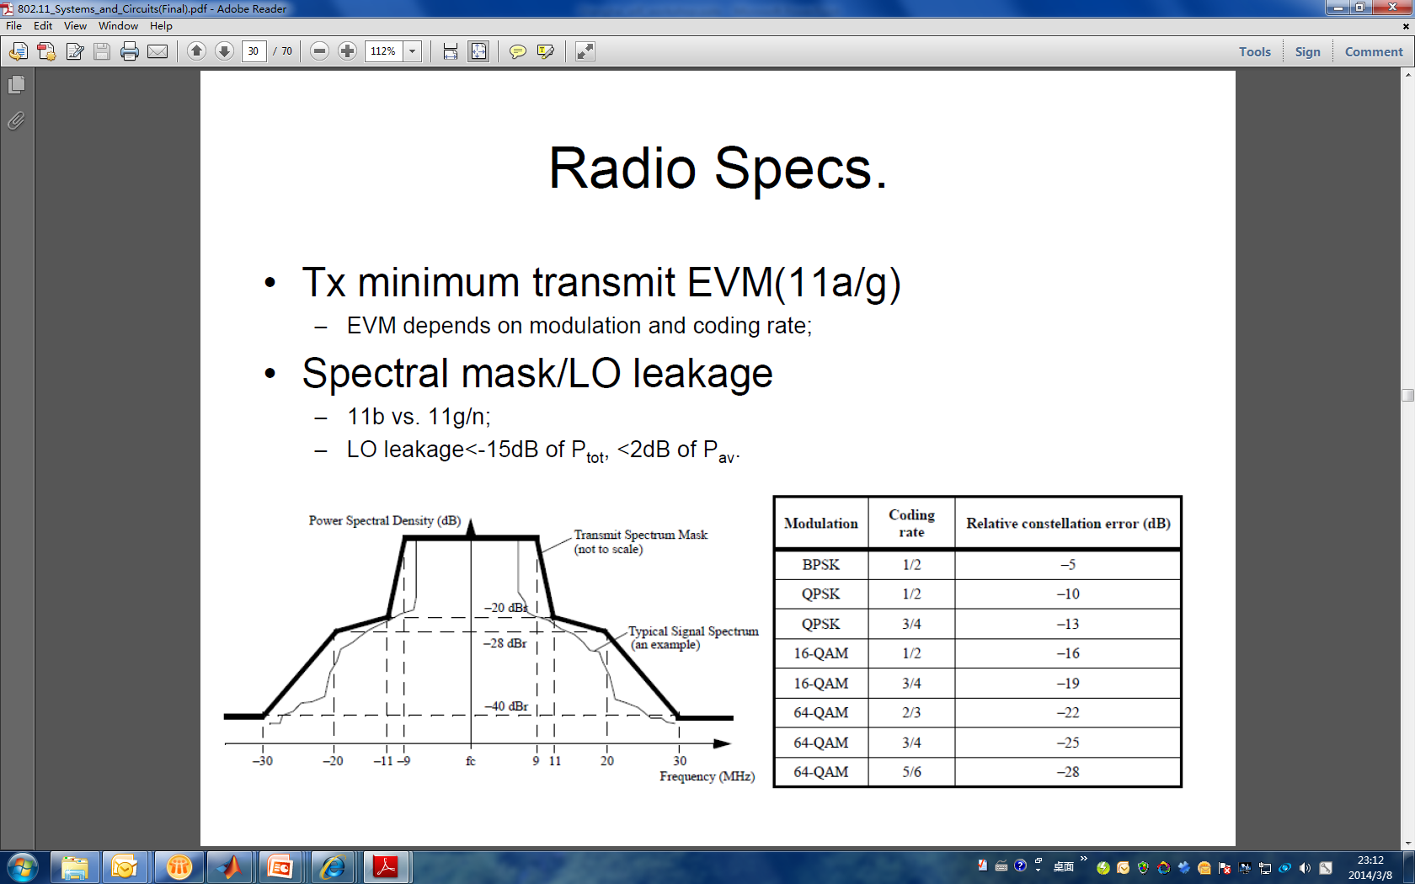
Quantized SM function for arbitrary MCS_{x}
CH₁
RCE TABLE
-10dBr
MCS₀
-24dBr
MCS₃
-34dBr
MCS₀
-35dBr
-40dBr
MCS₃
-45dBr
Δ(dB) =RCE_{MCS0}(dB)-RCE_{MCS3}(dB)=11dB
-51dBr
Noise floor
-30MHz
-10MHz
10MHz
30MHz
100MHz
SM of MCS₃ is generated by pushing RCE_{MCS0}-RCE_{MCS3}=11dB down from MCS₀ SM.
20MHz SM function,
a_{ref,MCSx}=0dBr,
0<|x|<=10MHz
where, Δ=RCE_{MCS0}-RCE_{MCSx}
f_{step}(x)|MCS_{x}=
a_{0,MCSx}=-24dBr-Δ,
10MHz<|x|<=20MHz
a_{1,MCSx}=-34dBr- Δ,
20MHz<|x|<=30MHz
Arbitrary bandwidth SM function: f_{step}|_{MCSx}(x/N₀)
For example, SM|_{160MHz}=f_{step}|_{MCSx} (x/8);
a_{2,MCSx}=-40dBr- Δ,
30MHz<|x|

Slide 16
Generic equation for ACPR|[BW0,BWadj],MCSx and AACPR|[BW0,Bwadj],MCSx
ch₁
a_{ref}
u(t) is Heaviside step function,
-10dBr
u(t)=
0,
t<0
1,
t>=0
-24dBr
t_{adj}=2*N_{adj}/N₀; t_{aadj}=2*(N_{adj}+N_{aadj})/N₀; BW₁=10MHz*N₀;
P_{ref}|BW₀= a_{ref}*BW₀=2*a_{ref}*BW₁;
a₀
-34dBr
MCS₀
-40dBr
MCS_{x}
a₁
Δ(dB) =RCE_{MCS0}(dB)-RCE_{MCSx}(dB)
BW₀
BW_{adj}
BW_{aadj}
a₂
-30MHz*N0
-10MHz*N0
10MHz*N0
30MHz*N0
Noise floor
1
ACI|[BW₀,BW_{adj}],MCS_{x}= BW₁*{ Σ a_{i,MCSx}*[(t_{adj}-i)*u(t_{adj}-i)-(t_{adj}-i-1)*u(t_{adj}-i-1)]+a_{2,MCSx}*u(t_{adj}-2) }
ACPR|[BW₀,BW_{adj}],MCSx =P_{ref}|BW₀- ACI|[BW₀,BW_{adj}],MCS_{x}
=BW₁*{2*a_{ref,MCSx} - Σ a_{i,MCSx}*[(t_{adj}-i)*u(t_{adj}-i)-(t_{adj}-i-1)*u(t_{adj}-i-1)]-a_{2,MCSx}*u(t_{adj}-2)}
i=0
1
i=0
The above generic equation can be used to generate a look-up table in the next page.

Slide 17
ACPR Table
BW₀ | 20M |  |  |  | 40M |  |  |  | 80M |  |  |  | 160M
BW_{adj} | 20M | 40M | 80M | 160M | 20M | 40M | 80M | 160M | 20M | 40M | 80M | 160M | 20M | 40M | 80M | 160M
MCS0 | 26.60 | 26.40 | 26.04 | 25.39 | 27.01 | 26.60 | 26.40 | 26.04 | 30.02 | 27.01 | 26.60 | 26.40 | 33.03 | 30.02 | 27.01 | 26.60
MCS1 | 31.60 | 31.40 | 31.04 | 30.39 | 32.01 | 31.60 | 31.40 | 31.04 | 35.02 | 32.01 | 31.60 | 31.40 | 38.03 | 35.02 | 32.01 | 31.60
MCS2 | 34.60 | 34.40 | 34.04 | 33.39 | 35.01 | 34.60 | 34.40 | 34.04 | 38.02 | 35.01 | 34.60 | 34.40 | 41.03 | 38.02 | 35.01 | 34.60
MCS3 | 37.60 | 37.40 | 37.04 | 36.39 | 38.01 | 37.60 | 37.40 | 37.04 | 41.02 | 38.01 | 37.60 | 37.40 | 44.03 | 41.02 | 38.01 | 37.60
MCS4 | 40.60 | 40.40 | 40.04 | 39.39 | 41.01 | 40.60 | 40.40 | 40.04 | 44.02 | 41.01 | 40.60 | 40.40 | 47.03 | 44.02 | 41.01 | 40.60
MCS5 | 43.60 | 43.40 | 43.04 | 42.39 | 44.01 | 43.60 | 43.40 | 43.04 | 47.02 | 44.01 | 43.60 | 43.40 | 50.03 | 47.02 | 44.01 | 43.60
MCS6 | 46.60 | 46.40 | 46.04 | 45.39 | 47.01 | 46.60 | 46.40 | 46.04 | 50.02 | 47.01 | 46.60 | 46.40 | 53.03 | 50.02 | 47.01 | 46.60
MCS7 | 49.60 | 49.40 | 49.04 | 48.39 | 50.01 | 49.60 | 49.40 | 49.04 | 53.02 | 50.01 | 49.60 | 49.40 | 56.03 | 53.02 | 50.01 | 49.60

Slide 18
ACI and AACI calculation with known ACPR
With the table of ACPR in slide 17, ACI is easy to calculate by a simple straightforward equation. So does AACI.
Here if there is 3 channels ch₁,ch₂,ch₃, ch₂ is ch₁’s adjacent channel and ch₃ is ch₁’s alternative adjacent channel. The MCS_{chx} represent the MCS type of the ch_{x}. Then the generic equation of calculating ACI and AACI in TX side is as follows:
ACI|[ch₁,ch₂] =P_{TX}-ACPR |[BW₁,BW₂],MCS_{ch1} -PL(d)
AACI|[ch₁,ch₃] =P_{TX}-AACPR |[BW₁,BW₃],MCS_{ch1} -PL(d)
where BW_{x} represents the bandwidth of ch_{x}. More generally, the ACPR and AACPR can be calculated by the equation as shown in the page 16.

Slide 19
Conclusion
A generic method of ACI/AACI calculated based on TX side specification is proposed here
  from which generic analytic equations are developed and is easier to be migrated into system simulations. Two examples show how to use them in specific scenarios.
Wireless channels is only models as large scale path loss
  which makes calculation of ACI in TX side plus path loss can be applied in the RX side to simulate the TX side OOB impairment on noise floor in RX side.
Complicated integration method over signal waveform is replaced by summation of step line function over SM designed for different MCS.
  A generic function is given for calculating OOB emission or ACI/AACI in TX side under all scenarios which makes system simulator easier to take this effect into account without consuming too much calculation resources.
Yu Cai, Huawei Technologies

Slide 20
Conclusion (Cont’)
ACI/AACI due to AC/AAC leakage would have impact on noise floor level of the RX and CCA detection sensitivity
  CCA is a criteria to judge a channel if busy or not, it has strong correlation with ACI and AACI. The ACI and AACI would also have great impact on SNR when both channel are working simultaneously. Both channel SNR degradation can be calculated quantitatively by them.
AACI calculation is mediocre generalization of ACI calculation while scenarios is much more complicated
  In system level simulations, ACI impact can be calculated by the table in slide 17. The ACI happens in scenarios for any adjacent channels which are not orthogonal, for example, OBSS in typical. The bandwidth would not be necessarily the same as the main channel. However, for alternative channel interference, since the scenarios might have much complicated cases (for example, main channel 20MHz, AC 40MHz, AAC 160MHz, etc.), the lookup table similar to ACPR table in slide 17 would be no doubt much larger.
Yu Cai, Huawei Technologies

Slide 21
Open question for calculating ACI/AACI based on RX side specification
ACI, AACI calculation strongly depends on receiver architecture, for example, heterodyne receiver or direct conversion receiver.
The jamming effect evaluation due to ACI and AACI in RX side strongly associates with BB algorithm. Therefore, a generic method applied to different bandwidth and different MCS is difficult to derived.
ACI and AACI is specified in the standard as ACR and AACR which can be thought as a AC/AAC blocker when the main channel are 3dB above its sensitivity level. However, it doesn’t specify how it will be migrated to generalized scenarios when the received signal is much higher above sensitivity and when main channel and AC bandwidth are different from each other.
Reasonable modeling ACI/AACI in RX side needs to take channel select/blocker rejection filter and anti-aliasing filter model into consideration, which has significant impact on receiver BB processing, PER, moreover, sensitivity.

Slide 22
Reference
 | Author | Title | Source | Date
[1] | Tian-Wei Huang | 80-MHz Non-Contiguous Channel Spectrum | 11-11-0063-00-00ac-80-mhz-non-contiguous-channel-spectrum | 2011-1
[2] | Paul Chiuchiolo, Mark Webster | Power Amp Effects for HRb OFDM | 11-00-0393-00-000g-power-and-effects-for-hrb-ofdm | 2000-11
[3] | Colin Lanzl | IEEE P802.15 Working Group for Wireless Personal Area Networks (WPANs) | 15-04-0663-00-004b-recommendations-power-amp-model-and-multipath-rms-delay-spread | 2004-11
[4] | Mark Webster and Karen Halford | Spectral Mask Considerations for 802.11 HRb | 11-00-0283-00-00sb-spectrum-mask-considerations-for-802-11-hrb | 2000-09
[5] | Mark Webster | Suggested PA Model for 802.11 HRb | 11-00-0294-00-00sb-suggested.. | 2000-09
[6] | Bijoy Bhukania | 11n Spectrum Mask Alignment | 11-11-0160-00-000m-11n-spectrum-mask-alignment

