Slide 1
ACI and AACI for 802.11ax System Simulations
Date: 2014-07-15
Authors:

Slide 2
Summary
Adjacent channel interference (ACI) or alternative adjacent channel interference (AACI)
  Scenarios where overlap BSS working in adjacent channel or alternative adjacent channel have significant ACI and AACI problems, which are necessarily to be evaluated to determine its impact on system performance.
Out of band emission (OOB), spectrum mask (SM) and ACI, AACI
  Out of band emission normally comes from non-linearity of transmitter, especially from PA. In order to control the worst case of OOB emission, signal has to be kept under SM. The most simple way of qualitatively calculating ACI is from SM. But the SM is only for MCS0 and not specified for other MCS. Generic method of calculating ACI for different bandwidth adjacent channel with different MCS are still open question.
ACI calculation in RX side and in TX side
  Calculation of ACI, AACI is supposed to do in both TX and RX side in system simulation. TX side calculation includes OOB emission due to non-linearity of transmitter circuit (mostly from PA) which will lead to noise floor increased in AC and AAC. Nevertheless, RX side calculation is more complicated since it strongly associated with receiver architecture, RF/analog filter modeling and BB receiver algorithm which has direct impact on sensitivity.
Yu Cai, Huawei Technologies

Slide 3

Example: ACI and AACI calculation in RX with 2 adjacent channel bandwidth of 40MHz
ch₁
ch₂
ACPR|[chx,chy](dB)= Pch_{x}(dB)-ACI|[chx,chy](dB)
AACPR|[chx,chy] (dB)=P|chx(dB)-AACI|[chx,chy](dB)
ACI calculation is by integrating all the signal power which leak to the adjacent band.
ACPR|[chx,chy] is the adjacent channel power ratio between the signal in channel x and the leakage from the signal in channel x to channel y.
Signal waveform in RX in CH1
Signal waveform in RX in CH2
-100MHz
-60MHz
-20MHz
20MHz
60MHz
Noise floor
AACI
ACI
P
-20MHz
20MHz
P_{ref}|ch₁ =
PSDch₁
P_{ref}|ch₂ =
PSDch₂
-60MHz
-20MHz
20MHz
-20MHz
ACI|[ch₁,ch₂] =
PSDch₁
ACI|[ch₂,ch₁] =
PSDch₂
-20MHz
-60MHz
60MHz
-60MHz
AACI|[ch₁,ch₂] =
PSDch₁
AACI|[ch₂,ch₁] =
PSDch₂
20MHz
-100MHz

Slide 4
OOB Emission and PA non-linearity
ACI|[ch₁,ch₂] = OOB|[ch₁,ch₂]+PL+F |Rx, [ch₁,ch₂]
ACI Definition: , where F means the Rx filter effect.
OOB Emission normally comes from non-linearity of PA, we also called it as out of band leakage.
Normally we can used adjacent channel power ratio (ACPR) and alternative adjacent channel power ratio (AACPR) to evaluate it. But it also needs to calculate ACI and AACI. Then ACPR=Channel Power/ACI, AACPR=Channel Power/AACI.
The other simple way of evaluating OOB Emission is through SM, which can give us qualitative impression how bad the ACI, AACI is. Normally SM represents the worst case of tolerable signal waveform.
Rapp model can be used to evaluate how non-linearity of PA exert its impact on signal waveform. We can control the shape of signal waveform by changing backoff value from P1dB to adjust PA’s non-linearity and its OOB Emission and ACI, AACI. The effect is shown in the next slides.

Slide 5
PA non-linearity vs. backoff value and its impact on ACP [2] (Rapp model p=3)
Backoff
from Full
Saturation
P = 3
backoff=3.4dB
backoff=4.6dB
backoff=8.1dB
backoff=12.0dB
backoff=16.0dB

Slide 6
Calculation of OOB Emission in TX side
We focus on the calculation of OOB emission at TX side in this slides.
  Calculation in TX side only needs to know the signal waveform in TX side.
  Signal waveform in TX side might also be irregular. Fortunately, standard of 802.11 specify SM and relative constellation error (RCE). That specified the worst signal waveform (with largest ACI, AACI) could be for MCS0.
Calculation of OOB emission based on SM in TX side + effect of wireless channel is equivalent to performing the calculation in RX side.

Slide 7
Equivalence of OOB Emission calculation in RX and TX side
Since it is assumed that signal waveform won’t change due to different channels, the only difference between TX and RX is PL (Path Loss)
ACI|[ch₁,ch₂]=P_{RX}-ACPR RX Side
=P_{TX}-PL(d)-ACPR
=P_{TX}-ACPR-PL(d) TX Side
AACI|[ch₁,ch₂]=P_{RX}-AACPR RX Side
=P_{TX}-PL(d)-AACPR
=P_{TX}-AACPR-PL(d) TX Side
where, ACI|[ch₁,ch₂] means ACI from ch₁ to ch₂

Slide 8
Example: Simulation scenarios and path loss (PL) calculation
TX₁
ch₂
TX₂
P_{TX2}=20dBm
P_{TX1}=17dBm
ch₁
Path loss can be calculated in terms of channel D path loss model.
MCS₀,
d₁=15m,
40MHz
MCS₃,
d₂=20m,
80MHz
P_{RX1}=P_{TX1}-PL(15)=-49.27dBm
P_{RX2}=P_{TX2}-PL(20)=-50.64dBm
RX
PL(d)=LFS (d_{BP})+35*log10(d/ d_{BP})+SF d> d_{BP} =10m for Channel D
SF=0,
L_{FS} (d)=20*log10(d)+20*log10(f)-147.5 f=2.4*10^9 Hz
PL(d)= 20*log10(f)-147.5 +35*log10(d)-15*log10( d_{BP})
f=2.4*10^9 Hz, d_{BP}=10m
PL(d₁)=66.27dB
PL(d₂)=70.64dB

Slide 9
Calculation complexity due to two adjacent channels with different bandwidth and MCS
Bandwidth of major signal band (BW₀) might not be equivalent to the bandwidth of the adjacent band (BW_{adj}) or alternative adjacent band (BW_{aadj}).
  For example, BW₀ =40MHz, BW_{adj} =20MHz, BW_{aadj} =80MHz
MCS of major signal band might not be equivalent to the MCS of the adjacent band (BW_{adj}) or alternative adjacent band (BW_{aadj}).
  For example, Major band=MCS3, Adjacent band=MCS5, Alternative adjacent band=MCS0.
  3. In order to cover all these scenarios, signal waveform (SM function) scalability and quantization needs to be introduced.

Slide 10
SM Scalability (40MHZ to 80MHz)
PSD
PSD
0dBr
0dBr
f(x/2)
-20dBr
-20dBr
-28dBr
-28dBr
-40dBr
-40dBr
-60
-40
-21
-19
19
40
60
-120
-80
80
120
21
39
41
-42
-41
-39
-38
38
42
Scaling of 40MHz piecewise SM is not equivalent to 80M SM.
40MHz SM
80MHz SM
f_{40MHz}(x/2)

Slide 11
Stepwise SM Scaling (40MHZ to 80MHz)
PSD
PSD
0dBr
0dBr
f_{step}(x/2)
-20dBr
-20dBr
-28dBr
-28dBr
-40dBr
-40dBr
-60
-40
-21
-19
21
40
60
-120
-80
80
120
19
39
41
-20
20
-42
-41
-39
-38
38
42
-40
-40
Scaling of 40MHz piecewise SM is not equivalent to 80M SM.

Slide 12
SM Quantization----Due to piecewise line and scalability
CH1
0dBr
-10dBr=[0+(-20)]/2
SM function normally is piecewise line function and on which integration for system simulator is not straightforward. We simplified it as step line function which makes life easier.
-24dBr =[(-20)+(-28)]/2
-20dBr
-34dBr=[(-28)+(-40)]/2
-28dBr
-40dBr
-40dBr
-30MHz
-10MHz
10MHz
30MHz
100MHz
Noise floor
20MHz SM function, quantized from green piecewise line SM function f(x) to step line function, f_{step}(x)
a_{ref,MCS0}=0dBr
0<|x|<=10MHz
f_{step}(x)=
a_{0,MCS0}=-24dBr
10MHz<|x|<=20MHz
Arbitrary bandwidth SM function: f_{step}(x/N0)
For example, SM|_{160MHz}=f_{step}(x/8);
a_{1,MCS0}=-34dBr
20MHz<|x|<=30MHz
a_{2,MCS0}=-40dBr
30MHz<|x|

Slide 13
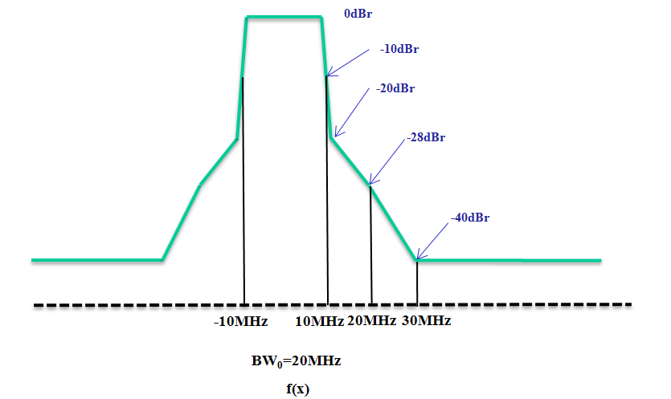
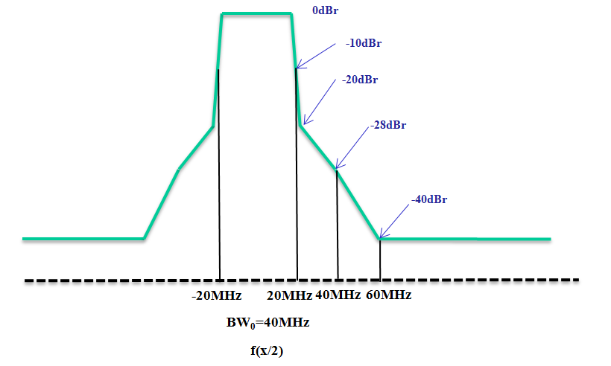
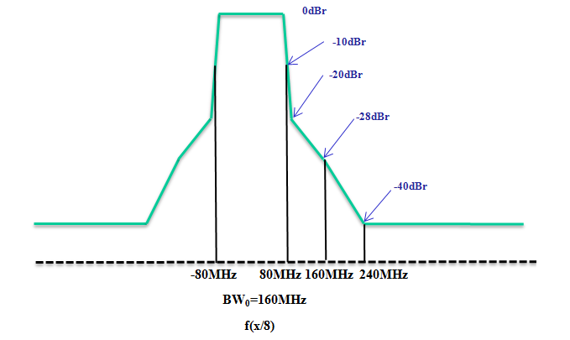
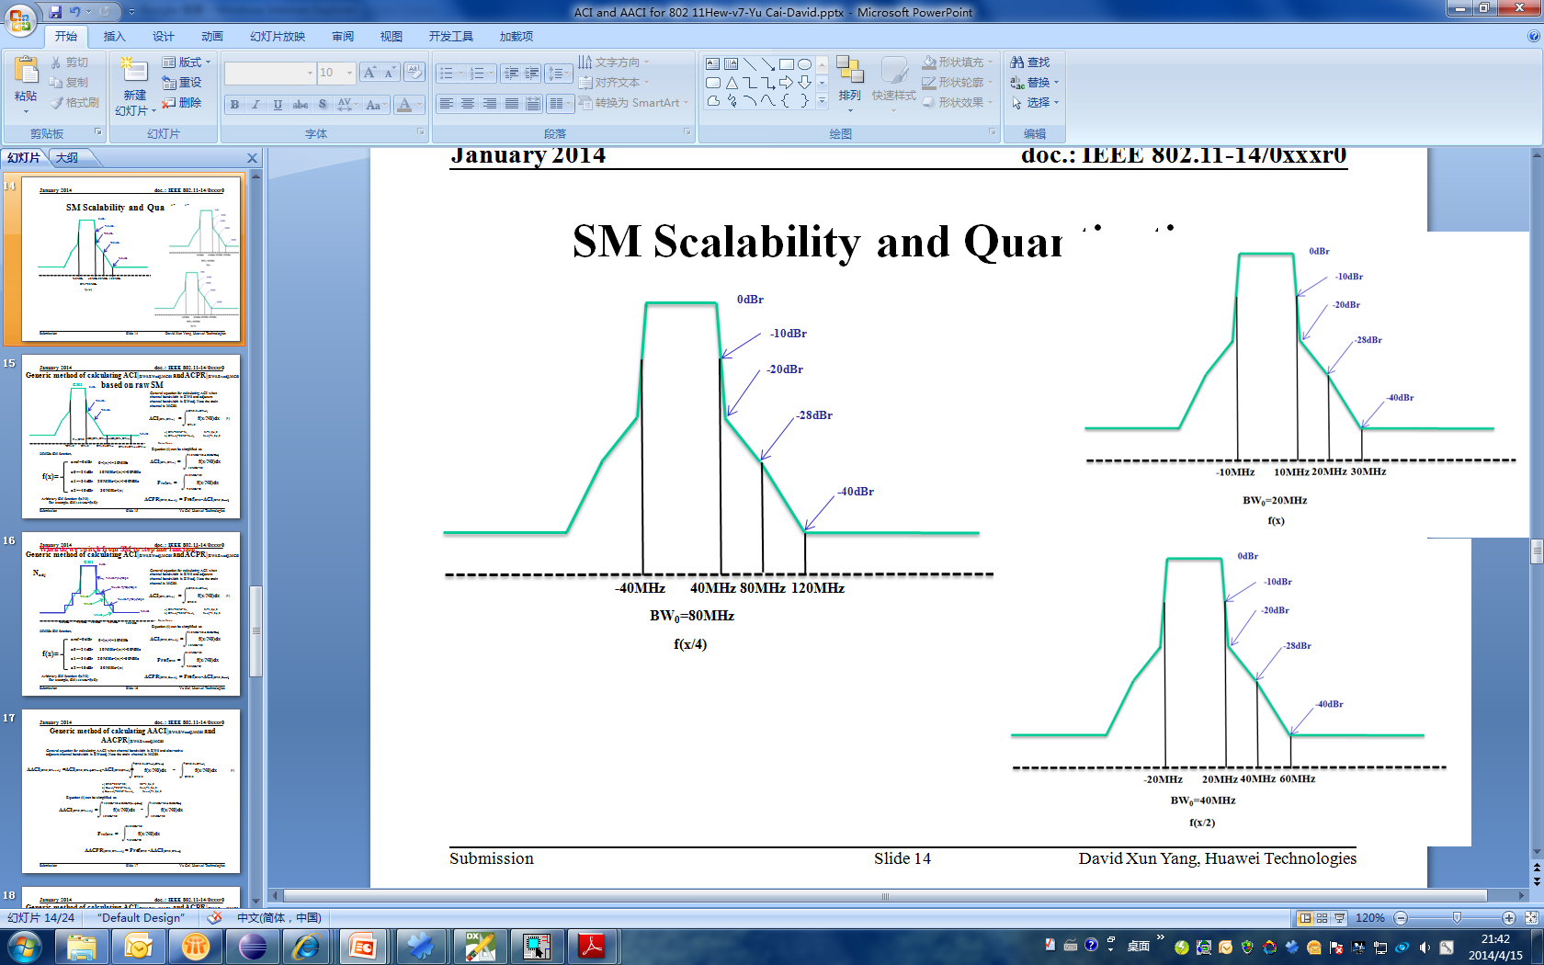
Stepwise SM Scalability ( from 20MHz to 160MHz)
f_{step}(x/2)
where, f_{step}(x) is the function of SM @ 20MHz
f_{step}(x/4)
f_{step}(x/8)

Slide 14
OOB Emission for 2 adjacent channel with arbitrary bandwidth
-------based on stepwise line integration
CH1
0dBr
Note: Main channel bandwidth is BW₀, adjacent channel bandwidth is BWadj, Alternative channel bandwidth is BWaadj. Here SM function f(x) at 20MHz used to represent MCS0 case. If major channel bandwidth is more than 20MHz, f(x/N0) is scaled to fit the scenarios, where N0 is the times of 20MHz. Nadj and Naadj represent times of adjacent, alternative adjacent channel channel to 20MHz.
-20dBr
-28dBr
-40dBr
P_{ref}|_{BW0}
ACI|[BW₀,BW_{adj}]
AACI|[BW₀,BW_{adj}]
-BW₀/2
BW₀/2
BW₀/2+BW_{adj}
BW₀/2+BW_{adj}+BW_{aadj}
Noise floor
Equation (1) can be simplified as
BW0/2+BWadj
10MHz*N0
ACI|[BW₀,BW_{adj}] =
f_{step}(x/N0)dx
P_{ref}|BW₀ =
f_{step}(x/N0)dx
BW₀/2
(1)
-10MHz*N0
a) BW₀=20M*N₀, N₀=1,2,4,8
b) BW_{adj}=20M*N_{adj}, N_{adj}=1,2,4,8
c) BW_{aadj}=20M*N_{aadj}, N_{aadj}=1,2,4,8
10MHz*N0+10MHz*2Nadj
ACI|[BW₀,BW_{adj}] =
f_{step}(x/N0)dx
10MHz*N0
where, [BW₀,BW_{adj}] means interference from BW₀ to BW_{adj}, vice versa.
ACPR|[BW0,Bwadj] = Pref|BW0 -ACI|[BW0,Bwadj]

Slide 15
AACI and AACPR for 2 adjacent channel with arbitrary bandwidth
-------based on stepwise line integration
AACI|[BW0,BWaadj] =ACI|[BW0,BWadj+BWaadj]-ACI|[BW0,BWadj]=
BW0/2+BWadj+BWaadj
-
BW0/2+BWadj
f_{step}(x/N0)dx
f_{step}(x/N0)dx
(2)
BW0/2
BW0/2
Equation (2) can be simplified as
10MHz*N0+10MHz*2(Nadj+Naadj)
10MHz*N0+10MHz*2Nadj
AACI|[BW0,BWaadj] =
-
f_{step}(x/N0)dx
f_{step}(x/N0)dx
10MHz*N0
10MHz*N0
AACPR|[BW0,BWaadj] = P_{ref}|BW0 -AACI|[BW0,BWaadj]

Slide 16
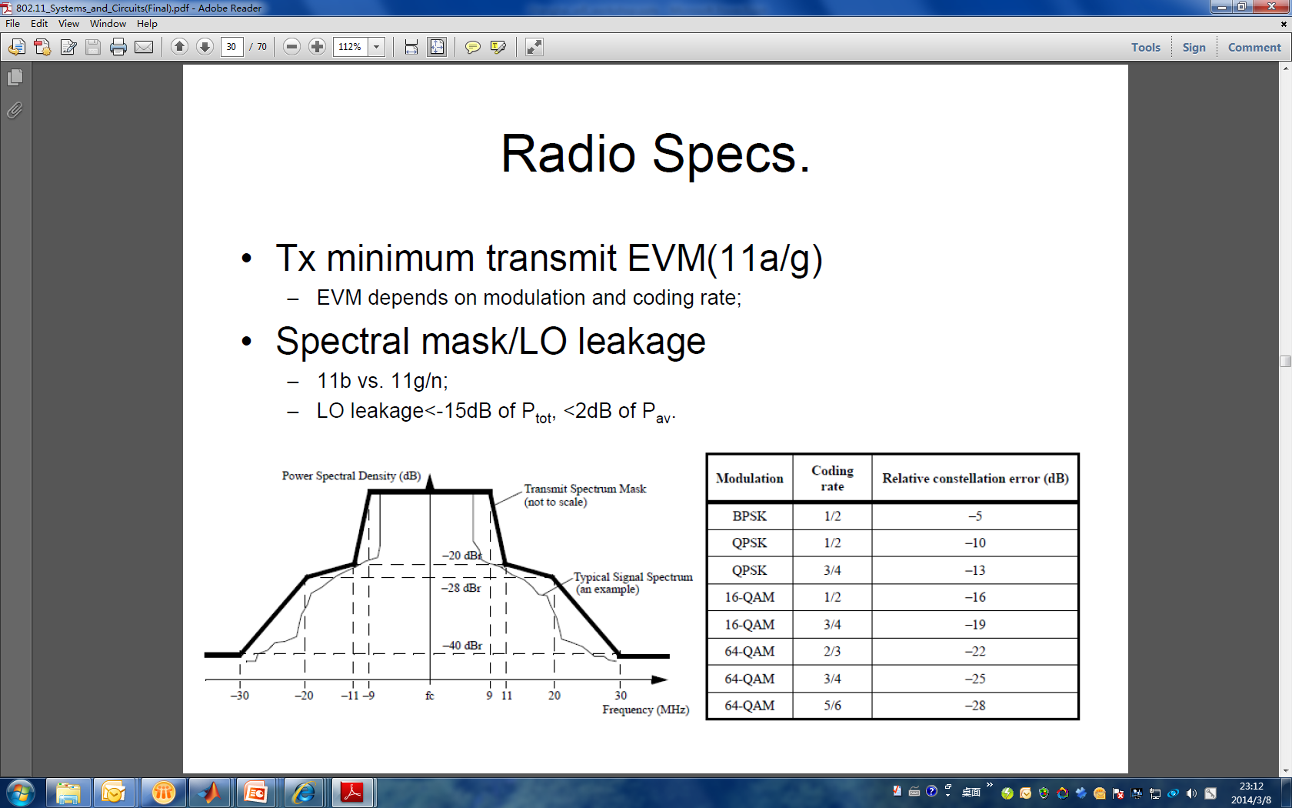
Quantized SM function for arbitrary MCS_{x}
CH₁
RCE TABLE
-10dBr
MCS₀
-24dBr
MCS₃
-34dBr
MCS₀
-35dBr
-40dBr
MCS₃
-45dBr
Δ(dB) =RCE_{MCS0}(dB)-RCE_{MCS3}(dB)=11dB
-51dBr
Noise floor
-30MHz
-10MHz
10MHz
30MHz
100MHz
SM of MCS₃ is generated by pushing RCE_{MCS0}-RCE_{MCS3}=11dB down from MCS₀ SM.
20MHz SM function,
a_{ref,MCSx}=0dBr,
0<|x|<=10MHz
where, Δ=RCE_{MCS0}-RCE_{MCSx}
f_{step}(x)|MCS_{x}=
a_{0,MCSx}=-24dBr-Δ,
10MHz<|x|<=20MHz
a_{1,MCSx}=-34dBr- Δ,
20MHz<|x|<=30MHz
Arbitrary bandwidth SM function: f_{step}|_{MCSx}(x/N₀)
For example, SM|_{160MHz}=f_{step}|_{MCSx} (x/8);
a_{2,MCSx}=-40dBr- Δ,
30MHz<|x|

Slide 17
Generic equation for ACPR|[BW0,BWadj],MCSx and AACPR|[BW0,Bwadj],MCSx
ch₁
a_{ref}
u(t) is Heaviside step function,
-10dBr
u(t)=
0,
t<0
1,
t>=0
-24dBr
t_{adj}=2*N_{adj}/N₀; t_{aadj}=2*(N_{adj}+N_{aadj})/N₀; BW₁=10MHz*N₀;
P_{ref}|BW₀= a_{ref}*BW₀=2*a_{ref}*BW₁;
a₀
-34dBr
MCS₀
-40dBr
MCS_{x}
a₁
Δ(dB) =RCE_{MCS0}(dB)-RCE_{MCSx}(dB)
BW₀
BW_{adj}
BW_{aadj}
a₂
-30MHz*N0
-10MHz*N0
10MHz*N0
30MHz*N0
Noise floor
1
ACI|[BW₀,BW_{adj}],MCS_{x}= BW₁*{ Σ a_{i,MCSx}*[(t_{adj}-i)*u(t_{adj}-i)-(t_{adj}-i-1)*u(t_{adj}-i-1)]+a_{2,MCSx}*u(t_{adj}-2) }
ACPR|[BW₀,BW_{adj}],MCSx =P_{ref}|BW₀- ACI|[BW₀,BW_{adj}],MCS_{x}
=BW₁*{2*a_{ref,MCSx} - Σ a_{i,MCSx}*[(t_{adj}-i)*u(t_{adj}-i)-(t_{adj}-i-1)*u(t_{adj}-i-1)]-a_{2,MCSx}*u(t_{adj}-2)}
i=0
1
1
i=0
ACI|[BW0,BWadj+BWaadj],MCSx= BW₁*{ Σ a_{i,MCSx}*[(t_{aadj}-i)*u(t_{aadj}-i)-(t_{aadj}-i-1)*u(t_{aadj}-i-1)]+a_{2,MCSx}*u(t_{aadj}-2) }
AACI|[BW0,BWaadj],MCSx= ACI|[BW0,BWadj+BWaadj],MCSx - ACI|[BW0,BWadj],MCSx
AACPR|[BW0,BWadj],MCSx =P_{ref}|BW0- AACI|[BW0,BWaadj],MCSx
i=0

Slide 18
ACI and AACI calculation in TX side with known ACPR and AACPR
Here if there is 3 channels ch₁,ch₂,ch₃, ch₂ is ch₁’s adjacent channel and ch₃ is ch₁’s alternative adjacent channel. The MCS_{chx} represent the MCS type of the ch_{x}. Then the generic equation of calculating ACI and AACI in TX side is as follows:
ACI|[ch₁,ch₂] =P_{TX}-ACPR |[BW₁,BW₂],MCS_{ch1} -PL(d)
AACI|[ch₁,ch₃] =P_{TX}-AACPR |[BW₁,BW₃],MCS_{ch1} -PL(d)
where BW_{x} represents the bandwidth of ch_{x}. The ACPR and AACPR is calculated by the equation as shown in the page 17.

Slide 19
ACPR Table
BW₀ | 20M |  |  |  | 40M |  |  |  | 80M |  |  |  | 160M
BW_{adj} | 20M | 40M | 80M | 160M | 20M | 40M | 80M | 160M | 20M | 40M | 80M | 160M | 20M | 40M | 80M | 160M
MCS0 | 26.60 | 26.40 | 26.04 | 25.39 | 27.01 | 26.60 | 26.40 | 26.04 | 30.02 | 27.01 | 26.60 | 26.40 | 33.03 | 30.02 | 27.01 | 26.60
MCS1 | 31.60 | 31.40 | 31.04 | 30.39 | 32.01 | 31.60 | 31.40 | 31.04 | 35.02 | 32.01 | 31.60 | 31.40 | 38.03 | 35.02 | 32.01 | 31.60
MCS2 | 34.60 | 34.40 | 34.04 | 33.39 | 35.01 | 34.60 | 34.40 | 34.04 | 38.02 | 35.01 | 34.60 | 34.40 | 41.03 | 38.02 | 35.01 | 34.60
MCS3 | 37.60 | 37.40 | 37.04 | 36.39 | 38.01 | 37.60 | 37.40 | 37.04 | 41.02 | 38.01 | 37.60 | 37.40 | 44.03 | 41.02 | 38.01 | 37.60
MCS4 | 40.60 | 40.40 | 40.04 | 39.39 | 41.01 | 40.60 | 40.40 | 40.04 | 44.02 | 41.01 | 40.60 | 40.40 | 47.03 | 44.02 | 41.01 | 40.60
MCS5 | 43.60 | 43.40 | 43.04 | 42.39 | 44.01 | 43.60 | 43.40 | 43.04 | 47.02 | 44.01 | 43.60 | 43.40 | 50.03 | 47.02 | 44.01 | 43.60
MCS6 | 46.60 | 46.40 | 46.04 | 45.39 | 47.01 | 46.60 | 46.40 | 46.04 | 50.02 | 47.01 | 46.60 | 46.40 | 53.03 | 50.02 | 47.01 | 46.60
MCS7 | 49.60 | 49.40 | 49.04 | 48.39 | 50.01 | 49.60 | 49.40 | 49.04 | 53.02 | 50.01 | 49.60 | 49.40 | 56.03 | 53.02 | 50.01 | 49.60

Slide 20
Example: ACI|[ch₁,ch₂],MCS₀
ch₁
where ch₁ means major channel with bandwidth of BW₀ and adjacent channel with bandwidth of BW_{adj}. The difference between ACI|[ch₁,ch₂],MCS₀ and ACI|[BW₀,BW_{adj}],MCS0 is major channel power in ch1 when calculating ACI|[ch₁,ch₂],MCS₀ is an arbitrary value while major channel power density is a normalized value (0dBm/Hz) when calculating ACI|[BW₀,BW_{adj}],MCS₀ .
-10dBr
-24dBr
-34dBr
-40dBr
-60MHz
-20MHz
20MHz
60MHz
100MHz
Noise floor
AACP
ACP
P
ch₁:BW₀=40MHz, ch₂: BW_{adj}=80MHz,
N₀=2,N_{adj}=4, t=2*4/2=4, BW₁=20MHz;
ACI|_{[2,4],MCS0}=BW₁*(a_{0,MCS0}+a_{1,MCS0}+2*a_{2,MCS0})=a_{0,MCS0}*20MHz+a_{1,MCS0}*20MHz+a_{2,MCS0}*2*20*MHz,
a_{ref,MCS0}=0, a_{0,MCS0}=-24,a_{1,MCS0}=-34,a_{2,MCS0}=-40;
P_{ref}|BW0=0 dBm/Hz+10log₁₀(40MHz)=76.02dBm
ACI|_{[BW0,BWadj ],MCS0}= 10log₁₀(10^{^(-24/10)}*20M+10^{^(-34/10)}*20M+10^{^(-40/10)}*40M)=49.62dBm
ACPR|_{[BW0,BWadj],MCS0}=P_{ref}|_{BW0}-ACI| _{[BW0,BWadj ],MCS0} =76.02-49.62=26.4dB
ACI|_{[ch1,ch2],MCS0}=P_{TX1}-ACPR|_{[BW0,Bwadj],MCS0}-PL(d₁) =17dBm-26.4dB-66.27dB=-75.67dBm
P_{RX2}=P_{TX2}-PL(d₂)= -50.64dBm

Slide 21
Example: ACI|[ch₂,ch₁],MCS₃
ch₂
-10dBr
-24dBr
-34dBr
MCS₀
-35dBr
-40dBr
MCS₃
-45dBr
Δ =RCE_{MCS0}-RCE_{MCS3}=-5-(-16)=11dB
-51dBr
Noise floor
-120MHz
-40MHz
40MHz
120MHz
200MHz
AACP
ACP
P
ch₂:BW₀=80MHz, ch₁: BW_{adj}=40MHz,
N₀=4,N_{adj}=2, t=2*2/4=1, BW₁=40MHz;
ACI|[4,2],MCS3=BW₁*(a_{0,MCS3})=a_{0.MCS3}*40MHz,
Δ =11,a_{ref}=0, a_{0,MCS3}=-35,a_{1,MCS3}=-45,a_{2,MCS3}=-51;
P_{ref}|BW0=0 dBm/Hz+10log₁₀(80MHz)=79.03dBm
ACI|[BW₀,BW_{adj}],MCS3 = 10log₁₀(10^{^(-35/10)}*40M)=41.02dBm
ACPR|[BW0,BWadj],MCS3 =P_{ref}|BW0-ACI|[BW₀,BW_{adj}],MCS₃=79.03-41.02=38.01dB
ACI|[ch2,ch1],MCS3=P_{TX2}-ACPR|[BW0,BWadj],MCS3-PL(d₂)=-50.64dBm-38.01dB=-88.65dBm
P_{RX1}= P_{TX1}-PL(d₁)=-49.27dBm

Slide 22
Conclusion
A generic method of calculating OOB emission in TX side is proposed here
  from which generic analytic equations are developed and is easier to be migrated into system simulations. Two examples show how to use them in specific scenarios.
Wireless channels won’t have impact on signal waveform
  which makes calculation of ACI in TX side plus path loss can be applied in the RX side to simulate the TX side OOB impairment on noise floor in RX side.
Complicated integration method over signal waveform is replaced by summation of step line function over SM designed for different MCS.
  A generic function is given for calculating OOB emission under all scenarios which makes system simulator easier to take this effect into account without consuming too much calculation resources.
Yu Cai, Huawei Technologies

Slide 23
Conclusion (Cont’)
ACI & AACI would have impact on CCA and SNR on AC and AAC
  CCA is a criteria to judge a channel if busy or not, it has strong correlation with ACI and AACI. The ACI and AACI would also have great impact on SNR when both channel are working simultaneously. Both channel SNR degradation can be calculated quantitatively by them.
System simulation model would take ACI into consideration while AACI scenarios might be too complicated to be involved
  In system level simulations, ACI impact can be calculated by the table in slide 19. The ACI happens in scenarios for any adjacent channels which are not orthogonal, for example, OBSS in typical. The bandwidth would not be necessarily the same as the main channel. However, for alternative channel interference, since the scenarios might have much complicated cases (for example, main channel 20MHz, AC 40MHz, AAC 160MHz, etc.), it might not be worthy to take all sorts of combination of AC, AAC bandwidth, MCS into consideration at this time.
Yu Cai, Huawei Technologies

Slide 24
Open question for calculating ACI, AACI in RX side
ACI, AACI calculation strongly depends on receiver architecture, for example, heterodyne receiver or direct conversion.
Heterodyne receiver is sensitive to channel selection filter image rejection ratio. Both of these needs to be taken into modeling if this architecture is adopted.
Direct conversion receiver needs to have convincing model which reflects impact of real IQ imbalance and anti-aliasing filter.
Sensitivity and maximum tolerable AC/AAC blocker is specified in the standard. However, how to calculate the impact of blocker’s performance on sensitivity is strongly associated with receiver algorithm. Therefore, RX side calculation is unavoidable in a sense.

Slide 25
Reference
 | Author | Title | Source | Date
[1] | Tian-Wei Huang | 80-MHz Non-Contiguous Channel Spectrum | 11-11-0063-00-00ac-80-mhz-non-contiguous-channel-spectrum | 2011-1
[2] | Paul Chiuchiolo, Mark Webster | Power Amp Effects for HRb OFDM | 11-00-0393-00-000g-power-and-effects-for-hrb-ofdm | 2000-11
[3] | Colin Lanzl | IEEE P802.15 Working Group for Wireless Personal Area Networks (WPANs) | 15-04-0663-00-004b-recommendations-power-amp-model-and-multipath-rms-delay-spread | 2004-11
[4] | Mark Webster and Karen Halford | Spectral Mask Considerations for 802.11 HRb | 11-00-0283-00-00sb-spectrum-mask-considerations-for-802-11-hrb | 2000-09
[5] | Mark Webster | Suggested PA Model for 802.11 HRb | 11-00-0294-00-00sb-suggested.. | 2000-09
[6] | Bijoy Bhukania | 11n Spectrum Mask Alignment | 11-11-0160-00-000m-11n-spectrum-mask-alignment

