Slide 1
Analysis on Multiplexing Schemes exploiting frequency selectivity in WLAN Systems
Date: 2014-7-17
Authors:

Slide 2
Abstract
We introduce frequency selective multiplexing using OFDMA for consideration in IEEE 802.11ax and provide an initial analysis that captures the gains that can be obtained through OFDMA.

Slide 3
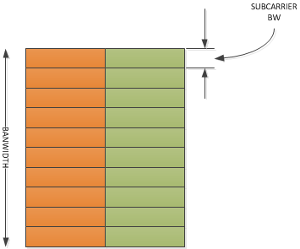
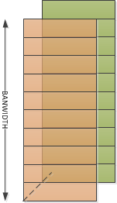
Multiplexing Techniques in 802.11
OFDM
MU-MIMO
Widely used in 802.11
Introduced in 802.11ac

Slide 4
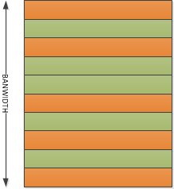
Considerations for introducing OFDMA
Already explored time and space multiplexing
Frequency is another dimension in the triad
Allows frequency sensitive multiplexing
Need to support large number of users in dense deployments
Cellular standards use OFDMA in such deployment scenarios
802.11ax contributions have proposed the use of OFDMA in such scenarios for short data frames [2]
Extract scheduling gains/selection diversity by scheduling users not in outage
Easily done at AP where channel state information is available for MU-MIMO

Slide 5
Quantifying gains from OFDMA
Insights from the literature [1]
Per sub-carrier bit, power coupled with user selection outperforms per sub-carrier bit , power loaded OFDM with TDM among users
We are interested in finding out merits of OFDMA relative to 802.11 style OFDM with TDM among users
Even in the absence of sophisticated scheduling algorithms
In particular, assuming arbitrarily chosen users
MU-MIMO requires careful user selection
Does the same hold true for OFDMA?
Notes:
The blue square indicates that we will treat this first and then take up MU-MIMO

Slide 6
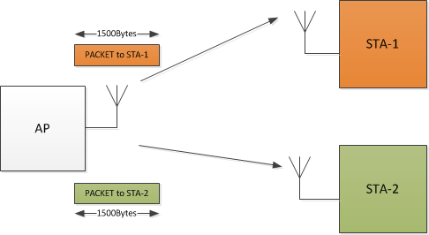
Experiment Design
Assume channel is known at AP
Depends on Multiplexing technique
Compare time taken to transmit data MPDUs using
a) OFDM
b) OFDMA
STAs -1 & 2 are arbitrarily chosen.

Slide 7
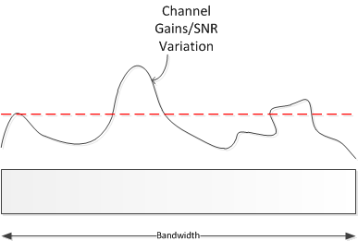
Time taken to transmit a packet
Use the Capacity formula to map instantaneous SNR per subcarrier to the rate
$$C_{i}=\log_{2}\left(1+\frac{{\left|h_{i}\right|}^{2}}{σ^{2}}\right)$$
Compute the average rate
$$\overline{C}=\frac{1}{N_{data}}\sum_{i=1}^{N_{data}}{C_{i}}$$
Use the average rate to compute
# of bits per OFDM Symbol
Compute # of OFDM Symbols per packet ➔ time taken to transmit the packet

Slide 8
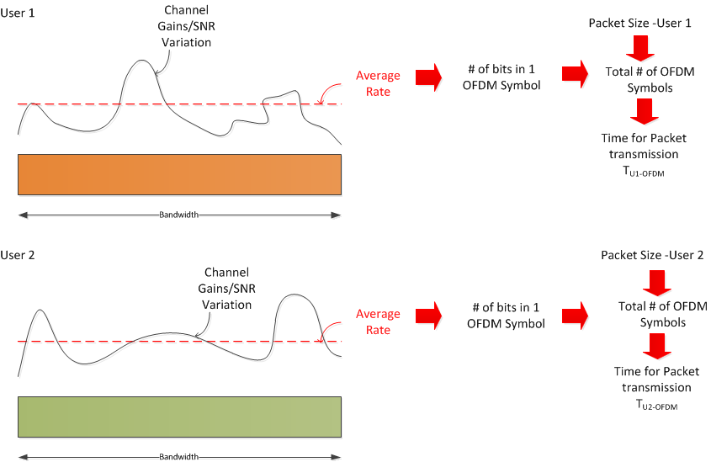
OFDM
$$T_{OFDM}=T_{U1−OFDM}+T_{U2−OFDM}$$

Slide 9
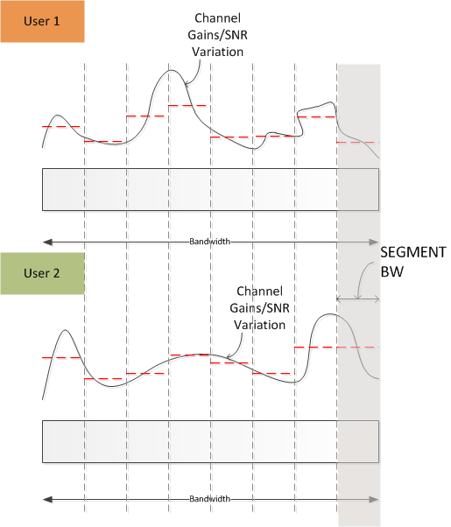
OFDMA
If the transmission of one user’s data MPDU is complete, use the entire BW for the second user.
$T_{U1−OFDMA}$
$T_{U2−OFDMA}$
Choose user with maximum rate for each segment
$$T_{OFDMA}=T_{U1−OFDMA}+T_{U2−OFDMA}$$

Slide 10
Comparing OFDM with OFDMA
For a choice of two users (instantiated by random generation of channels)
→ compute $T_{OFDM}$ and $T_{OFDMA}$
Plot CDF of $T_{OFDM}−T_{OFDMA}$ computed at every instant over many instantiations
1
$T_{OFDM}−T_{OFDMA}$ < 0
→OFDM is better
$T_{OFDM}−T_{OFDMA}$ > 0
→OFDMA is better
CDF
0
0

Slide 11
Comparing OFDM with OFDMA
Not apples-to-apples!
OFDM – 802.11 style is at a disadvantage.
OFDMA assumes per segment adaptation which is advantageous in a frequency selective channel
Notes:
OFDM Parameters as in 802.11
Bandwidth = 80MHz
# of Antennas at STA = 1
# of Antennas at AP = 1
Segment BW = 5MHz
Assume packet transmission is always successful
No PHY abstraction
SNR = 14dB
Outdoor UMi Channel Model

Slide 12
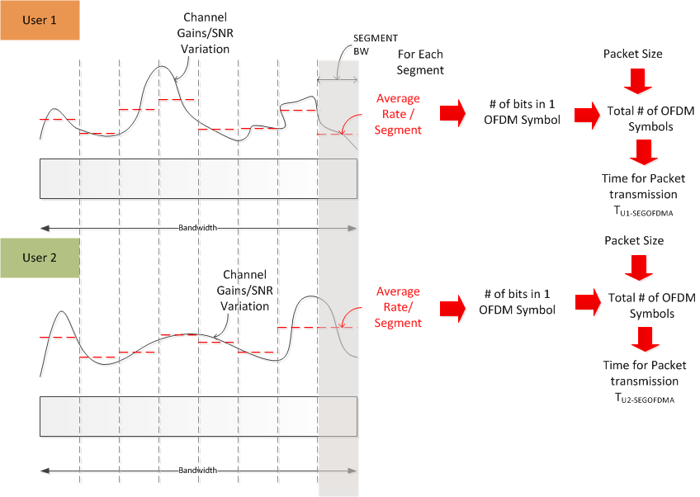
Fairly comparing OFDM and OFDMA
Since rate is chosen per segment → segmented OFDM
$$T_{SEGOFDM}=T_{U1−SEGOFDM}+T_{U2−SEGOFDM}$$

Slide 13
Comparing SEG-OFDM with OFDMA
Gains due to user selection still persists!
Notes:
OFDM Parameters as in 802.11
Bandwidth = 80MHz
# of Antennas at STA = 1
# of Antennas at AP = 1
Segment BW = 5MHz
Assume packet transmission is always successful
No PHY abstraction
SNR = 14dB
Outdoor UMi Channel Model

Slide 14
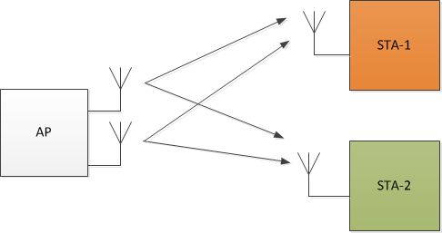
Comparison with SDMA
Update AP to have 2 antennas
Assume MRT transmission with the precoder set to the inverse of the concatenated channel.
Measure total MPDU transmission time $T_{SDMA}$

Slide 15
Sensitivity to user selection in SDMA
SDMA is better
Notes:
OFDM Parameters as in 802.11
Bandwidth = 80MHz
# of Antennas at STA = 1
# of Antennas at AP = 1
Segment BW = 1 subcarrier 312.5KHz
Assume packet transmission is always successful
No PHY abstraction
SNR = 14dB
Outdoor UMi Channel Model

Slide 16
Observations
OFDMA can be considered as a multiplexing technique in 802.11ax
There is a measurable advantage that can be extracted by frequency adaptive loading of users even in the absence of sophisticated user selection algorithms.
This advantage persists even when 802.11 OFDM is *improved* to support the adaptive loading of subcarriers (slide #13)
This advantage increases with an increasing frequency selectivity of the channel (as is likely to be the case in the outdoor scenario)
The channel frequently favors OFDMA over SDMA
Both have similar channel state information requirements at the transmitter.
Basic mechanisms that were incorporated to support MU-MIMO can be reused to support OFDMA.

Slide 17
Next Steps
Scale up spatial dimensions at both AP and STAs to include results with MIMO
Evaluate assuming non-ideal CSI at AP
Update metric to include throughput evaluated using PHY abstraction
Discuss evaluation methodology to study techniques like OFDMA

Slide 18
References
[1] C.Y. Wong, R. S. Cheng, K. B. Letaief and R. D. Murch, “ Multiuser OFDM with Adaptive Subcarrier, Bit and Power Allocation”, IEEE Journal on Selected Areas in Communications, Vol. 17, No.10 Oct 99
[2] Brian Hart, 11-14-0855-00-00ax-techniques-for-short-downlink-frames.pptx

