Slide 1
Functional Requirements Discussion
Date: 2014-08-06
Authors:

Slide 2
Overview
General Problems with draft Functional Requirements:
Requirements (11-14-0567r5) do not contain sufficient details defining conditions in which requirement applies.
Requirements are not mapped to simulation scenarios which define important details needed for requirement verification.
Most requirements do not include quantitative performance metric.-- “improve” is not adequate to define next generation WLAN performance goal.
Many questions about 5th percentile requirement
Packet Delay (latency) requirement is inadequate
Proposed Access Efficiency Requirement

Slide 3
The 5th Percentile of per Station Throughput
The current definition of 5th Percentile Throughput needs additional clarification to be measurable:
“The TGax amendment shall define a mechanism or mechanisms to improve the 5th percentile of per station throughput (measured at the MAC data service access point), without degradation of other performance requirements including transmission latency and average throughput per station, compared to the existing IEEE 802.11 standard and its amendments operating in the same band (IEEE 802.11n in 2.4 GHz and IEEE 802.11ac in 5 GHz) and in the same dense deployment scenario.” [Ref 1]
We need to define:
Which STAs are considered when defining the group from which the 5th Percentile STAs are chosen,
Which scenario(s) are to be considered,
The measures of throughput used to define a 5th Percentile STA.

Slide 4
Which STAs are considered when defining the group from which the 5th Percentile STAs are chosen?
Are the STAs in a single BSS, ESS, or all in the scenario?
What is the offered traffic load for this requirement?
Are only active STAs considered (STAs who have transmitted or received data during the measurement time)?
Should STAs sending/receiving only control or management frames be included?

Slide 5
Which scenario(s) are to be considered?
How many scenarios should be considered?
Which scenario(s):
Indoor Hotspot
Outdoor Hotspot
Others
Do we need to modify the scenario(s) so that there the group of STAs being considered is statistically significant.
How many STAs should be in the group considered
Should we only consider the worst-case scenario for this requirement, or is requirement verification needed in all scenarios?

Slide 6
Which measures of throughput should be used to define a 5th Percentile STA?
Should we use average throughput per STA, averaged only over the same selected STAs in the “5th percentile group”?
Over what time is the STA throughput averaged?
The whole simulation duration (excluding “warm up” time if any)?
An agreed measurement duration?
If a STA in a scenario has low data rate flows (e.g. the STA is only supporting e-mail traffic) should its throughput be compared with other STAs which have high data rate flows (e.g. video streaming)?
Is the target vs. achieved throughput ratio a better measure?

Slide 7
Video Transmission Latency
It is clear that the prevalence of video traffic will continue to increase and will become the dominating traffic type for WLAN in the near future.
HD TVs and the popularity of video casting from/to mobile devices is defining the user experience by the quality of wireless video. PER is a primary QOS metric.
In addition to PER, Video traffic uses WLAN packet latency and jitter as additional metrics for QOS. [Ref 2] [Ref 3]
Since 11ax needs to provide QOS for high density video traffic, 11ax functional requirements should also address video packet delay across the WLAN.

Slide 8
11ax Needs Packet Latency Requirement
For most streaming video services (youtube, netflix, etc) sizeable video buffering at the display is used to combat jitter and adds 1-10secs end-to-end delay. Packet delay is only a small portion of total delay and even high delays(10-50msec) are perceived as tolerable.
But for interactive video, wireless virtual desktop and other video applications, end-to-end delay is not tolerable.
11ax needs to define a packet latency requirement which will address the needs of next generation users using delay-sensitive applications.
The WLAN packet delay should be derived from an end-to-end delay budget for interactive video applications.
The WLAN portion of the end-to-end delay should be an additional functional requirement for 11ax only for delay-sensitive applications.
Are currently defined EDCA Access Categories adequate for low latency applications?

Slide 9
Changes to Transmission Latency Requirement
Existing TGax R6, with changes [Ref 1] :
The mechanisms defined in the TGax amendment shall significantly improve the average transmission latency of latency sensitive applications to satisfy QoS requirements of various applications, when compared to the existing IEEE 802.11 standard and its amendments operating in the same band (IEEE 802.11n in 2.4 GHz and IEEE 802.11ac in 5 GHz) and in the same deployment scenario. 11ax average transmission latency for interactive video in scenarios 1 and 2 shall be less than 1.0 msec (TBR?).
Notes: The transmission latency is measured from the time that the MPDU is ready for transmission (i.e., begins CSMA/CA access) MAC receives a packet till the time that PHY starts transmitting. The transmission latency requirements satisfying the QoS of typical applications are defined in TGax Evaluation Methodology Document. [In fact, requirements are currently NOT in Evaluation Methodology Document.]

Slide 10
Access Efficiency
The market success of mobile WLAN devices has led to degraded user experience in hotspots with dense STAs.
Carriers have presented many 11ax contributions highlighting the severe problems experienced today by WLAN users in overloaded public hotspots. [Ref 4] [Ref 5]
Efficiency of WLAN channel use can be as low as 10% in certain conditions. This means that successful WLAN data transmission is reduced to 10% while ~90% of channel is used for control and management frames and wasted transmissions (collisions). [Ref 6]
11ax must address this problem in a meaningful way.
An Access Efficiency Requirement for 11ax would provide a significant improvements for overloaded hotspots.

Slide 11
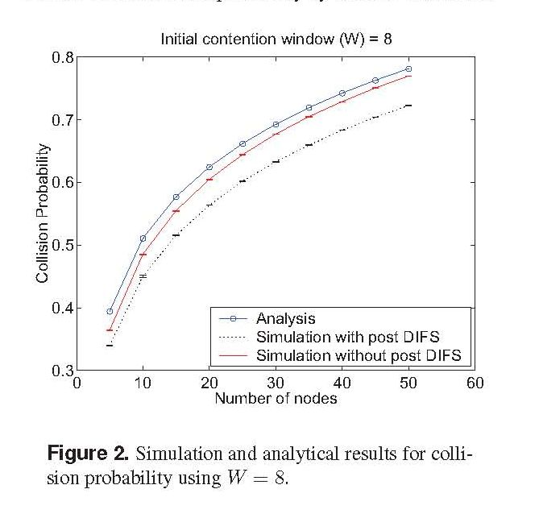
Collisions in Saturated Channels
Collisions can waste more than 70% of channel time in overloaded BSSs when channel is saturated,
i.e. available traffic far exceeds channel capability. [Ref 6] [Ref 7]

Slide 12
Why Access Efficiency?
Throughput is a great metric to evaluate overall WLAN system efficiency.
WLAN system efficiency has many components:
Spectral efficiency
Data rate (time/transport efficiency)
MAC overhead efficiency (MAC headers & control/management frames)
PHY overhead efficiency (IFS, GIs, Preambles, PHY headers, etc)
Access efficiency (efficiency of data transmissions, e.g. PER/collision effects)
Improving ANY single aspect of WLAN efficiency will boost throughput.
Using only a throughput metric will not require reasonable improvements in multiple system efficiency components.
Functional requirements setting minimum required metrics for multiple system efficiency components will produce maximum 11ax improvement.

Slide 13
Separate Ways to Boost Throughput: 11ax Needs BOTH for Best Results
MAC
access
efficiency
PHY
data
rate

Slide 14
Access Efficiency Draft Requirement
The TGax amendment shall provide a mechanism to increase BSS channel access efficiency in overloaded channel scenarios with many associated STAs. The TGax amendment shall provide at least one mode of operation capable of achieving 60%(TBR) or greater Access Efficiency when compared to scenarios providing 20-25%(TBR) access efficiency when using existing IEEE 802.11 standard and its amendments operating in the same band (IEEE 802.11n in 2.4 GHz and IEEE 802.11ac in 5 GHz), in the same deployments for scenarios 1 and 3, with the same number of STAs and same traffic loading.
Notes: Access efficiency is calculated by dividing the BSS Average Total Throughput by the BSS Throughput Time-Averaged Data Rate. This metric provides the unit-less percentage of time that the channel is occupied by data packets which are successfully transmitted and received. Control frames, management frames, and collision frames are excluded from access efficiency calculation.

Slide 15
Questions and Discussion THANK YOU !

Slide 16
Straw Polls
Should all 11ax functional requirements be further detailed to remove ambiguities? 28%: 10/28/75 (Y/N/A)
Should all 11ax functional requirements be further detailed to include minimum quantitative performance metric? 39%: 15/24/68
Should all 11ax functional requirements be mapped to appropriate simulation scenario(s)? 59%: 20/14/65
Should 11ax include a functional requirement for access efficiency? 46%: 23/27/54

Slide 17
References
11-14-0567-05-00ax-proposed-tgax-functional-requirements , L. Wang et al, Marvell
11-13-1158-00-0hew-video-traffic-and-applications-for-hew, B. Carney et al, Sony.
11-13-1159-01-0hew-video-app-performance-requirements-and-simulation-paramters, G. Li & Y. Liao, Intel.
11-13-0556-01-0hew-wi-fi-interference-measurements-in-korea, M. Cheong et al, ETRI.
11-14-0112-01-0hew-wi-fi-interference-measurements-in-korea-part-ii, J. Lee et al, ETRI.
“Collision Probability in Saturated IEEE 802.11 Networks”, H. Vu, T. Sakurai, Australian Telecommunication Networks & Applications Conference (ATNAC), December 2006.
11-13-0505-00-0hew-mac-efficiecy-analysis-for-hew-sg, Park & Akhmetov, Intel.

