Slide 1
Functional Requirements Comments
Date: 2014-07-15
Authors:

Slide 2
Abstract
This contribution proposes changes to the Functional Requirements document in including:
Clarification of the “5th Percentile” Throughput Requirement
A new “Packet Delay” requirement, and
A new “Access Efficiency” requirement

Slide 3
The 5th Percentile of per Station Throughput
The current definition of 5th Percentile Throughput needs additional clarification to be measurable:
“The TGax amendment shall provide a mechanism to improve the 5th percentile of per station throughput (measured at the MAC data service access point), compared to the existing IEEE 802.11 standard and its amendments operating in the same band (IEEE 802.11n in 2.4 GHz and IEEE 802.11ac in 5 GHz) and in the same deployment scenario.”
We need to define:
Which STAs are considered when defining the group from which the 5th Percentile STAs are chosen
Which scenario(s) are to be considered
The measures of throughput used to define a 5th Percentile STA

Slide 4
Which STAs are considered when defining the group from which the 5th Percentile STAs are chosen
Are the STAs in a single BSS, ESS, or all in the scenario?
Are only active STAs considered (STAs who have transmitted or received data during the measurement time)?
Should STAs only sending/receving control/messaging frames included?

Slide 5
Which scenario(s) are to be considered?
How many scenarios should be considered?
Which scenario(s):
  Indoor Hotspot
  Outdoor Hotspot
  Others
Do we need to modify the scenario(s) so that there the group of STAs being considered is statistically significant.
  How many STAs should be in the group considered?

Slide 6
The measures of throughput used to define a 5th Percentile STA
Over what time is the STA throughput averaged?
  The whole simulation duration (excluding “warm up” time if any)
  An agreed measurement duration
If a STA in a scenario has low data rate flows (e.g. the STA is only supporting e-mail traffic) should its throughput be compared with other STAs which have high data rate flows (e.g. video streaming)?
  Is the target vs. achieved throughput ratio a better measure?

Slide 7
Video Packet Delay
It is clear that the prevalence of video traffic will continue to increase and will become the dominating traffic type for WLAN in the near future.
HD TVs and the popularity of video casting from/to mobile devices is defining the user experience by the quality of wireless video. PER is indeed important here.
In addition to PER, Video traffic uses packet delay and jitter as primary metrics for QOS. [1] [2]
Since HEW needs to provide QOS for high density video traffic, HEW functional requirements should also address video packet delay across the WLAN.

Slide 8
HEW Needs Packet Delay Requirement
For most streaming video services (youtube, netflix, etc) sizeable video bufferring is used to combat jitter and adds considerable end-to end delay. WLAN packet delay is only a small proportion of total delay and is perceived as tolerable.
BUT for interactive teleconferencing, gaming and other video applications, end-to-end delay is not tolerable.
HEW needs to define a packet delay requirement which will address the needs of next generation users.
The WLAN packet delay should be derived from an end-to-end delay budget for gaming applications.
The WLAN portion of the end-to-end delay should be included as an additional functional requirement for HEW.
AC Access Delay may be measured at STA and AP to quantify system performance for video packets.

Slide 9
Packet Delay Draft Requirement
The TGax amendment shall provide a mechanism to improve packet delay of data transmission, compared to the existing IEEE 802.11 standard and its amendments operating in the same band (IEEE 802.11n in 2.4 GHz and IEEE 802.11ac in 5 GHz) and in the same deployment scenario. WLAN Data Packet delay in scenario X shall be less than 1.0 msec.

Slide 10
Access Efficiency
The market success of mobile WLAN devices has led to degraded user experience in hotspots with dense STAs
Carriers have presented many HEW contributions highlighting the severe problems experienced today by WLAN users in overloaded public hotspots.
Efficiency of WLAN channel use can be as low as 10% in certain conditions. This means that successful WLAN data transmission is reduced to 10% while 90% of channel is wasted on control and management frames and unsuccessful data transmissions (collisions).
HEW must address this problem in a meaningful way.
An Access Efficiency Requirement for HEW would provide a solution for overloaded hotspots.

Slide 11
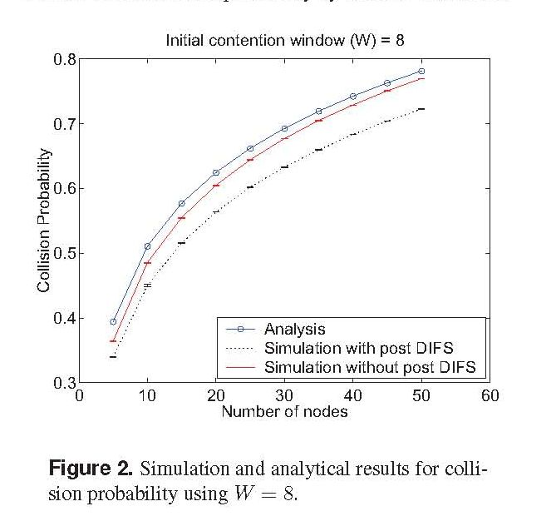
Collisions in Saturated Channels
Collisions waste more than 70% of channel time in overloaded BSSs when channel is saturated,
i.e. available traffic far exceeds channel capability. [3] [4]

Slide 12
Access Efficiency Draft Requirement
The TGax amendment shall provide a mechanism to increase BSS channel access efficiency in overloaded channel scenarios with many associated STAs. Access Efficiency(AccEff) is calculated by dividing the BSS Average Total Throughput by the BSS Throughput Time-Averaged Data Rate. The TGax amendment shall provide at least one mode of operation capable of achieving 60% or greater AccEff when compared to scenarios providing 20-25%AccEff when using existing IEEE 802.11 standard and its amendments operating in the same band (IEEE 802.11n in 2.4 GHz and IEEE 802.11ac in 5 GHz), in the same deployment scenario and with the same number of STAs and traffic loading.

Slide 13
References
11-13-1158-00-0hew-video-traffic-and-applications-for-hew, Carney et al, Sony.
11-13-1159-01-0hew-video-app-performance-requirements-and-simulation-paramters, G. Li & Y. Liao, Intel.
H. L. Vu, T. Sakurai, “Collision Probability in Saturated IEEE 802.11 Networks”, Australian Telecommunication Networks & Applications Conference (ATNAC), December 2006.
11-13-0505-00-0hew-mac-efficiecy-analysis-for-hew-sg, Park & Akhmetov, Intel.

