Slide 1
Performance Evaluation of OBSS Densification
Date: 2014-07-14
Name | Affiliations | Address | Phone | Email
Po-Kai Huang | Intel |  |  | po-kai.huang@intel.com
Robert Stacey | Intel |  |  | robert.stacey@intel.com
Rongzhen Yang | Intel |  |  | rongzhen.yang@intel.com
Qinghua Li | Intel |  |  | qinghua.li@intel.com

Slide 2
Introduction
The potential gain of OBSS densification techniques has been investigated by many contributions [1-16]
DSC algorithm by Graham Smith [1-5,8,9,14,16]
PHY System Simulation by Broadcom [6,7]
MAC System Simulation [11,12]
Integrated MAC/PHY System Simulation [10]
Performance Measurement [13]
Coexistence issue with legacy devices [10,11,15]
This contribution focuses on
Using MAC system simulation to evaluate the performance for different CCA levels in Scenario 1, 2, and 3 in simulation scenarios document [17]
Investigating the performance when there are both AX devices that raise CCA levels and legacy devices that do not raise CCA levels

Slide 3
Interference Model
Model Preamble error
For a device, when its state is idle or medium busy, it acquires the first arriving packet with power higher than signal detect CCA threshold.
When the packet is acquired, if the SINR of the preamble is less than or equal to 0dB, the whole packet is declared in error.
Use the maximum interference in each MPDU for PER decision

Slide 4
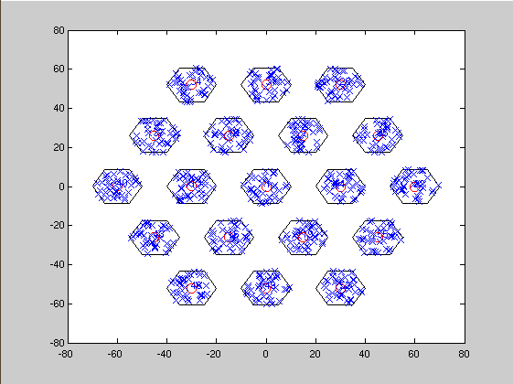
Simulation Setup – Scenario 3
2.4GHz with 20 MHz bandwidth
TXOP: 4ms
Channel D path loss
Channel D shadow fading
1x1 and no antenna gain
Full buffer traffic
MSDU size: 1000 bytes
One channel
Cell radius: 10m
ICD: 30m (Reuse 3)
Simulation Time: 100s
40 STAs per BSS
Power of STA: 15 dBm
Power of AP: 20 dBm
Only uplink transmissions
Genie MCS selection
RTS/CTS: on
1 drop

Slide 5
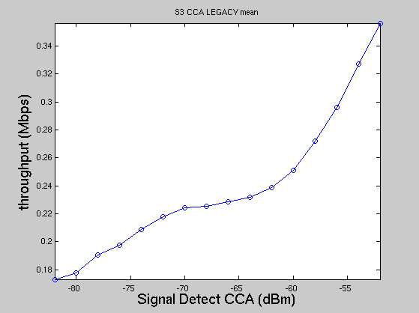
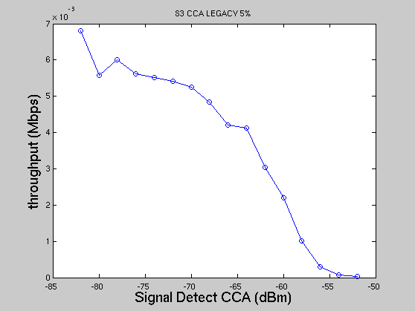
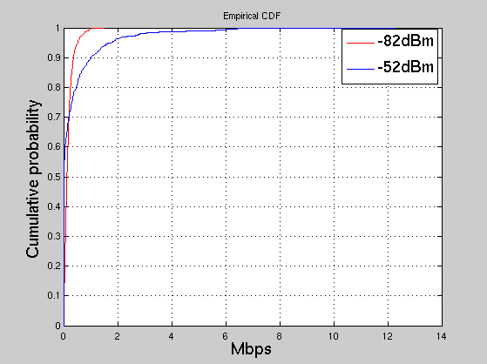
Simulation Results – Scenario 3
Simulate the scenario for different CCA levels
Signal Detect CCA (dBm) | -82 | -80 | -78 | -76 | -74 | -72 | -70 | -68 | -66 | -64 | -62 | -60 | -58 | -56 | -54 | -52
Energy Detect CCA (dBm) | -62 | -62 | -62 | -62 | -62 | -62 | -62 | -62 | -62 | -62 | -62 | -60 | -58 | -56 | -54 | -52
Notes:
More Drops. 5GHZ

Slide 6
Discussion
There is around 10 dB difference between our MCS table and Broadcom’s MCS table.
Suspect that this is the reason why best CCA level for 5% throughput may be lower than the range [-70,-60] dBm.
MCS table for channel D with impairments
MCS table used by Broadcom [6]
MCS | 0 | 1 | 2 | 3 | 4 | 5 | 6 | 7 | 8
SINR(dB) | 10.2 | 13.5 | 17.5 | 19 | 23.5 | 27 | 29.5 | 31.5 | 35
MCS | 0 | 1 | 2 | 3 | 4 | 5 | 6 | 7 | 8
SINR(dB) | 3.2 | 7.0 | 9.6 | 11.8 | 15.5 | 18.8 | 20.4 | 21.9 | 25.0

Slide 7
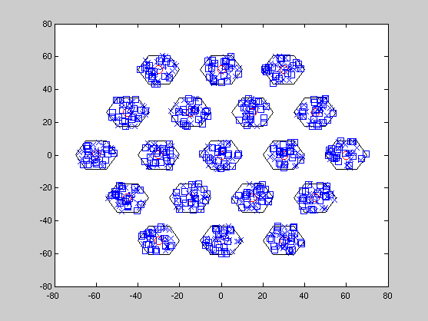
Simulation Setup – Scenario 3 Mixed Environment
20 devices in each cell are AX (square) that raise CCA levels
20 devices in each cell are legacy (cross) that do not raise CCA levels

Slide 8
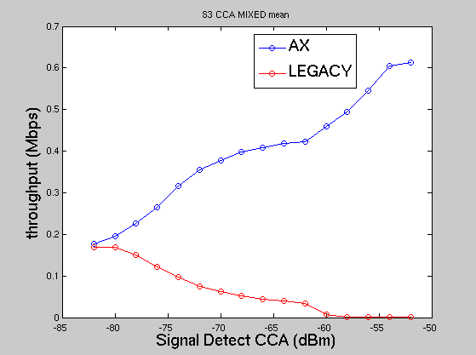
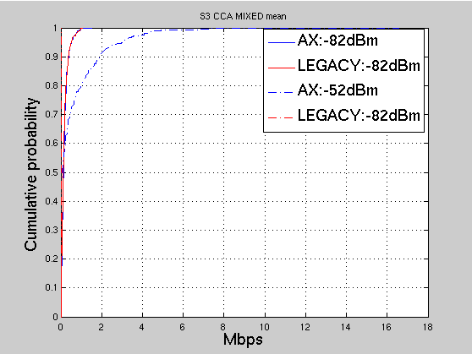
Simulation Results – Scenario 3
Simulate the performance where half devices are AX that raise CCA levels and half devices are legacy that do not raise CCA levels
Signal Detect CCA (dBm) | -82 | -80 | -78 | -76 | -74 | -72 | -70 | -68 | -66 | -64 | -62 | -60 | -58 | -56 | -54 | -52
Energy Detect CCA (dBm) | -62 | -62 | -62 | -62 | -62 | -62 | -62 | -62 | -62 | -62 | -62 | -60 | -58 | -56 | -54 | -52

Slide 9
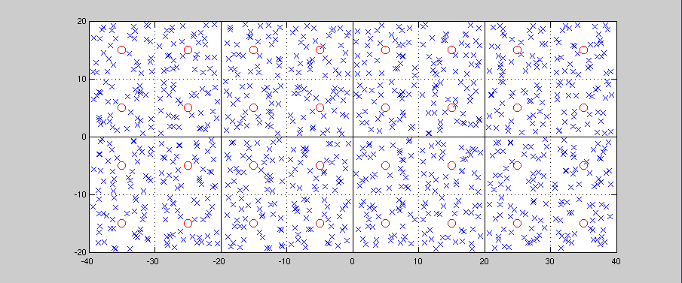
Simulation Setup – Scenario 2
2.4GHz with 20 MHz bandwidth
TXOP: 4ms
Channel D path loss
Channel D shadow fading
1x1 and no antenna gain
Full buffer traffic
MSDU size: 1000 bytes
Four channels (Fixed distribution)
Simulation Time: 50s
32 STAs per cell
Power of STA: 15 dBm
Power of AP: 20 dBm
Only uplink transmissions
Genie MCS selection
RTS/CTS: on
1 drop

Slide 10
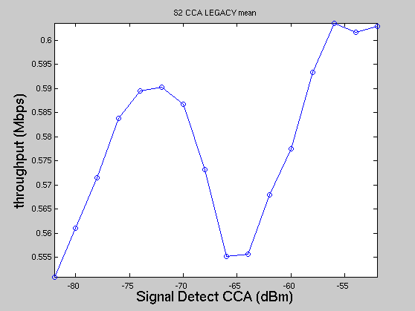
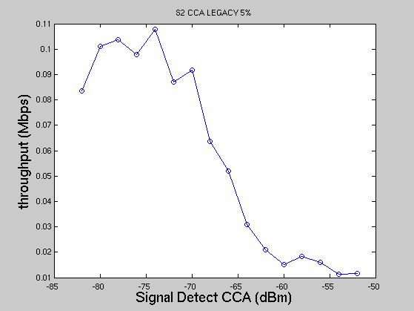
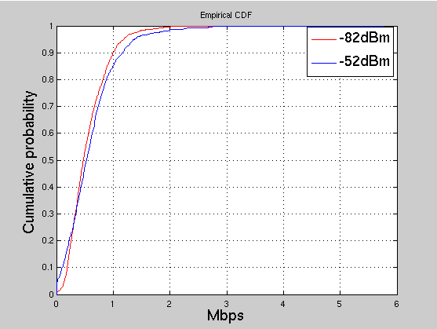
Simulation Results – Scenario 2
Simulate the scenario for different CCA levels
Signal Detect CCA (dBm) | -82 | -80 | -78 | -76 | -74 | -72 | -70 | -68 | -66 | -64 | -62 | -60 | -58 | -56 | -54 | -52
Energy Detect CCA (dBm) | -62 | -62 | -62 | -62 | -62 | -62 | -62 | -62 | -62 | -62 | -62 | -60 | -58 | -56 | -54 | -52

Slide 11
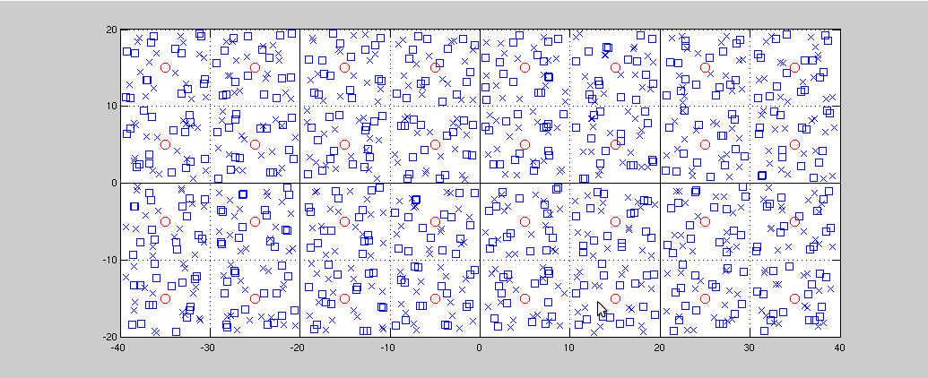
Simulation Setup – Scenario 2 Mixed Environment
16 devices in each cell are AX (square) that raise CCA levels
16 devices in each cell are legacy (cross) that do not raise CCA levels

Slide 12
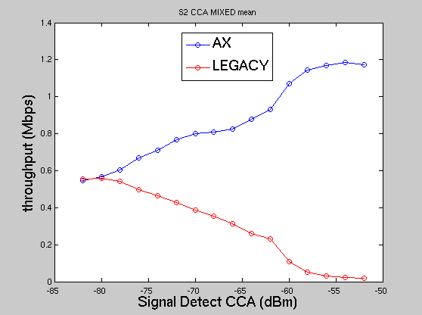
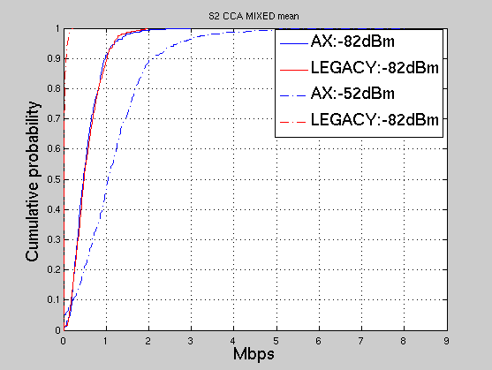
Simulation Results – Scenario 2
Simulate the performance where half devices are AX that raise CCA levels and half devices are legacy that do not raise CCA levels
Signal Detect CCA (dBm) | -82 | -80 | -78 | -76 | -74 | -72 | -70 | -68 | -66 | -64 | -62 | -60 | -58 | -56 | -54 | -52
Energy Detect CCA (dBm) | -62 | -62 | -62 | -62 | -62 | -62 | -62 | -62 | -62 | -62 | -62 | -60 | -58 | -56 | -54 | -52

Slide 13
Simulation Setup – Scenario 1
2.4GHz with 20 MHz bandwidth
TXOP: 4ms
Channel B path loss
Channel B shadow fading
1x1 and no antenna gain
Full buffer traffic
MSDU size: 1000 bytes
Three channels (random selection per AP)
Simulation Time: 50s
10 STAs per apartment
Power of STA: 15 dBm
Power of AP: 20 dBm
Only uplink transmissions
Genie MCS selection
RTS/CTS: on
1 drop
(Note that this figure is presented in 2D mode.)

Slide 14
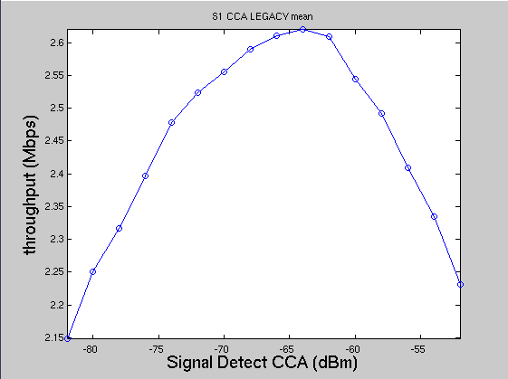
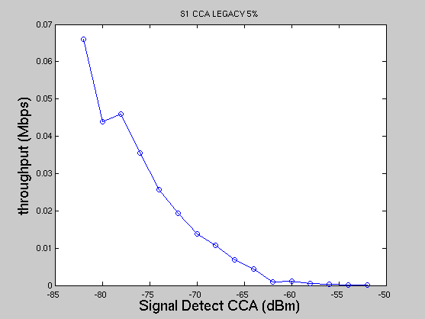
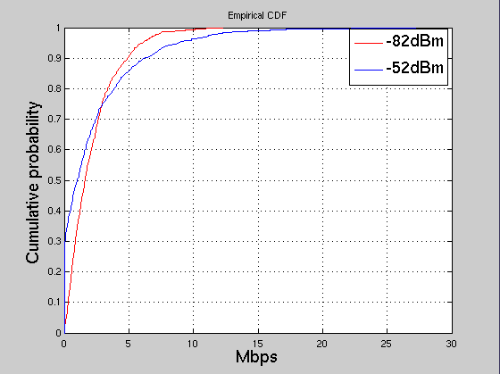
Simulation Results – Scenario 1
Simulate the scenario for different CCA levels
Signal Detect CCA (dBm) | -82 | -80 | -78 | -76 | -74 | -72 | -70 | -68 | -66 | -64 | -62 | -60 | -58 | -56 | -54 | -52
Energy Detect CCA (dBm) | -62 | -62 | -62 | -62 | -62 | -62 | -62 | -62 | -62 | -62 | -62 | -60 | -58 | -56 | -54 | -52

Slide 15
Simulation Setup – Scenario 1 Mixed Environment
5 devices in each cell are AX (square) that raise CCA levels
5 devices in each cell are legacy (cross) that do not raise CCA levels
(Note that this figure is presented in 2D mode.)

Slide 16
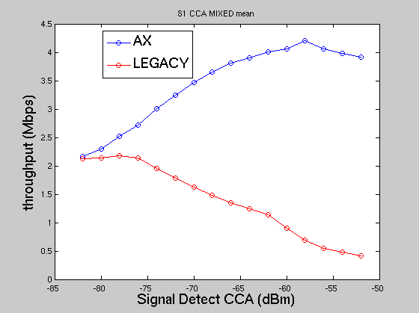
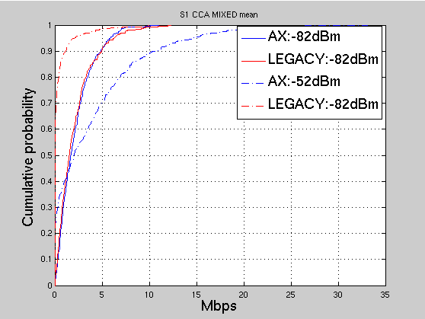
Simulation Results – Scenario 1
Simulate the performance where half devices are AX that raise CCA levels and half devices are legacy that do not raise CCA levels
Signal Detect CCA (dBm) | -82 | -80 | -78 | -76 | -74 | -72 | -70 | -68 | -66 | -64 | -62 | -60 | -58 | -56 | -54 | -52
Energy Detect CCA (dBm) | -62 | -62 | -62 | -62 | -62 | -62 | -62 | -62 | -62 | -62 | -62 | -60 | -58 | -56 | -54 | -52

Slide 17
Conclusion
The best CCA level for mean and 5% throughput may not be a fixed value
The best CCA level depends on the scenario
The best CCA level may also depend on the parameter setting
Raising CCA levels for AX devices directly will affect the performance of legacy devices
The coexistence issue with legacy devices needs to be carefully investigated

Slide 18
Reference
Graham Smith, DSP Group, 11-13-1290-01 Dynamic Sensitivity Control for HEW
Graham Smith, DSP Group, 11-13-1487-02 Dense Apartment Complex Capacity Improvements with Channel selection and Dynamic Sensitivity Control
Graham Smith, DSP Group, 11-13-1489-05 Airport Capacity Analysis
Graham Smith, DSP Group, 11-14-0045-02 E-Education Analysis
Graham Smith, DSP Group, 11-14-0058-01 Pico Cell Use Case Analysis
Ron Porat, Broadcom, 11-14-0082-00 Improved Spatial Reuse Feasibility - Part I
Nihar Jindal, Broadcom, 11-14-0083-00 Improved Spatial Reuse Feasibility - Part II
Graham Smith, DSP Group, 11-14-0294-02 Dynamic Sensitivity Control Channel Selection and Legacy Sharing
Graham Smith, DSP Group, 11-14-0328-02 Dense Apartment Complex Throughput Calculations
Jinjing Jiang, Marvell, 11-14-0372-00 System level simulations on increased spatial reuse
Imad Jamil, Orange, 11-14-0523-00 Mac Simulation Results for DSC and TPC
Frank LaSita, InterDigital, 11-14-0578-00 Residential Scenario CCA/TPC Simulation Discussion
John Son, WILUS Institue/SK Telecom, 11-14-0628-00 Measurements on CCA Thresholds in OBSS Environment

Slide 19
Reference
Graham Smith, DSP Group, 11-14-0365-01 Dynamic Sensitivity Control Implementation
James Wang, MediaTek, 11-14-0637-00 Spatial Reuse and Coexistence with Legacy Devices
Graham Smith, DSP Group, 11-14-0779-00 Dynamic Sensitivity Control Practical Usage
11-14-0621-04, TGax Simulation Scenarios

Slide 20
Appendix – MCS table
MCS table for Channel D with impairments
MCS table used by Broadcom [6]
MCS | 0 | 1 | 2 | 3 | 4 | 5 | 6 | 7 | 8
SINR(dB) | 10.2 | 13.5 | 17.5 | 19 | 23.5 | 27 | 29.5 | 31.5 | 35
MCS | 0 | 1 | 2 | 3 | 4 | 5 | 6 | 7 | 8
SINR(dB) | 3.2 | 7.0 | 9.6 | 11.8 | 15.5 | 18.8 | 20.4 | 21.9 | 25.0

Slide 21
Appendix – Genie MCS selection
Before a TX transmits packet, it checks the interference at the RX and use the value to select the best MCS with 10% PER.

