Slide 1
LDPC Coding for 45GHz
Date: 2014-09-09
Authors:
Name | Affiliations | Address | Phone | Email
Liguang Li | ZTE Corporation | Shenzhen China |  | li.liguang9@zte.com.cn
Jun Xu | ZTE Corporation | Shenzhen China |  | xu.jun@zte.com.cn
Zhifeng Yuan | ZTE Corporation | Shenzhen China |  | yuan.zhifeng@zte.com.cn
Sun Bo | ZTE Corporation | Xi’anChina |  | Sun.bo1@zte.com.cn
Weimin Xing | ZTE Corporation | Xi’anChina |  | xing.weimin@zte.com.cn
Kaibo Tian | ZTE Corporation | Xi’anChina |  | Tian,kaibo@zte.com.cn
Shiwen HE | Southeast University (SEU) | Nanjing China |  | hesw01@seu.edu.cn
Haiming WANG | Southeast University (SEU) | Nanjing China |  | hmwang@seu.edu.cn

Slide 2
Background
Structured LDPC codes have been adopted in several IEEE standards, which have the feature of good performance, low complexity, and high throughput.
  One parity check matrix H of size M*N is represented by one base matrix Hb of size mb*nb and one expand factor
  In 802.16e, 6 base matrices were applied to support 4 code rates and 19 code lengths (2005)
  In 802.11n/ac, 12 base matrices were applied to support 4 code rates and 3 code lengths（2009)
  In 802.11ad, 4 base matrices were applied to support 4 code rates and fixed code length（2012）
Ultra high throughput requirement of 11aj (45 GHz)
  Maximum throughput of 10 G bps

Slide 3
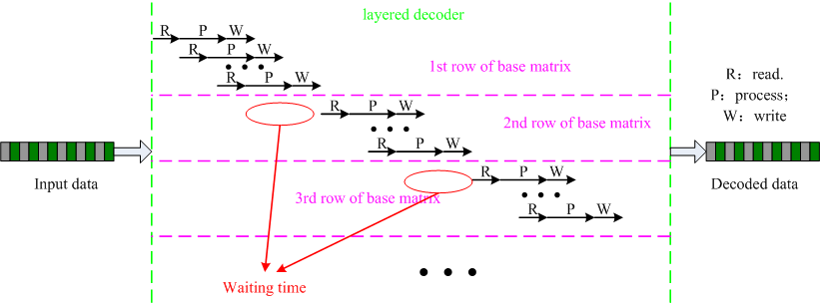
Background
Layered decoder:
  ‘R’ denotes that message is read in from memory, ‘P’ denotes the processing of CNU(check node update unit), ‘W’ denotes that message is written into memory.
  There is a waiting time between one row update and the next row update for one LDPC base matrix.
  Pipeline decoder^{[4][5]:}
  The waiting time is reduced or eliminated
  Address conflict can be avoided

Slide 4
Background
  The shortcomings of 802.11ad LDPC and other LDPC codes
  Limited decoding throughput due to a waiting time
  a waiting time between one row update and the next row update for one LDPC base matrix degrade the whole decoding throughput obviously.
  High routing complexity.
  Since base matrices for different code rates are random and independent, complex banyan networks are used for the routing operation.
  Cycle shift operation and inverse cycle shift operation make the routing complexity double
  Poor performance of signaling field coding in 802.11ad.
  Based on the code base matrix of rate ¾, signaling field coding fails to fully obtain LDPC code gain.
  Not high girth
  More cyclic shift operation are needed for encoder
  the check part of base matrix is not a strictly low triangular matrix

Slide 5
Proposed base matrices
  For all base matrices, the check part is a strictly low triangular matrix.
  All none -1 elements in the same column of different base matrices are from a set with 4 elements.
  For all base matrices, the girth of all systematic bit nodes ≥ 8, and the girth of all parity bit nodes ≥ 6
Features
  Most none -1 elements
  are even number
  The first none -1 element of each column is equal to zero.

Slide 6
Proposed base matrix
  The code size n=672, and the four code rates are r₀=1/2, r₁=5/8, r₂=3/4 and r₃=13/16 respectively, the number of systematic bits corresponding to the four code rates are k₀=336, k₁=420, k₂=504 and k₃=546 respectively, and the expand factor z=42.
  r₀=1/2：
  r₁=5/8：
-1 | 0 | -1 | 0 | -1 | 0 | -1 | 0 | 0 | -1 | -1 | -1 | -1 | -1 | -1 | -1
0 | -1 | -1 | 34 | -1 | 12 | -1 | 36 | 18 | 0 | -1 | -1 | -1 | -1 | -1 | -1
8 | -1 | 0 | -1 | 0 | -1 | 0 | -1 | -1 | 13 | 0 | -1 | -1 | -1 | -1 | -1
-1 | 16 | 40 | -1 | 32 | -1 | 22 | -1 | -1 | -1 | 19 | 0 | -1 | -1 | -1 | -1
-1 | 20 | -1 | 22 | -1 | 2 | -1 | 28 | 32 | -1 | -1 | 21 | 0 | -1 | -1 | -1
30 | -1 | 18 | -1 | -1 | 14 | -1 | 30 | -1 | 37 | -1 | -1 | 31 | 0 | -1 | -1
40 | -1 | 12 | -1 | 38 | -1 | 6 | -1 | -1 | -1 | 26 | -1 | -1 | 13 | 0 | -1
-1 | 24 | -1 | 20 | 10 | -1 | 2 | -1 | -1 | -1 | -1 | 18 | -1 | -1 | 5 | 0
-1 | 0 | -1 | 0 | 0 | 0 | 0 | 0 | 0 | -1 | 0 | -1 | -1 | -1 | -1 | -1
0 | -1 | 0 | -1 | 32 | -1 | 22 | -1 | 18 | 0 | 19 | 0 | -1 | -1 | -1 | -1
8 | 16 | 40 | 34 | -1 | 12 | -1 | 36 | 32 | -1 | -1 | 21 | 0 | -1 | -1 | -1
30 | 20 | 18 | 22 | 38 | -1 | 6 | -1 | -1 | 13 | -1 | -1 | 31 | 0 | -1 | -1
-1 | 24 | -1 | 20 | -1 | 2 | -1 | 28 | 16 | 37 | -1 | -1 | -1 | 13 | 0 | -1
40 | -1 | 12 | -1 | 10 | 14 | 2 | 30 | -1 | 19 | -1 | -1 | -1 | -1 | 5 | 0

Slide 7
Proposed base matrix
  r₀=3/4：
  r₁=13/16：
0 | 0 | 0 | 0 | 0 | 0 | 0 | 0 | 0 | 0 | 0 | 0 | 0 | -1 | -1 | -1
8 | 16 | 40 | 34 | 32 | 12 | 22 | 36 | 18 | 13 | 19 | 0 | -1 | 0 | -1 | -1
30 | 20 | 18 | 22 | 38 | 2 | 6 | 28 | 32 | 37 | 26 | 21 | 31 | -1 | 0 | -1
40 | 24 | 12 | 20 | 10 | 14 | 2 | 30 | 16 | 19 | 34 | 18 | -1 | 13 | 5 | 0
0 | 0 | 0 | 0 | 0 | 0 | 0 | 0 | 0 | 0 | 0 | 0 | 0 | 0 | -1 | -1
30 | 20 | 18 | 22 | 38 | 2 | 6 | 28 | 32 | 37 | 26 | 21 | 34 | -1 | 0 | -1
40 | 24 | 12 | 20 | 10 | 14 | 2 | 30 | 16 | 19 | 34 | 18 | 8 | 13 | 5 | 0

Slide 8
Performance of proposed base matrix
  Performance comparison on AWGN channel:

Slide 9
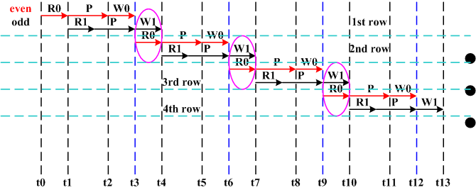
Advantage of the proposed base matrix
  Base Matrix: Most of elements unequal to -1 are even.
With the parallelism of 21, some clocks(t4-t3) reduction for every transition to next row. And speed up the decoding.

Slide 10
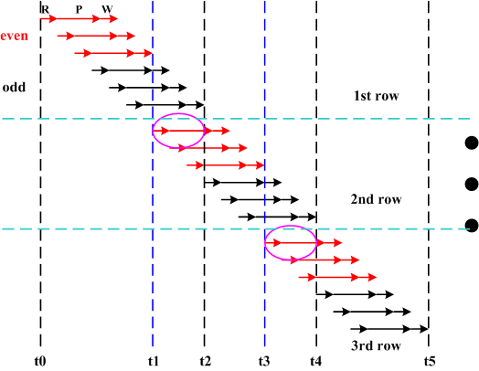
Advantage of the proposed base matrix
  Base Matrix: Most of elements unequal to -1 are even.
With the parallelism of 7, some clocks(t2-t1) reduction for every transition to next row. And speed up the decoding.

Slide 11
Advantage of the proposed base matrix
  Throughput:
  Pipeline decoder:
  Layered decoder:
  Decoder of proposed base matrices:
f_{s}：Operating frequency, N: size of LDPC code, zf ： expand factor, p：decoder parallelism, mb：number of base matrix’s rows, Iter： number of decoding iteration, t： clock number of ‘RPW’, x： clock number in advance.
  With code rate ¾, p=21, iter=10, fs=500MHz, Throughput:
 | t =3 clk | t =4clk | t =5 clk | t =6 clk | t =7 clk | t =8 clk
Pipeline decoder | 4.0976 G bps | 4.0482 G bps | 4.0000G bps | 3.9529 G bps | 3.9070G bps | 3.8621 G bps
Layered decoder | 2.1000G bps | 1.6800 G bps | 1.4000G bps | 1.2000G bps | 1.0500G bps | 0.9333 G bps
Layered decoder x=1： | 2.7769G bps | 2.0870 G bps | 1.6716G bps | 1.3942G bps | 1.1957G bps | 1.0467 G bps
Layered decoder x=2： | 4.0976G bps | 2.7541 G bps | 2.0741G bps | 1.6634G bps | 1.3884G bps | 1.1915G bps

Slide 12
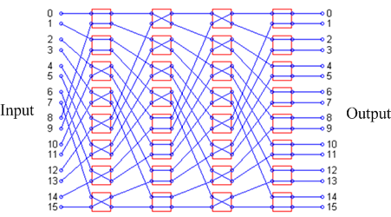
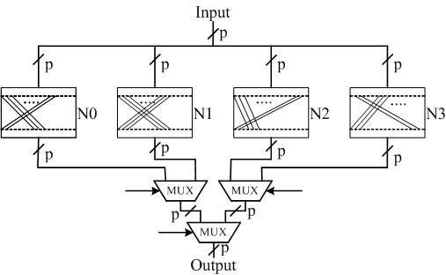
Advantage of the proposed base matrix
  Base Matrix: All elements unequal to -1 in the same column of different base matrices are from the same set with 4 elements.
Banyan network:
Every column of base matrix need a banyan network for cyclic shift operation.
Fixed network:
4 fixed network are provided for cyclic shift operation of every column of base matrix.

Slide 13
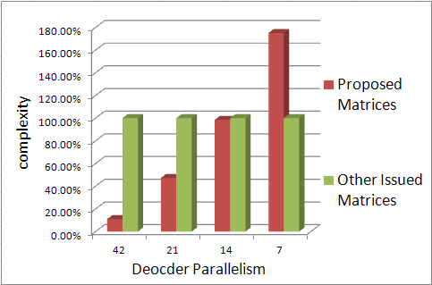
Advantage of the proposed base matrix
  Base Matrix: All the elements unequal to -1 in the same column of different base matrixes are from a set with 4 elements.
  Complexity of network: with fixed network, proposed base matrices have simpler network(less modules of Either-or Operation).
  Proposed matrices:
  Fix network,
  Other issued matrices:
  Banyan network
  Complexity = number of levels ×number of Either-or Operation modules.

Slide 14
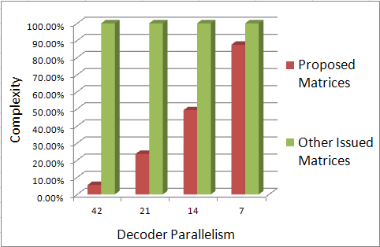
Advantage of the proposed base matrix
  Base Matrix: The first element unequal to -1 every column is 0.
  Inverse cycle shift operation of every column can be avoided, needing half of cycle shift operation.

Slide 15
Proposed LDPC base matrix
Conclusion
  Most of elements unequal to -1 are even
    Decoding time reduction and high decoding speed.
  All the elements unequal to -1 in the same column of different base matrices are from a set with 4 elements
    Low complex fixed network instead of Banyan network
  The first element unequal to -1 of every column is 0.
    Inverse cycle shift operation can be avoided .
  The check parts of all base matrices are strictly low triangular matrices.
    Less cyclic shift operation for LDPC encoder

Slide 16
Signaling field coding
Why the signaling field coding need special designed
  The lowest code rate should be used for signaling field to maintain a robust reception
  The signaling bits is much less than the systematic bits of the one LDPC code word.
  Principle
  Compatible with the data field’s LDPC code,
  Good performance.
  Signaling field
  SIG-A of 72 bits is encoded to 1024 bits, and SIG-B of 40 bits is encoded to 672 bits.

Slide 17
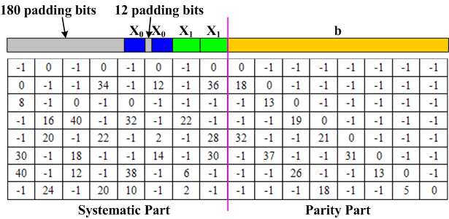
Proposed Signaling field Coding
Encoding the signaling field with 72 bits(SIG-A)
  The signaling bits of SIG-A can be shown as . The length of and are 30 and 42 respectively.
  The signaling bits repeat once and is encoded to generate the parity sequence with length of 336 bits by using rate 1/2 LDPC code with the element of base matrix .
  The mother codeword is . And the sequence of first 1024 bits of three copies of is LDPC code output.
  The location of , and in the base matrix show as:

Slide 18
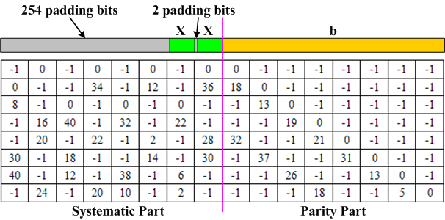
Proposed Signaling field Coding
Encoding the Signaling field with 40 bits(SIG-B)
  The signaling bits of SIG-B can be shown as .
  The signaling bits repeat once and is encoded to generate the parity sequence with length of 336 bits by using rate 1/2 LDPC code base matrix .
  The mother codeword is . And the sequence of first 672 bits of three copies of is LDPC code output.
  The location of and in the base matrix show as:

Slide 19
Signaling field coding
Performance(AWGN)
  Simulation condition:
  64 bits input, 672 bits output,
  AWGN, QPSK
  NEW:
  Proposed coding scheme
  11ad:
  Scheme issued in 802.11ad

Slide 20
Proposed LDPC base matrix
Comparison
Good
Data field coding Performance
Poor
Both have the same performance
Proposed LDPC
LDPC of 11ad
Signaling coding
performance
Simplicity
Coding gain ≈ 0.8dB for BLER=0.01
Proposed LDPC is less than about 40% of 11ad.
Throughput
More than about 150% times

Slide 21
Conclusion
  We proposed a new LDPC base matrix for group discussion
We also design the signaling field coding procedure using the proposed LDPC base matrix .

Slide 22
References
[1]. IEEE Std 802.11ad
[2].“11-14-0716-02-00aj-phy-sig-frame-structure-for-ieee-802-11aj-45ghz”
[3].“Rate=5/6 LDPC Coding for OFDMA PHY”, C80216e-05_066r2，Robert Xu, etc
[4]. Min-seok Oh, Kyuhyuk Chung ,etc. “IEEE C802.16e-06/168 -Informative: LDPC parallel processing in IEEE802.16e ”.
[5]. Brian Classon, Yufei Blankenship. “IEEE C802.16e-05/066r3- LDPC coding for OFDMA PHY”.
[6].“High Girth LDPC Coding for OFDMA PHY”, IEEE C80216e-05_126r1， Robert Xu,
Mansour, M.M.; Shanbhag N.R.
[7]. "A 640-Mb/s 2048-Bit Programmable LDPC Decoder Chip", IEEE Journal of Solid-State Circuits, vol. 41, no. 3, pp. 684-698, Mar. 2006
[8]. T. Zhang and K. K. Parhi, "Joint (3,k)-Regular LDPC Code and Decoder/Encoder Design", IEEE Transactions on Signal Processing vol. 52, no. 4, pp. 1065-1079, April, 2004

Slide 23
Straw Poll
Do you support to add to the 11aj spec the LDPC basic check matrixes for 45GHz operation as proposed in slide6-7?
Y/N/A

