Slide 1
Dynamic Sensitivity Control
Practical Usage
Date: 2014-July
Authors:

Slide 2
Previous DSC Presentations
13/1012r4 Dynamic Sensitivity Control
13/1290r1 Dynamic Sensitivity Control
13/1487r2 Dense Apartment Complex DSC and CH Select
14/0045r2 E-Education
14/0058r1 Pico Cell
14/0294r2 DSC, Channel Selection and legacy sharing
14/0328r2 Dense Apartment Complex Throughput Calculations
14/0635r1 DSC Implementation
14/0779r0 DSC Practical Usage
  Legacy, settings

Slide 3
Objectives
DSC basics
Interworking with Legacy networks/STAs
Looking at other’s simulations
  Fixed CCA versus DSC
Practical aspects of setting DSC Margin and Upper Limit
How to use DSC

Slide 4
Dynamic Sensitivity Control - DSC
Scheme where STA measures the RSSI of the AP Beacon (R dBm)
Sets RX Sensitivity Threshold at (R – M) dBm, where M is the “Margin”
  Example:
    STA receives Beacon at -50dBm, with Margin = 20dB
    STA sets RX Sensitivity Threshold to -70dBm.
Also set an Upper Limit, L, to Beacon RSSI to cater for case when STA is very close to AP.
  Need to ensure that all the STAs in the wanted area do see each other. Hence if one STA very close to AP, then it could set RX Sensitivity too high.
  Example:
    STA receives Beacon at -15dBm, L = -30dBm, M = 20dBm
    STA sets RX Sensitivity Threshold at -30 -20 = -50dBm (NOT –35dBm)
If the RX sensitivity threshold is higher than the CCA Threshold then CCA Threshold = RX Sensitivity Threshold

Slide 5
DSC maintains full sensitivity
It is important to note the difference between DSC and simply setting the CCA Threshold or the RX sensitivity to a higher value
The chance of hidden STAs in the home network is greatly reduced
The DSC STA, maintains full range. The sensitivity will move towards lowest value as the STA moves away from the AP
See next Slide

Slide 6
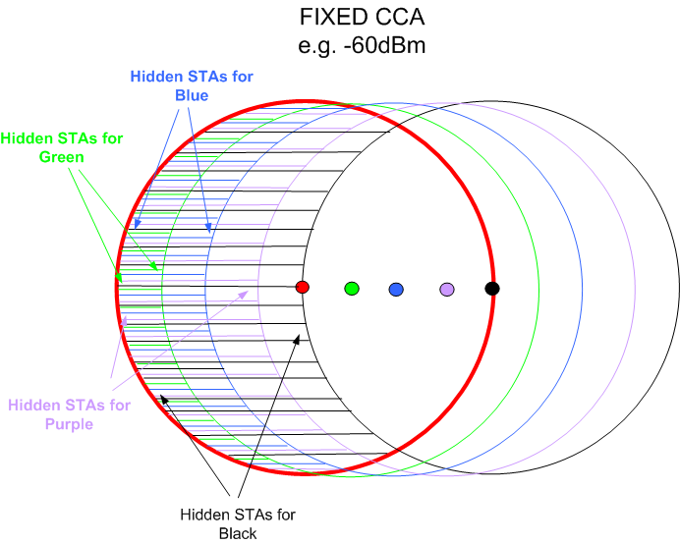
Hidden STAs – Fixed CCA vs DSC
DSC
Note NO hidden STAs

Slide 7
DSC
ADVANTAGES
DSC can increase the area throughput by significant amounts
  296% improvement for Single Apartment Complex
  412% improvement for Double Apartment Complex
  800% improvement for Cell Structure network
DSC used in conjunction with channel selection can eliminate OBSS completely in dense apartment scenario
DSC does not require any hardware changes and is simple to implement
DSC can improve performance for all PHYs
DSC does not degrade the range of a STA
CONCERNS
Effect on legacy networks/STAs
How to set DSC parameters in unmanaged networks
  Avoid hidden STAs

Slide 8
Legacy
(Discussed also in 14/0294)

Slide 9
Legacy STAs and DSC STAs
A legacy STA in the same network as a DSC STA is completely unaffected by the DSC STAs.
The legacy STA may be held off from transmitting by STA in OBSS, but will compete equally with DSC STAs in same BSS
  As other DSC STAs will ignore OBSS STAs their traffic is often occurring during a time when the legacy STA cannot TX, and hence overall contention is lessened.

Slide 10
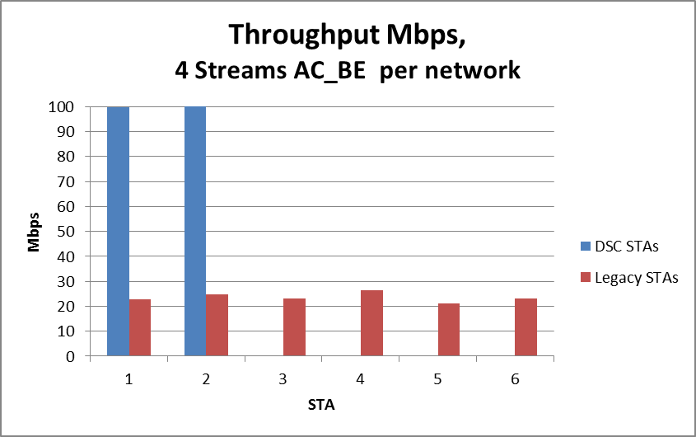
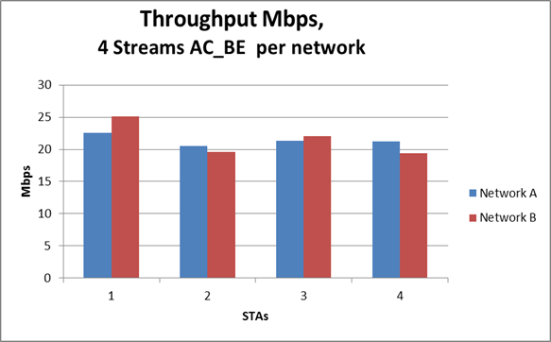
Legacy DSC mix (11n 2SS 270Mbps 32k Agg, 100Mbps)
DSC 100Mbps
Legacy ~22Mbps
DSC Network with
2 DSC STAs
2 Legacy STAs
OBSS Network
4 Legacy STAs
Legacy ~22Mbps
Legacy STAs are not affected
BUT look at the DSC STAs!

Slide 11
“Sharing” DSC and Legacy Networks
DSC Network/STAs does not
Overlap with Legacy Network
DSC
Legacy
Legacy Network
Overlaps with DSC Network
Note: This assumes Margin is sufficient such that both Legacy
And DSC STAs can TX at same time.

Slide 12

DSC and Legacy STAs in apartment complex and cell cluster
DSC network sharing with a legacy network,
  DSC network does not see the legacy network
  Legacy network does see the DSC network
Legacy STAs will compete with own network STAs and with DSC STAs
DSC STAs just compete with DSC STAs
If Legacy STA wins it sends packet and completes even if DSC STA starts to transmit (DSC Margin is set to allow this – really important !)
If DSC STA starts a packet the Legacy STAs will hold off. As soon as DSC STA completes transmission all DSC and Legacy STAs will then compete for medium.
ALSO if DSC STA is transmitting when the Legacy STA completes its transmission, then the legacy STA will not hold off as CCA is now based on signal strength (i.e. -62dBm not -82dBm)

Slide 13
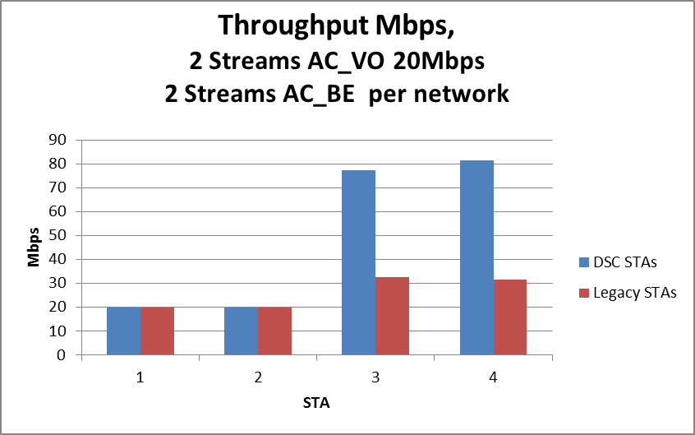
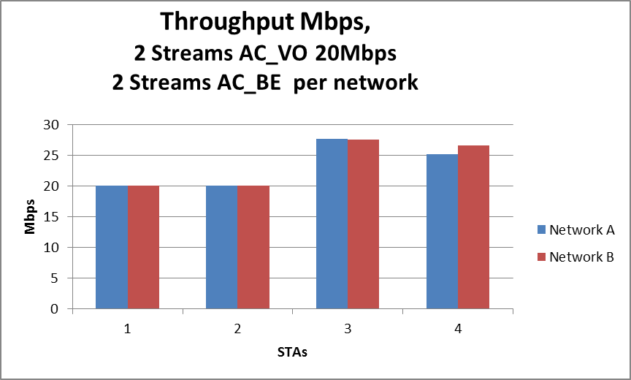
Throughput Simulations
Legacy STAs unaffected
But look at the DSC!
Legacy Sharing
DSC/Legacy Sharing

Slide 14
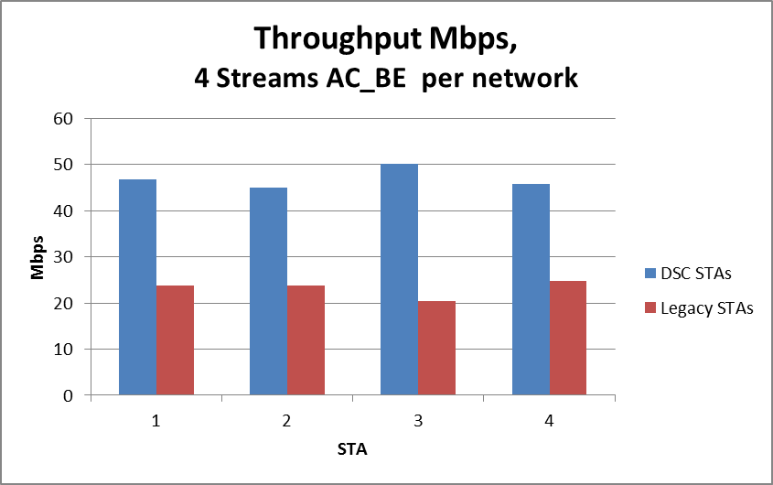
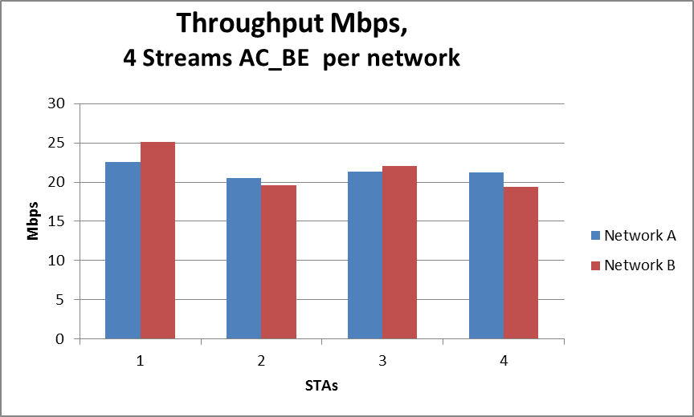
Throughput Simulations
Legacy Sharing
DSC/Legacy Sharing

Slide 15
Legacy and DSC Simulation
270Mbps 2SS 11n
Actually Legacy STAs are better off!!
DSC STAs are a lot better off
(incentive to use the feature, even by itself)

Slide 16
Other’s Simulations
(My) MAC Simulations assume that the DSC Margin is such that BOTH Legacy AND DSC STA can transmit at the same time
  The SNIR is sufficient to support the transmission
  The DSC Margin is set such that this happens!
Simulations that simply vary the CCA setting on all “DSC” STAs are not representative of what DSC is.
  CCA level may not be such that both legacy and “CCA STA” can transmit at same time. This is will be shown.

Slide 17
Simulations using varying
Settings for CCA

Slide 18
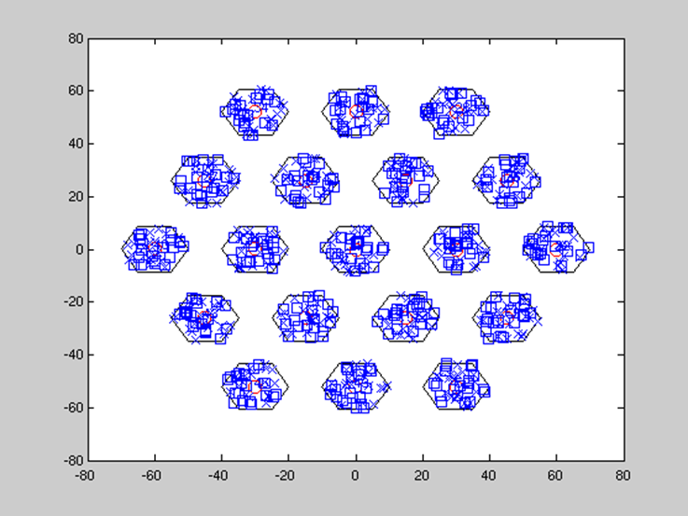
Set CCA - Simulations
For example consider simulation using the cell pattern with 3 channel re-use. Scenario 3.
Mixture of “CCA STAs” and legacy STAs.
  The “CCA STAs” are not using DSC but are simply STAs where the CCA threshold is set at varying levels.

Slide 19
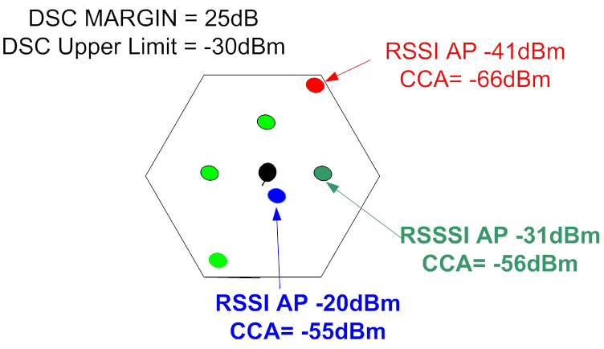
Example: Assume 10m radius cell, AP at center, 2.4GHz
Note: With DSC, CCA Threshold varies within the Cell
If CCA is higher than -66dBm then
SNIR is not assured and
simultaneous transmissions fail
If CCA is higher than -56dBm then
SNIR is not assured and
simultaneous transmissions fail

Slide 20
3 Channel repeat – Example
STA A and B
RSSI from AP = -41dBm
RSSI STAs A, B= -41dBm,
RSSI at AP A from STA B = -52dBm
RSSI at AP B from STA A = -52dBm
SNR at AP A = 11dB
SNR at AP B = 11dB
STA A must set CCA < -52dBm to share correctly
with STA B
STA A and C
RSSI STAs A, C = -58dBm
RSSI at AP A from STA C = -63dBm
RSSI at AP B from STA A = -52dBm
SNR at AP A = 22dB
SNR at AP B = 11dB
STA A must set CCA <-58dBm to share correctly
With STA C and B
STA D and C
RSSI STAs D, C = -66dBm
RSSI at AP A from STA C = -63dBm
RSSI at AP B from STA D = -63dBm
SNR at AP A = 22dB
SNR at AP B = 22dB
STA D must set CCA < -66dBm to share correctly
With STA B and STA C
NOTE: DSC sets -66dBm for STA A/B/C/D_
C
B
B
A
A
D
SNR=30dB

Slide 21
Observations - 1
In this scenario, valid CCA thresholds should never be set above -66dBm, in order to maintain (OBSS) SNR values.
  NOTE: TX power 23dBm, 2.4GHz, 0dBi antennas
With DSC each STA has a different effective CCA, not sure what happens when all set at same CCA
Fixing CCA threshold higher will result in the following:
  If a “CCA STA” starts to transmit when legacy STA is already transmitting (due to CCA), then both packets fail due to too low SNR
  A “CCA STA” already transmitting holds off legacy STA, and “CCA STA” packet is successful.
  RESULT: Legacy STA throughput is starved
  (as shown by simulation results)

Slide 22
Observations - 2
3 channel repeat will result in POOR THROUGHPUT
  Analysis showed that 7 channel repeat was necessary to provide the required SNR (I also assumed 3dB obstruction loss per cell wall)
  If DSC is applied correctly, legacy STAs will not suffer unduly. Also DSC STAs do not perform as well as they could
  One advantage of DSC is to allow better channel re-use, this is not represented by this scenario
As shown in previous DSC presentations, channel selection plus DSC is how to get optimal results
The DSC Margin is the “Dynamic” part of DSC. It is essential as this provides the protection to legacy STAs.
  In a given network the resulting CCA Threshold will vary from DSC STA to DSC STA
  Stepping CCA threshold and setting one value across all “CCA STAs” is not the same as DSC.
If CCA Threshold is such that a reasonable (OBSS) SNR is not resulting, legacy STAs will be shut out.

Slide 23
Unmanaged Networks

Slide 24
Unmanaged Networks Questions
Can the AP know what the settings for Upper Limit and Margin should be?
How does a STA set its Upper Limit and Margin if AP does not provide the settings?
Points:
  DSC STA will revert to maximum sensitivity as it wanders away from its AP. DSC does not limit the range (unlike fixed CCA).
  Legacy AP will not be affected by having DSC STAs for DL traffic, BUT the Margin on the DSC STA will ensure that UL traffic can be coincidental with OBSS traffic.
  What is effect if DSC STA is outside the DSC contention area?

Slide 25
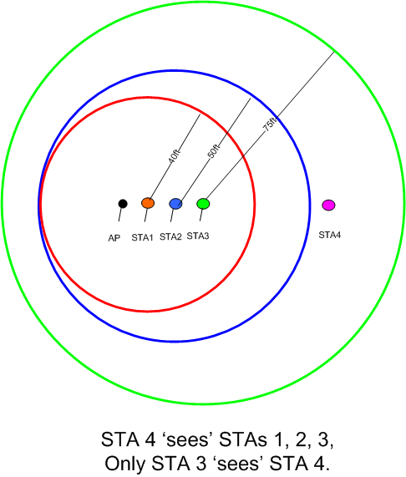
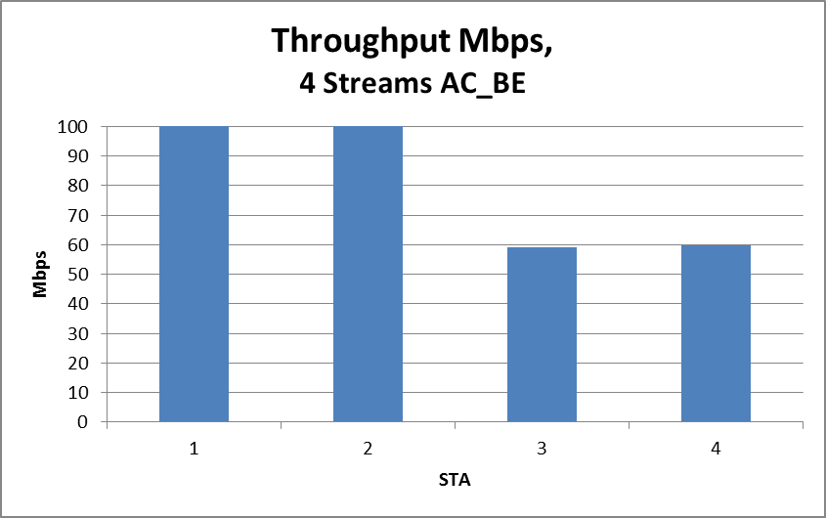
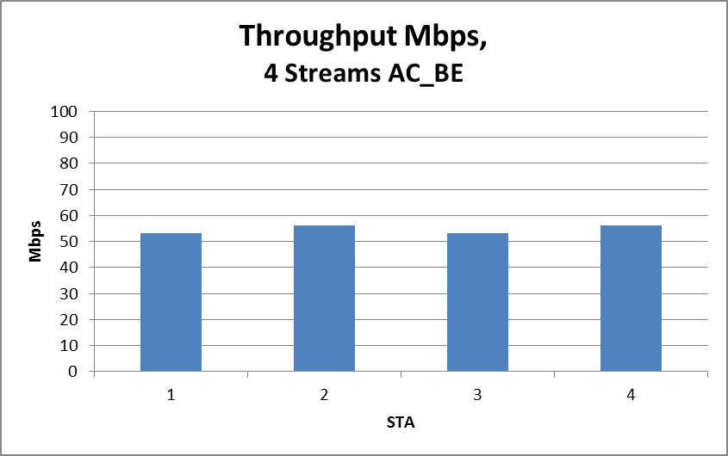
DSC STA outside area
If All Legacy
Simply reverts to
‘legacy’ throughputs on
Overlapping STAs

Slide 26
DSC STA outside of area (partially hidden)
Assuming legacy AP there is no undue effect if a DSC STA is outside the main area. It reverts to sharing with those it can see.
  It does get less traffic throughput
  BUT it equates to what it would get if all were legacy
Note: If DSC AP, then the DSC contention area may be defined and the “stray STA” is outside and hence not associated
Conclusion – there is no disadvantage
(similar to a STA at range with CCA set at -82dBm)
This is important, as in an unmanaged network, it is possible to set DSC for a ‘general’ condition without undue danger

Slide 27
Setting UL and Margin

Slide 28
UL and Margin Settings
Enterprise or Managed Area Networks
  UL and M set the contention areas such that channel re-use provides for desired high data rates (as per the 7 segment analyses)
  Extremely powerful for the DSC STAs but, as shown, legacy STAs do not suffer c.f. what happens if no DSC STAs present.
  Good incentive for STA vendors to implement DSC

Slide 29
UL and Margin Settings
Residential Service Provider
  In the dense apartment scenario DSC particularly useful, in this case relatively simple to know or preset the area. (DSC plus channel select effectively eliminates OBSS)
  In the house (townhouse or standalone) less chance of OBSS (assuming that channel select), and hence DSC settings can be lower.
  Could be preset based upon simple check list
    Size/type of property (e.g. apartment/house? Rooms? Floors?)
  Setting of UL and M may be set if prepared to carry out simple instructions
    Walk the (high data rate required) area.
    Walk the extremes (for DSC AP)
  Settings could be learnt - room for clever learning algorithms

Slide 30
UL and Margin Settings
Dumb User, residential
DSC AP
  Learning algorithm?
    After say 1 week, AP ‘knows’ distribution of its STAs.
    May use DSC to ‘prioritize’, for example, its HD video STAs
    Use of internal Receive Sensitivity threshold probably ‘dangerous’
DSC STA
  No real danger to assume a setting such as -40dBm and 20dB. High probability of avoiding OBSS and always ‘in range’ as STA moves away from AP (this is a the major feature of DSC versus a fixed, higher, CCA threshold).

Slide 31
Summary
For managed/enterprise area networks DSC has huge advantages and pretty simple to set up.
In residential networks DSC is particularly advantageous for the dense apartment scenario.
In practice the presetting of UL to -30/40dBm and Margin to 20/25dB would probably show significant advantages with respect to efficiency and OBSS.

