Slide 1
802-11 WG Agenda and Opening Report Beijing Interim May 2014
Date: 2014-05-21
Authors:

Slide 2
Abstract
This document is the 802.11 WG Agenda and WG reports for the 802.11 China Interim in Beijing, China May 2014.

Slide 3
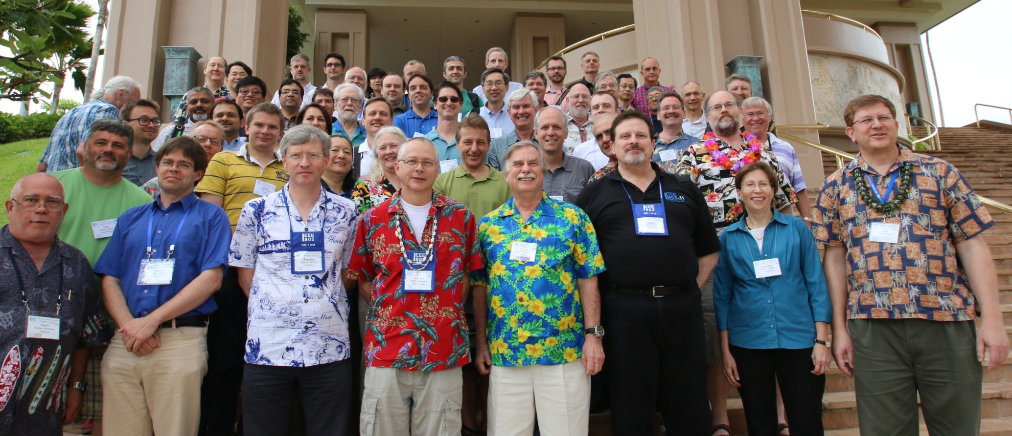
Photo from May 2014 802.11 Interim Waikoloa, HI

Slide 4
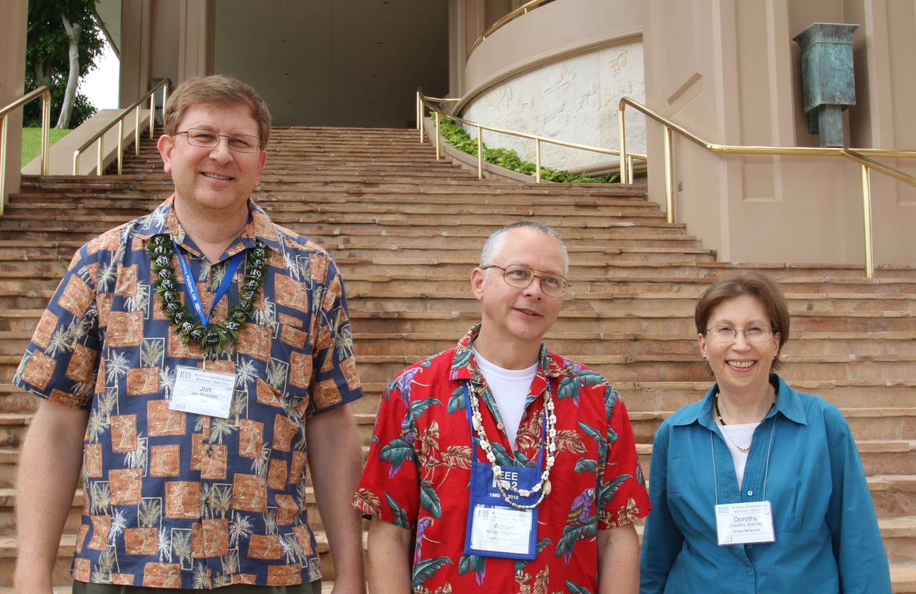
IEEE 802.11 2014-2016 Leadership
Jon Rosdahl (CSR Technologies) 1st Vice Chair
Adrian Stephens (Intel Corporation) Chair
Dorothy Stanley (Aruba Networks) 2nd Vice Chair

Slide 5
Interim Agenda plan
21 May 2014
9:00 - 10:00 IEEE 802.11 opening session
10:00 - 10:30 Tea Break
10:30 - 12:30 IEEE 802.11aj session
12:30 - 13:30 Lunch
13:30 - 15:30 IEEE 802.11aj session
15:30 - 16:00 Tea Break
16:00 - 18:00 IEEE 802.11aj session
22 May 2014
9:00 - 10:00 IEEE 802.11aj session
10:00 - 10:30 Tea Break
10:30 - 12:00 IEEE 802.11 closing session

Slide 6
802.11 agenda plan
Wednesday 09:00-10:00
Policies and Procedures
802.11 Status and Overview
Project status Reports
Other IEEE 802 and IEEE SA information

Slide 7
Policies and Procedures
Dorothy Stanley– 2nd Vice Chair
See doc: 11-14/0499r0

Slide 8
Letters of Assurance Report
Database is here.
9 Entries with 2014 submission dates.
9 Request for LoAs sent out as of March 2014.

Slide 9
IMAT Attendance Steps
https://imat.ieee.org/attendance
Login in with IEEE-SA account username/password
Select 802.11 China InterimBeijingCN21-May-2014
Enter the meeting code (given in the room)
Select Working Group: C/LM/WG802.11 Attendance
Mark Attendance for current slot

Slide 10
802.11 Activities

Slide 11
802.11 Working Group Session Documents
Document | Link to document
WG Agenda | https://mentor.ieee.org/802.11/dcn/14/11-14-0470-0000
Opening report | https://mentor.ieee.org/802.11/dcn/14/11-14-0510-0000
Snapshots | https://mentor.ieee.org/802.11/dcn/14/11-14-0471-0000
Supplementary Material | https://mentor.ieee.org/802.11/dcn/14/11-14-0472-0000
Motions | https://mentor.ieee.org/802.11/dcn/14/11-14-0473-0000
Closing report | https://mentor.ieee.org/802.11/dcn/14/11-14-0474-0000
1st vice chair | https://mentor.ieee.org/802.11/dcn/14/11-14-0493-0000
Treasurer | https://mentor.ieee.org/802.11/dcn/14/11-14-0495-0000
2nd vice chair | https://mentor.ieee.org/802.11/dcn/14/11-14-0499-0000

Slide 12
IEEE 802.11 Standards Pipeline
802.11-2015
802.11 -2012
MAC
GLK
802.11AK
PAD
802.11AQ
802.11aa
Video Transport
802.11ai
FILS
802.11ae
QoS Mgt Frames
WNG
802.11ax
802.11 ah
802.11af
TVWS
802.11aj
802.11ac
VHT 5GHz
PHY
802.11ad
VHT 60 GHz
Discussion Topics
Study
groups
TG without
Approved draft
WG
Letter Ballot
Sponsor
Ballot
Published
Amendment
Published
Standard
Slide 12
Notes:
doc.: IEEE 802.11-11/0483r0
May 2011
Bruce Kraemer (Marvell)
Page 12

Slide 13
IEEE 802.11 Revisions
802.11ai
FILS
MAC
e
QoS
802.11z
TDLS
802.11s
Mesh
802.11
-2003
802.11
-2007
802.11ae
QoS Mgt Frames
802.11
-1999
802.11r
Fast Roam
802.11
-2012
h
DFS & TPC
802.11u
WIEN
802.11aa
Video Transport
i
Security
802.11k
RRM
802.11V
Network
Management
802.11ak
GlobalLink
f
Inter AP
802.11Y
Contention
Based
Protocol
802.11aq
Service Discovery
d
Intl roaming
j
JP bands
802.11p
WAVE
802.11af
TV Whitespace
a 54 Mbps
5GHz
802.11ac
VHT
6Gbps @ 5GHz
b
11 Mbps
2.4GHz
802.11n
High
Throughput
(>100 Mbps)
g
54 Mbps
2.4GHz
802.11ad
VHT
6Gbps @ 60GHz
802.11W
Management
Frame
Security
802.11ah
<1GHz
PHY
802.11aj
40 & 60 GHz
Notes:
doc.: IEEE 802.11-11/0483r0
May 2011
Bruce Kraemer (Marvell)
Page 13

Slide 14
Summary of ballots and comment collections
Type | Label | Group | Opened | Dur (d) | # Comments | Pool | Approve | Disapprove | Abstain | Return % | Approve % | Result
CC | CC16 | ARC | 2014-03-26 | 10 | 17
CC | CC17 | TGak | 2014-03-28 | 28 | 100
CC | CC18 | ARC | 2014-04-18 | 8 | 0
WG Initial | LB201 | TGai | 2014-04-07 | 30 | 1158 | 336 | 195 | 34 | 28 | 78 | 85 | Passes

Slide 15
Current Membership Status
Status | Number
Aspirant | 128
Potential Voter | 51
Voter | 328
Ex Officio Voter | 8
Definitions:
  Aspirant: a member who has attended 1 qualifying meeting
  Potential Voter: a member who has attended 2 qualifying meetings and will become a voter at the start of the next plenary they attend
  Ex Officio Voter: a voter who has voting rights by virtue of their membership of the 802 EC and has requested to be recorded as an ex officio voter in 802.11
Data as of 2014-04-10

Slide 16
“Ex Officio” voting members
According to the 802 P&P, 802 voting EC members have the right to vote in 802.11.
The EC members have been asked to indicate if they are interested in exercising this right. Those interested are recorded as “Ex Officio” voters in 802.11.
Ex Officio voters will appear in WG ballot pools.

Slide 17
Recent voting member history

Slide 18
ANA Status
The latest database is 11-11/0270r21 (March 2014)
Changes since last meeting:
  None

Slide 19
PAR Expiration/Renewal Schedule
Project | PAR Expiration Date
AF | 31-DEC-2014
AH | 31-DEC-2014
AI | 31-DEC-2014
AC | 31-DEC-2014
AJ | 31-DEC-2016
AK | 31-DEC-2016
AQ | 31-DEC-2016
July 2014
extension requests

Slide 20
IEEE Store Contents - May 2014
Publication | Draft in TechStreet | Draft in Members Area | Published in Get 802?
IEEE P802.11REVmc | D2.0 $500 pdf | 2.8
IEEE Std 802.11af-2013 | $165 pdf
IEEE Std 802.11ac-2013 | $258 pdf
IEEE Std 802.11ad-2012 | $371 pdf |  | Yes
IEEE Std 802.11ae-2012 | $108 print |  | Yes
IEEE Std 802.11aa-2012 | $185 print |  | Yes
IEEE Std 802.11-2012 | $556 print |  | Yes
IEEE Std 802.11<x>: b, k, i, n, p, y, r, w, u, v, z, s | $100 - $309
802.11-2007
Last updated: 2014-04-25
Notes:
November 2011

Slide 21
802.11 drafts to ISO/IEC JTC1/SC6
Drafts are sent to ISO during sponsor ballot to solicit comments. Approved drafts may also be sent during working group ballot.
Any comments received from ISO are processed by the comment resolution committee
If P802.11REVmc D3 receives 75% approval in a forthcoming WG letter ballot, it will be sent to JTC1/SC6.
Notes:
November 2011

Slide 22
Recent Actions approved by 802.11 WG
Approved the Liaison to the IETF in 11-14/0683r1 and request that it be sent by the IEEE 802.11 WG Chair.
Approved the Liaison to the IETF in 11-14/0684r1 and request that it be sent by the IEEE 802.11 WG Chair.
Approved the liaising of 11-14-0552-00 to SC6 as the IEEE 802.11 WG response to SC6 NB comments on the recent FDIS ballots on 802.11aa/ad/ae.
Approved a 20 day Working Group Recirculation Ballot asking the question “Should P802.11REVmc D3.0 be forwarded to Sponsor Ballot?”
Approved a 30 day Working Group Technical Letter Ballot asking the question “Should P802.11ah D2.0 be forwarded to Sponsor Ballot?”
Approved the 3GPP liaison response in 11-14/0658r06.

Slide 23
Recent Actions approved by 802.11 WG
Approved the PAR extension contained in 11-14/0590r1 be posted to the IEEE 802 Executive Committee (EC) agenda for WG 802 preview and EC approval to submit to NesCom.
Approved the CSD contained in 11-14/0591r0 be posted to the IEEE 802 Executive Committee (EC) agenda for WG 802 preview and EC approval.
Approved the PAR extension contained in 11-14/0653r2 be posted to the IEEE 802 Executive Committee (EC) agenda for approval to submit to NesCom.
Approved the Five Criteria contained in 11-10/1153r0 be posted to the IEEE 802 Executive Committee (EC) agenda for WG 802 preview and EC approval.
Approved the IEEE 802.11 WG chair to liaise document “11-14-0705-00-0000-liaison-response-to-wba-carrier-wi-fi.doc” to the Wireless Broadband Alliance.

Slide 24
Group | Date(s) | Start | Duration
CAC | Monday Jun 9; July 7 | 12:00 ET | 1 hr
REG SC | Thursdays to July 31 | 12:30 ET | 1 hr
REG SC DSRC Tiger Team | Bi-weekly Fridays May 23 to July 31 | 13:00 ET | 1 hr
TGah | May 28, Jun 4, July 2, 9 | 20:00 ET | 2 hrs
TGai | Tuesdays to July 31 | 10:00 ET | 1 hr
TGak | Monday June 2, 16, 30 | 17:00 ET | 1.5 hrs
TGaq | Tuesday July 8 | 10:00 ET | 1 hr
TGmc | Friday June 20; July 11 | 10:00 ET | 2 hrs
TGax | Wed Jun 4, July 2 Wed Jun 18 | 10:00 ET 20:00ET | 2 hrs 2 hrs
Approved 16 May 2014 without objection

Slide 25
802.11 WG Appointed Positions
WG Secretary – Stephen McCann
Treasurer – Jon Rosdahl
Publicity – Stephen McCann
ANA Authority – Adrian Stephens
WG Technical Editors – Adrian Stephens, Peter Ecclesine

Slide 26
SC & TG officers for confirmation - Approved
Cat | Group | Chair | Vice Chair | Technical Editor | Secretary
SC | ARC | Mark HAMILTON | Joe LEVY
SC | REG | Richard KENNEDY
SC | PUB | Stephen MCCANN
SC | WNG | Clint CHAPLIN | Jim LANSFORD
TG | MC | Dorothy STANLEY | Mark HAMILTON, Jon ROSDAHL | Adrian STEPHENS, sub-editors Emily QI, Edward AU | Jon ROSDAHL
TG | AH | Yongho SEOK | Alfred ASTERJADHI , Zander LEI | Yongho SEOK, Alfred ASTERJADHI | Zander LEI
TG | AI | Hiroshi MANO | Marc EMMELMANN | Lee ARMSTRONG Ping FANG | Hitoshi MORIOKA
TG | AJ | Xiaoming PENG | Eldad PERAHIA, Haiming WANG | Jiamin CHEN | HAO Peng
TG | AK | Donald EASTLAKE | Mark HAMILTON | Donald EASTLAKE Norm FINN | Filip MESTANOV
TG | AQ | Stephen MCCANN | Yunsong YANG | Dan GAL | Dapeng LIU
TG | AX | Osama ABOUL-MAGD |  |  | Yasuhiko Inoue
To be updated
Officers recently changed

Slide 27
802.11 May 2014 Interim Closing Reports
11-14/0474r01 “May 2014 WG Closing Report"
Presented by Dorothy Stanley (Aruba Networks)
IEEE 802.11 2nd Vice Chair

Slide 28
Other IEEE 802 information

Slide 29
July 2014 Tutorials - 1
Monday 6-7:30pm
  Sponsored by 802.21
  Presented by Juan Carlos Zuniga
  “Pervasive Surveillance of Internet”
Abstract
  Pervasive surveillance of Internet refers to bulk-data collection and massive monitoring. Standards Developing Organizations (SDOs) such as IETF and W3C consider pervasive monitoring similar to other security problems and they are currently working to strengthen Internet technologies to better defend against this problem.
  The objective of this tutorial is to create awareness of the latest developments in this area, initiate dialogue within IEEE 802 WGs, and raise questions that could potentially need further consideration and generate immediate and long term action plans in the different IEEE 802 WGs.

Slide 30
July 2014 Tutorials – 2
Monday 7:30-9:00pm
“Spectrum Occupancy Sensing”
Presented by Apurva Mody et al
ABSTRACT
  Recently, FCC, NTIA and other regulators have broadened their horizons for cooperative spectrum sharing approaches in order to optimize spectrum utilization. For example see the PCAST Report [1] - Realizing Full Potential of Government Held Spectrum. FCC/ NTIA are in the process of opening new spectrum bands that specifically require multi-levels of regulated users to share the spectrum utilizing cognitive radio behavior. For our purposes, we define spectrum sharing as a mechanism that ensures that primary services are protected from interference while allowing other opportunistic devices to share the spectrum.

Slide 31
July 2014 tutorials - 3
Monday 9:00 – 10:30pm
NETCONF/YANG tutorial
Presented by Any Berman, YumaWorks
Sponsored by Pat Thaler
NETCONF is a standards track protocol developed in the IETF, and YANG is the associated data modeling language. Recently the IESG recommended the usage of NETCONF and YANG for new management work in the IETF that involves configuration management operations. This 1.5 hour tutorial covers the NETCONF and YANG concepts
Taken into account that the IEEE has been developing its data models with SMIv2, this session will highlight the differences and advantages of YANG/NETCONF over SMIv2/SNMP.
As an introduction, the basics will be covered (operations, datastore, capabilities, etc...), then some more advanced concepts such as NETCONF datastore editing, YANG constraints, YANG module reuse, NETCONF and YANG extensions, etc. The tutorial objectives are to trigger interest and provide some starting points to start developing data models with YANG.

Slide 32
July 2014 Birds of a Feather
Emerging Applications Birds-of-a-Feather
Wednesday, July 15, 2014, 6:15pm to 9:00pm. Replaces old “social”. Drinks & snacks. 1 Drink coupon per attendee, other drinks may be purchased.
On the evening of Wednesday, July 16, of the IEEE 802 July 2014 Plenary week, a Birds-of-a-Feather (BOF) session will be held for all attendees to gather and discuss Emerging Applications that may leverage or impact the overall IEEE 802 community. The format of the BOF will be short presentations from a selected panel to seed the discussion on how Emerging Applications may affect, leverage, or utilize technology based on the IEEE 802 family of standards.
Attendees should plan to gather at 6:30pm (serving starts at 6:15pm) for light hors d’oeuvres and a drink prior to the start of the BOF Panel at 7pm.
Proposals on Emerging Application topics are invited. Potential topics include, but are not limited to: Internet of Things, Vehicular Networking, Industrial Networking, Changing Existing Application Spaces, etc. Please submit your proposed topic via the Topic Proposal Submission Form. Submission deadline is May 21st, 2014.
Questions should be directed to Pat Thaler (pthaler@broadcom.com) or John D’Ambrosia (jdambrosia@ieee.org).

Slide 33
Early 802.11 Documentation Project
There is a continuing interest in being able to access early 802.11 submissions.
The submissions on the server are not necessarily accessible:
  Some submissions were never uploaded
  Some submissions are in word processor formats that are no longer generally available.
Vic Hayes, former chair, has a large paper archive of early submissions. He has obtained funding and will scan his archive of documents covering the early years of 802.11.

Slide 34
Early Documentation - continued
There will be thousands of documents. There are some tasks required to make this useful:
  Split bulk pdf files into a file per submission
  Perform OCR on .pdf files
  Merge .pdf files into 802.11 website document archive
There are probably other tasks not identified above.
As much as possible I hope to “Crowd-source” these tasks amongst the 802.11 members.
This is an FYI. Expect more detail at the next meeting.

Slide 35
Recess until Thursday 10:30am

