Slide 1
Consensus on Outdoor Channel Models for
System Level Simulations
Date: 2013-05-15
Authors:

Slide 2
Abstract
ITU-Urban Micro Channel Model [1] was agreed as a consensus model for AP←→ STA links.
In addition, System Level Simulations require modelling both AP←→ AP and STA←→ STA links. Our analysis [2] showed that the long term SINR is sensitive to the path loss model assumed. We propose a consensus model to use in simulations for Scenario IV.

Slide 3
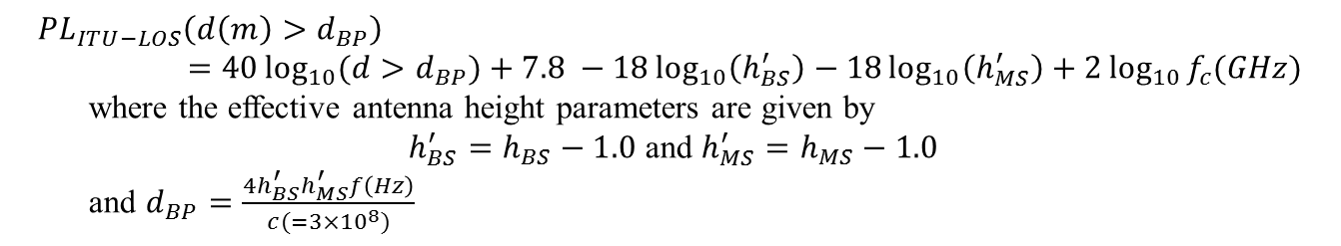
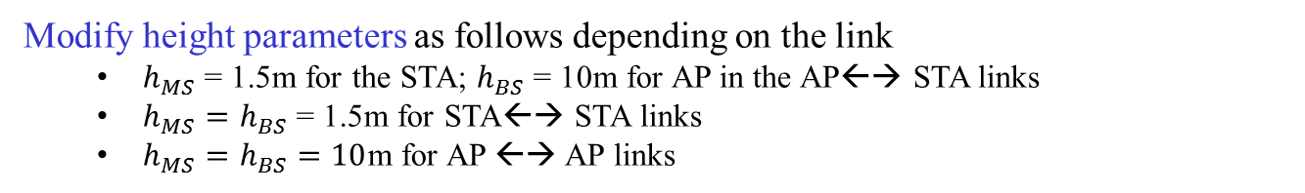
Path Loss Equations for Scenario IV
The following equations from ITU-UMi model[2] are to be used for computing the path loss for each drop in an outdoor scenario (Scenario IV)
LOS Links
$$PL_{ITU−LOS}(d(m) < d_{BP})=22.0\log_{10}{d }+28+20\log_{10}{f_{c}(GHz)}$$
$$PL_{ITU−LOS}\left(d\left(m\right)>d_{BP}\right)=40\log_{10}{(d>d_{BP})}+7.8 −18\log_{10}\left(h_{BS}^{′}\right)−18\log_{10}\left(h_{MS}^{′}\right)+2\log_{10}{f_{c}(GHz)}$$
where the effective antenna height parameters are given by
$h_{BS}^{′}=h_{BS}−1.0$ and $h_{MS}^{′}=h_{MS}−1.0$
and $d_{BP}=\frac{4h_{BS}^{′}h_{MS}^{′}f\left(Hz\right)}{c(=3×{10}^{8})}$
NLOS Links
$$PL_{ITU−NLOS}\left(d(m)\right)=36.7\log_{10}{(d)}+22.7+26.0\log_{10}{f_{c}(GHz)}$$
Modify height parameters as follows depending on the link
  $h_{MS}$ = 1.5m for the STA; $h_{BS}$ = 10m for AP in the AP←→ STA links
  $h_{MS}=h_{BS}$ = 1.5m for STA←→ STA links
  $h_{MS}=h_{BS}=10$m for AP ←→ AP links

Slide 4
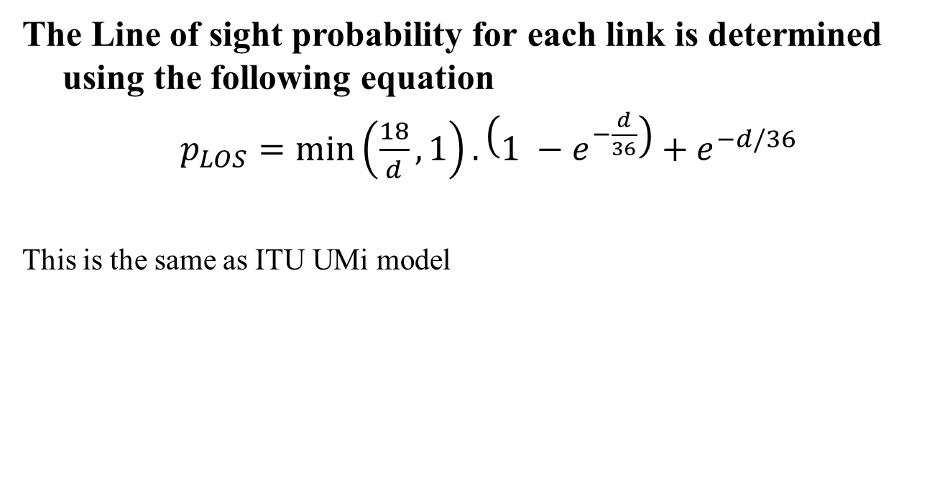
LOS Probability Equation for Scenario IV
The Line of sight probability for each link is determined using the following equation
$p_{LOS}=\min\left(\frac{18}{d}, 1\right).\left(1 −e^{−\frac{d}{36}}\right)+e^{−d/36}$
This is the same as ITU UMi model

Slide 5
Shadow Fading Parameters
For AP←→ STA
  Correlated Log-normal shadowing with Std. Dev. 3dB for LOS links and 4dB for NLOS links
For STA←→ STA links and AP←→ AP links
  Uncorrelated i.i.d. log-normal shadowing with [TBD] Std. Deviation.
Note: For TBD, we could consider re-using standard deviation of 3dB for LOS and 4dB for NLOS links

Slide 6
Short term Fading
For AP-STA, STA-STA and AP-AP link
  Use UMi parameters to generate multi-path channel for these links

Slide 7
Strawpoll
In scenario IV, for simulating channels needing UMi channels, do you agree to incorporate the following in the simulation scenarios document
  the path loss equations with the proposed height modifications as listed on Slide 3
Y/N/A 55/9/43

Slide 8
Straw poll 2
  In scenario IV, for simulating channels needing UMi channels, do you agree to incorporate the following in the simulation scenarios document
  the shadow fading model as mentioned in Slide 5
Y/N/A 19/11/79

Slide 9
References
[1] Report ITU-R M.2135-1, Guidelines for evaluation of radio interface technologies for IMT-Advanced, Dec 2009
[2] 11-14-0627-00-00ax-outdoor-models-for-system-level-simulations.pptx
[3] 11-14-0329-00-0hew-channel-model-for-different-links-in-simulations.pptx
[4] TR 36.843- v1.2.0 3GPP Device to Device Models
[5] Z. Wang, E. Tameh and A. Nix, Statistical Peer-to-Peer Models for outdoor urban environments at 2GHz and 5GHz, Proc. Of IEEE VTC, 2004

