Slide 1
Consideration on functional requirements
Date: 2014-05
Authors:

Slide 2
Summary
The approved PAR for 802.11ax emphasizes improving a number of performance metrics that directly translate to improving efficiency for indoor and outdoor deployment of large numbers of STAs in multi BSSs
A Functional Requirement document initially derived from the PAR to highlight key problem areas can guide and focus proposals in achieving a common goal
There have been some discussions[2][3][4] in the HEW study group as an initial effort for the functional requirements document development
We believe that an enhancement on spectrum efficiency will be needed to meet the PAR

Slide 3
Highlights of TGax PAR related to spectrum efficiency
Improve Average Throughput Per Station in dense deployment scenarios
    4 times improvement for at least one mode of operation (measured at the MAC data SAP)
    Target 5-10 times improvement
Focuses on relative improvement to existing IEEE 802.11 amendments
    IEEE 802.11n in 2.4 GHz and 5GHz
    IEEE 802.11ac in 5 GHz
Enable backward compatibility and coexistence with legacy IEEE 802.11 devices operating in the same band.

Slide 4
Key Proposed Aspects to Spectrum Efficiency Improvement from PAR
Improve WLAN efficiency in three categories of objectives:
    Make more efficient use of spectrum resources in scenarios with a high density of STAs per BSS.
    Significantly increase spectral frequency reuse and manage interference between neighboring overlapping BSS (OBSS) in scenarios with a high density of both STAs and BSSs.
    Increase robustness in outdoor propagation environments and uplink transmissions.

Slide 5
Identify Problem: Low spectrum efficiency of 802.11n&ac
Especially in dense deployment environment, many secondary channels can not be utilized due to unavailability of primary channel

Slide 6
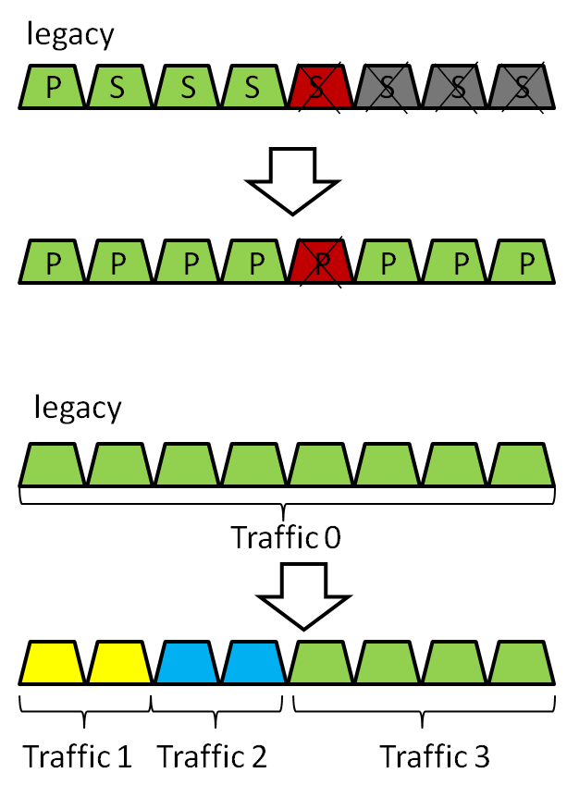
Example of 11ax spectrum efficiency enhancement
Existing legacy channel bonding
  Uses bonded channels for contiguous transmission
  Only one primary channel for the bonded channel
Examples of channel bonding for 11ax
  Establish multiple primary channels for efficient spectrum utilization
  Separate and flexible transmission for multiple streams of traffic

Slide 7
Extraction from current FR document discussion [2]
*Source from PAR[1]
improve WLAN efficiency in three categories of objectives:
    Make more efficient use of spectrum resources in scenarios with a high density of STAs per BSS.
    Significantly increase spectral frequency reuse and manage interference between neighboring overlapping BSS (OBSS) in scenarios with a high density of both STAs and BSSs.
    Increase robustness in outdoor propagation environments and uplink transmissions.
*Source from FR document[2]
Improve WLAN efficiency
    The TGax amendment shall provide a mechanism to increase spectral frequency reuse and manage interference between neighboring overlapping BSS (OBSS) in scenarios with a high density of STAs per BSS or a high density of both STAs and BSSs.
    The TGax amendment shall provide a mechanism to increase robustness in outdoor propagation environments and uplink transmissions.
The first category of WLAN efficiency improvement in the PAR is not fully addressed by [2]

Slide 8
A Proposal of FR amendment
In order to address the improve WLAN efficiency requirement in the PAR, we propose the following functional requirement
  The 802.11ax amendment shall provide a mechanism to increase spectral efficiency of 20 MHz and larger channels in scenarios with high density of 11ax STAs and in scenarios with presence of legacy devices

Slide 9
Reference
[1] 11-13-1410-02-0hew-802-11-hew-draft-par-and-5c.docx
[2] 11-14-0306-00-0hew-discussions-on-hew-functional-requirements.pptx
[3] 11-13-1411-00-0hew-from-par-to-functional-requirements-of-hew.ppt
[4] 11-13-0524-00-0hew-discussions-on-functional-requirements.pptx

