Slide 1
Consideration on MAC system calibration
Date: 2014-05
Authors:

Slide 2
Current status of simulation calibration
PHY calibration is under construction, there has been progress on how to calibrate long term SINR, instantaneous SINR [1][2]
The progress of MAC system calibration is much slower than that of PHY calibration
[3][4] define scenarios and performance test for calibrating integrated system level simulation
However there is potential risk to directly step into integrated SLS with unknown MAC behavior even in the simplest scenario (one BSS with two STAs)
It is overoptimistic to assume the underlay MAC will function perfectly as expected

Slide 3
An example: difficult to identify the problem
A rough throughput result using an off-the-shelf simulator replacing PHY abstraction with 802.11ac
Hard to know where the problem is
Not enough sample to converge?
Queuing of the upper layer frame?
Bug in MAC?

Slide 4
What should be tested in MAC calibration?
Introducing complicated PHY abstraction doesn’t bring benefits
PHY independent MAC feature
PHY dependent MAC feature
Defer & Backoff
OFDMA
RTS/CTS
MU-MIMO
A-MPDU aggregation
…
…
IEEE 802.11ax MAC layer

Slide 5
Further thinking on MAC calibration
MAC is an event driven entity with deterministic behavior set and nondeterministic behavior set
deterministic behavior set
Fixed deferral time (DIFS), Fixed shifting time from RX to TX (SIFS)
Fixed frame duration once frame length and MCS is decided
Etc.
Nondeterministic behavior set
Backoff time (within CW)
Backoff counter suspension (due to other STA transmission)
Retransmission (due to Collision)
In order to verify the MAC entity function, both deterministic set and nondeterministic behavior set shall be validated
It is sufficient to validate the deterministic behavior with examining simulation log
While only nondeterministic behavior test may need performance test (Throughput, Delay CDF etc.)

Slide 6
A hybrid approach for MAC calibration
MAC system calibration is an interim step towards integrated SLS calibration, therefore it has to be completed in a timely fashion
We propose to divide MAC calibration into two steps, in step one, we use simulation log to examine basic MAC features with deterministic behavior ; in step two use performance test to verify nondeterministic MAC behavior
Simulation Log : each company completes a set of specified test items and examine the results, no comparison is need
Basic deferral and backoff
Basic RTS/CTS
Etc.
Performance test : results should be compared between companies
Aggregation
RTS/CTS for hidden node
EDCA performance with 2 contention STAs
EDCA performance with multiple contention STAs

Slide 7
Simulation Log 1: Defer and backoff
Check the simulation output log if the data frame sending/receiving time matches the basic defer and backoff procedure of 802.11 EDCA
Scenario and simulation parameter setting
Frame payload length=1200 Bytes
MCS0
Output
Check the event time of Start/End of a data frame, Start/End of ACK frame
STA
AP
Data
Simulation start
Simulation log check point
CP 1
CP 2
CP 3
CP 4
CP 5
STA
DIFS
backoff
Frame
SIFS
ACK
DIFS
backoff
Frame
SIFS
ACK

Slide 8
Simulation Log 1: Defer and backoff (cont.)
… …
s 0.011844060 _1_ MAC --- 1 cbr 1236 [34 0 1 0] check point 1 (CP1)
r 0.013408090 _0_ MAC --- 1 cbr 1200 [34 0 1 0] check point 2 (CP 2)
s 0.013424090 _0_ MAC --- 0 ACK 36 [0 1 0 0] check point 3 (CP 3)
r 0.013476120 _1_ MAC --- 0 ACK 36 [0 1 0 0] check point 4 (CP 4)
s 0.013564120 _1_ MAC --- 2 cbr 1236 [34 0 1 0] check point 5 (CP 5)
r 0.015128150 _0_ MAC --- 2 cbr 1200 [34 0 1 0]
s 0.015144150 _0_ MAC --- 0 ACK 36 [0 1 0 0]
r 0.015196180 _1_ MAC --- 0 ACK 36 [0 1 0 0]
… …
Extracted from NS2 simulator
 | Simulation Log | Standard definition | Matching?
Frame duration | Tcp2-Tcp1= 1564 us | ceil((FrameLength*8)/rate/OFDMsymbolduration) * OFDMsymbolduration + PHY Header
SIFS | Tcp3-Tcp2=16 us | 16 us
ACK duration | Tcp4-Tcp3=52 us | ceil((ACKFrameLength*8)/rate/OFDMsymbolduration) * OFDMsymbolduration + PHY Header
Defer & backoff duration | Tcp5-Tcp4=88 us | DIFS(34 us)+backoff (CWmin) =34us+6*9us

Slide 9
Simulation Log 2: RTS/CTS
Check the simulation output log if the RTS/CTS sending/receiving time matches the RTS/CTS procedure of 802.11 EDCA
Scenario
Frame payload length=1500 Bytes
MCS0
Output
Check the event time of Start/End of a RTS frame, Start/End of a CTS frame, Start/End of a data frame, Start/End of ACK frame
STA
RTS/CTS
AP
Data
Simulation start
Simulation log check point
CP 1
CP 2
CP 3
CP 4
CP 5
CP 6
STA
DIFS
backoff
RTS
SIFS
CTS
SIFS
Frame
SIFS
ACK

Slide 10
Simulation Log 2: RTS/CTS (cont.)
… …
s 0.010025000 _1_ MAC --- 0 RTS 20 [830 0 1 0] check point 1 (CP 1)
r 0.010077017 _0_ MAC --- 0 RTS 20 [830 0 1 0] check point 2 (CP 2)
s 0.010093017 _0_ MAC --- 0 CTS 14 [7f4 1 0 0] check point 3 (CP 3)
r 0.010137034 _1_ MAC --- 0 CTS 14 [7f4 1 0 0] check point 4 (CP 4)
s 0.010153034 _1_ MAC --- 0 cbr 1536 [0 0 1 0] check point 5 (CP 5)
r 0.012089051 _0_ MAC --- 0 cbr 1500 [0 0 1 0] check point 6 (CP 6)
s 0.012105051 _0_ MAC --- 0 ACK 36 [0 1 0 0]
r 0.012173068 _1_ MAC --- 0 ACK 36 [0 1 0 0]
… …
 | Simulation Log | Standard definition | Matching?
RTS duration | Tcp2-Tcp1=52 us | ceil((RTSFrameLength*8)/rate/OFDMsymbolduration) * OFDMsymbolduration + PHY Header
CTS duration | Tcp4-Tcp3=44 us | ceil((CTSFrameLength*8)/rate/OFDMsymbolduration) * OFDMsymbolduration + PHY Header
Frame duration | Tcp6-Tcp5= 1936 us | ceil((FrameLength*8)/rate/OFDMsymbolduration) * OFDMsymbolduration + PHY Header

Slide 11
Performance test 1: Frame aggregation
Check throughput and frame transmission delay performance with and without frame aggregation
Throughput VS. Frame payload length [0:200Bytes:2000Bytes]
Delay CDF [Frame payload length 1500Byte]
Scenario
Extra parameter setting for A-MPDU aggregation
Number of MPDU aggregated=5
Fixed MCS: MCS 0, MCS 8
STA
AP
Data

Slide 12
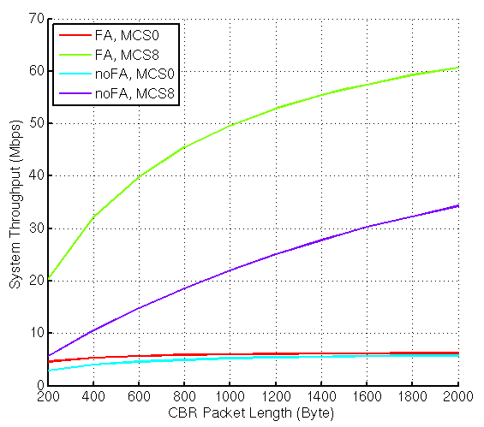
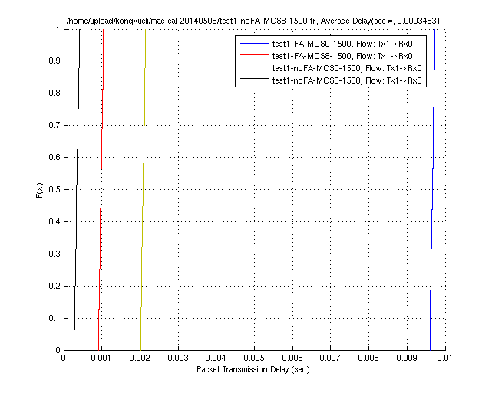
Performance test 1: Frame aggregation (Cont.)
The throughput and delay CDF results demonstrate the correct behavior of frame aggregation, frame aggregation bring higher throughput with the price of longer frame transmission delay
It is time consuming to obtain performance test results
From the view point of validating MAC behavior, comparing performance tests seems no better than examining simulation log and less straightforward
Throughput VS. frame length
Frame transmission delay CDF

Slide 13
Performance test 2: Two STAs contention
Check the system throughput and frame transmission delay with and without RTS/CTS
Throughput VS. Frame payload length [0:200Bytes:2000Bytes]
Delay CDF [Frame payload length 1500Byte]
w/ and w/o RTS/CTS
STA1
AP
Data
Data
STA2

Slide 14
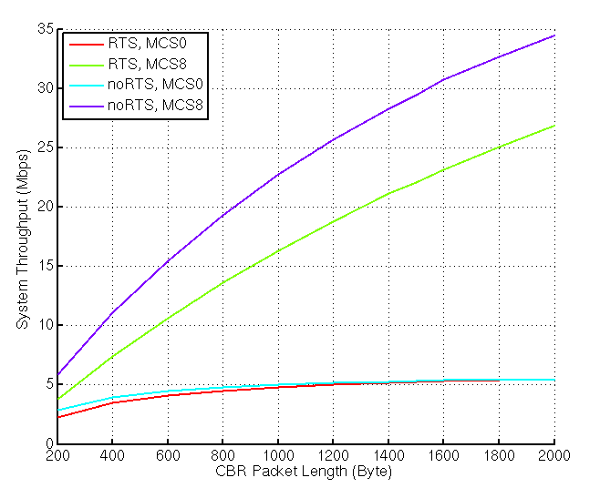
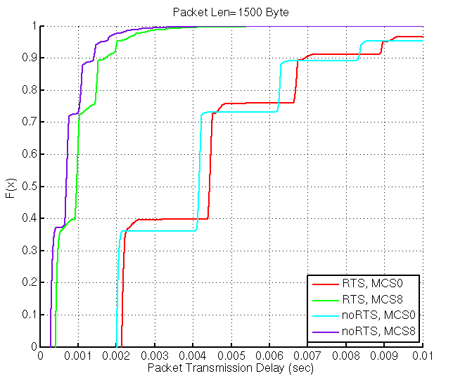
Performance test 2: Two STA contention (cont.)
Turning on RTS/CTS only provides throughput improvement when frame length reaches certain level
Throughput VS. frame length
Frame transmission delay CDF

Slide 15
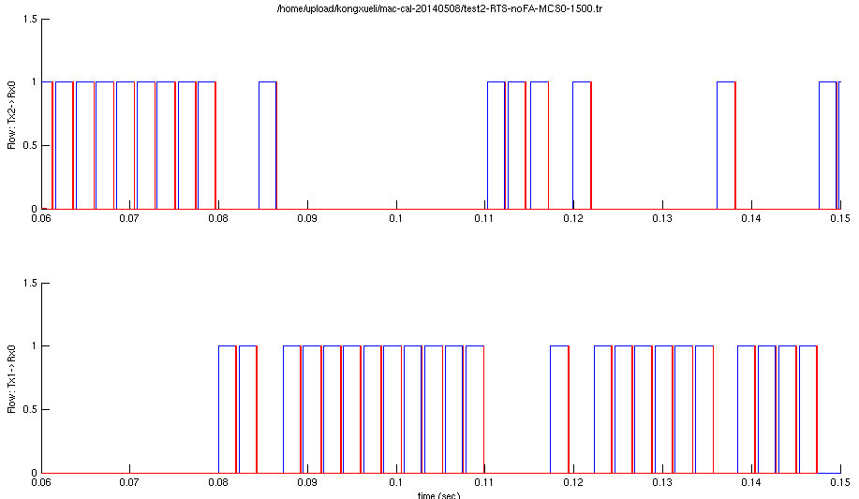
Performance test 2: Two STAs contention (cont.)
Again, from the view point of validating MAC function, the following visualized simulation log is more straightforward to use
Two STAs alternatively gain channel control

Slide 16
Performance test 3: Hidden node
Check the system throughput and frame transmission delay with and without RTS/CTS
Throughput VS. Frame payload length [0:200Bytes:2000Bytes]
Delay CDF [Frame payload length 1500Byte]
Turn off path loss and shadowing, use global configuration to create hidden node scenario
w/ and w/o RTS/CTS
STA1
AP
STA2
Data
Data
r=X (TBD)

Slide 17
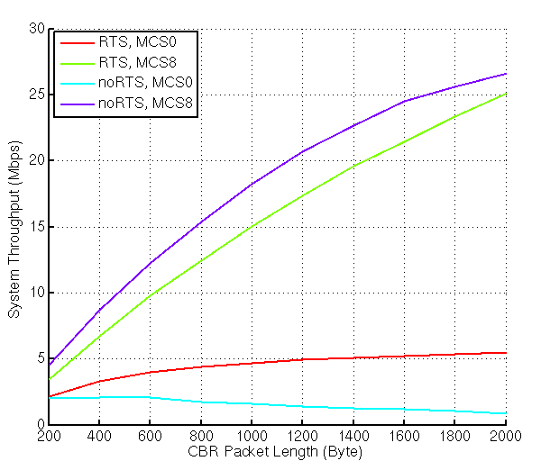
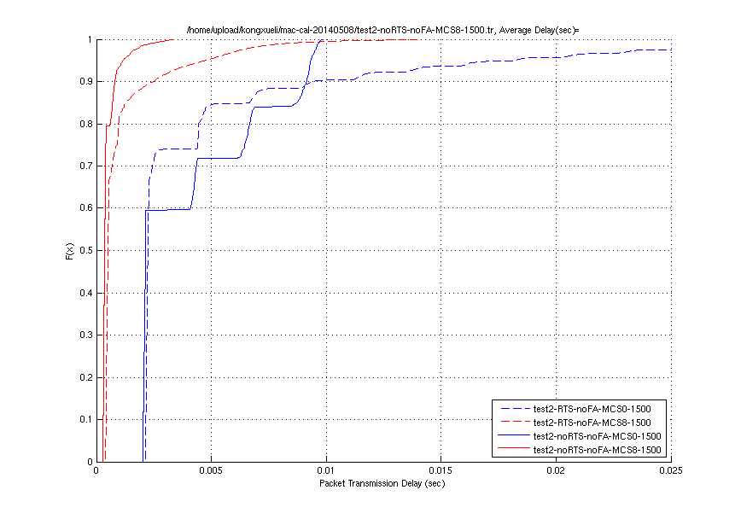
Performance test 3: Hidden node (cont.)
Throughput under hidden node scenario is improved by turning RTS/CTS on
Throughput VS. frame length
Frame transmission delay CDF

Slide 18
Summary
A hybrid approach for MAC calibration is proposed
Examine simulation log for deterministic MAC behavior
Compare performance test for nondeterministic MAC behavior
Examining simulation log is a straightforward way to verify deterministic MAC behavior, it is also useful to verify nondeterministic behavior under some scenarios
Performance comparison is commonly used for simulation system calibration, however it consumes simulation time and requires efforts for deciding scenarios and common parameter setting
It is suggested to leverage simulation log and conduct performance test only if necessary

Slide 19
Reference
[1] 11-14-0336-00-0hew-calibration-of-long-term-sinr-for-system-simulator
[2] 11-14-0335-00-0hew-instantaneous-sinr-calibration-for-system-simulation
[3] 11-14-0356-00-0hew-calibration-of-system-level-simulators
[4] 11-14-0385-00-0hew-simulation-methodology-and-calibration

