Slide 1
Outdoor Channel Models for
System Level Simulations
Date: 2013-05-12
Authors:

Slide 2
Abstract
ITU-Urban Micro Channel Model [1] was agreed as a consensus model for AP←→ STA links. System Level Simulations require modelling both AP←→ AP and STA←→ STA links. We first identify different models for such links, analyse quantitatively and propose a model that would hopefully become the consensus model in our simulations

Slide 3
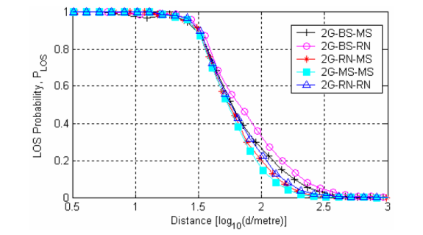
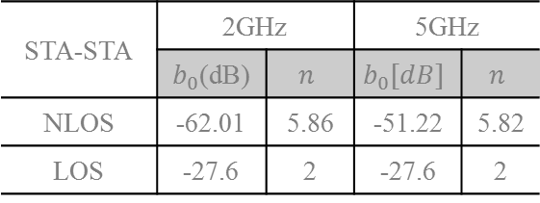
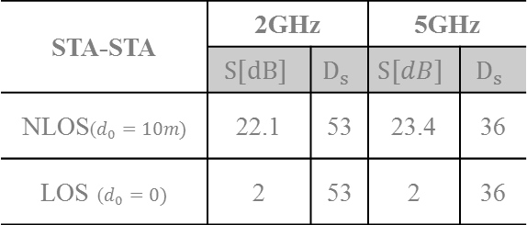



Issue Synopysis
In the latest HEW SG meeting, we proposed a path loss channel [2] for outdoor STA-STA links based on earlier empirical studies
STA-STA | 2GHz |  | 5GHz
 | $b_{0}$(dB) | $$n$$ | $$b_{0}[dB]$$ | $$n$$
NLOS | -62.01 | 5.86 | -51.22 | 5.82
LOS | -27.6 | 2 | -27.6 | 2
Path Loss
$$L_{1}\left[dB\right]=b+10n\log_{10}(d(m))$$
$$b[dB]=b_{0}+20\log_{10}\left(f(MHz)\right)$$
STA-STA | 2GHz |  | 5GHz
 | $$S[dB]$$ | $$D_{s}$$ | $$S[dB]$$ | $$D_{s}$$
NLOS($d_{0}=10m)$ | 22.1 | 53 | 23.4 | 36
LOS ($d_{0}=0)$ | 2 | 53 | 2 | 36
Log-Normal Shadowing Std. Dev.
$$σ_{Shadow}\left(d\right)=S.\left(1 −e^{−\frac{\left(d −d_{0}\right)}{D_{s}}}\right)$$
LoS Probability
Read from a curve (can be implemented as linear interpolation)
Short-term fading
No recommendation

Slide 4
Issue Synopsis
It was pointed out that 3GPP had a D2D path loss model[3] that used a modification of the Winner II/ITU models for simulations
This is an effort to contrast and identify the quantitative differences between the different models and their impact on geometry in outdoor environment
  Compare different alternatives for the path-loss and shadow fading models on the STA-STA link
  Identify alternatives for path-loss and shadow fading models on the AP-AP link. Compare their impact on the geometry
  Propose a consensus model for both STA-STA and AP-AP links

Slide 5
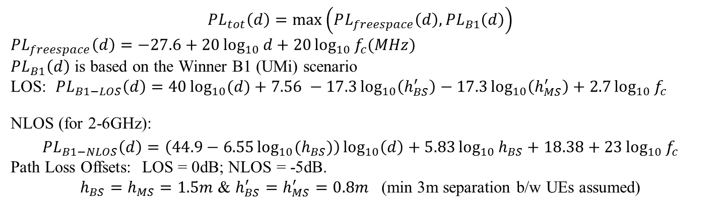


The 3GPP D2D Channel Model
Document TR 36.843- v1.2.0 [3] shows the channel parameters to be assumed for system level simulations when both UEs are outdoor.
$$PL_{tot}\left(d\right)=\max\left(PL_{freespace}\left(d\right), PL_{B1}\left(d\right)\right)$$
$$PL_{freespace}\left(d\right)=−27.6+20\log_{10}{d}+20\log_{10}{f_{c}(MHz)}$$
$PL_{B1}\left(d\right)$ is based on the Winner B1 (UMi) scenario
LOS: $PL_{B1−LOS}\left(d\right)=40\log_{10}{(d)}+7.56 −17.3\log_{10}\left(h_{BS}^{′}\right)−17.3\log_{10}\left(h_{MS}^{′}\right)+2.7\log_{10}{f_{c}}$
NLOS (for 2-6GHz):
$$PL_{B1−NLOS}\left(d\right)=\left(44.9−6.55\log_{10}{{(h}_{BS})}\right)\log_{10}\left(d\right)+5.83\log_{10}{h_{BS}+18.38+23\log_{10}{f_{c}}}$$
Path Loss Offsets: LOS = 0dB; NLOS = -5dB.
$h_{BS}=h_{MS}=1.5m$ & $h_{BS}^{′}=h_{MS}^{′}=0.8m$ (min 3m separation b/w UEs assumed)
Path Loss
$f_{c}$ is in GHz
d is in m
Log-Normal Shadowing Std. Dev.
$σ_{Shadow}=7dB$ , i.i.d.
$$p_{LOS}=\min\left(\frac{18}{d}, 1\right).\left(1 −e^{−\frac{d}{36}}\right)+e^{−d/36}$$
LoS Probability
Short-term fading
ITU – UMi (with no modifications)
Note that the document advises that these are not based on any experimental evidence and were adopted for the purpose of relative comparisons of D2D techniques

Slide 6
Method for down selection
There is clear difference in the proposed LOS probability, path loss and shadowing models
  Perform numerical evaluation
    If there is not much difference between the two models, leave the choice open
    If there is difference, then we need to agree on common model for simulations
In the following slides, we will compare 4 models for path loss and shadowing for STA-STA and AP-AP links
  Model from our previous contribution[2] – which we will call it Wang (after the first author in the paper)
  D2D – 3GPP[3]
  ITU – UMi[1]
  ITU – Modified (by changing the height parameter)

Slide 7
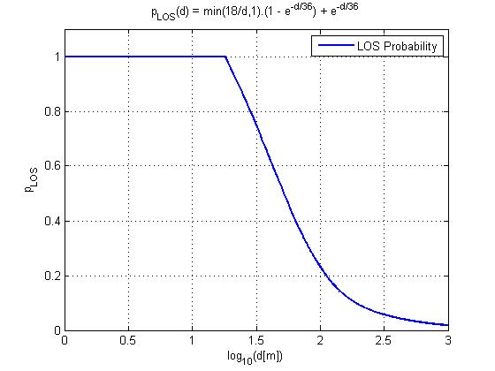

LOS Probability
UMi Model
Empirical Observation
Distances of interest for 802.11
Heavier tail compared to empirical observation
Reasonable agreement between model and Empirical Observation
Recommendation: Use the LOS probability equation from UMi Model

Slide 8




Path Loss Equation Comparisons
LOS Links
Four Choices
$$d_{BP}=\frac{4h_{BS}^{′}h_{MS}^{′}f\left(Hz\right)}{c(=3×{10}^{8})}$$
$$PL_{freespace}\left(d\right)=−27.6+20\log_{10}{d(m)}+20\log_{10}{f_{c}(MHz)}$$
Wang
$$PL_{Wang}\left(d\right)=PL_{freespace}(d)$$
D2D – 3GPP
$$PL_{D2D−3GPP}\left(d\right)=\max\left(PL_{freespace}\left(d\right), PL_{B1}\left(d\right)\right)$$
$$PL_{B1−LOS}(d(m) < d_{BP})=22.7\log_{10}{d }+27+20\log_{10}{f_{c}(GHz)}$$
$$PL_{B1−LOS}\left(d\left(m\right)>d_{BP}\right)= 40\log_{10}{(d>d_{BP})}+7.56 −17.3\log_{10}\left(h_{BS}^{′}\right)−17.3\log_{10}\left(h_{MS}^{′}\right)+2.7\log_{10}{f_{c}(GHz)}$$
$h_{MS}^{′}=0.8;h_{BS}^{′}=0.8;$
ITU
$$PL_{ITU−LOS}(d(m) < d_{BP})=22.0\log_{10}{d }+28+20\log_{10}{f_{c}(GHz)}$$
$$PL_{ITU−LOS}\left(d\left(m\right)>d_{BP}\right)=40\log_{10}{(d>d_{BP})}+7.8 −18\log_{10}\left(h_{BS}^{′}\right)−18\log_{10}\left(h_{MS}^{′}\right)+2\log_{10}{f_{c}(GHz)}$$
$h_{MS}^{′}=0.5;h_{BS}^{′}=9;$
ITU - Modified
$PL_{ITU −Modified}\left(d\right)=PL_{ITU−LOS}(d)$ with $h_{MS}^{′}=0.5;h_{BS}^{′}=0.5;$

Slide 9
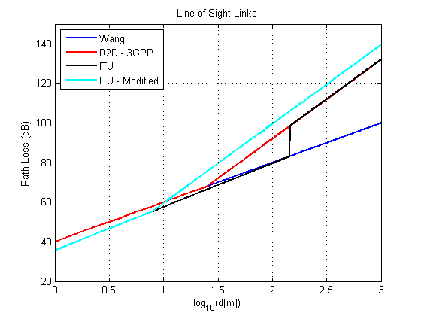
Path Loss Equation Comparisons
LOS Links
LOS Probability = 1
Where LOS links are likely, ITU, D2D & Wang mostly agree on the path loss

Slide 10


Path Loss Equation Comparisons
NLOS Links
Four Choices
$$PL_{freespace}\left(d\right)=−27.6+20\log_{10}{d(m)}+20\log_{10}{f_{c}(MHz)}$$
Wang
$PL_{Wang−NLOS}\left(d\right)=$ $−62.01+58.6\log_{10}{d}+20\log_{10}{f_{c}(MHz)}$
D2D – 3GPP
$$PL_{D2D−3GPP}\left(d\right)=\max\left(\begin{aligned}PL_{freespace}\left(d\right), \\ PL_{B1−NLOS}\left(d\right)+Offset_{NLOS}\end{aligned}\right)$$
$$PL_{B1−NLOS}\left(d\right)=\left(44.9 −6.55\log_{10}\left(h_{BS}\right)\right) \log_{10}{(d)}+18.38 +5.83\log_{10}\left(h_{BS}\right)+23\log_{10}{f_{c}\left(GHz\right)}$$
$h_{BS}=1.5m$; $Offset_{NLOS}=−5dB:$
ITU
$$PL_{ITU−NLOS}\left(d\right)=36.7\log_{10}{(d)}+22.7+26.0\log_{10}{f_{c}(GHz)}$$
ITU - Modified
$PL_{ITU −Modified}\left(d\right)=PL_{ITU−NLOS}(d)$

Slide 11
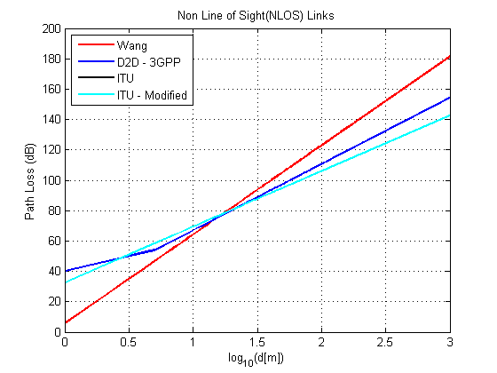
Path Loss Equation Comparisons
NLOS Links
ITU & 3GPP reasonably agree in distances of interest
Likely NLOS Links
ITU & ITU Modified are the same for NLOS links

Slide 12
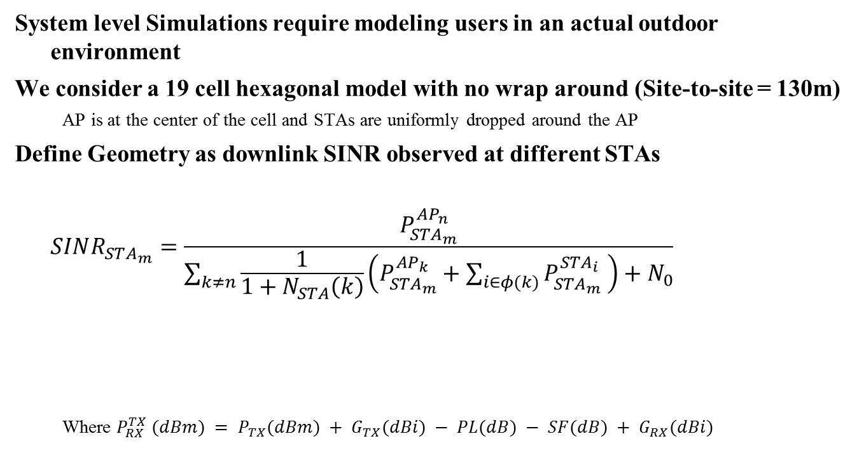
How do the models impact Geometry
System level Simulations require modeling users in an actual outdoor environment
We consider a 19 cell hexagonal model with no wrap around (Site-to-site = 130m)
  AP is at the center of the cell and STAs are uniformly dropped around the AP
Define Geometry as downlink SINR observed at different STAs
$$SINR_{STA_{m}}=\frac{P_{STA_{m}}^{AP_{n}}}{\sum_{k≠n}{\frac{1}{1+N_{STA}\left(k\right)}\left(P_{STA_{m}}^{AP_{k}}+\sum_{i∈φ(k)}{P_{STA_{m}}^{STA_{i}} }\right)+N_{0}}}$$
  Where $P_{RX}^{TX} (dBm) = P_{TX}(dBm) + G_{TX}(dBi) − PL(dB) − SF(dB) + G_{RX}(dBi)$
The received power at STA-m from AP-n
-174dBm/Hz * BW = -101dBm/20MHz
The # of STAs associated with AP-k
The received power at STA-m from STA-i
The received power at STA-m from AP-k
The set of STAs associated with AP-k
Shadow Fading
Path Loss
Transmit Power
AP = 30dBm
STA = 15dBm
Antenna Gain – Assume 0dBi

Slide 13
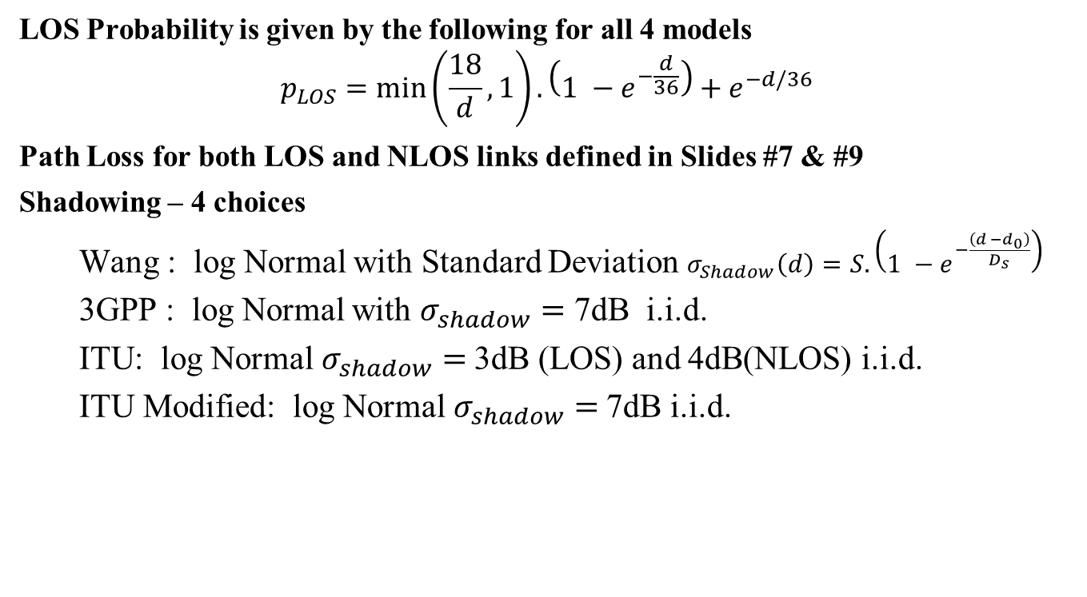
STA-STA Link Parameters
LOS Probability is given by the following for all 4 models
$$p_{LOS}=\min\left(\frac{18}{d}, 1\right).\left(1 −e^{−\frac{d}{36}}\right)+e^{−d/36}$$
Path Loss for both LOS and NLOS links defined in Slides #7 & #9
Shadowing – 4 choices
  Wang : log Normal with Standard Deviation $σ_{Shadow}\left(d\right)=S.\left(1 −e^{−\frac{\left(d −d_{0}\right)}{D_{s}}}\right)$
  3GPP : log Normal with $σ_{shadow}=$ 7dB i.i.d.
  ITU: log Normal $σ_{shadow}=$3dB (LOS) and 4dB(NLOS) i.i.d.
  ITU Modified: log Normal $σ_{shadow}=$7dB i.i.d.

Slide 14
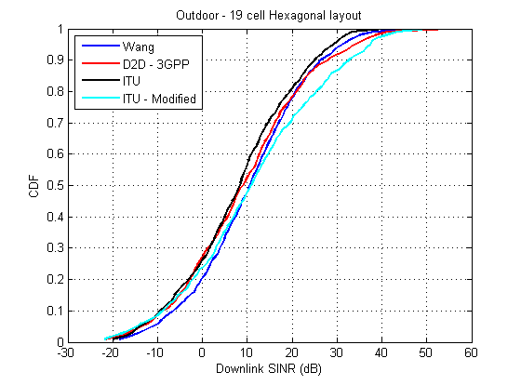
Downlink SINR
ITU gives the same geometry as the D2D -3GPP
ITU Modified shows higher SINR

Slide 15
Consensus Model for STA-STA Link
The Downlink SINR is not heavily impacted by choosing either
  ITU or
  ITU Modified
The models are with-in tolerance limits of the empirical observations
We had agreed to the ITU-UMi as the preferred model for simulating AP-STA links
  Continue using path loss equations for ITU-UMi with modifications to the height parameters for AP (now set to 1.5m)
  Update STA-STA link shadowing to have a i.i.d. log normal distribution whose Std. Deviation is 7dB

Slide 16
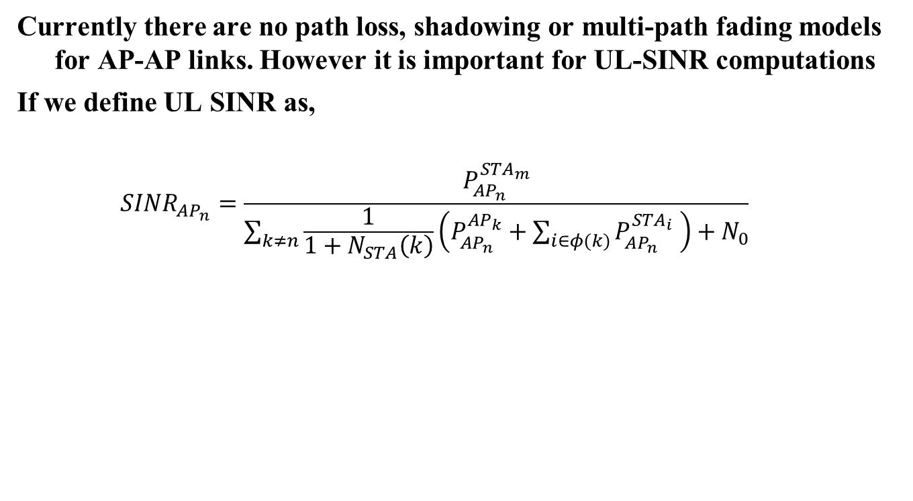
Model for AP-AP link
Currently there are no path loss, shadowing or multi-path fading models for AP-AP links. However it is important for UL-SINR computations
If we define UL SINR as,
  $$SINR_{AP_{n}}=\frac{P_{{AP}_{n}}^{STA_{m}}}{\sum_{k≠n}{\frac{1}{1+N_{STA}\left(k\right)}\left(P_{{AP}_{n}}^{AP_{k}}+\sum_{i∈φ(k)}{P_{{AP}_{n}}^{STA_{i}} }\right)+N_{0}}}$$
The received power at AP-n from STA-m
The # of STAs associated with AP-k
-174dBm/Hz * BW = -101dBm/20MHz
The received power at AP-n from AP-k
The set of STAs associated with AP-k
The received power at AP-n from STA-i
The received power from neighboring APs dominate interference compared to STAs in the neighboring BSS

Slide 17
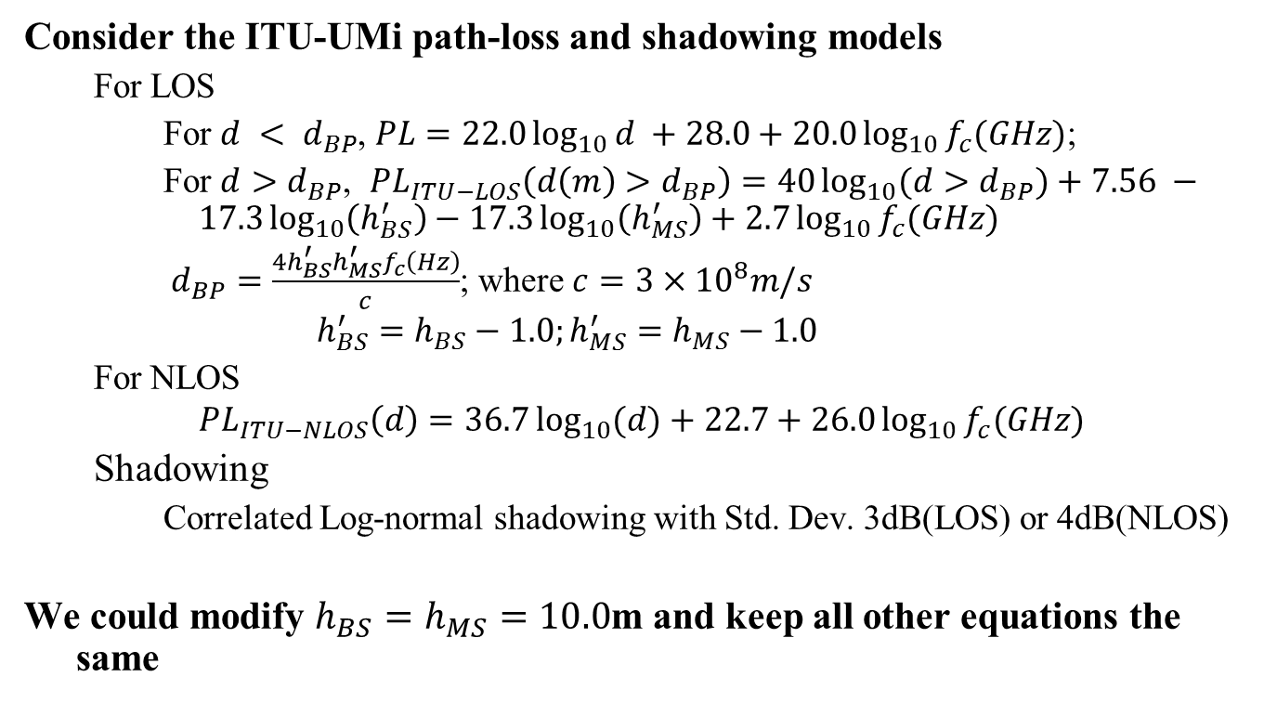
Modifying the ITU for AP-AP
Consider the ITU-UMi path-loss and shadowing models
  For LOS
    For $d < d_{BP}$, $PL=22.0\log_{10}{d }+28.0+20.0\log_{10}{f_{c}(GHz)}$;
    For $d>d_{BP}$, $PL_{ITU−LOS}\left(d\left(m\right)>d_{BP}\right)=40\log_{10}{(d>d_{BP})}+7.56 −17.3\log_{10}\left(h_{BS}^{′}\right)−17.3\log_{10}\left(h_{MS}^{′}\right)+2.7\log_{10}{f_{c}(GHz)}$
    $d_{BP}=\frac{4h_{BS}^{′}h_{MS}^{′}f_{c}\left(Hz\right)}{c}$; where $c=3×{10}^{8}m/s$
    $$h_{BS}^{′}=h_{BS}−1.0;h_{MS}^{′}=h_{MS}−1.0$$
  For NLOS
    $$PL_{ITU−NLOS}\left(d\right)=36.7\log_{10}{(d)}+22.7+26.0\log_{10}{f_{c}(GHz)}$$
  Shadowing
    Correlated Log-normal shadowing with Std. Dev. 3dB(LOS) or 4dB(NLOS)
We could modify $h_{BS}=h_{MS}=10.0$m and keep all other equations the same

Slide 18
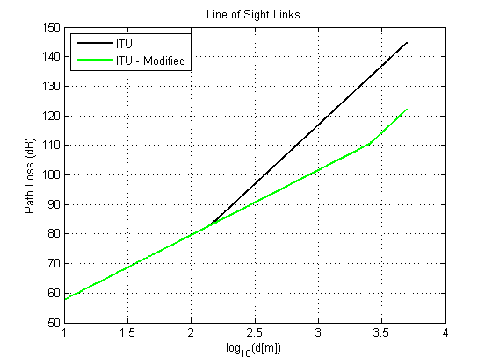

AP-AP path loss for LOS Link
Low $p_{LOS}$
AP Distance Ranges
Due to low probability of LOS links, this difference in path loss will likely not show up on uplink SINR

Slide 19
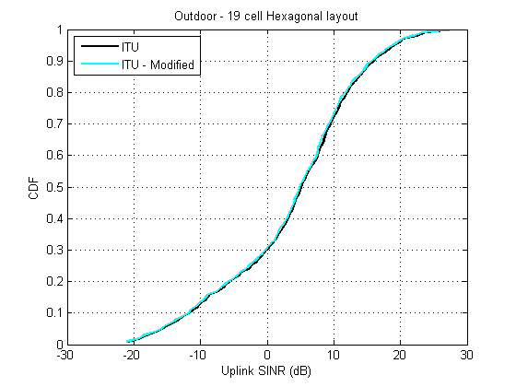
Uplink Geometry

Slide 20
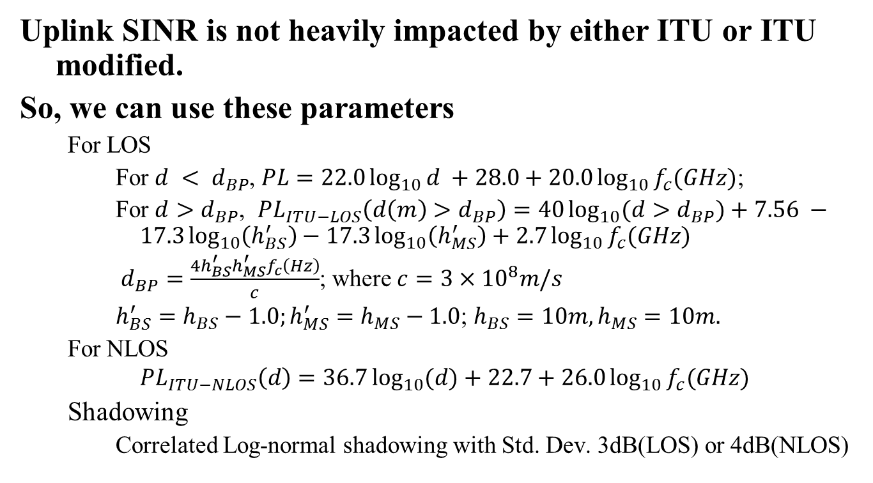
Model for AP-AP link
Uplink SINR is not heavily impacted by either ITU or ITU modified.
So, we can use these parameters
  For LOS
    For $d < d_{BP}$, $PL=22.0\log_{10}{d }+28.0+20.0\log_{10}{f_{c}(GHz)}$;
    For $d>d_{BP}$, $PL_{ITU−LOS}\left(d\left(m\right)>d_{BP}\right)=40\log_{10}{(d>d_{BP})}+7.56 −17.3\log_{10}\left(h_{BS}^{′}\right)−17.3\log_{10}\left(h_{MS}^{′}\right)+2.7\log_{10}{f_{c}(GHz)}$
    $d_{BP}=\frac{4h_{BS}^{′}h_{MS}^{′}f_{c}\left(Hz\right)}{c}$; where $c=3×{10}^{8}m/s$
    $h_{BS}^{′}=h_{BS}−1.0;h_{MS}^{′}=h_{MS}−1.0$; $h_{BS}=10m, h_{MS}=10m.$
  For NLOS
    $$PL_{ITU−NLOS}\left(d\right)=36.7\log_{10}{(d)}+22.7+26.0\log_{10}{f_{c}(GHz)}$$
  Shadowing
    Correlated Log-normal shadowing with Std. Dev. 3dB(LOS) or 4dB(NLOS)

Slide 21
A note on the short term fading
STA-STA and AP-AP are mostly interfering links.
  Adding their received power as interference is a commonly used practice.
However, to simulate impact of beamforming on frequency selective interference (flashlight effect), it may be argued that short term fading is necessary.
In that case, we can use the same parameters as ITU UMi to simulate short term fading on the interfering links.
  3GPP does this as well.

Slide 22
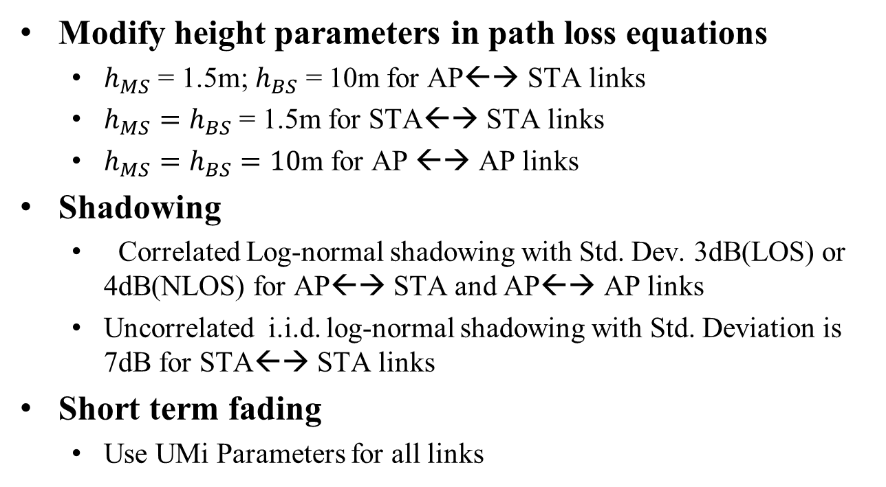
Recommendation
Modify height parameters in path loss equations
  $h_{MS}$ = 1.5m; $h_{BS}$ = 10m for AP←→ STA links
  $h_{MS}=h_{BS}$ = 1.5m for STA←→ STA links
  $h_{MS}=h_{BS}=10$m for AP ←→ AP links
Shadowing
  Correlated Log-normal shadowing with Std. Dev. 3dB(LOS) or 4dB(NLOS) for AP←→ STA and AP←→ AP links
  Uncorrelated i.i.d. log-normal shadowing with Std. Deviation is 7dB for STA←→ STA links
Short term fading
  Use UMi Parameters for all links

Slide 23
References
[1] Report ITU-R M.2135-1, Guidelines for evaluation of radio interface technologies for IMT-Advanced, Dec 2009
[2] 11-14-0329-00-0hew-channel-model-for-different-links-in-simulations.pptx
[3] TR 36.843- v1.2.0 3GPP Device to Device Models
[4] Z. Wang, E. Tameh and A. Nix, Statistical Peer-to-Peer Models for outdoor urban environments at 2GHz and 5GHz, Proc. Of IEEE VTC, 2004

